Slide 1
Performance Analysis of Open Loop SU-MIMO Receivers for IEEE 802.11ay
Date: 2016-14-03
Authors:

Slide 2
Introduction
This work presents the performance analysis of the open loop 2 x 2 SU-MIMO schemes using OFDM and SC modulations with parameters defined in IEEE 802.11ad standard, [1].
The Maximum Likelihood (ML), Zero Forcing (ZF), and Linear Minimum Mean Square Error (LMMSE) receivers are considered and the performance of the Single Carrier (SC) and OFDM modulations is compared.
The simulations were completed for the frame format proposed in [2].

Slide 3
SU-MIMO PPDU Frame Format
The MIMO frame uses a structure similar to one proposed in [2], defines 2 streams and consists of preamble, header and PSDU:
Legacy preamble and header, uses SC modulation:
  L-STF – legacy Short Training Field (STF), “L” means legacy;
  L-CE – legacy Channel Estimation (CE);
  L-Header – legacy header;
New part, uses SC modulation:
  EDMG Header-A new header of type “A” used to support new capabilities for reception of SU-MIMO or “bonding” frames;
  EDMG-CE - new CE used for channel estimation for the considered SU-MIMO stream;
Data part, uses OFDM or SC modulation:
  PSDU – contains data, single PSDU is mapped to the streams applying horizontal or vertical coding/mapping;

Slide 4
MIMO MCS Set
MIMO configuration:
  N_{TX} = 2 transmit and N_{RX} = 2 receive antennas;
The original set of the Modulation and Coding Schemes (MCSs) is considered, in case of MIMO transmission the corresponding data rate is increased 2x times:
  SC: MCSs 1 – 12, original rate: 0.385 – 4.62 Gbps, the extended MIMO rate: 0.77 – 9.24 Gbps;
  OFDM: MCSs 13 – 24, original rate: 0.693 - 6.7568 Gbps, the extended MIMO rate: 1.386 - 13.5136 Gbps;
MCS index is the same for both streams, MCS link adaptation per stream is not performed;

Slide 5
SC PHY MIMO Mapping
Horizontal mapping:
Vertical mapping:

Slide 6
SC PHY MIMO Mapping (Cont’d)
Vertical mapping + interleaving (“interlacing”):
Vertical mapping:
  Codewords are equally distributed over the streams;
Interleaving:
  Spans codeword over the time;

Slide 7
OFDM PHY MIMO Mapping
Horizontal mapping:
Horizontal coding/mapping:
  Assigns legacy data block of 336 subcarriers alternatively to the first or the second stream;
  Interleaving and mapping inside each data block is the same as in the IEEE 802.11ad standard;

Slide 8
OFDM PHY MIMO Mapping (Cont’d)
Legacy mapping of symbols to subcarriers defined in the IEEE 802.11ad standard for dual carrier modulations SQPSK/QPSK:
Index P(k) in the second half sub-band is defined based on the STP/DTP mapping.

Slide 9
OFDM PHY MIMO Mapping (Cont’d)
Vertical mapping + interleaving (“interlacing”) for SQPSK/QPSK:
Vertical mapping:
  Codewords are equally distributed over the streams for QPSK modulation;
Note: in the simulations STP mode was used only.

Slide 10
OFDM PHY MIMO Mapping (Cont’d)
Codewords legacy interleaver for 16QAM/64QAM in the IEEE 802.11ad standard:
  Maps 2 codewords to the band for 16QAM modulation;
  Maps 3 codewords to the band for 64QAM modulation;
Interleaving:
  Spans each codeword over the entire band;

Slide 11
OFDM PHY MIMO Mapping (Cont’d)
Vertical mapping + interleaving for 16QAM:
Vertical mapping:
  Mapping is done using pairs of symbols;
  Codewords are equally distributed over the streams;
Interleaving:
  Spans codeword over the entire bandwidth;

Slide 12
OFDM PHY MIMO Mapping (Cont’d)
Vertical mapping + interleaving for 64QAM:
Vertical mapping:
  Mapping is done using triplets of symbols;
  Codewords are equally distributed over the streams;
Interleaving:
  Spans codeword over the entire bandwidth;

Slide 13
Considered MIMO Receivers
Linear receivers:
  Zero Forcing (ZF) receiver, solves Least Squares (LS) estimation problem;
  Unbiased Linear Minimum Mean Square Error (LMMSE) receiver, solves LMMSE estimation problem, bias compensation is applied;
Non-linear receivers:
  Maximum Likelihood (ML) receiver, solves ML estimation problem;
Modulation types:
  OFDM modulation, uses both linear and non-linear receivers, signal processing is done at the 2.64 GHz sample rate;
  Single Carrier (SC) modulation, uses linear fractionally spaced receivers, signal processing is done at the Fs = 2.64 GHz sample rate, i.e. 1.5x oversampling to the chip rate Fc = 1.76 GHz is applied;
  The ML receiver is not considered for the SC modulation due to high implementation complexity;

Slide 14
SNR Definition
Let’s consider an example of 2 x 2 MIMO system and define the received vector Y as follows:
where S is the transmit signal vector, H is the channel matrix, Z is the noise vector, and Y is the receive vector.
The Signal to Noise Ratio (SNR) is defined in instantaneous sense per receive antenna at the sample rate 2.64 GHz as follows:
where P_{s1} and P_{s2} define average power per the first and the second transmit antennas accordingly, H₁₁, H₁₂, H₂₁, H₂₂ are channel matrix components, and 2σ_{Z}² is a variance of noise complex vector Z components (σ_{z}² is variance per real or imaginary part). In the simulations it is assumed that P_{s1} = P_{s2} = 1.
An average SNR over antennas can be introduced using Frobenius matrix norm definition:
Note: in order to have a fair comparison of MIMO performance to the SISO case, one should make the SNR adjustment.

Slide 15
SISO vs. MIMO
Let’s consider Phased Antenna Array (PAA) of size 4 x 4 with dual polarizations, there are 32 Power Amplifiers (PAs) and 32 Low Noise Amplifiers (LNAs).
Let’s assume no cross-polarization leakage, PA power = p, LNA noise power = n.
Scenario 1: We transmit two streams, each one in its polarization.
  At each LNA, the signal power = (16)²×p;
  Combining coherently 16 LNAs, we get “Rx stream power” = (16)⁴×p, “Rx stream noise” = 16×n, “average SNR” = p/n + 36 dB;
Scenario 2: We transmit single stream, the same one in both polarizations.
  At each LNA, the signal power = (16)²×p;
  Combining coherently 32 LNAs, we get “Rx power” = (32)²×(16)²×p, “Rx noise” = 32×n , SNR = p/n + 39 dB;
Scenario 3: We transmit/receive single stream with 32 elements, all of them have the same polarization.
  At each LNA, the signal power = (32)²×p;
  Combining coherently 32 LNAs, we get “Rx power” = (32)²×(32)²×p, “Rx noise” = 32×n , SNR = p/n + 45 dB;
In this work when SISO is compared to MIMO, scenario 1 vs. scenario 2 is considered. So, the SNR is adjusted by 3 dB.

Slide 16
LOS Channel Model
The Line Of Sight (LOS) channel model for the particular case of 2 x 2 MIMO scheme is introduced as follows:
where φ_{ij} describes channel phase between j-th transmitter and i-th receiver antennas and α defines the power attenuation of cross-link terms.
The model supposes that phases are independent random variables and uniformly distributed from 0 to 2π.
The cross-link power attenuation coefficient α depends on the coupling between transmit antennas and the distance between transmit and receive antennas. The α coefficient lies in the range [0, 1].

Slide 17
NLOS Rayleigh Channel Model
The Non Line of Sight (NLOS) channel model is defined by the 3D channel matrix with additional third time dimension as follows:
where N_{RX} = 2 is the number of receiver antennas, N_{TX} = 2 is the number of transmit antennas, and N_{taps} is the maximum number of taps in the channel impulse response realization.
Each H_{ij} has exponential decay envelope in time domain with t_{RMS} = 3 ns and independent distributed taps. The amplitudes of the taps are Rayleigh distributed and taps are taken at the sampling rate 2.64 Gsps.
The total power of each H_{ij} channel realization in time domain is normalized to unit power on instantaneous basis.
The cross links are independent of the main links and have the same power as the main links.

Slide 18
Simulation Assumptions
The performance of SC and OFDM MIMO receivers was simulated and compared under LOS and NLOS channel models described above.
LOS model:
  For LOS channel model several values for the cross-link power attenuation coefficient α equal to -5, -10, -15, and -20 dB were simulated.
  The real measured cross coupling for two orthogonal polarizations is equal to ~-20 - -23 dB, [3]. The cross-link attenuation for two arrays spaced by the distance of 30 cm (equal to the length of the laptop’s lid) is equal to ~-15 dB for the distance up to 2 m between devices, [3].
NLOS Rayleigh model:
  Rayleigh model with exponential delay profile, t_{RMS} = 3 ns, 4 independent channels with equal power.
The PPDU length in the simulation was equal to 8192 bytes. LDPC decoder used Layered Belief Propagation (LBP) algorithm with “min-sum” approximation. The maximum number of iterations per codeword is limited to 20. The total number of simulated packets per SNR point is equal to 10⁵.
The receivers used ideal channel knowledge to perform demodulation of the packet. The impairments like Phase Noise (PN), Power Amplifier (PA), Carrier Frequency Offset (CFO), and Sampling Frequency Offset (SFO) were not simulated. An ideal packet acquisition was considered.

Slide 19
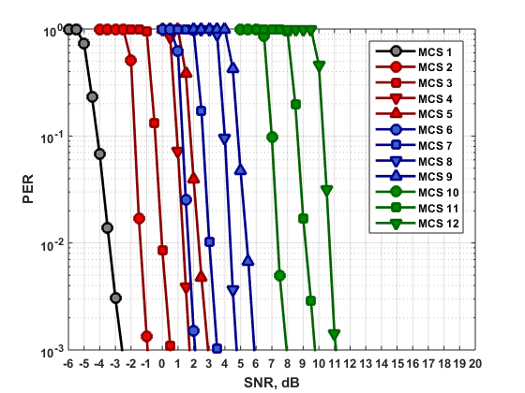
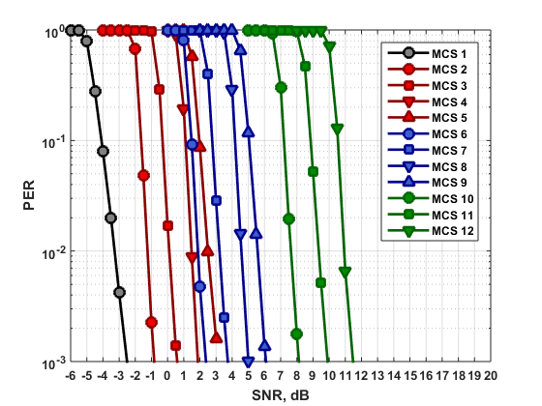
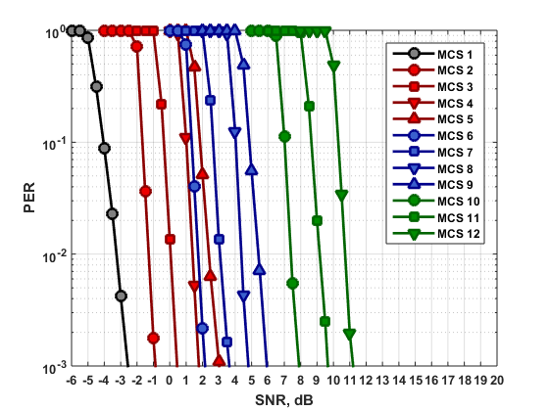
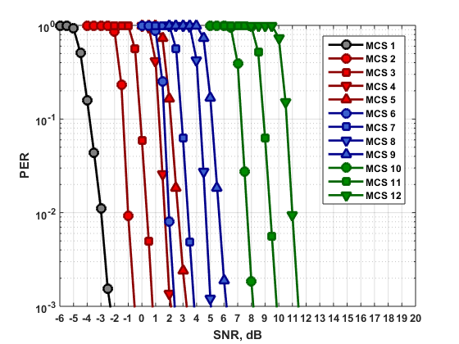
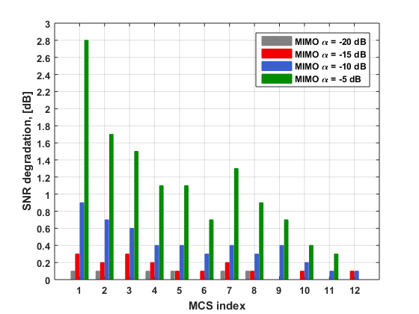
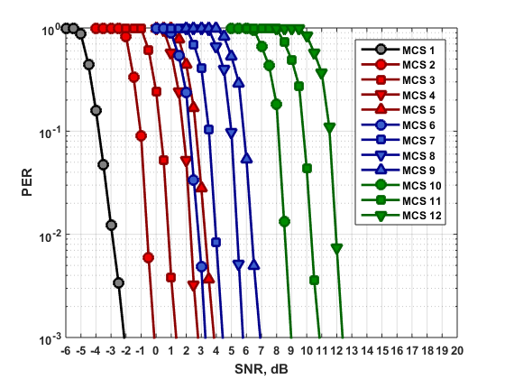
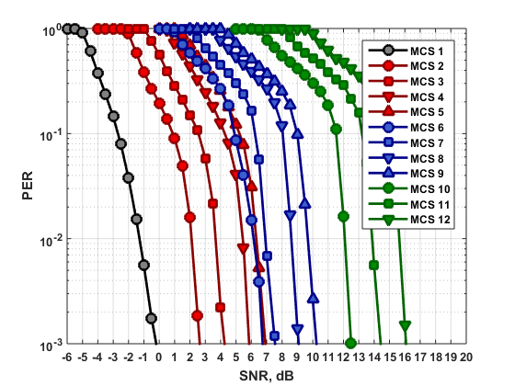
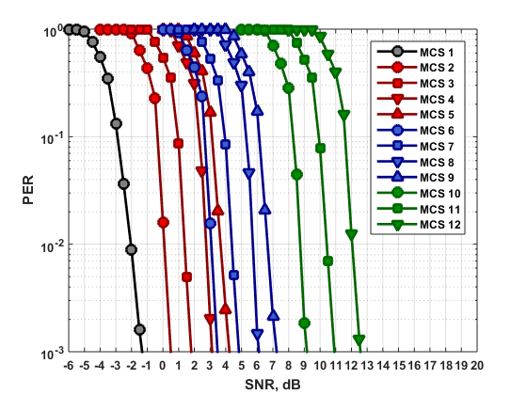
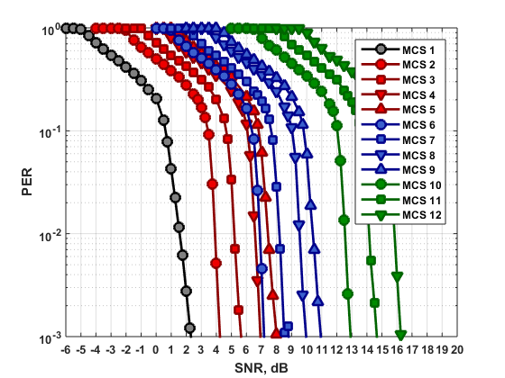
LOS Simulation Results – MIMO SC
Unbiased LMMSE receiver
ZF receiver
α = -20 dB
α = -15 dB
α = -20 dB
α = -15 dB
SNR loss of ZF comp. to LMMSE
α = -10 dB
α = -5 dB
α = -10 dB
α = -5 dB
The performance of the receiver significantly degrades with increasing of α from -20 to -5 dB;
The unbiased LMMSE exhibits better performance comparing to the ZF receiver. The ZF SNR loss comparing to the unbiased LMMSE is larger for larger α and decreases with MCS index.

Slide 20
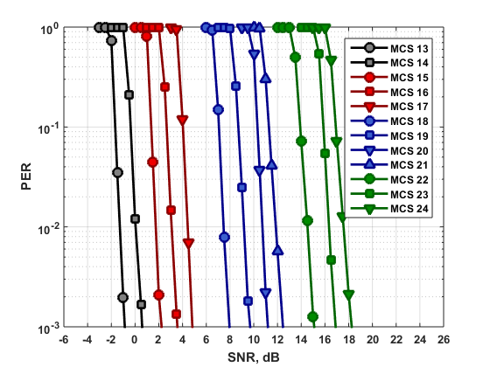
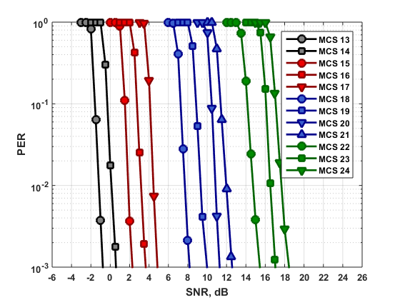
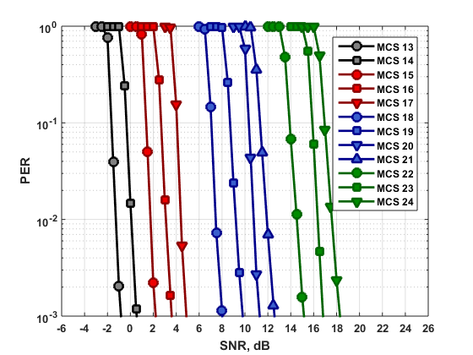
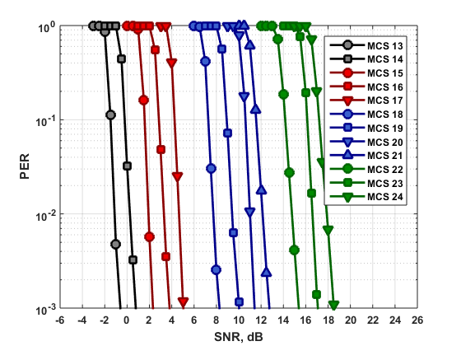
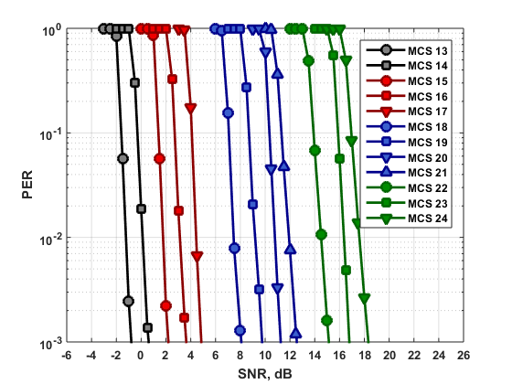
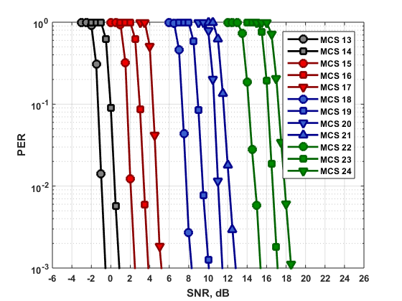
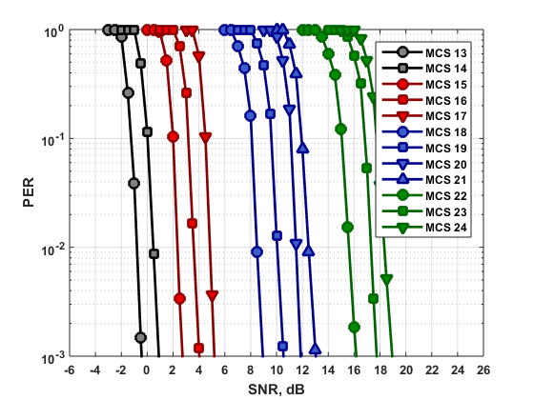
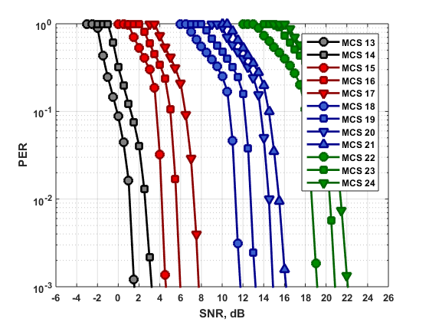
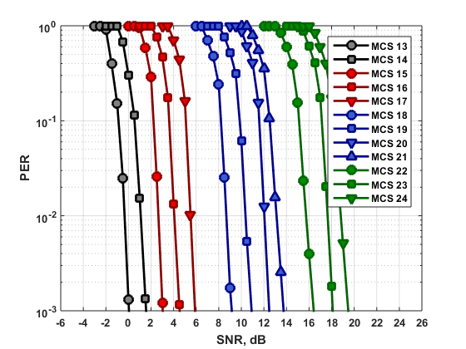
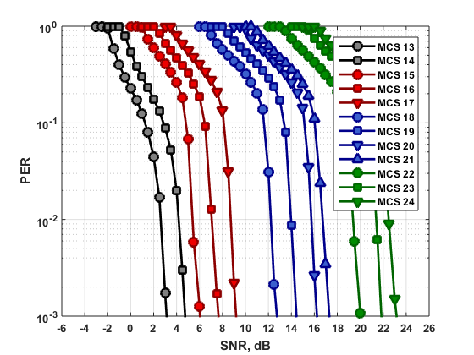
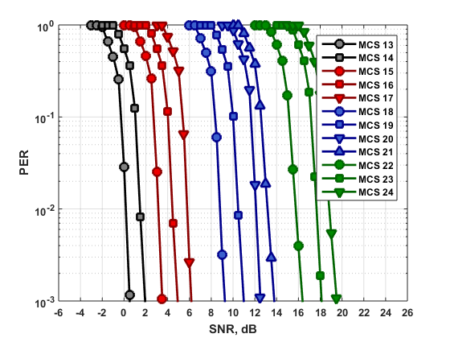
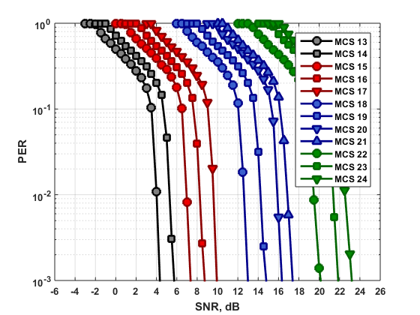
LOS Simulation Results – MIMO OFDM
ML receiver
Unbiased LMMSE receiver
ZF receiver
α = -20 dB
α = -15 dB
α = -20 dB
α = -15 dB
α = -20 dB
α = -15 dB
α = -10 dB
α = -5 dB
α = -10 dB
α = -5 dB
α = -10 dB
α = -5 dB
The performance of the receiver significantly degrades with increasing of α from -20 to -5 dB;
The ML receiver exhibits the best performance, unbiased LMMSE has an intermediate result, and ZF has a worst performance among the considered receivers.

Slide 21
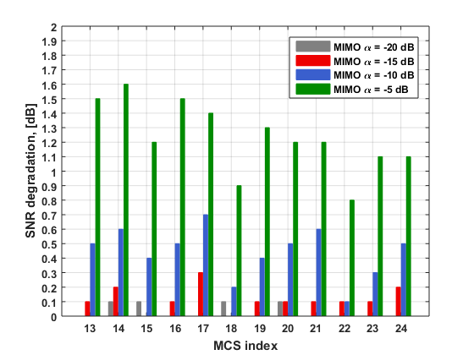
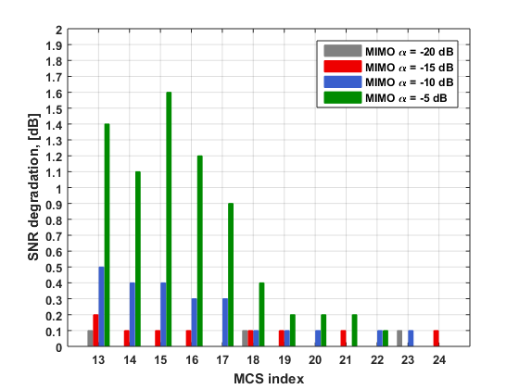
LOS Simulation Results – MIMO OFDM (Cont’d)
SNR loss of LMMSE comp. to ML
SNR loss of ZF comp. to LMMSE
The degradation of the unbiased LMMSE performance comparing to the ML receiver is larger for larger α. Also ML has better performance for the high encoding rates.
The degradation of the ZF performance comparing to the unbiased LMMSE receiver is larger for larger α and decreases with MCS index.

Slide 22
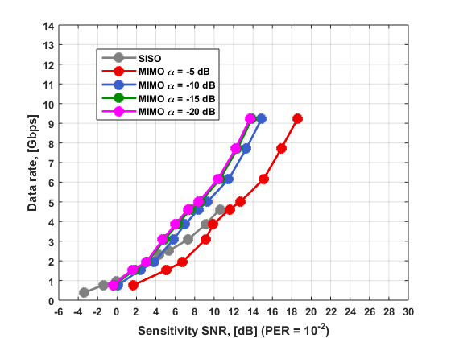
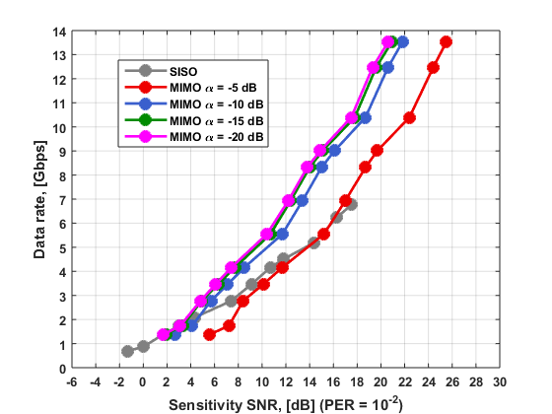
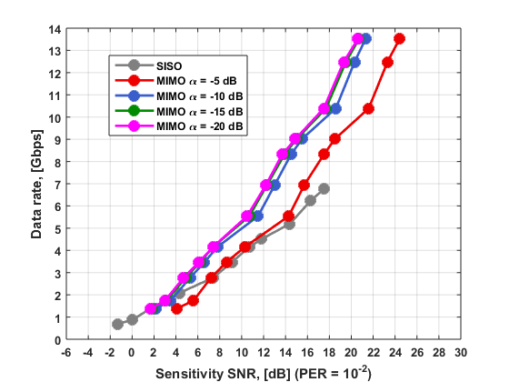
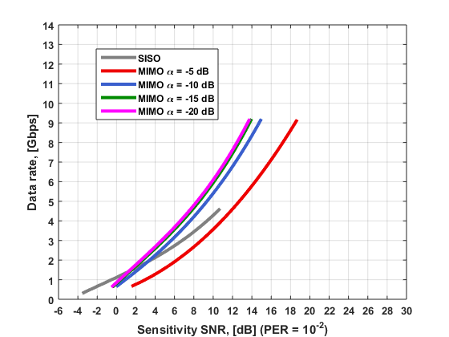
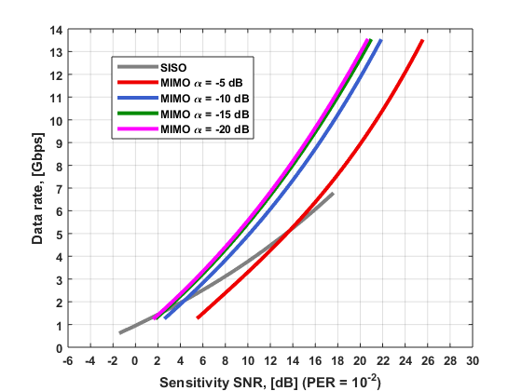
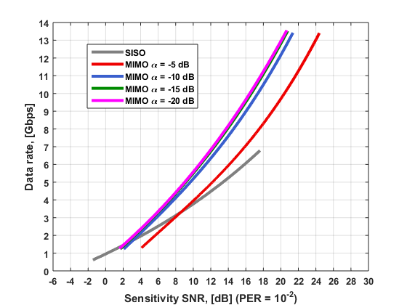
LOS Simulation Results – MIMO vs. SISO
SC unbiased LMMSE receiver
OFDM unbiased LMMSE receiver
OFDM ML receiver
Note: the SNR in MIMO case is adjusted by 3 dB for fair comparison to the SISO case.
The MCSs 4 and 5 were excluded from the data rate vs. SNR curves.
The sensitivity SNR corresponds to the fixed level of PER = 10⁻².
The smoothed curves in the second row were obtained from the simulated ones by cubic interpolation.
The data rate/SNR when the MIMO provides benefit comparing to the SISO case depends on the modulation type (SC or OFDM) and α.
SC interpolated curves
OFDM LMMSE interpolated curves
OFDM ML interpolated curves

Slide 23
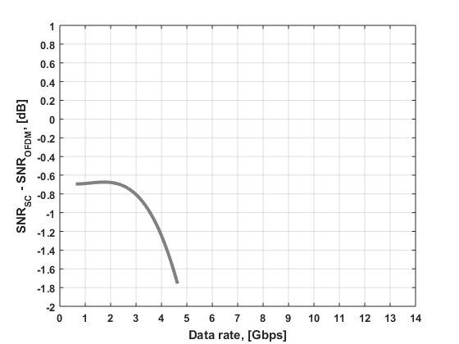
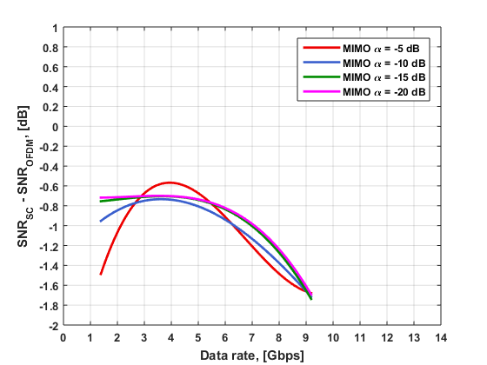
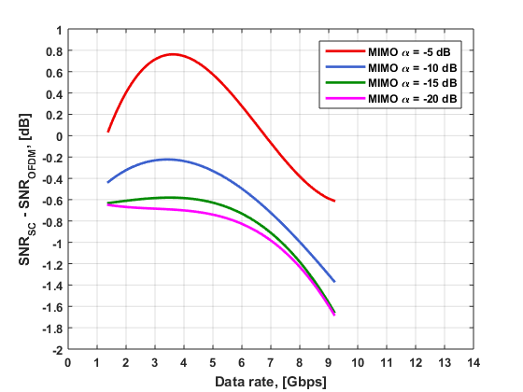
LOS Simulation Results – SC vs. OFDM
SISO SC unbiased LMMSE receiver
SISO OFDM ML (or ZF) receiver
MIMO SC unbiased LMMSE receiver
MIMO OFDM unbiased LMMSE receiver
MIMO SC unbiased LMMSE receiver
MIMO OFDM ML receiver
SISO: SC has better performance than OFDM, the OFDM SNR loss can be ~ 0.7 – 1.8 dB;
MIMO: SC unbiased LMMSE has better performance than OFDM unbiased LMMSE for all α, the OFDM SNR loss can be ~0.6 - 1.7 dB;
MIMO: OFDM ML has an advantage over the SC unbiased LMMSE for α = -5 dB, for all other α SC is better;

Slide 24
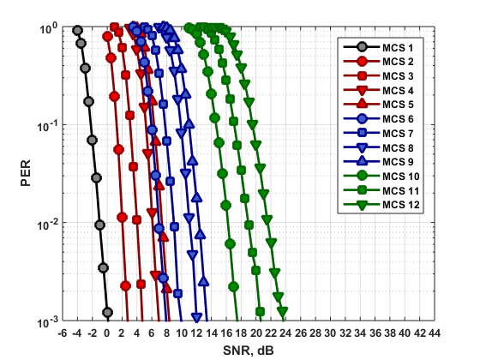
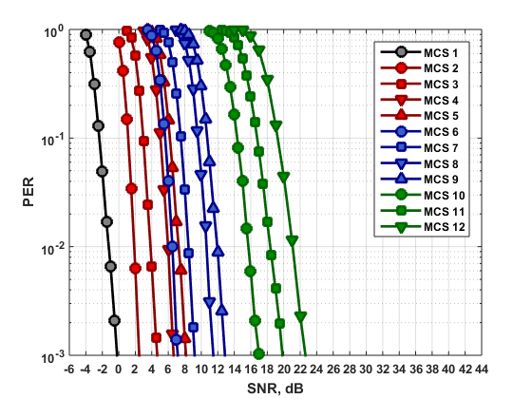
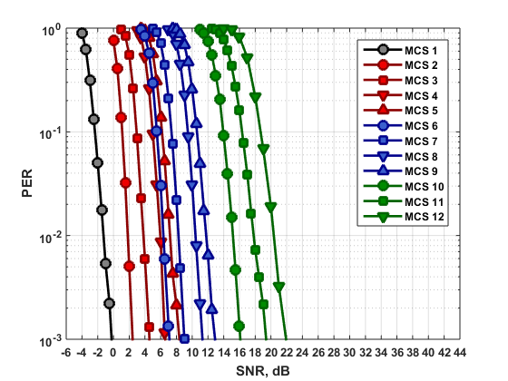
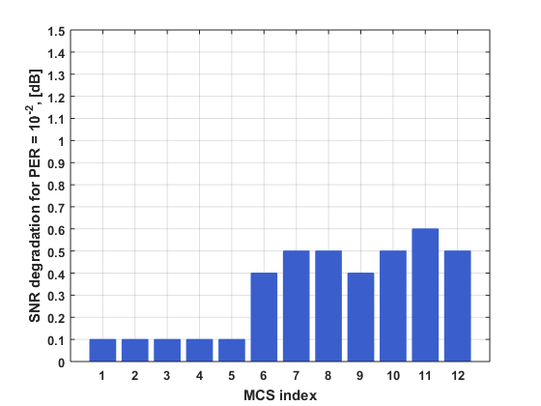
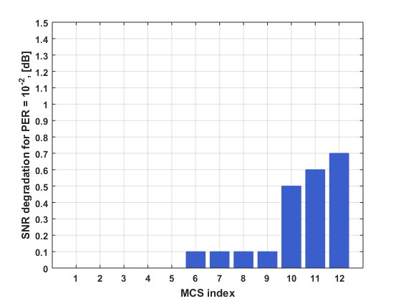
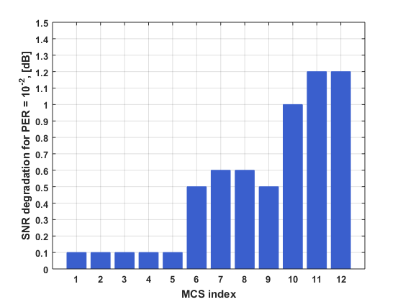
NLOS Simulation Results – MIMO SC
The figures below present simulation results for the unbiased LMMSE receiver only. ZF receiver exhibits poor performance and these results are not provided.
Horizontal
Vertical
Vertical + interleaver
SNR loss for horizontal coding comparing to the vertical + interleaving for 16QAM modulation can be up to ~1.2 dB.
Vertical coding provides enhancement starting from QPSK modulation.
Interleaver provides enhancement starting from 16QAM modulation.
Horizontal vs. Vertical
Vertical vs. Vertical + interleaver
Horizontal vs. Vertical + interleaver

Slide 25
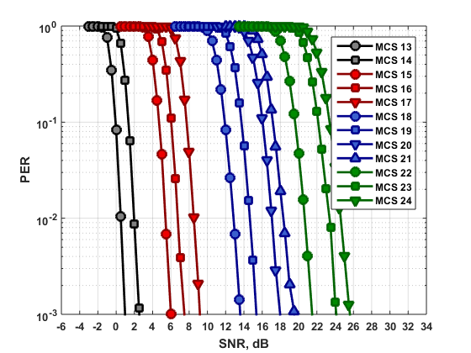
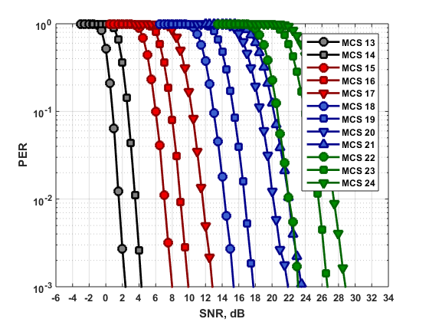
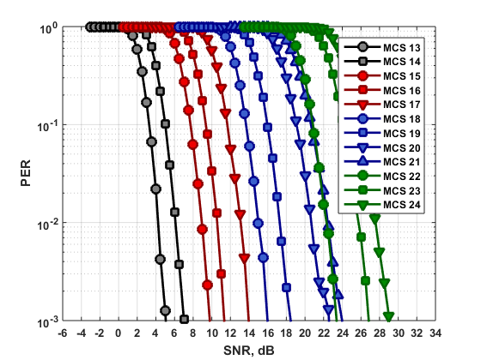
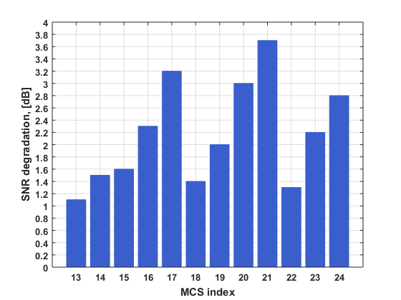
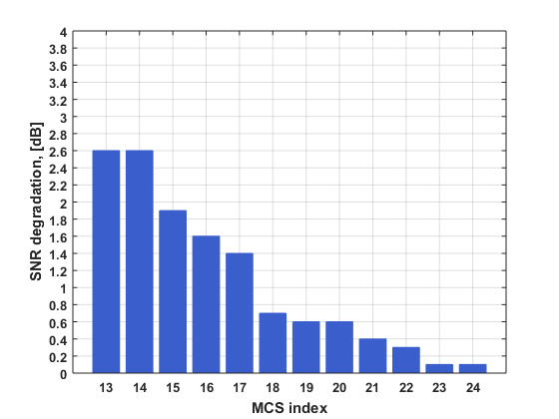
NLOS Simulation Results – MIMO OFDM
Horizontal coding/mapping
The ML receiver exhibits the best performance, unbiased LMMSE has the intermediate result, and ZF has the worst performance.
The SNR loss for the unbiased LMMSE comparing to the ML receiver increases for high encoding rates and can be up to ~ 3.7 dB.
The SNR loss of the ZF receiver decreases with MCS index. The largest value is equal to ~2.6 dB.
ML receiver
Unbiased LMMSE receiver
ZF receiver
SNR loss of LMMSE comp. to ML
SNR loss of ZF comp. to LMMSE

Slide 26
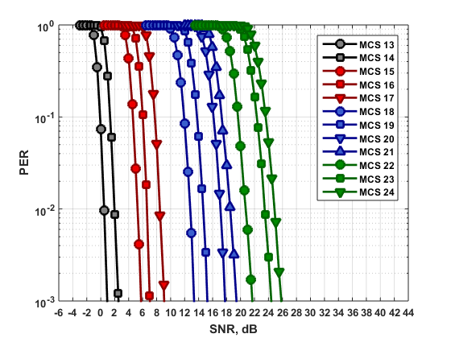
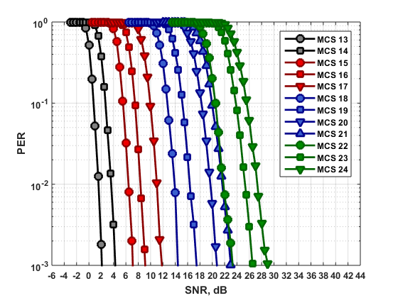
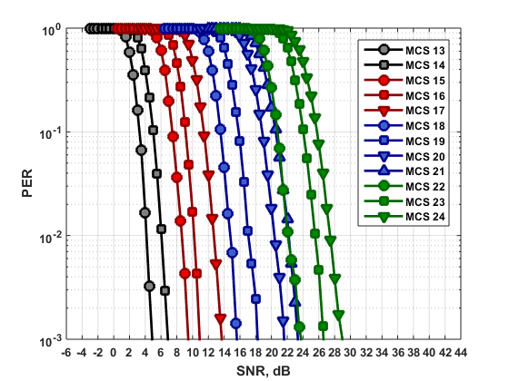
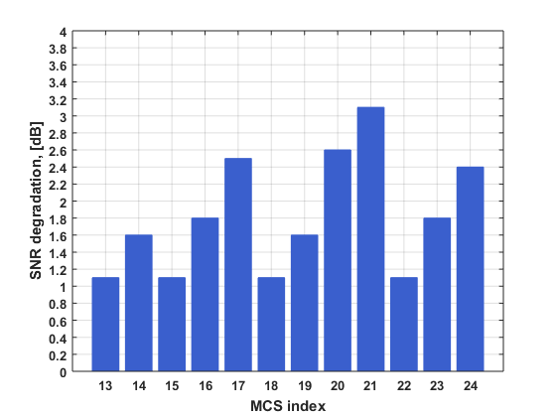
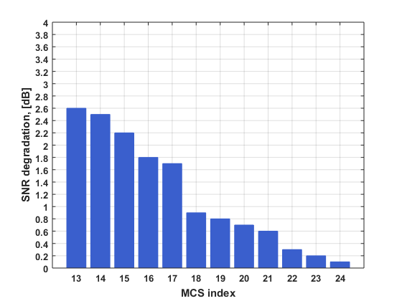
NLOS Simulation Results – MIMO OFDM (Cont’d)
Vertical coding/mapping
The ML receiver exhibits the best performance, unbiased LMMSE has the intermediate result, and ZF has the worst performance.
The SNR loss for the unbiased LMMSE comparing to the ML receiver increases for high encoding rates and can be up to ~ 3.1 dB.
The SNR loss of the ZF receiver decreases with MCS index. The largest value is equal to ~2.6 dB.
ML receiver
Unbiased LMMSE receiver
ZF receiver
SNR loss of LMMSE comp. to ML
SNR loss of ZF comp. to LMMSE

Slide 27
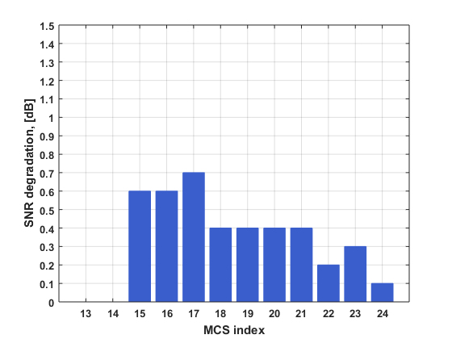
NLOS Simulation Results – MIMO OFDM (Cont’d)
Horizontal vs. Vertical
Unbiased LMMSE receiver
For ML receiver horizontal and vertical coding provide similar performance results.
For unbiased LMMSE receiver horizontal coding can have SNR loss up to ~0.7 dB comparing to the vertical coding.

Slide 28
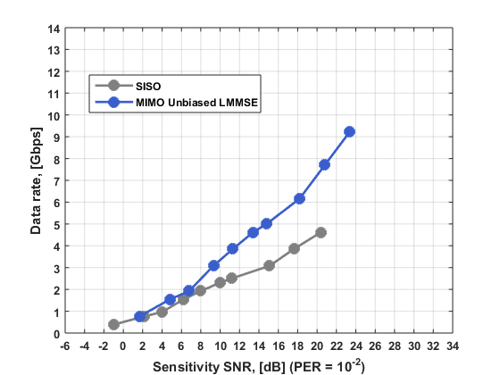



NLOS Simulation Results – MIMO vs. SISO
Vertical coding/mapping + interleaving
Note: the SNR in MIMO case is adjusted by 3 dB for fair comparison to the SISO case.
The MCSs 4 and 5 were excluded from the data rate vs. SNR curves.
The sensitivity SNR corresponds to the fixed level of PER = 10⁻².
The smoothed curves in the second row were obtained from the simulated ones by cubic interpolation.
The MIMO SC provides better data rate for the same SNR as in SISO case starting from the data rate ~1.0 Gbps.
The MIMO OFDM ML and unbiased LMMSE receivers exhibit data rate enhancement over the SISO case for all SNRs. The MIMO ZF receiver provides better data rate starting from the data rate ~2.5 Gbps.
SC unbiased LMMSE receiver
OFDM ML / unbiased LMMSE / ZF receiver
SC interpolated curves
OFDM ML / unbiased LMMSE / ZF
interpolated curves

Slide 29



NLOS Simulation Results – SC vs. OFDM
Horizontal
Vertical + interleaving
SISO SC unbiased LMMSE receiver
SISO OFDM ML (or ZF) receiver
MIMO SC unbiased LMMSE receiver
MIMO OFDM ML / unbiased LMMSE receiver
MIMO SC unbiased LMMSE receiver
MIMO OFDM ML / unbiased LMMSE receiver
SISO: SC has better performance (~ 0.4 dB) than OFDM for the data rate < 2.2 Gbps, for the data rate > 2.2 Gbps OFDM is significantly better (~2.0 dB).
Horizontal MIMO: SC unbiased LMMSE has better performance (~1.1 dB) than OFDM unbiased LMMSE for the data rate up to 7.0 Gbps, for the data rate > 7.0 Gbps OFDM is better (~ 0.5 dB); OFDM ML has significant SNR gain over the SC unbiased LMMSE receiver which can be up to ~2.8 dB.
Vertical MIMO: SC unbiased LMMSE has better performance (~1.1 dB) than OFDM unbiased LMMSE; OFDM ML has significant SNR gain over the SC unbiased LMMSE receiver which can be up to ~1.6 dB.

Slide 30
Conclusions
This work presents the results of simulation analysis of SU-MIMO schemes using OFDM and SC modulations. The ML, ZF, and LMMSE receivers are considered and the performance of the SC and OFDM modulations were compared.
It was shown that MIMO SC has an advantage over the MIMO OFDM for the considered LOS channel model.
For the NLOS channel model for horizontal coding the MIMO SC unbiased LMMSE receiver exhibits better performance for the data rates up to 7.0 Gbps and the MIMO OFDM unbiased LMMSE exhibits better performance for the data rates > 7.0 Gbps.
For the NLOS channel model for vertical coding and interleaving the MIMO SC unbiased LMMSE receiver exhibits better performance for the entire considered data range.
However MIMO OFDM ML receiver has significantly better performance in the entire considered data range over the MIMO SC unbiased LMMSE in the considered NLOS channel.

Slide 31
SFD SP/M
Would you agree to insert the following in section 7 of the SFD:”
  The 11ay specification shall enable both SC and OFDM modulations for SU-MIMO and MU-MIMO data transmission;
  “

Slide 32
References
IEEE 802.11ad standard, December 2012.
A. Eitan, et al., “PHY Frame Format proposal for 11ay,” IEEE 11-16/0061r0.
A. Maltsev, et al., “Experimental Measurements for Short Range LOS SU-MIMO,” IEEE 11-15/ 0632r1.

