Slide 1
Multi-Channel Spatial Sharing
Date: 2016-03-17
Authors:
Name | Company | Address | Phone | Email
Kyungtae Jo | LG Electronics |  |  | kyungtae.jo@lge.com
SungJin Park |  |  |  | allean.park@lge.com
HanGyu Cho |  |  |  | hg.cho@lge.com
JinMin Kim |  |  |  | jinmin1230.kim@lge.com
Saehee Bang |  |  |  | saehee.bang@lge.com
Sang G. Kim |  |  |  | sanggook.kim@lge.com

Slide 2
Introduction
Background
11ad includes “Spatial Sharing (SPSH) Protocol”.
11ay has to support the SPSH for multi-channel.
Therefore, existing SPSH protocol should be reinforced and remedied for 11ay.
This contribution intends to investigate how spatial sharing protocol in single channel for 11ad is modified to extend to the spatial reuse for multi-channel.

Slide 3
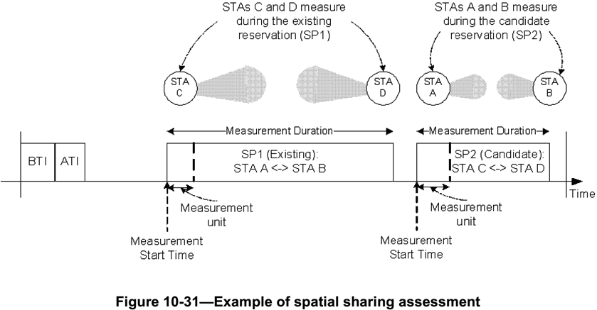
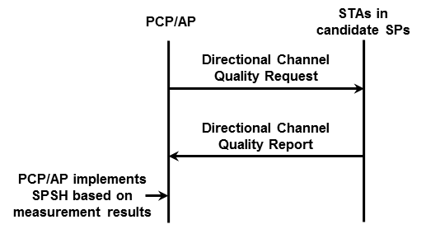
Recap : 11ad SPSH
Spatial sharing mechanisms allow SPs belonging to different STAs in the same spatial vicinity to be scheduled concurrently over the same channel.
The PCP/AP should request STAs to perform and report spectrum and radio resource measurements to assess the possibility to perform spatial sharing.

Slide 4
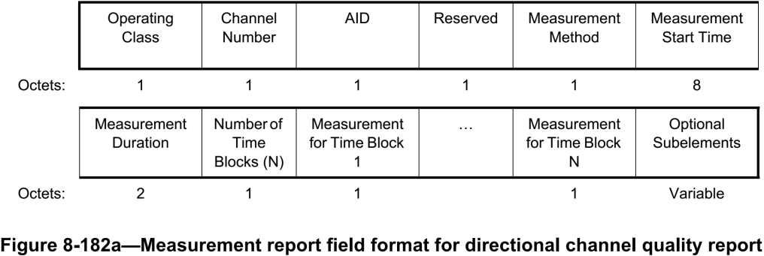
Recap : 11ad SPSH (cont.)
Directional Channel Quality Request/Report
Operating Class and Channel Number fields together specify the channel frequency and spacing for which the measurement request applies.
AID field indicates the Target STA.
Measurement Method field : If this field is set to 0, it indicates ANIPI. If this field is set to 1, it indicates RSNI.
Measurement for Time Block fields are set to the ANIPI value measured during each measurement unit, which is the ratio of Measurement Duration to Number of Time Blocks.

Slide 5
Proposal for Multi-Channel SPSH
For multi-channel SPSH, channel measurements for the channels should be achieved.
We suggest how to modify the Directional Channel Quality Request/Report frames for multi-channel SPSH.
* T_{cs} may be needed for RF bandwidth set to the assigned channels

Slide 6
Proposal : Modified Directional Channel Quality Request
Channel mapping for multi-channel SPSH in Directional Channel Quality Request frame
Multi-channel SPSH can be supported by modifying Directional Channel Quality Request frame that already exists in 11ad.
Channel bitmap for the channels requested by AP is carried in the reserved bits.
 | Operating Class | Channel Number | AID | Reserved | Measurement Method | Measurement Start Time | Measurement Duration | Number of Time Blocks | Optional Sub-elements
Octets: | 1 | 1 | 1 | 1 | 1 | 8 | 2 | 1 | Variable
 | Measurement channel bitmap | Reserved
Bits: | 4 | 4
 | Description
Measurement channel bitmap | Set the 1st bit to 1: Request about channel measurement on Channel 1, 0: NOT request on Channel 1
 | Set the 2nd bit to 1: Request about channel measurement on Channel 2, 0: NOT request on Channel 2
 | Set the 3rd bit to 1: Request about channel measurement on Channel 3, 0: NOT request on Channel 3
 | Set the 4th bit to 1: Request about channel measurement on Channel 4, 0: NOT request on Channel 4

Slide 7
Proposal: Modified Directional Channel Quality Report
Channel mapping for multi-channel SPSH in Directional Channel Quality Report frame
Multi-channel SPSH can be supported by modifying Directional Channel Quality Report frame that already exists in 11ad.
Channel bitmap for the channels measured by STAs is carried in the reserved bits.
 | Operating Class | Channel Number | AID | Reserved | Measurement Method | Measurement Start Time | Measurement Duration | Number of Time Blocks | Measurement for Time block 1 | … | Measurement for Time block M | Optional sub-elements
Octets: | 1 | 1 | 1 | 1 | 1 | 8 | 2 | 1 |  |  |  | Variable
 | Measurement channel bitmap | Reserved
Bits: | 4 | 4
 | Description
Measurement channel bitmap | Set the 1st bit to 1: Request about channel measurement on Channel 1, 0: NOT request on Channel 1
 | Set the 2nd bit to 1: Request about channel measurement on Channel 2, 0: NOT request on Channel 2
 | Set the 3rd bit to 1: Request about channel measurement on Channel 3, 0: NOT request on Channel 3
 | Set the 4th bit to 1: Request about channel measurement on Channel 4, 0: NOT request on Channel 4

Slide 8
Summary
We suggest that “Enhanced Directional Channel Quality Request/Report frame” are modified by using the reserved bits of existing “Directional Channel Quality Request/Report frame” of 11ad in order to keep backward compatibility with legacy.

Slide 9
Straw poll/motion
Insert the following in the SFD:
“11ay shall provide means to extend spatial sharing to be supported in multi-channel”

