Slide 1
Multi-Channel Spatial Sharing
Date: 2016-03-17
Authors:
Name | Company | Address | Phone | Email
Kyungtae Jo | LG Electronics |  |  | kyungtae.jo@lge.com
SungJin Park |  |  |  | allean.park@lge.com
HanGyu Cho |  |  |  | hg.cho@lge.com
JinMin Kim |  |  |  | jinmin1230.kim@lge.com
Saehee Bang |  |  |  | saehee.bang@lge.com
Sang G. Kim |  |  |  | sanggook.kim@lge.com

Slide 2
Introduction
Background
11ad includes “Spatial Sharing (SPSH) Protocol”.
11ay has to support the SPSH for multi-channel.
Therefore, existing SPSH protocol should be reinforced and remedied for 11ay.
This contribution intends to investigate how spatial sharing protocol in single channel for 11ad is modified to extend to the spatial reuse for multi-channel/multi-antenna.

Slide 3
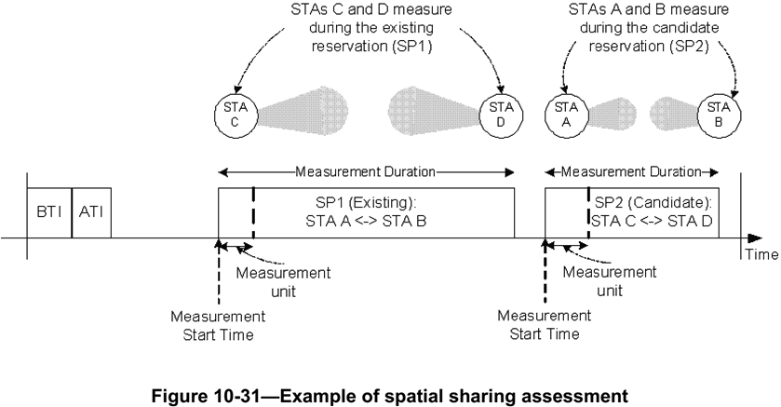
Recap : 11ad SPSH
Spatial sharing mechanisms allow SPs belonging to different STAs in the same spatial vicinity to be scheduled concurrently over the same channel.
The PCP/AP should request STAs to perform and report spectrum and radio resource measurements to assess the possibility to perform spatial sharing.
STAs that participate in an SP and that support spatial sharing should perform beamforming training with each other before engaging in any other communication or performing any measurements.

Slide 4
Recap : 11ad SPSH (cont.)
Directional Channel Quality Request/Report
Operating Class and Channel Number fields together specify the channel frequency and spacing for which the measurement request applies.
AID field indicates the Target STA.
Measurement Method field : If this field is set to 0, it indicates ANIPI. If this field is set to 1, it indicates RSNI
Measurement for Time Block fields are set to the ANIPI value measured during each measurement unit, which is the ratio of Measurement Duration to Number of Time Blocks.

Slide 5
Proposal for Multi-channel SPSH
For multi-channel SPSH, channel measurements for the channels should be achieved.
There are 2 options how to indicate measurement information for multi-channel SPSH in the modified Directional Channel Quality Request/Report frames.
Consistent measurement mode for multi-channel
Same measurement information over multiple channels, e.g., Number of Time Blocks, Measurement Duration, Measurement Method and Measurement Report Method for measurement
Same Measurement Start Time over multiple channels
Flexible measurement mode for multi-channel
Different measurement information for each channel
It can achieve the dynamic SPSH measurement.
* T_{cs} may be needed for RF bandwidth set to the assigned channels

Slide 6
Proposal : Modified Directional Channel Quality Request
 | Operating Class | Channel Number | AID | Reserved | Measurement Method | Measurement Start Time | Measurement Duration | Number of Time Blocks | Optional Sub-elements
Octets: | 1 | 1 | 1 | 1 | 1 | 8 | 2 | 1 | Variable
 | Measurement channel bitmap | Reserved
Bits: | 4 | 4
 | Description
Measurement channel bitmap | Set the 1st bit to 1: Request about channel measurement on Channel 1, 0: NOT request on Channel 1
 | Set the 2nd bit to 1: Request about channel measurement on Channel 2, 0: NOT request on Channel 2
 | Set the 3rd bit to 1: Request about channel measurement on Channel 3, 0: NOT request on Channel 3
 | Set the 4th bit to 1: Request about channel measurement on Channel 4, 0: NOT request on Channel 4

Slide 7
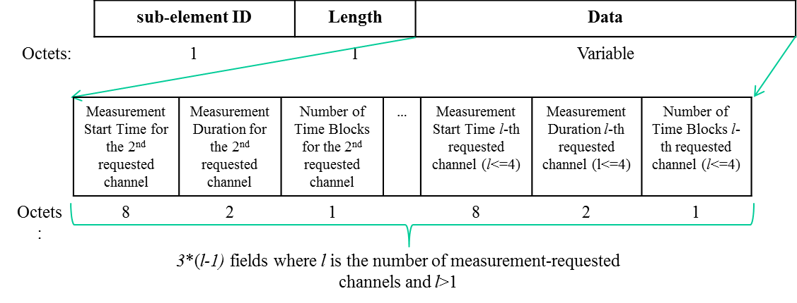
Extended sub-element on Proposed Request Frame
Measurement information for flexible measurement is transmitted by Modified Directional Channel Quality Request
Measurement information about the first-requested channel is carried in the Measurement for Time Blocks fields.
Optional Sub-elements are consisted of measurement information about requested channel except for first-requested channel in channel bitmap.
Extended Measurement Requset sub-element

Slide 8
Proposal: Modified Directional Channel Quality Report
 | Operating Class | Channel Number | AID | Reserved | Measurement Method | Measurement Start Time | Measurement Duration | Number of Time Blocks | Measurement for Time block 1 | … | Measurement for Time block M | Optional sub-elements
Octets: | 1 | 1 | 1 | 1 | 1 | 8 | 2 | 1 |  |  |  | Variable
 | Measurement channel bitmap | Reserved
Bits: | 4 | 4
 | Description
Measurement channel bitmap | Set the 1st bit to 1: Request about channel measurement on Channel 1, 0: NOT request on Channel 1
 | Set the 2nd bit to 1: Request about channel measurement on Channel 2, 0: NOT request on Channel 2
 | Set the 3rd bit to 1: Request about channel measurement on Channel 3, 0: NOT request on Channel 3
 | Set the 4th bit to 1: Request about channel measurement on Channel 4, 0: NOT request on Channel 4

Slide 9
Extended sub-element on Proposed Report Frame
Optional sub-elements according to requested measurement information
Measurement result about the first-requested channel is carried in the Measurement for Time Blocks fields.
Optional Sub-elements are consisted of measurement results about requested channel except for first-requested channel in channel bitmap.
Extended Measurement Requset sub-element

Slide 10
Summary
We suggest that “Enhanced Directional Channel Quality Request/Report frame” are modified by using the reserved bits of existing “Directional Channel Quality Request/Report frame” of 11ad in order to keep backward compatibility with legacy.

Slide 11
Straw poll/motion
Insert the following in the SFD:
“The 11ay beamforming protocol supports multi-beamforming for multiple array antennas. Multi-beamforming means that a transmitter simultaneously sends SSW frames in multiple polarized directions.”
Y-27, N-0, A-6

