Slide 1
Discussion of Wake-Up Receivers for LRLP
Date: 2016-03-14
Authors:

Slide 2
Introduction
This is a continued discussion of the LP-WUR (low-power wake-up receiver) that was brought up in [1]
In this presentation we present a state-of-the-art example of wake-up receiver from Lund University
We also address some questions related including WURs as part of an upcoming LRLP standard

Slide 3
Outline
Recap of wake-up receiver
Sensitivity requirements for LRLP
State-of-the-art example of wake-up receiver from Lund University
Possible improvements
Conclusions

Slide 4
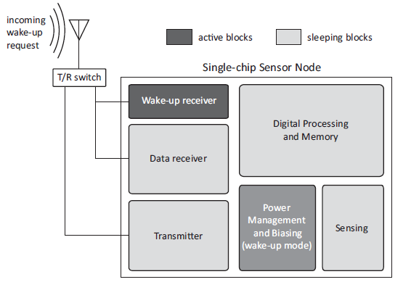
Wake-up receiver - recap
A low-power receiver that can detect an incoming wake-up request
Incoming wake-up request may be duty-cycled to achieve stand-by power consumption below level of the wake-up receiver
A wake-up receiver may operate in-band or in another frequency band
Wake-up Receiver [2]

Slide 5
Wake-up sensitivity requirements
If the wake-up receiver is seen as a low-power option for short range only, then the wake-up receiver sensitivity may be quite poor. We may still want to have a sensitivity requirement?
If the wake-up receiver shall be possible to use at all times it needs the same sensitivity as the regular receiver (hard to achieve low power in that case)
Any requirement for the wake-up receiver needs to have a reasonable balance to achieve both low power and sufficient usefulness.

Slide 6
Wake-up receiver from Lund University (1/4)
Research on wake-up receivers at LU was conducted around 2012-2014 [3-4]
The research shows large gain by using a combination of periodic wake-up beacons together with wake-up receivers
LU implementation show
  ~50uW, 0.07mm² for wake-up receiver in 65nm CMOS
  It is possible to reach 1uw stand-by power using periodic wake-up beacons

Slide 7
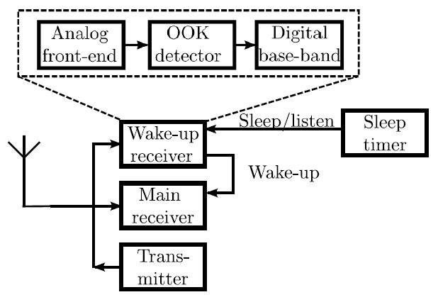
Wake-up receiver from Lund University (2/4)
On-Off Keying to allow low-power implementation
50uW 2.45GHz Wake-up receiver
  97% beacon detection and 0.04% false alarm probability at -94dBm
Wake-up Receiver

Slide 8
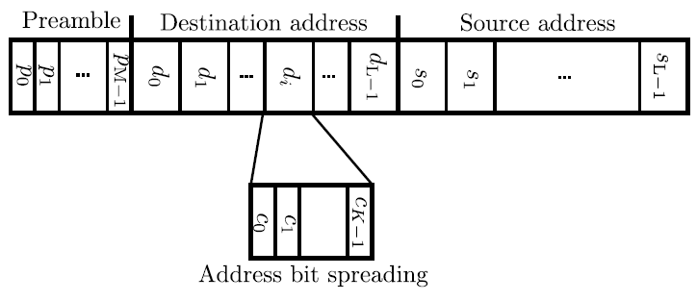
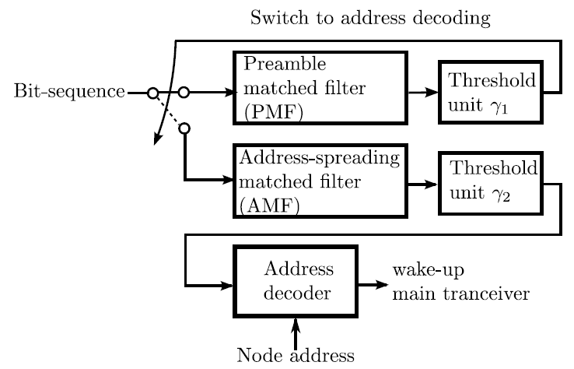
Wake-up receiver from Lund University (3/4)
Wake-up Beacon and detector

Slide 9
Wake-up receiver from Lund University (4/4)
Detector output is band-pass filtered
  Low frequency information lost
Use Manchester coding (”1, 0” → ”10, 01”)
  Band-pass characteristic
  Improves sensitivity
The figure shows the measured BER for a Manchester coded sequence
  varying data rate
  RF powers of -85, -88 and -90 dBm.

Slide 10
Possible Improvements
  Using a fairly old technology (65nm CMOS) it seems to be possible to make a ~50uw wake-up receiver.
    Power consumption will likely improve further using a modern 28nm or 14nm CMOS or SoI technology
  Well-balanced requirements on the wake-up receiver can enable both low power and improve usefulness compared to having only proprietary solutions. Without requirements, poor implementations may cause poor implementations giving the standard bad reputation
  The design of the preamble is key to enable good solutions for wake-up receivers

Slide 11
Conclusions
Wake-up receivers can potentially help achieve very low standby power, but lot of questions remain
Current best wake-up receivers with reasonable sensitivity consume around 50uW active power
  Typically simple OOK technique is used
  Using preamble design tailored for wake-up receivers
  Potential for further power (and area) reduction using state-of-the-art technology (28nm and below)
Need to decide how to treat Wake-up receivers in standardization

Slide 12
Straw Poll
Should the wake up receiver have a requirement on sensitivity?
Y/N/A:

Slide 13
Straw Poll
Wake-up receivers may operate in-band or in a separate (lower) frequency band. Should wake-up receivers operate in-band?
Y/N/A:

Slide 14
References
M. Park, S. Azizi, R. Stacey, E. Perahia. LP-WUR (Low-Power Wake-Up Receiver): Enabling Low-Power and Low-Latency Capability for 802.11. 2016-01-18
N. Pletcher, J. M. Rabaey, Ultra-Low Power Wake-Up Receivers for Wireless Sensor Networks, Technical Report No. UCB/EECS-2008-59, May 20, 2008.
C. Bryant, H. Sjöland, A 2.45GHz, 50uW wake-up receiver front-end with 88dBm sensitivity and 250kbps data rate ESSCIRC 2014, Venice, Italy, pp. 235-238.
N. Seyed Mazloum, O. Edfors, Performance Analysis and Energy Optimization of Wake-Up Receiver Schemes for Wireless Low-Power Applications, IEEE Transactions on Wireless Communications, Vol. 13, No. 12, pp. 7050-7061, 2014.

Slide 15
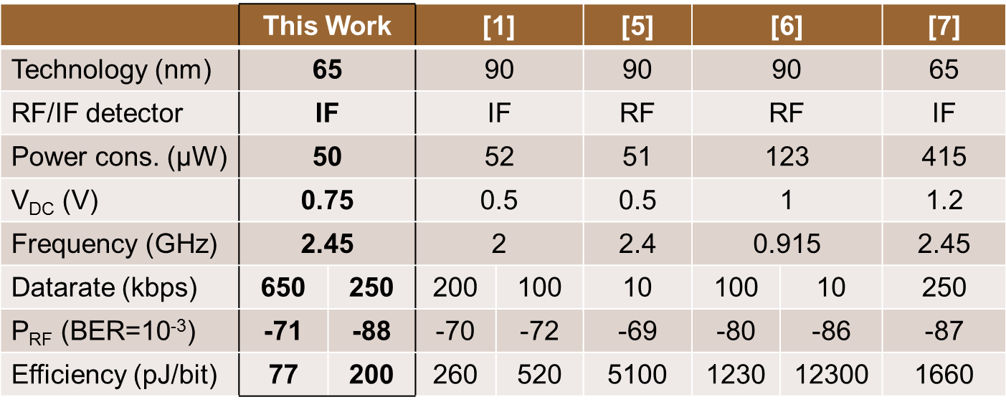
Wake-up receiver from Lund University
Comparison other Wake-up receivers
For references in table see [3]

