Slide 1
Discussion on LRLP Timeline
Date: 2016-03-14
Authors:

Slide 2
Contents of this Contribution
Review of Timelines for 2 Published Amendments
Review of Timelines for 2 In Process Amendments
LRLP Projected Timeline

Slide 3
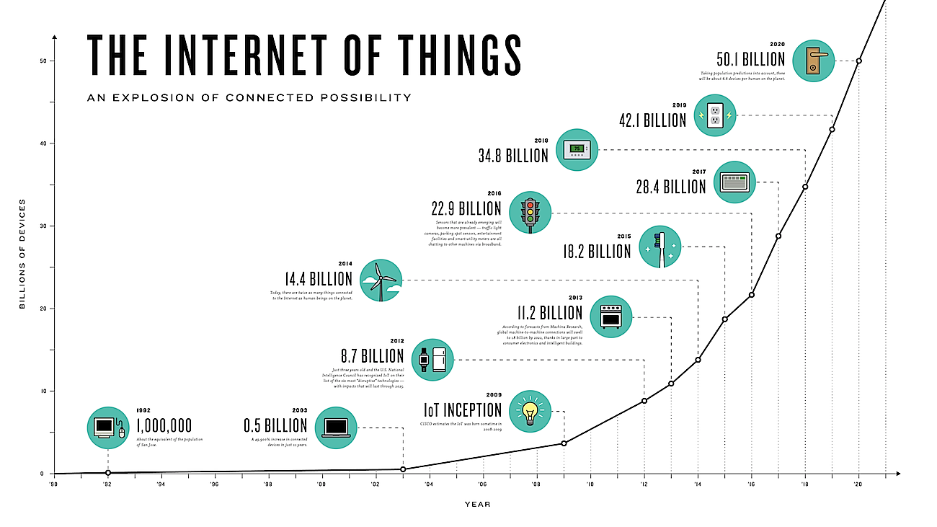
Growth of IoT till 2020
2018
2020
Reference: http://theconnectivist-img.s3.amazonaws.com/wp-content/uploads/2014/05/Unknown.png
(http://www.i-scoop.eu/internet-of-things/)

Slide 4
802.11ad Timeline
PAR approved: December 2008
Initial Working Group Letter Ballot: October 2010
Recirculation Working Group Letter Ballot: April 2011
Initial Sponsor Ballot: January 2012
Recirculation Sponsor Ballot: March 2012
Final Working Group Approval: July 2012
RevCom & Standards Board Final Approval: Oct 2012
22 months
6 months
9 months
Reference: http://www.ieee802.org/11/Reports/802.11_Timelines.htm

Slide 5
802.11ac Timeline
PAR approved: September 2008
Initial WG Letter Ballot : June 2011
Recirculation WG Letter Ballot: February 2012
Initial Sponsor Ballot: May 2013
Recirculation Sponsor Ballot: August 2013
Final Working Group Approval: November 2013
RevCom & SB approval: December 2013
33 months
8 months
15 months
Reference: http://www.ieee802.org/11/Reports/802.11_Timelines.htm

Slide 6
802.11ah Timeline
PAR approved: October 2010
Initial WG Letter Ballot: November 2013
Recirculation WG Letter Ballot: July 2014
Initial Sponsor Ballot: November 2015
Recirculation Sponsor Ballot: March 2016
Final Working Group Approval (predicted): July 2016
RevCom & SB approval (predicted): August 2016
38 months
8 months
16 months
Reference: http://www.ieee802.org/11/Reports/802.11_Timelines.htm

Slide 7
802.11ax Predicted Timeline
May 2014
HEW TG (IEEE 802.11ax)
Nov 2014 First TG SFD draft was approved
January 2016 Proposed TG Draft
July 2016
Draft 1.0
WG LB
March 2017
Draft 2.0
Recirculation
March 2019
Publication
March 2016 Draft 0.1 Approval and start of comment collection
May 2013
HEW SG
We are Here
26 months (between TG formation and Draft 1.0)
34 months (between TG formation and Draft 2.0)
Reference: Osama Aboul-Magd, “IEEE 802.11-16/1516r3,” January 2016

Slide 8
LRLP Projected Timeline
LRLP TG formation
LRLP Draft 2.0
Discussion starts in WFA
LRLP TIG to work on report development
Technical requirements, use cases
LRLP submits report in Mar 2016
LRLP TIG approved [1]
Initial Sponsor
Ballot
LRLP 1st Gen
LRLP Draft 1.0
LRLP SG starts
LRLP Draft 0.1
July 2015
Mar 2016
May 2016
Nov 2016
March 2018
July 2018
Jan 2019
Nov 2019
March 2020
Sep 2015
20 months
9 months
6 months
15 months
33 months
8 months
11ac Timeline
TG formation
(Sept 2008)
Draft 0.1
(Jan 2011)
Draft 1.0
(June 2011)
Draft 2.0
(Feb 2012)
Initial Sponsor
Ballot (May 2013)

Slide 9
Discussion on Achieving LRLP Timeline
Efficient execution of LRLP amendment will enable subset of 50 billion devices to be 802.11 enabled by 2020
LRLP 1st gen timeline of March 2020 will assist in developing battery-operated IoT devices for niche applications with winning edge over competing technologies
Decide on a limited set of features within the Study Group
Focused PAR description
Delve deep in these limited features to achieve the requirements derived from selective use cases
Good quality of Draft 1.0 can lead to efficient and short comment resolution phase between Draft 1.0 and Draft 2.0 recirculation

Slide 10
Conclusion
We have reviewed the timelines for published and in-process amendments
802.11ad timeline
802.11ac timeline
802.11ah timeline
802.11ax predicted timeline
We have presented a projected timeline for LRLP amendment

Slide 11
References
[1] IEEE 11-15/0775r1: Integrated Long Range Low Power Operation for IoT

