Slide 1
Simulation results of spatial reuse with various MCSs
Date: 2016-03-14
Authors:

Slide 2
Abstract
Several contributions have been presented to evaluate the effect of DSC and TPC with simulation results [1], [2].
  Spatial reuse with DSC can improve mean throughput.
  On the other hand, spatial reuse may increase interference, especially when STAs are not located near an AP, and the effect of increased interference has not been evaluated in detail.
  To maximize the advantage of spatial reuse and reduce the effect of interference, the following controls seem to be necessary:
    ON/OFF of DSC
    Threshold adjustment and TPC
    MCS optimization
In this contribution, we present simulation results with several MCS parameters and evaluate how the MCS selection affect the performance.

Slide 3
DSC and receiver behavior
In this document, regarding DSC, only OBSS_PD level is controlled.
We assume the following receiver behavior:
  During carrier sensing, an STA detects signals with >= -76dBm in a 80MHz channel bandwidth.
  Detection of the legacy preamble:
    If the legacy preamble is detected properly, the frame is regarded as a wireless LAN frame.
    Otherwise, the frame is regarded as a non wireless LAN frame, and the channel status is checked with CCA-ED threshold (-56dBm with 80MHz).
  If both the legacy and the HE preambles are detected properly, the BSS color of the received frame is checked.
    If it is the same as the BSS color of the STA’s BSS, the detection process continues.
    Otherwise, the detection is terminated, and the channel status is checked with OBSS_PD level (between -56dBm and -76dBm, variable).

Slide 4
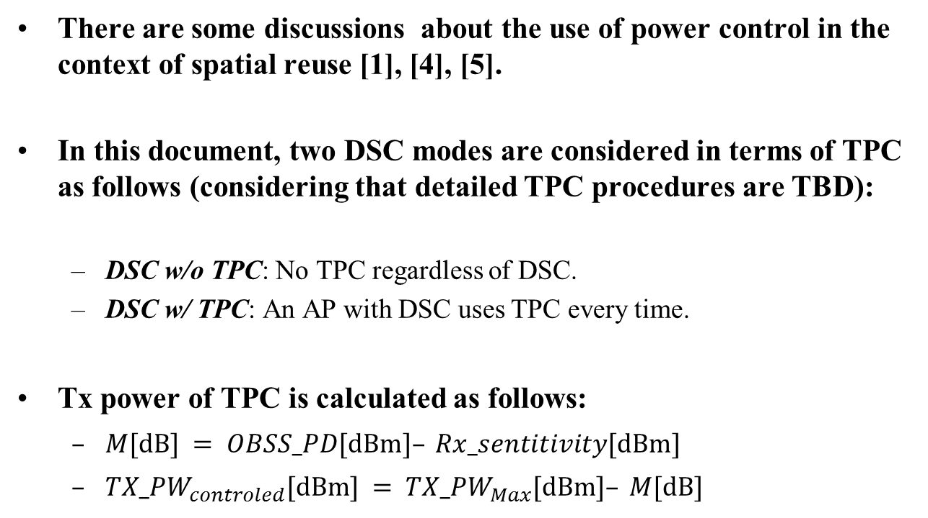
TPC
There are some discussions about the use of power control in the context of spatial reuse [1], [4], [5].
In this document, two DSC modes are considered in terms of TPC as follows (considering that detailed TPC procedures are TBD):
  DSC w/o TPC: No TPC regardless of DSC.
  DSC w/ TPC: An AP with DSC uses TPC every time.
Tx power of TPC is calculated as follows:
  $M[\text{dB}] = OBSS_PD[\text{dBm}]– Rx_sentitivity[\text{dBm}]$
  ${TX_PW}_{controled}[\text{dBm}] = {TX_PW}_{Max}[\text{dBm}]– M[\text{dB}]$

Slide 5
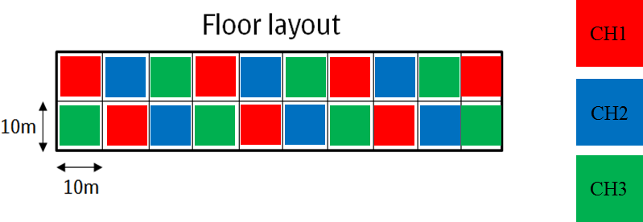
Simulation scenario
Residential Scenario is used:
  3 frequency reuse.
  AP is located at the center of each room. Two STAs are located in a room randomly.
  5dB penetration loss for a wall between two adjacent BSSs. This enables DSC effective and the throughput can be improved.
  We evaluate the performance with BSS F since there are may OBSSs around it.
A
B
C
D
E
F
G
H
I
J
K
L
M
N
O
P
Q
R
S
T
d=30m and 3walls,
RSSI = -78.60dBm
Min SINR in BSS_F is 10dB (two walls)
(with interference from AP Q)
F
C
d=14m, 2walls
RSSI = -62.17dBm
d=22m, 3walls
RSSI = -74.13dBm
N
Q

Slide 6
Simulation parameters (1/2)
PHY parameters
BW | All BSSs at 5GHz [80 MHz, no dynamic bandwidth]
Channel model | TGac D NLOS per link (no shadow fading)
Data Preamble Type | [5GHz, 11ac], duration is considered.
STA TX Power | 15 dBm per antenna
AP TX Power | 20 dBm per antenna
AP number of TX/RX antennas | 1/1
STA number of TX/RX antennas | 1/1
AP antenna gain | 0 dBi
STA antenna gain | -2 dBi
Noise Figure | 7dB
CCA-SD threshold | -76dBm/80MHz
CCA-ED (for any signal) threshold | -56dBm/80MHz
Rx sensitivity | -76dBm/80MHz (a packet with lower rx power is dropped)
OBSS-PD threshold | -73/-68/-62 dBm
Link Adaption | Fixed MCS =3 or 5 or 7
PHY abstraction | RBIR, BCC
Channel correlation | Same as defined in the used channel model
Capture Window | 800 nsec
Preemption Level | 9.0 dB (if a new PPDU arrives with rx power above 9.0dB the current reception, then capture phase is re-entered with this new PPDU)

Slide 7
Simulation parameters (2/2)
MAC parameters
Access protocol | [EDCA, AC_BE with default parameters] [CWmin = 15, CWmax = 1023, AIFSn=3 ]
Queue length | A single queue for each traffic link is set inside AP/STA sized of 2000 packets
Traffic type | UDP 200Mbit/s per a STA
MPDU size | 1540 Bytes (1472 Data + 28 IP header + 40 MAC header)
Aggregation | [A-MPDU / max aggregation size / BA window size, No A-MSDU, with immediate BA], Max aggregation: 32 MPDUs with 4-byte MPDU delimiter
Max number of retries | 10
Beacon | Disabled
RTS/CTS | OFF
Traffic direction | DL only
Throughput metric | Histogram of per non-AP STA throughput (received bits/overall simulation time)

Slide 8
Simulation results (MCS 5 only)
Throughput is evaluated with DSC and without DSC (legacy only), MCS5 only.
  OBSS_PD threshold (=p): -73dBm, -68dBm, -62dBm
  TPC: ON/OFF
The throughput with DSC is higher than that of legacy as a whole.
The conditions with DSC (w/TPC, OBSS_PD level = -62dBm, -68dBm) show the highest mean throughput.
However, around CDF 5%, the throughput of these conditions is low.
  As shown in Slide 5, if the location of the STA is not near the AP, the SINR is worse and the throughput decreases.
To avoid the degradation, we need further control considering the interference level.

Slide 9
Simulation results (MCS3, 5, 7)
MCS3
MCS5
MCS7
The simulation results with MCS 3,5 and 7 (legacy and with DSC w/TPC, OBSS_PD_level = -68dBm) are the following:
  Over 20%tile: The throughput is the highest on the condition of “DSC w/TPC, MCS7”.
  Between 15%tile and 20%tile: The throughput is the highest on the condition of “DSC w/TPC, MCS5”.
  Below 15%tile: The throughput is the highest on the conditions of “legacy only, MCS7” or “DSC w/TPC, MCS3”.
    The throughput decreases on the condition of “DSC w/ TPC, MCS7” compared with the case of legacy.

Slide 10
Statistic values
 |  | Average |  | 5%tile |  | 50%tile
 |  | Value (Mbit/s) | Gain (to "legacy only") | Value (Mbit/s) | Gain (to "legacy only") | Value (Mbit/s) | Gain (to "legacy only")
MCS3 | legacy only | 29.93 | 1.00 | 26.37 | 1.00 | 27.89 | 1.00
 | DSC w/o TPC (p=-73dBm) | 36.75 | 1.23 | 27.38 | 1.04 | 34.49 | 1.24
 | DSC w/o TPC (p=-68dBm) | 36.28 | 1.21 | 26.88 | 1.02 | 33.04 | 1.18
 | DSC w/o TPC (p=-62dBm) | 43.78 | 1.46 | 28.64 | 1.09 | 45.22 | 1.62
 | DSC w/ TPC (p=-73dBm) | 35.77 | 1.20 | 26.93 | 1.02 | 29.52 | 1.06
 | DSC w/ TPC (p=-68dBm) | 52.11 | 1.74 | 51.90 | 1.97 | 52.13 | 1.87
 | DSC w/ TPC (p=-62dBm) | 52.01 | 1.74 | 51.50 | 1.95 | 52.12 | 1.87
MCS5 | legacy only | 54.27 | 1.00 | 45.22 | 1.00 | 53.29 | 1.00
 | DSC w/o TPC (p=-73dBm) | 62.62 | 1.15 | 46.92 | 1.04 | 58.91 | 1.11
 | DSC w/o TPC (p=-68dBm) | 62.18 | 1.15 | 47.79 | 1.06 | 58.61 | 1.10
 | DSC w/o TPC (p=-62dBm) | 77.81 | 1.43 | 41.76 | 0.92 | 83.15 | 1.56
 | DSC w/ TPC (p=-73dBm) | 65.61 | 1.21 | 46.92 | 1.04 | 61.06 | 1.15
 | DSC w/ TPC (p=-68dBm) | 85.65 | 1.58 | 11.87 | 0.26 | 97.62 | 1.83
 | DSC w/ TPC (p=-62dBm) | 90.18 | 1.66 | 9.79 | 0.22 | 97.61 | 1.83
MCS7 | legacy only | 65.08 | 1.00 | 53.82 | 1.00 | 64.00 | 1.00
 | DSC w/o TPC (p=-73dBm) | 71.68 | 1.10 | 54.28 | 1.01 | 68.83 | 1.08
 | DSC w/o TPC (p=-68dBm) | 70.76 | 1.09 | 55.69 | 1.03 | 68.08 | 1.06
 | DSC w/o TPC (p=-62dBm) | 85.87 | 1.32 | 41.45 | 0.77 | 92.25 | 1.44
 | DSC w/ TPC (p=-73dBm) | 74.97 | 1.15 | 55.11 | 1.02 | 66.90 | 1.05
 | DSC w/ TPC (p=-68dBm) | 98.78 | 1.52 | 14.32 | 0.27 | 117.90 | 1.84
 | DSC w/ TPC (p=-62dBm) | 97.36 | 1.50 | 11.44 | 0.21 | 118.11 | 1.85

Slide 11
Effect of MCS selection and DSC
In the residential scenario, SINR may be worse due to interference when adjacent APs transmit frames at the same time, and the throughput may decrease by half if a STA is located far from the AP.
To achieve higher throughput by using DSC, transmitted frames should be received successfully with a high probability.
In order to improve the throughput regardless of the location of STAs, one of the possible ways is use of MCS control in conjunction with DSC, i.e., optimization of the OBSS_PD threshold.

Slide 12
Conclusion
We evaluated the throughput with the residential scenario to show the effect of spatial reuse with several MCS parameters.
  DSC improves the mean and average throughput. However, in the worst small percentile cases, the throughput decreases since the STAs are located randomly.
  In order to achieve higher throughput, one of the possible ways is use of MCS control in conjunction with DSC, i.e., optimization of the OBSS_PD threshold.

Slide 13
References
[1] Takeshi Itagaki, “Dynamic CCA control and TPC Simulation Results with SS1~SS3,” doc.: IEEE 802.11-15/1045r0
[2] Jinmin Kim, “Simulation results for spatial reuse in 11ax,” doc.: IEEE 802.11-15/1284r0
[3] Ron Porat, “11ax Evaluation Methodology,” doc.:IEEE 802.11-14/0571r12
[4] James Wang, “Adaptive CCA and TPC,” doc.:IEEE 802.11-15/1069r3
[5] V. Mhatre, K. Papagiannaki, and F. Bacceli, “Interference mitigation through power control in high density 802.11 WLANs” in Proc. IEEE INFOCOM 2007, Anchorage, USA, May 2007.

