Slide 1
Snapshot of Residential Wi-Fi Activity - 2016
Date: 2016-03-12
Name | Affiliation | Address | Phone | Email
Carol Ansley | ARRIS International, plc | 3871 Lakefield Dr, Suwanee, GA | +1-678-473-8630 | carol.ansley@arris.com

Slide 2
Introduction
Data was gathered from a recent deployment in a North American residential setting.
This presentation provides a snapshot of some of the data that is relevant to 11ax simulation scenarios and goals.
This snapshot of current behavior can be compared to the simulation models as a checkpoint.

Slide 3
Data Background
Data was gathered from 1040 recently deployed dual band/concurrent AP/Gateway devices.
Devices were polled 4 times a day to minimize load on monitoring system.
Data was collected from January 23rd through January 30th, 2016.
STA data only includes traffic to/from STAs.
  Other traffic, like beacons and other MAC traffic, was not included.

Slide 4
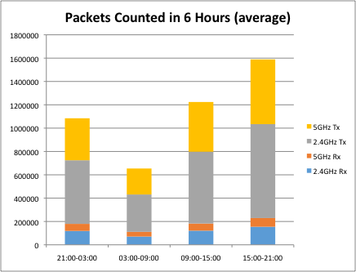
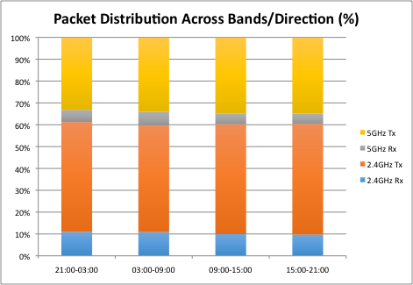
STA Traffic by Band
Highest traffic level during “primetime”.
Most traffic still traverses the 2.4GHz radio.
While the volume of traffic changes, the percentage split across 2.4GHz versus 5 GHz remains fairly constant.

Slide 5
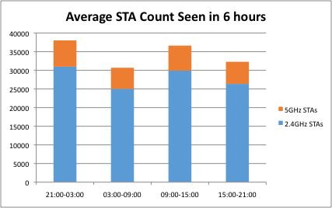
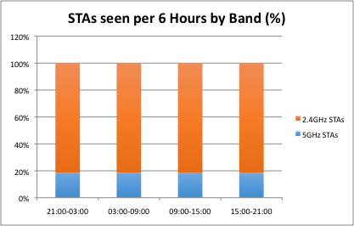
STA Statistics by Band
Count of STAs per AP varies across the day.
The ratio of 5GHz STAs to 2.4GHz STAs is almost unchanged across the day.
Note the 5GHz STAs are 20% of total STAs, but account for about 40% of total packets.

Slide 6
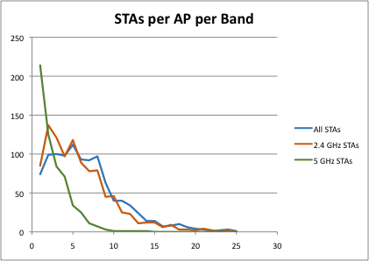
General STA statistics
Compared with earlier measurements, overall STAs/AP has not grown much
  6.6 STAs/AP 2.4 GHz + 5 GHz
5 GHz may be spreading slowly
  3% of APs were 5GHz only
  44% of APs were 2.4GHz only
Because this deployment
was recent, users may still
have had other APs in use.

Slide 7
Summary
Wi-Fi traffic in residential areas is time of day dependent.
  Portion of STA population tends to migrate away during the day which suggests they are mobile devices the owner tends to take with them.
While 5GHz devices are spreading in the network and accounting for more than their fair share of traffic, 2.4GHz devices still predominate in sheer numbers as well as traffic.

Slide 8
References
None.

