Slide 1
HE-SIG-B Compression Mode
Date: 2016-03-14
Authors:
Name | Affiliation | Address | Phone | Email
Kaushik Josiam | Samsung | 1301, E. Lookout Dr, Richardson TX 75082 | (972) 761 7437 | k.josiam@samsung.com
Rakesh Taori |  | 1301, E. Lookout Dr, Richardson TX 75082 | (972) 761 7470 | rakesh.taorig@samsung.com
Sanghyun Chang |  | Maetan 3-dong; Yongtong-Gu Suwon; South Korea | +82-10-8864-1751 | s29.chang@samsung.com
Hyunjeong Kang |  | Maetan 3-dong; Yongtong-Gu Suwon; South Korea | +82-31-279-9028 | hyunjeong.kang@samsung.com
Mark Rison |  | Innovation Park, Cambridge CB4 0DS (U.K.) | +44 1223 434633 | m.rison@samsung.com
Fei Tong |  | Innovation Park, Cambridge CB4 0DS (U.K.) | +44 1223 434600 | f.tong@samsung.com
Ron Porat | Broadcom |  |  | rporat@broadcom.com
Sriram Venkateswaran
Matthew Fischer |  |  |  | mfischer@broadcom.com
Zhou Lan
Leo Montreuil
Andrew Blanksby
Vinko Erceg
Mingyue Ji

Slide 2
Authors (continued)
Authors:
Name | Affiliation | Address | Phone | Email
Robert Stacey | Intel | 2111 NE 25th Ave, Hillsboro OR 97124, USA | +1-503-724-893 | robert.stacey@intel.com
Shahrnaz Azizi |  |  |  | shahrnaz.azizi@intel.com
Po-Kai Huang |  |  |  | po-kai.huang@intel.com
Qinghua Li |  |  |  | quinghua.li@intel.com
Xiaogang Chen |  |  |  | xiaogang.c.chen@intel.com
Chitto Ghosh |  |  |  | chittabrata.ghosh@intel.com
Laurent Cariou |  |  |  | laurent.cariou@intel.com
Yaron Alpert |  |  |  | yaron.alpert@intel.com
Assaf Gurevitz |  |  |  | assaf.gurevitz@intel.com
Ilan Sutskover |  |  |  | ilan.sutskover@intel.com

Slide 3
Authors (continued)
Name | Affiliation | Address | Phone | Email
Hongyuan Zhang | Marvell | 5488 Marvell Lane, Santa Clara, CA, 95054 | 408-222-2500 | hongyuan@marvell.com
Yakun Sun |  |  |  | yakunsun@marvell.com
Lei Wang |  |  |  | Leileiw@marvell.com
Liwen Chu |  |  |  | liwenchu@marvell.com
Jinjing Jiang |  |  |  | jinjing@marvell.com
Yan Zhang |  |  |  | yzhang@marvell.com
Rui Cao |  |  |  | ruicao@marvell.com
Sudhir Srinivasa |  |  |  | sudhirs@marvell.com
Bo Yu |  |  |  | boyu@marvell.com
Saga Tamhane |  |  |  | sagar@marvell.com
Mao Yu |  |  |  | my@marvel..com
Xiayu Zheng |  |  |  | xzheng@marvell.com
Christian Berger |  |  |  | crberger@marvell.com
Niranjan Grandhe |  |  |  | ngrandhe@marvell.com
Hui-Ling Lou |  |  |  | hlou@marvell.com

Slide 4
Authors (continued)
Name | Affiliation | Address | Phone | Email
Alice Chen | Qualcomm | 5775 Morehouse Dr. San Diego, CA, USA |  | alicel@qti.qualcomm.com
Albert Van Zelst |  | Straatweg 66-S Breukelen, 3621 BR Netherlands |  | allert@qti.qualcomm.com
Alfred Asterjadhi |  | 5775 Morehouse Dr. San Diego, CA, USA |  | aasterja@qti.qualcomm.com
Arjun Bharadwaj |  | 5775 Morehouse Dr. San Diego, CA, USA |  | arjunb@qti.qualcomm.com
Bin Tian |  | 5775 Morehouse Dr. San Diego, CA, USA |  | btian@qti.qualcomm.com
Carlos Aldana |  | 1700 Technology Drive San Jose, CA 95110, USA |  | caldana@qca.qualcomm.com
George Cherian |  | 5775 Morehouse Dr. San Diego, CA, USA |  | gcherian@qti.qualcomm.com
Gwendolyn Barriac |  | 5775 Morehouse Dr. San Diego, CA, USA |  | gbarriac@qti.qualcomm.com
Hemanth Sampath |  | 5775 Morehouse Dr. San Diego, CA, USA |  | hsampath@qti.qualcomm.com
Lin Yang |  | 5775 Morehouse Dr. San Diego, CA, USA |  | linyang@qti.qualcomm.com
Menzo Wentink |  | Straatweg 66-S Breukelen, 3621 BR Netherlands |  | mwentink@qti.qualcomm.com
Naveen Kakani |  | 2100 Lakeside Boulevard Suite 475, Richardson TX 75082, USA |  | nkakani@qti.qualcomm.com
Raja Banerjea |  | 1060 Rincon Circle San Jose CA 95131, USA |  | rajab@qit.qualcomm.com
Richard Van Nee |  | Straatweg 66-S Breukelen, 3621 BR Netherlands |  | rvannee@qti.qualcomm.com

Slide 5
Authors (continued)
Name | Affiliation | Address | Phone | Email
Rolf De Vegt | Qualcomm | 1700 Technology Drive San Jose, CA 95110, USA |  | rolfv@qca.qualcomm.com
Sameer Vermani |  | 5775 Morehouse Dr. San Diego, CA, USA |  | svverman@qti.qualcomm.com
Simone Merlin |  | 5775 Morehouse Dr. San Diego, CA, USA |  | smerlin@qti.qualcomm.com
Tao Tian |  | 5775 Morehouse Dr. San Diego, CA, USA |  | ttian@qti.qualcomm.com
Tevfik Yucek |  | 1700 Technology Drive San Jose, CA 95110, USA |  | tyucek@qca.qualcomm.com
VK Jones |  | 1700 Technology Drive San Jose, CA 95110, USA |  | vkjones@qca.qualcomm.com
Youhan Kim |  | 1700 Technology Drive San Jose, CA 95110, USA |  | youhank@qca.qualcomm.com

Slide 6
Authors (continued)
Name | Affiliation | Address | Phone | Email
Jianhan Liu | Mediatek USA | 2860 Junction Ave, San Jose, CA 95134, USA | +1-408-526-1899 | jianhan.Liu@mediatek.com
Thomas Pare |  |  |  | thomas.pare@mediatek.com
ChaoChun Wang |  |  |  | chaochun.wang@mediatek.com
James Wang |  |  |  | james.wang@mediatek.com
Tianyu Wu |  |  |  | tianyu.wu@mediatek.com
Russell Huang |  |  |  | russell.huang@mediatek.com
James Yee | Mediatek | No. 1 Dusing 1st Road, Hsinchu, Taiwan | +886-3-567-0766 | james.yee@mediatek.com
Alan Jauh |  |  |  | alan.jauh@mediatek.com
Frank Hsu |  |  |  | frank.hsu@mediatek.com
Joonsuk Kim | Apple |  |  | joonsuk@apple.com
Aon Mujtaba |  |  |  | mujtaba@apple.com
Guoqing Li |  |  |  | guoqing_li@apple.com
Eric Wong |  |  |  | ericwong@apple.com
Chris Hartman |  |  |  | chartman@apple.com

Slide 7
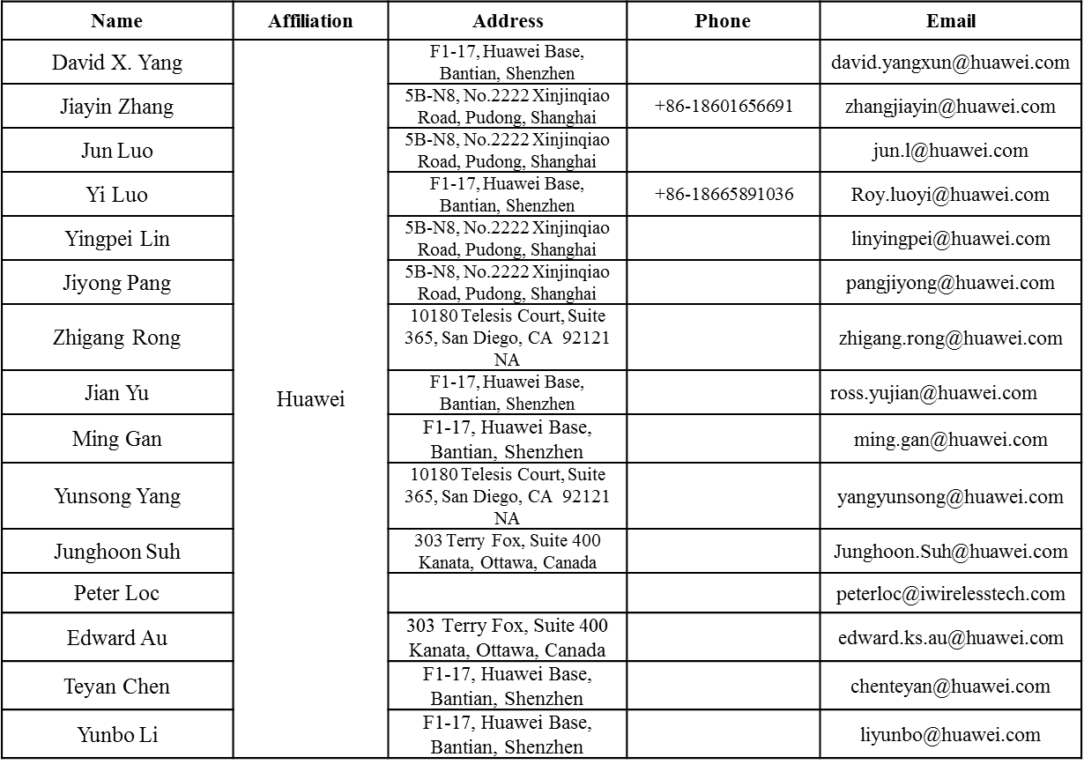
Authors (continued)

Slide 8
Authors (continued)
Name | Affiliation | Address | Phone | Email
Jinmin Kim | LG Electronics | 19, Yangjae-daero 11gil, Seocho-gu, Seoul 137-130, Korea |  | Jinmin1230.kim@lge.com
Kiseon Ryu |  |  |  | kiseon.ryu@lge.com
Jinyoung Chun |  |  |  | jiny.chun@lge.com
Jinsoo Choi |  |  |  | js.choi@lge.com
Jeongki Kim |  |  |  | jeongki.kim@lge.com
Dongguk Lim |  |  |  | dongguk.lim@lge.com
Suhwook Kim |  |  |  | suhwook.kim@lge.com
Eunsung Park |  |  |  | esung.park@lge.com
JayH Park |  |  |  | Hyunh.park@lge.com
HanGyu Cho |  |  |  | hg.cho@lge.com
Thomas Derham | Orange |  |  | thomas.derham@orange.com
Bo Sun | ZTE | #9 Wuxingduan, Xifeng Rd., Xi'an, China |  | sun.bo1@zte.com.cn
Kaiying Lv |  |  |  | lv.kaiying@zte.com.cn
Yonggang Fang |  |  |  | yfang@ztetx.com
Ke Yao |  |  |  | yao.ke5@zte.com.cn
Weimin Xing |  |  |  | xing.weimin@zte.com.cn
Brian Hart | Cisco Systems | 170 W Tasman Dr, San Jose, CA 95134 |  | brianh@cisco.com
Pooya Monajemi |  |  |  | pmonajem@cisco.com

Slide 9
Authors (continued)
Name | Affiliation | Address | Phone | Email
Yasushi Takatori | NTT | 1-1 Hikari-no-oka, Yokosuka, Kanagawa 239-0847 Japan | +81 46 859 3135 | takatori.yasushi@lab.ntt.co.jp
Yasuhiko Inoue |  |  | +81 46 859 5097 | inoue.yasuhiko@lab.ntt.co.jp
Shoko Shinohara |  |  | +81 46 859 5107 | Shinohara.shoko@lab.ntt.co.jp
Yusuke Asai |  |  | +81 46 859 3494 | asai.yusuke@lab.ntt.co.jp
Koichi Ishihara |  |  | +81 46 859 4233 | ishihara.koichi@lab.ntt.co.jp
Junichi Iwatani |  |  | +81 46 859 4222 | Iwatani.junichi@lab.ntt.co.jp
Akira Yamada | NTT DOCOMO | 3-6, Hikarinooka, Yokosuka-shi, Kanagawa, 239-8536, Japan | +81 46 840 3759 | yamadaakira@nttdocomo.com
Masahito Mori | Sony Corp. |  |  | Masahito.Mori@jp.sony.com
Yusuke Tanaka |  |  |  | YusukeC.Tanaka@jp.sony.com
Yuichi Morioka |  |  |  | Yuichi.Morioka@jp.sony.com
Kazuyuki Sakoda |  |  |  | Kazuyuki.Sakoda@am.sony.com
William Carney |  |  |  | William.Carney@am.sony.com
Sigurd Schelstraete | Quantenna | 3450 W. Warren Ave, Fremont, CA 94538 |  | Sigurd@quantenna.com
Huizhao Wang |  |  |  | hwang@quanetnna.com

Slide 10
Authors (continued)
Name | Affiliation | Address | Phone | Email
Tomoko Adachi | Toshiba |  |  | tomo.adachi@toshiba.co.jp
Narendar Madhavan |  |  |  | narendar.madhavan@toshiba.co.jp
Kentaro Taniguchi |  |  |  | kentaro.taniguchi@toshiba.co.jp
Toshihisa Nabetani |  |  |  | toshihisa.nabetani@toshiba.co.jp
Tsuguhide Aoki |  |  |  | tsuguhide.aoki@toshiba.co.jp
Koji Horisaki |  |  |  | kouji.horisaki@toshiba.co.jp
David Halls |  |  |  | david.halls@toshiba-trel.com
Filippo Tosato |  |  |  | filippo.tosato@toshiba-trel.com
Zubeir Bocus |  |  |  | zubeir.bocus@toshiba-trel.com
Fengming Cao |  |  |  | fengming.cao@toshiba-trel.com
Parag Kulkarni |  |  |  | parag.kulkarni@toshiba-trel.com
Minho Cheong | Newracom, Inc. | 9008 Research Dr, Irvine, CA 92618 | +1-949-390-7146 | minho.cheong@newracom.com
Reza Hedayat |  |  |  | reza.hedayat@newracom.com
Young Hoon Kwon |  |  |  | younghoon.kwon@newracom.com
Yongho Seok |  |  |  | yongho.seok@newracom.com
Daewon Lee |  |  |  | daewon.lee@newracom.com
Yujin Noh |  |  |  | yujin.noh@newracom.com

Slide 11
HE-SIG-B Compression for MU-MIMO
For MU-MIMO over the entire BW, 1 bit in HE-SIG-A indicates compression. [1]
  RU Size is set to the largest RU for the BW (20MHz – 242 tone RU, 40 – 484, 80– 996, 160 – 2x996)
  The SFD states that the user specific sub-fields are split equally between the two HE-SIG-B Channels for efficient load-balancing
  Only RU signaling is absent in the HE-SIG-B common fields
In this presentation
  Resolve Open Issue of number of user signaling
  Clarify “equal split” between the two content channels
  Optimize HE-SIG-B length by not requiring HE-SIG-B common field with compression.

Slide 12
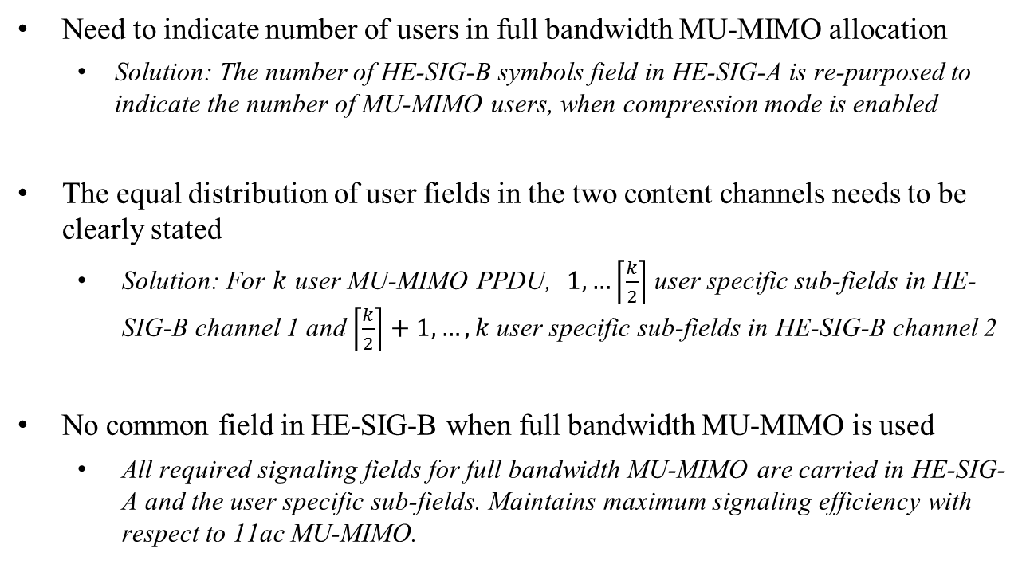
Compression mode - TBDs
Need to indicate number of users in full bandwidth MU-MIMO allocation
  Solution: The number of HE-SIG-B symbols field in HE-SIG-A is re-purposed to indicate the number of MU-MIMO users, when compression mode is enabled
The equal distribution of user fields in the two content channels needs to be clearly stated
      Solution: For $k$ user MU-MIMO PPDU, $1,…\left\lceil \frac{k}{2}\right\rceil$ user specific sub-fields in HE-SIG-B channel 1 and $\left\lceil \frac{k}{2}\right\rceil +1, …,k$ user specific sub-fields in HE-SIG-B channel 2
    No common field in HE-SIG-B when full bandwidth MU-MIMO is used
      All required signaling fields for full bandwidth MU-MIMO are carried in HE-SIG-A and the user specific sub-fields. Maintains maximum signaling efficiency with respect to 11ac MU-MIMO.

Slide 13
Summary

Slide 14
References
[1] 11-15-1315-01-00ax-HE-SIG-B Mapping and Compression.pptx
[2] 11-15-0132-15-00ax-spec-framework.docx

Slide 15
Straw Poll #1
  Do you agree to add the following description to the SIGB number of symbols fields in Table 2 in the SFD: HE-SIG-A fields for the HE MU PPDU of the SFD?
Field | Length (bits) | Description | Encoding
SIGB Number Of Symbols | 4 | Support about 16 users using MCS0 per BCC. When SIGB compression mode is enabled, the SIGB number of symbols are re-purposed to indicate the number of MU-MIMO users

Slide 16
Straw Poll #2
Do you agree to modify the HE-SIG-B compression mode description in the SFD [Page 9, line 2-4 in 11-15-0132-15-00ax-spec-framework.docx] as follows:
  In an HE MU PPDU the HE-SIG-A field shall indicate the number of STAs when full bandwidth MU-MIMO compressed SIG-B mode is indicated. Details are TBD. When SIGB compression mode is enabled, the SIGB number of symbols are re-purposed to indicate the number of MU-MIMO users
  [PHY Motion 111, Janaury 2016, see [26]]

Slide 17
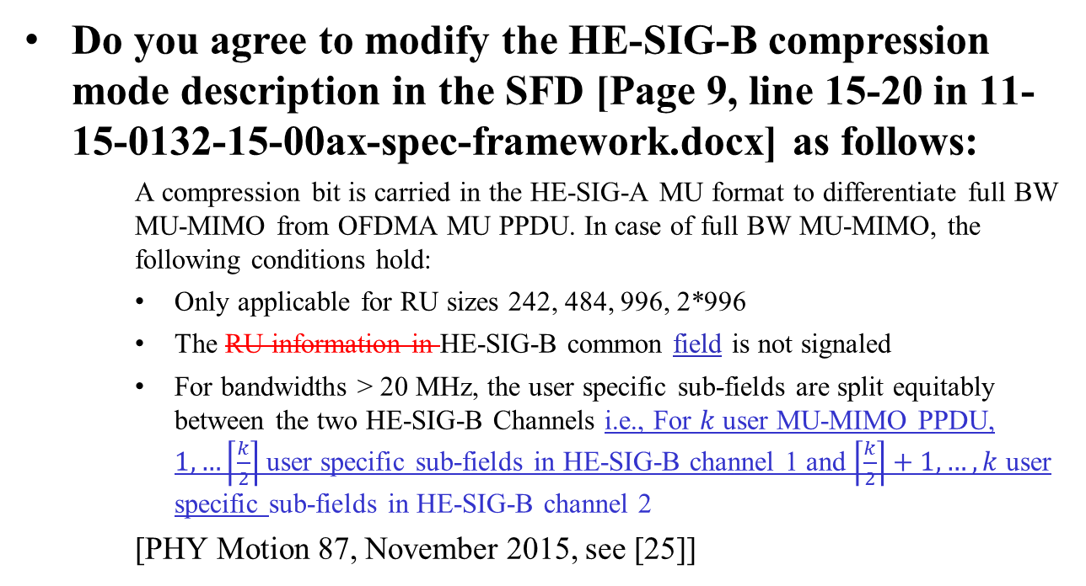
Straw Poll #3
Do you agree to modify the HE-SIG-B compression mode description in the SFD [Page 9, line 15-20 in 11-15-0132-15-00ax-spec-framework.docx] as follows:
    A compression bit is carried in the HE-SIG-A MU format to differentiate full BW MU-MIMO from OFDMA MU PPDU. In case of full BW MU-MIMO, the following conditions hold:
    Only applicable for RU sizes 242, 484, 996, 2*996
    The RU information in HE-SIG-B common field is not signaled
    For bandwidths > 20 MHz, the user specific sub-fields are split equitably between the two HE-SIG-B Channels i.e., For $k$ user MU-MIMO PPDU, $1,…\left\lceil \frac{k}{2}\right\rceil$ user specific sub-fields in HE-SIG-B channel 1 and $\left\lceil \frac{k}{2}\right\rceil +1, …,k$ user specific sub-fields in HE-SIG-B channel 2
    [PHY Motion 87, November 2015, see [25]]

