Slide 1
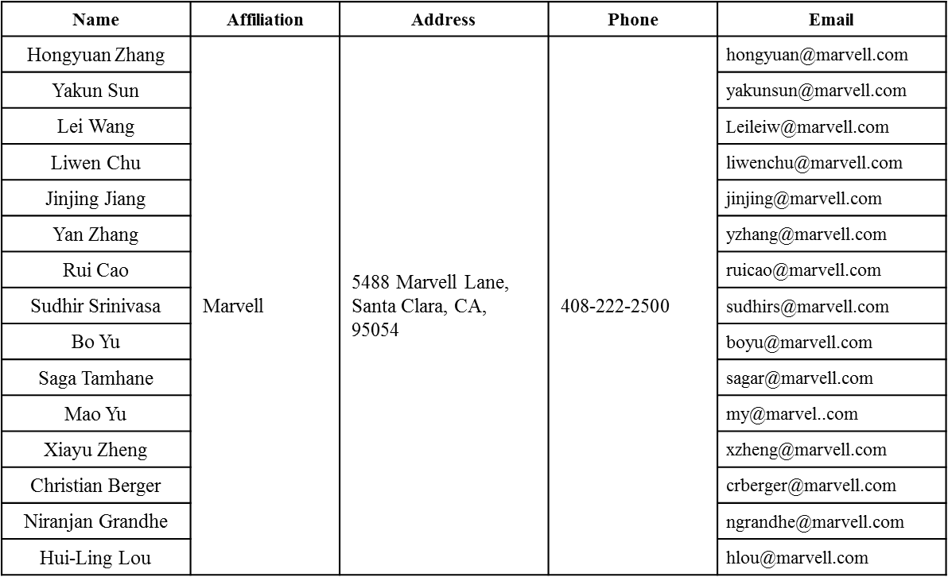
PHY Padding Remaining Issues
Date: 2016-03-14
Authors:

Slide 2
Authors (continued)
Name | Affiliation | Address | Phone | Email
Ron Porat | Broadcom |  |  | rporat@broadcom.com
Matthew Fischer |  |  |  | mfischer@broadcom.com
Sriram Venkateswaran
Zhou Lan
Leo Montreuil
Andrew Blanksby
Vinko Erceg
Robert Stacey | Intel | 2111 NE 25th Ave, Hillsboro OR 97124, USA | +1-503-724-893 | robert.stacey@intel.com
Eldad Perahia |  |  |  | eldad.perahia@intel.com
Shahrnaz Azizi |  |  |  | shahrnaz.azizi@intel.com
Po-Kai Huang |  |  |  | po-kai.huang@intel.com
Qinghua Li |  |  |  | quinghua.li@intel.com
Xiaogang Chen |  |  |  | xiaogang.c.chen@intel.com
Chitto Ghosh |  |  |  | chittabrata.ghosh@intel.com
Rongzhen Yang |  |  |  | rongzhen.yang@intel.com
Laurent cariou |  |  |  | laurent.cariou@intel.com

Slide 3
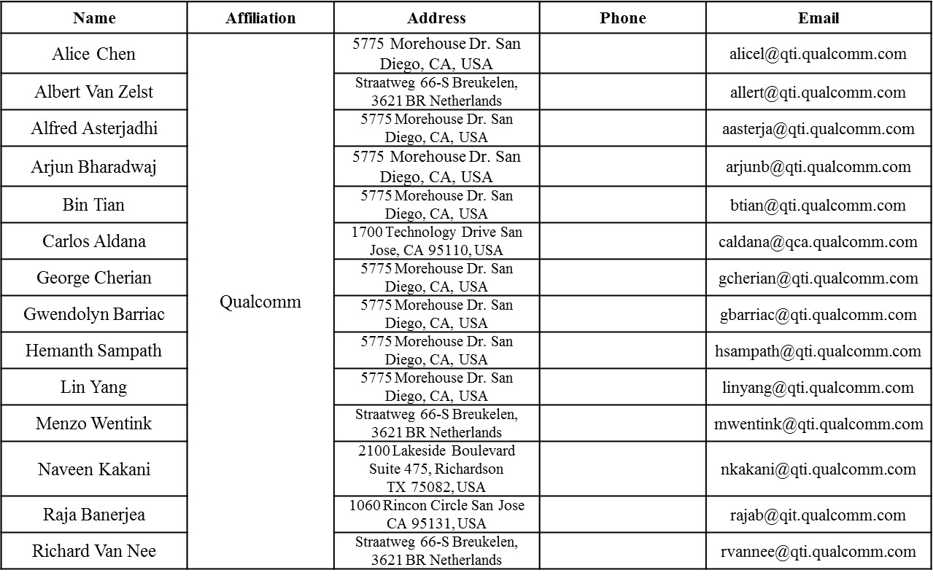
Authors (continued)

Slide 4
Authors (continued)
Name | Affiliation | Address | Phone | Email
James Yee | Mediatek | No. 1 Dusing 1st Road, Hsinchu, Taiwan | +886-3-567-0766 | james.yee@mediatek.com
Alan Jauh |  |  |  | alan.jauh@mediatek.com
Frank Hsu |  |  |  | frank.hsu@mediatek.com
Thomas Pare | Mediatek USA | 2860 Junction Ave, San Jose, CA 95134, USA | +1-408-526-1899 | thomas.pare@mediatek.com
ChaoChun Wang |  |  |  | chaochun.wang@mediatek.com
James Wang |  |  |  | james.wang@mediatek.com
Jianhan Liu |  |  |  | Jianhan.Liu@mediatek.com
Tianyu Wu |  |  |  | tianyu.wu@mediatek.com
Russell Huang |  |  |  | russell.huang@mediatek.com
Brian Hart | Cisco Systems | 170 W Tasman Dr, San Jose, CA 95134 |  | brianh@cisco.com
Pooya Monajemi |  |  |  | pmonajem@cisco.com
Joonsuk Kim | Apple |  |  | joonsuk@apple.com
Aon Mujtaba |  |  |  | mujtaba@apple.com
Guoqing Li |  |  |  | guoqing_li@apple.com
Eric Wong |  |  |  | ericwong@apple.com
Chris Hartman |  |  |  | chartman@apple.com

Slide 5
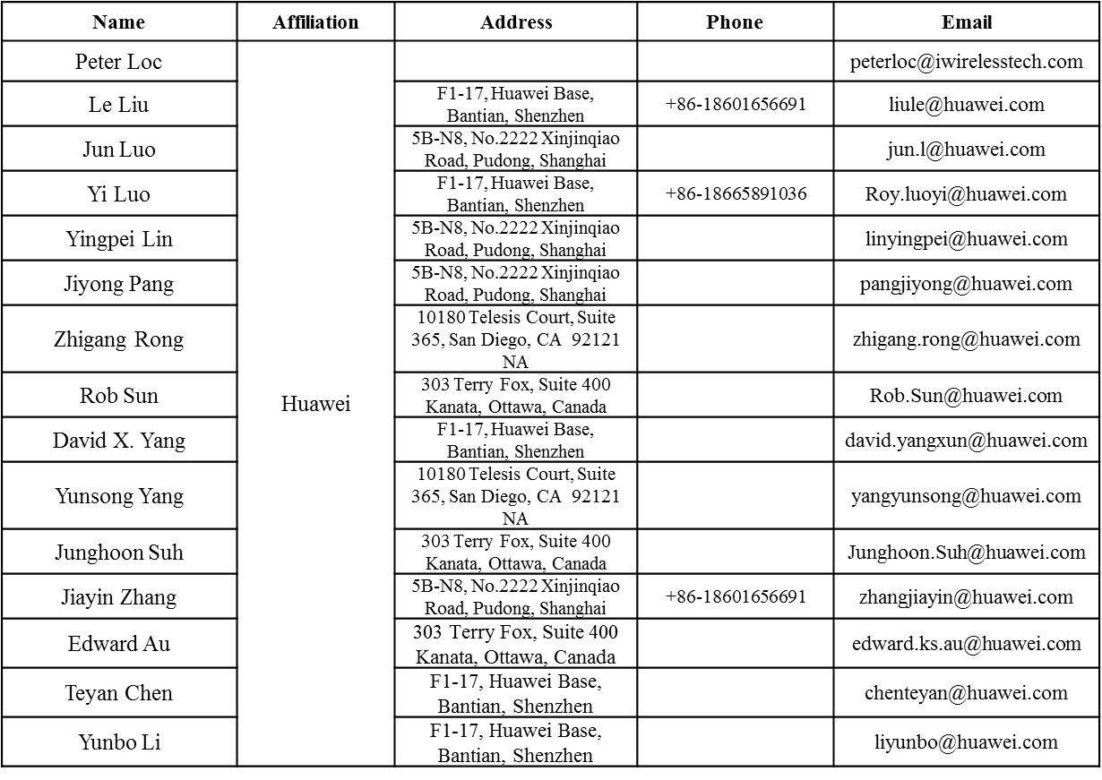
Authors (continued)

Slide 6
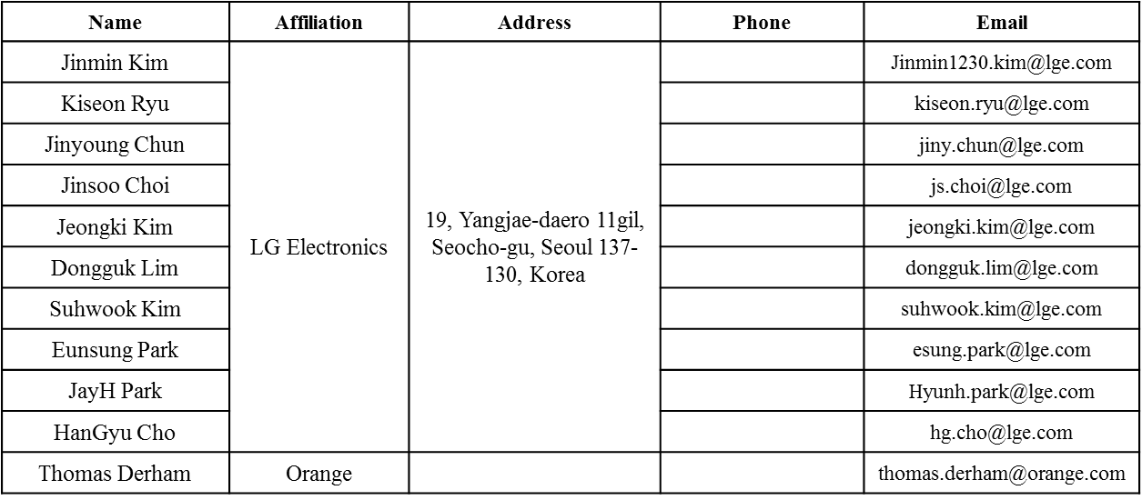
Authors (continued)
Bo SunBo Sun | ZTE | #9 Wuxing duan, Xifeng Rd, Xi’an, China |  | SubSub.bo1@zte.com.cn
Kaiying Lv |  |  |  | lv.kaiying@zte.com.cn
Yonggang Fang |  |  |  | yfang@ztetx.com
Ke Yao |  |  |  | Yao.ke5@zte.com.cn
Weimin Xing |  |  |  | Xing.weimin@zte.com.cn

Slide 7
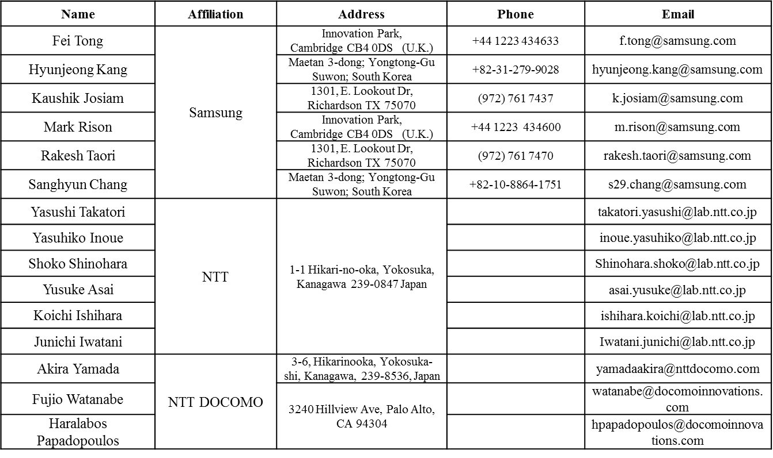
Authors (continued)

Slide 8
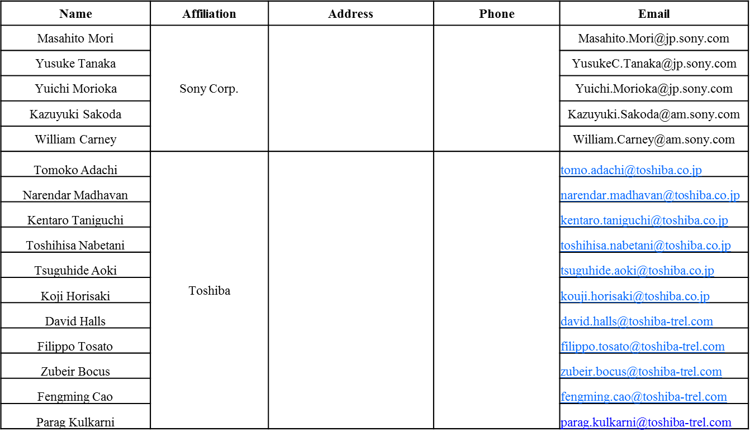
Authors (continued)

Slide 9
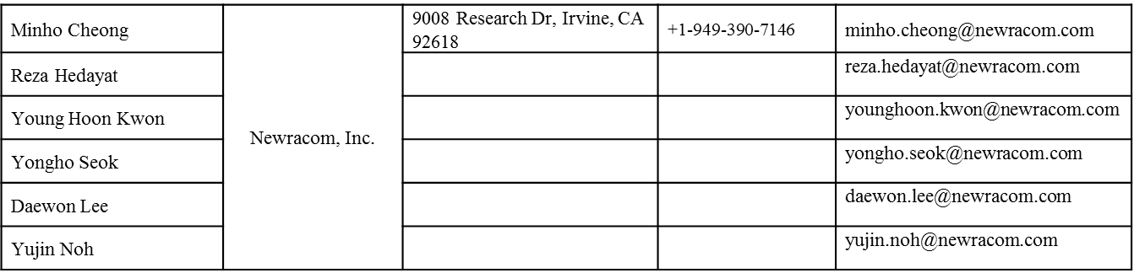
Authors (continued)

Slide 10
Overview
11ax has decided PHY padding and PE mechanism for SU, DL-MU and UL-MU, with detailed math.
Some leftover issues:
  1. DCM: parameter setting and non-integer NDBPS.short for 26-tone RU.
  2. Post-FEC padding bit definition: random-vs-known-vs-repeat.
  3. PE Field Definition: random-vs-known

Slide 11
I. DCM
For DCM, 2 data tones are used to jointly transmit the bits of one constellation, meanwhile “NCBPS” still indicates “number of coded bits per symbol”, therefore it is mathematically convenient to define NSD/NSD.short being ½ of normal non-DCM cases, for the same MCS.
In 26-tone RU, if NSD.short = 3, when MCS0-DCM is introduced, NDBPS.short = ½*NSD.short is a non-integer, i.e. NDBPS = 6, therefore not able to be evenly distributed in the 4 symbol segments of the last symbol.
  Other RUs and other DCM-supported MCSs have no issue.

Slide 12
Solution
Propose to define NSD.short = 2 for 26-tone RU when DCM=1.
  Equivalently, the bit distribution of the last symbol for MCS0-DCM is [1 1 1 3] for the 4 segments.
    Same NSD.short is also applied to MCS1,3,4 with DCM, for consistency.
  Although not evenly distributed, it maintains all the math in the padding procedure and makes no exceptions—important for implementation/verification phases.
RU Size | DCM=0: NSD.short | DCM=1: NSD.short
26 | 6 | 2
52 | 12 | 6
106 | 24 | 12
242 | 60 | 30
484 | 120 | 60
996 | 240 | 120
996x2 | 492 | 246

Slide 13
II. Post-FEC padding Bits and PE Definitions
We have not decided what bits are used for post-FEC paddings, and also the content of PE.
It is better that the spec does NOT specify those bits, because post-FEC padding and PE are supposed to be ignored by the receiver and buy more processing time.

Slide 14
SP1
Do you agree to replace Table-3 NSD.short in 3.3.5 Padding and packet extension of SFD to the following table?
RU Size | DCM=0: NSD.short | DCM=1: NSD.short
26 | 6 | 2
52 | 12 | 6
106 | 24 | 12
242 | 60 | 30
484 | 120 | 60
996 | 240 | 120
996x2 | 492 | 246

Slide 15
SP2
Do you agree to add the following text in SFD 3.3.5
  The post-FEC bits are un-specified by 11ax spec
  The content of PE field is un-specified by 11ax spec

