Slide 1
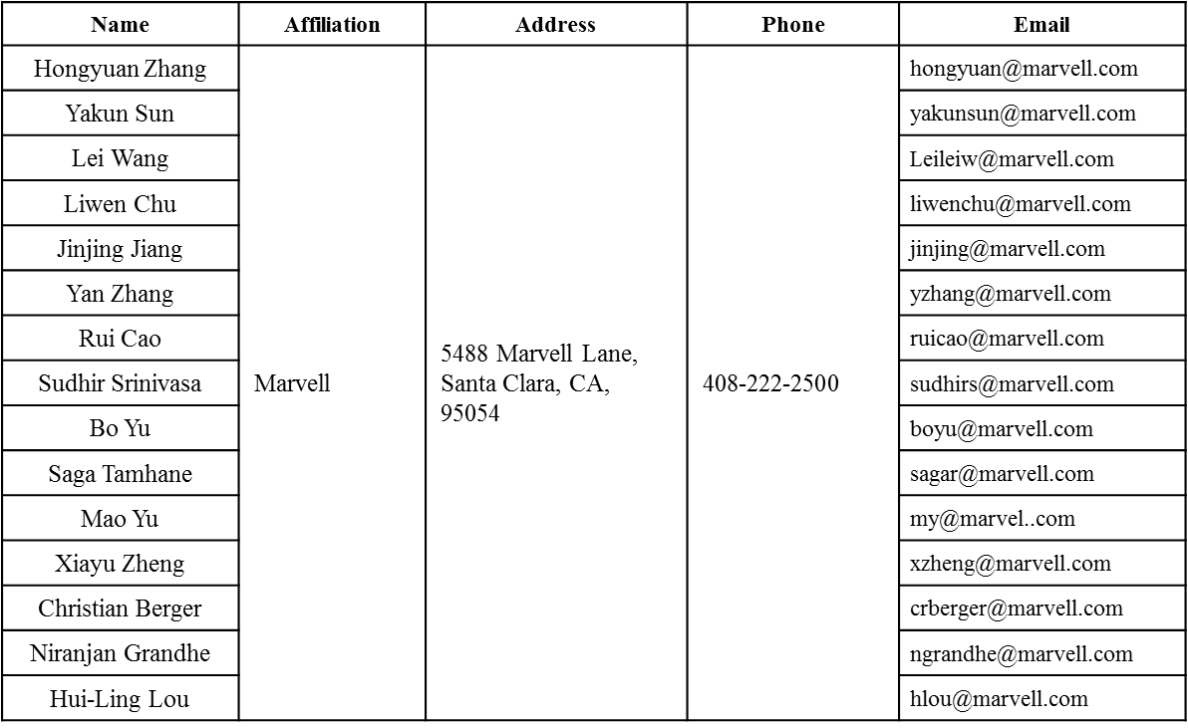
Spectral Mask Discussions
Date: 2016-03-14
Authors:

Slide 2
Authors (continued)
Name | Affiliation | Address | Phone | Email
Ron Porat | Broadcom |  |  | rporat@broadcom.com
Matthew Fischer |  |  |  | mfischer@broadcom.com
Sriram Venkateswaran
Zhou Lan
Leo Montreuil
Andrew Blanksby
Vinko Erceg
Robert Stacey | Intel | 2111 NE 25th Ave, Hillsboro OR 97124, USA | +1-503-724-893 | robert.stacey@intel.com
Eldad Perahia |  |  |  | eldad.perahia@intel.com
Shahrnaz Azizi |  |  |  | shahrnaz.azizi@intel.com
Po-Kai Huang |  |  |  | po-kai.huang@intel.com
Qinghua Li |  |  |  | quinghua.li@intel.com
Xiaogang Chen |  |  |  | xiaogang.c.chen@intel.com
Chitto Ghosh |  |  |  | chittabrata.ghosh@intel.com
Rongzhen Yang |  |  |  | rongzhen.yang@intel.com
Laurent cariou |  |  |  | laurent.cariou@intel.com

Slide 3
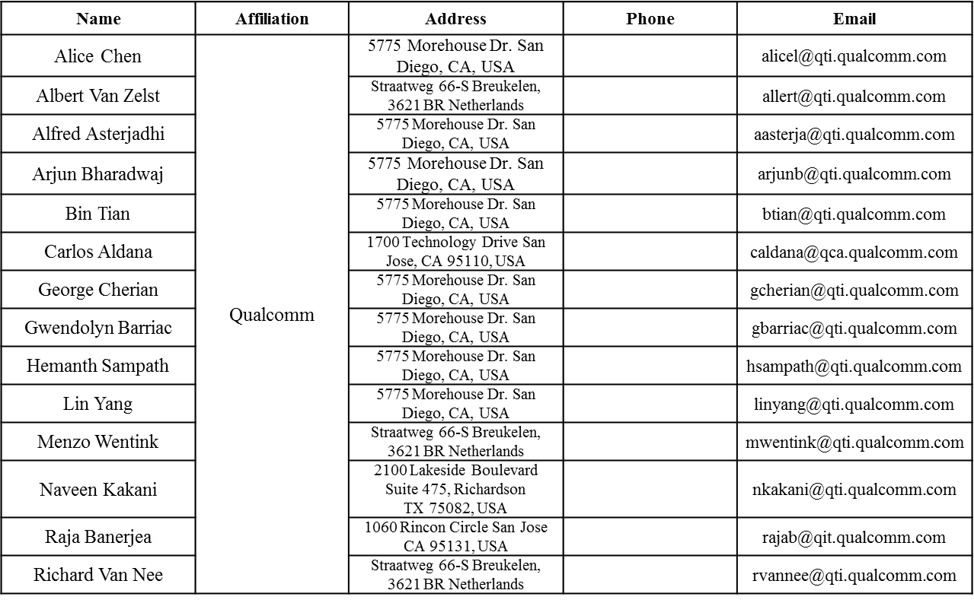
Authors (continued)

Slide 4
Authors (continued)
Name | Affiliation | Address | Phone | Email
James Yee | Mediatek | No. 1 Dusing 1st Road, Hsinchu, Taiwan | +886-3-567-0766 | james.yee@mediatek.com
Alan Jauh |  |  |  | alan.jauh@mediatek.com
Frank Hsu |  |  |  | frank.hsu@mediatek.com
Thomas Pare | Mediatek USA | 2860 Junction Ave, San Jose, CA 95134, USA | +1-408-526-1899 | thomas.pare@mediatek.com
ChaoChun Wang |  |  |  | chaochun.wang@mediatek.com
James Wang |  |  |  | james.wang@mediatek.com
Jianhan Liu |  |  |  | Jianhan.Liu@mediatek.com
Tianyu Wu |  |  |  | tianyu.wu@mediatek.com
Russell Huang |  |  |  | russell.huang@mediatek.com
Brian Hart | Cisco Systems | 170 W Tasman Dr, San Jose, CA 95134 |  | brianh@cisco.com
Pooya Monajemi |  |  |  | pmonajem@cisco.com
Joonsuk Kim | Apple |  |  | joonsuk@apple.com
Aon Mujtaba |  |  |  | mujtaba@apple.com
Guoqing Li |  |  |  | guoqing_li@apple.com
Eric Wong |  |  |  | ericwong@apple.com
Chris Hartman |  |  |  | chartman@apple.com

Slide 5
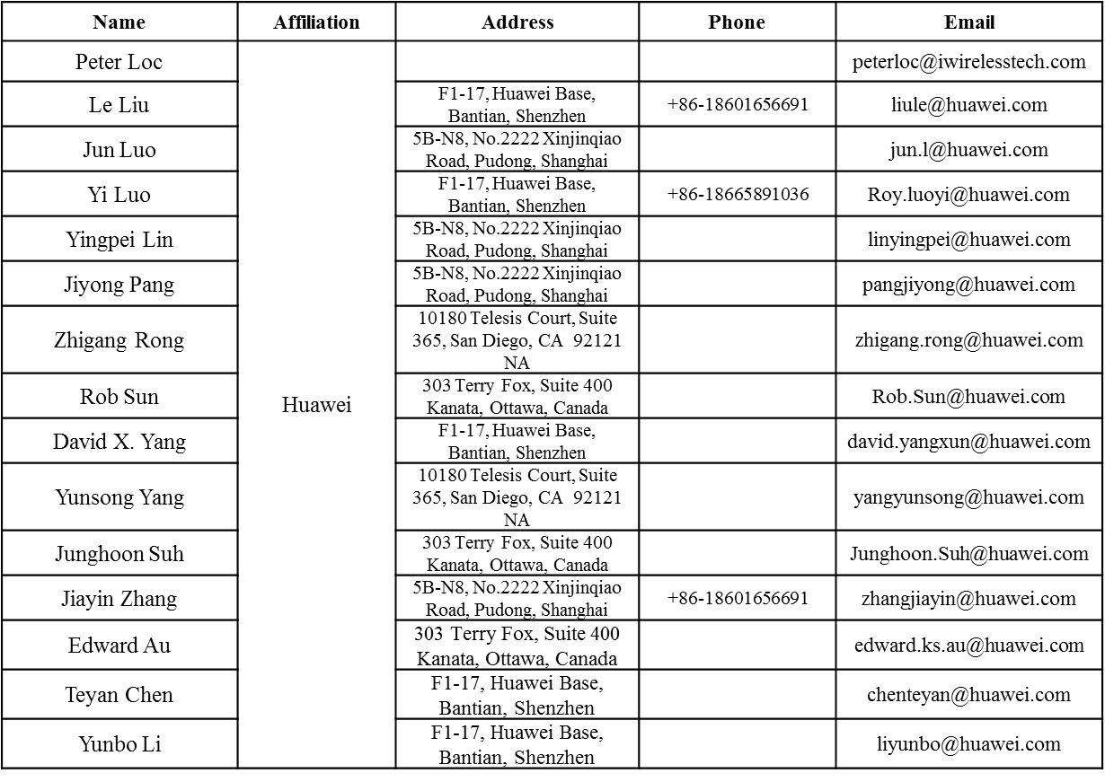
Authors (continued)

Slide 6
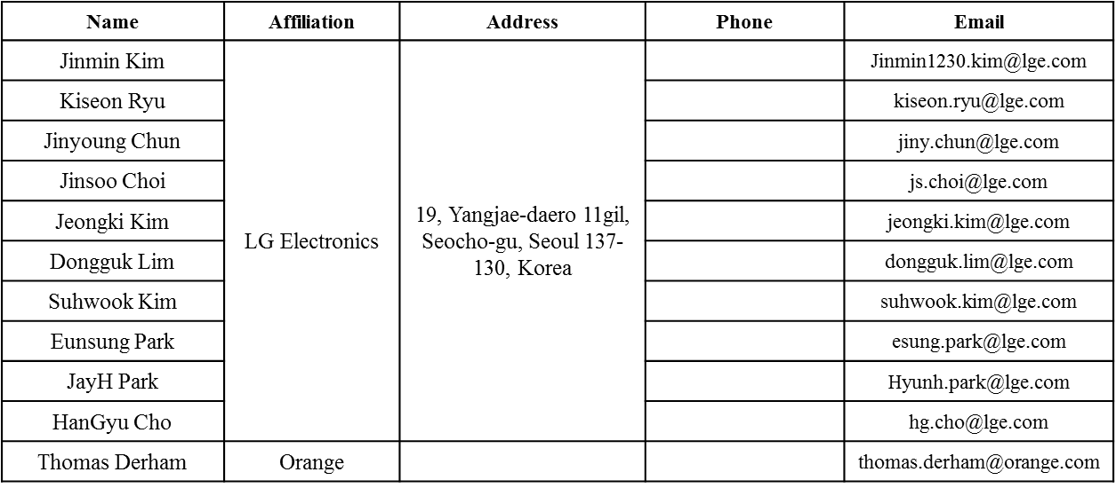
Authors (continued)
Bo SunBo Sun | ZTE | #9 Wuxing duan, Xifeng Rd, Xi’an, China |  | SubSub.bo1@zte.com.cn
Kaiying Lv |  |  |  | lv.kaiying@zte.com.cn
Yonggang Fang |  |  |  | yfang@ztetx.com
Ke Yao |  |  |  | Yao.ke5@zte.com.cn
Weimin Xing |  |  |  | Xing.weimin@zte.com.cn

Slide 7
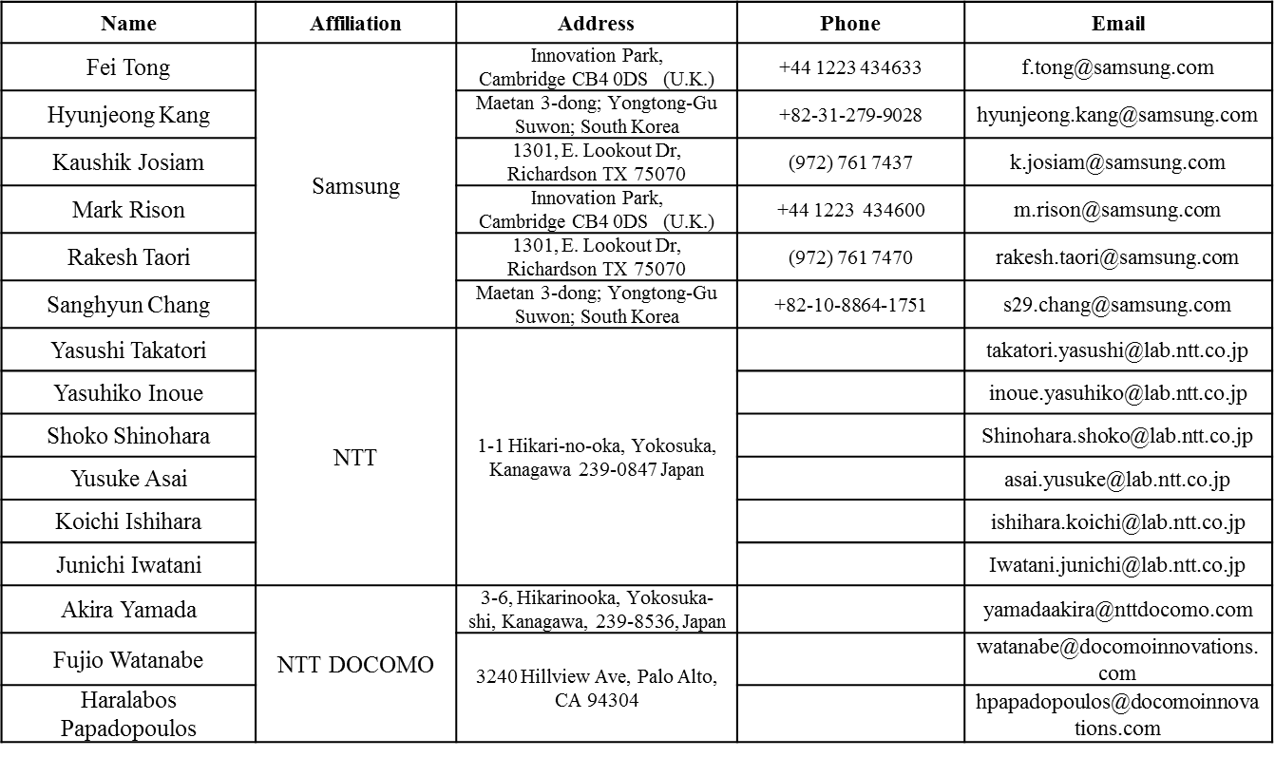
Authors (continued)

Slide 8
Discussions
HE-Trigger-based PPDU shall follow the power control requirement as defined in SFD:
“STAs that participate in HE trigger-based PPDU shall support per chain max(P-32,-10dBm) as the min Tx power, with P the max power the STA can transmit at the antenna connector of that chain using MCS0 while meeting the TX EVM and spectral mask requirements. A STA transmitting at and above the min power shall support the EVM requirements for TBD MCS (but at least MCS7).”
On Tx spectral mask, current SFD only states the relative dBr value at different MHz.
At low power level like -10dBm, it is tougher to meet the dBr mask than EVM requirement.
Propose to define absolute dBc value on the masks, similar to 11ac (next page).

Slide 9
Proposed SFD Change
Similar to 11ac, add absolute dBc value into the mask when dBr mask results in very low power level at offset (due to very low Tx Power):
For 20MHz PPDU, the transmit spectrum shall not exceed the maximum of the interim transmit spectral mask and –53 dBm/MHz at any frequency offset.
For 40MHz PPDU, the transmit spectrum shall not exceed the maximum of the interim transmit spectral mask and –56 dBm/MHz at any frequency offset.
For 80MHz and 160MHz PPDUs, the transmit spectrum shall not exceed the maximum of the interim transmit spectral mask and –59 dBm/MHz at any frequency offset.

Slide 10
Strawpoll
Do you agree to add the following text in SFD chapter 3.4?
For 20MHz PPDU, the transmit spectrum shall not exceed the maximum of the interim transmit spectral mask and –53 dBm/MHz at any frequency offset, for both 2.4GHz and 5GHz bands.
For 40MHz PPDU, the transmit spectrum shall not exceed the maximum of the interim transmit spectral mask and –56 dBm/MHz at any frequency offset, for both 2.4GHz and 5GHz bands.
For 80MHz and 160MHz PPDUs, the transmit spectrum shall not exceed the maximum of the interim transmit spectral mask and –59 dBm/MHz at any frequency offset.

