Slide 1
Scenario for LRLP SIG
Date: 2016-03-13
Authors:
Name | Affiliation | Address | Email
Stéphane BARON | Canon | Cesson-Sevigné, France | stephane.baron@crf.canon.fr
Patrice NEZOU |  |  | patrice.nezou@crf.canon.fr
Romain GUIGNARD |  |  | romain.guignard@crf.canon.fr
Pascal VIGER |  |  | pascal.viger@crf.canon.fr
Fumihide GOTO |  | Tokyo, Japan | goto.fumihide@canon.co.jp

Slide 2
Abstract
This presentation introduces 3 scenarios in the scope of the Long Range Low Power Interest group:
  1) Remote controlled camera
  2) Wearable LRLP devices for security squad.
  3) Home security scenario.

Slide 3
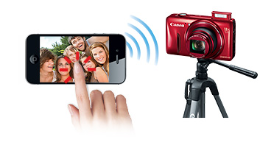
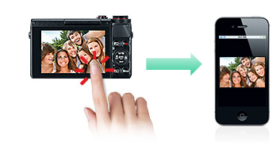





Use Case 1 :Remote Control Use Case
indoor
LRLP
(15 meters)
After the photo shoot, each friends can choose and save the photos they want.
Easy group selfies
outdoor
Share!
LRLP
Share!
(160 meters)
“Share!, How about my son?”
“This is your son’s goal scene.”
“Please give me.” “Me too”….
- Party, Wedding Ceremony, Kid’s Soccer, Amusement Park, Game
- Easy to share by any combination of camera within group.

Slide 4
Use case 1 : Remote Controlled camera (Summary)
Smartphone, tablet or camera will remotely control another camera.
Use Case 1-a) Indoor scenario
  Smartphone gets Images from camera.
  Smartphone releases camera’s shutter.
Use Case 1-b) Outdoor scenario
  Camera releases another camera’s shutter.
LRLP Requirements:
    Low power AP
    Distance : 15m (Indoor), 160m (Outdoor)
    Battery lifetime : 24h
    latency : Live view : 250ms. Remote shutter release : 25ms
    Time synchro : 1ms (for image timestamping)
    Bandwidth: Live view : 1Mbps. Shutter release : Control packets only (about 10-20 KBytes)
(Either Camera or Smartphone is AP.)
LRLP
LRLP

Slide 5





Use case 2 : Wearable LRLP devices for security squad
  Scenario:
    When an intervention is required in an area covered by LRLP AP (especially indoor area), the mobile units use this AP access to secure and optimize their intervention.
    Members of the squad can :
      Stream in live their “viewing” thanks to portable devices.
      View live video from other camera (fixed or mobile) on wireless display.
      Send data (sensor's info, position, images, etc.) to the HQ.
      Receive info (instructions, map, etc.) from HQ.
Max 1Km
Max 200m
  LRLP Requirements:
    Distance : 200m between Camera, 1km camera-AP (indoor/outdoor)
    Battery lifetime : 24h
    latency : 1s during streaming
    Bandwidth: 1Mbps

Slide 6
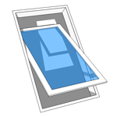
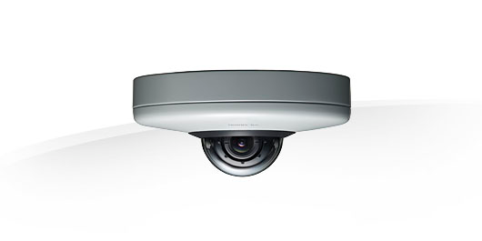

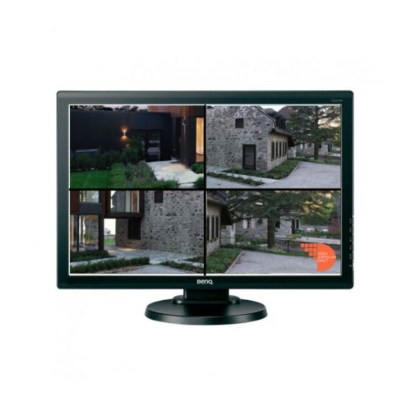

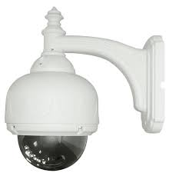



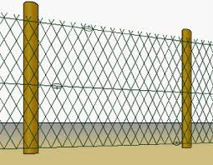
Use case 3 : Home security
Camera
Sensor
LRLP
Outdoor Camera
Home VMS
LRLP
Legacy 802.11
User Smart Phone

Slide 7
Use case 3 : Home security
  Scenario:
    LRLP device indoor/outdoor: Fixed video surveillance camera at home.
      No wire for easy installation, battery operated. Activation of the camera by centralized VMS (video monitoring system) upon surveillance system activation (scheduled activation, or manual activation by user)
      streaming after alarm reception via centralized VMS or local device detection (dedicated sensor).
    LRLP capable AP : indoor.
  LRLP Requirements:
    Distance : 150m between indoor AP and LRLP devices.
    Battery lifetime : 2 years.
    3 different levels of power consumption:
      First power level: Waiting for activation (sleeping state) : 33% of the time
      Second power level: Activated, waiting for alarm (waiting state) : 66% of the time
      Third power level: Active, sending data to the VMS, or a smartphone : 1% of the time
    Latency:
      First level: 5s
      Second level: 100ms for alarms, 1s order for status report.
      Third level: 25ms
    Bandwidth:
      First and second level : < 250Kbps
      Third level : 10Mbps

Slide 8
Summary
We presented three scenarios and requirements for Long Range Low Power SIG.
  We propose to have different levels of requirements corresponding to different levels of power consumption.

