Slide 1
Power Control for Multi-User Transmission in 802.11ax
Date: 2016-03-13
Authors:

Slide 2
Abstract
This contribution reviews power control for MU transmissions in 802.11ax.

Slide 3
Table of Contents
Introduction
Power pre-correction for HE trigger-based PPDU (UL)
Power boosting for HE MU PPDU (DL)
Conclusion

Slide 4
Introduction
802.11 TGax has included MU transmissions in the 11ax Specification Framework Document (SFD) [7].
We discuss the need for power pre-correction in HE trigger-based PPDU (UL) transmission.
  We discuss the implications of STA power classes defined in the SFD [1] on the UL MU Power pre-correction mechanism.
We discuss the possibility of per RU power boosting for HE MU PPDU (DL) transmission

Slide 5
Transmit Power Pre-correction for HE Trigger-Based PPDUs (UL)

Slide 6
Power Pre-correction for HE Trigger-Based PPDUs
Power differences between STAs in an UL MU transmission results in a degradation of the performance
  For OFDMA, power differences may result in significant interference from stronger signals to weaker signals due to the loss of orthogonality caused by Inter Carrier Interference (ICI) between STAs due to timing misalignments, Doppler etc [3] or I/Q imbalance [5].
  For UL MU MIMO, power differences may result in ill-conditioned matrix operations as well as dynamic range issues [4].
May need to pre-correct power from different STAs to ensure that power is roughly the same at the AP. Pre-correction compensates for the different arrival power of the STAs due to location, transmit power etc.
  In [3] it is shown analytically that rough power control or user scheduling should keep users within 10 dB of each other. Analysis is for maximum 64 QAM. Constraints may be more stringent for higher modulations and less stringent for lower modulations.
  In [4] it is shown that power differences between uplink clients can be about 6 dB for the highest rates and much more for lower rates. Analysis is for UL MU-MIMO with 802.11ac numerology and may be more sensitive for UL MU OFDMA with new numerology.
  In [5] it is shown that I/Q imbalance may result in performance degradation on the image of the scheduled RU and is exacerbated by the different user arrival powers.

Slide 7
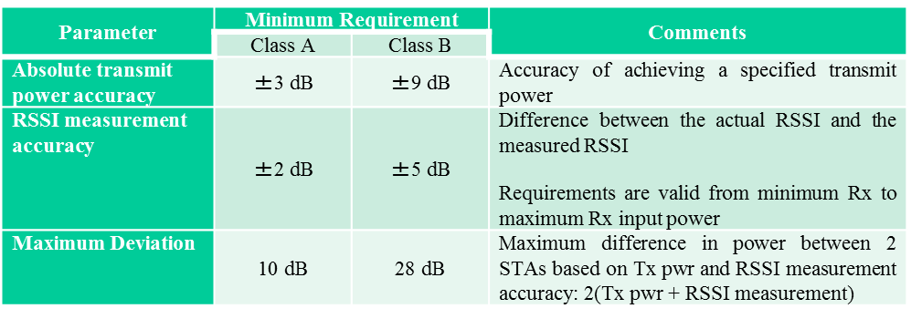
STA Classes
There are two STA classes that support HE trigger-based PPDUs [1]
  • Class A: STAs that are high capability devices
  • Class B: STAs that are low capability devices
A STA that transmits an HE trigger-based PPDU shall support the absolute transmit power requirements and the RSSI measurement accuracy requirements for two device classes
  Class B may have maximum deviation of 28 dB while class A may have a maximum deviation of 10 dB.
  In scenarios where there are a mixture of class A and class B devices, the different requirements may result in poor uplink MU transmission.

Slide 8
Pre-correction for HE Trigger-Based PPDU Transmission with Different STA Classes
In scenarios where there are different classes of STAs:
Option 1: Class A and B may not be scheduled together if they belong to different classes
  Condition may be for both scheduled STAs and Random Access STAs
  Condition may be for Random Access STAs only
Option 2: Class A and B STAs may be scheduled together
  May need a mechanism to compensate for the larger inaccuracy of Class B STAs.
Option 3: Ignore the problem

Slide 9
Power Boosting for HE MU PPDUs (DL)

Slide 10
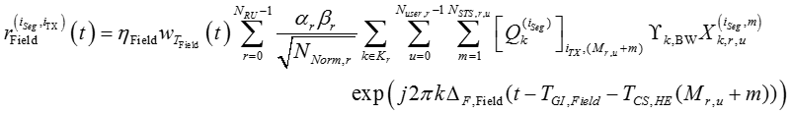
Power Boosting for HE MU PPDUs (DL)
The time domain representation of the signal for HE SU PPDU, HE MU PPDU and HE extended range SU PPDU on frequency segment i_{Seg} of transmit chain i_{TX} shall be as specified in Equation [2]
This wording includes HE MU PPDUs (DL OFDMA transmission)
  Advantages:
    Single BSS: Allows for optimal downlink power allocation for OFDMA transmission
    Multiple BSSs: May improve spatial reuse by limiting interference to OBSSs for RUs that schedule STAs “close” to the AP.
Q: Should independent power boosting be allowed per RU in an HE MU PPDU transmission?
(26‑4)
is the power boost factor for the r-th RU, where

Slide 11
Conclusion
Contribution looks at transmit power control issues for UL/DL MU PPDUs
For HE trigger-based PPDUs (UL):
  Transmit power pre-correction is required to avoid performance degradation due to power differences between STAs.
  For STAs of different power/RSSI accuracies, a pre-correction mechanism may be needed to compensate for increased inaccuracy of class B STAs to ensure that they can be scheduled in the same UL MU transmission as class A STAS.
For HE MU PPDU transmissions (DL):
  Per RU power boosting may provide some advantages in downlink OFDMA transmission.

Slide 12
Straw Poll 1
Do you agree to add the following to the TGax SFD ?
In an HE trigger-based PPDU transmission, a power pre-correction mechanism may be used to limit the difference in receive powers at the AP.
Y/N/A

Slide 13
Straw Poll 2
Do you agree to add the following to the TGax SFD ?
The mechanism shall be flexible enough to allow for scheduling STAs with different minimum requirements in an HE trigger-based PPDU transmission.
Y/N/A

Slide 14
Straw Poll 3
Do you agree to add the following to the TGax SFD ?
In an HE trigger-based PPDU transmission, STAs with different minimum requirements shall not be scheduled together.
Y/N/A

Slide 15
Straw Poll 4
Do you agree to add the following to the TGax SFD ?
In a DL HE-MU-PPDU, using subchannelization, an OFDMA system can potentially allocate different transmit powers to different allocations.
Y/N/A

Slide 16
References
11-15/0132r15, Specification Framework, R. Stacey, Intel
11-16/0024r1, Draft Specification, R. Stacey, Intel
11-14/1446r0: Analysis of frequency and power requirements for UL-OFDMA, L. Wilhelmsson, Ericsson
11-09/1036r0: Uplink MU-MIMO Sensitivity to Power Differences and Synchronization Errors, R. Van Nee, Qualcomm
11-14/1314r2: I/Q Imbalance Impact to TGax OFDMA Uplink Reception, R. Yang, InterDigital

Slide 17
Joint power and frequency requirements [3]
Degradation due to MUI as a function of power ratio and frequency error
The requirements for MUI seems reasonable, although rough power control or proper scheduling (selection of users with somewhat similar powers) is required, say within 10 dB
Note: this slide is from [3]

Slide 18
Simulation Results
(IQI = -30dBc vs. -40dBc, 64QAM, AWGN)
Legend: “dP = xdB” : The same I/Q imbalance applied to Tx and Rx sides; “dP = xdB, Rx0”: I/Q imbalance applied to Tx side only
The performance is highly sensitive to the IQI level
The performance depends on the received power difference
Perfect Rx IQI compensation can improve the performance
Note: this slide is from [5]

