Slide 1
The benefits of Opportunistic Wireless Encryption
Date: 2016-03-16
Authors:

Slide 2
Abstract
Security is a delicate topic
  Past experiences with insufficient 802.11/Wi-Fi security
    WEP, WPA1, WPS …
  Huge market impact because of press reports etc.
Opportunistic Wireless Encryption (OWE) fills a (severe) gap in the IEEE 802.11 standard
  802.11 does not allow for unauthenticated but encrypted operation
OWE is simple to add, requires no hardware changes
  Few software changes, can even operate on legacy equipment
OWE is simple to use, no configuration required

Slide 3
Situation analysis
 |  | Authenticated
 |  | No | Yes
Encrypted | No | Open Free, anonymous access Often combined with captive portal re terms & conditions | Captive portal IP layer Credential submission through HTTPS
 | Yes | Missing in 802.11 Free, anonymous access like “Open” method Wireless traffic encrypted, secure Client protection | RSNA or Captive portal & opportunistic encryption combined

Slide 4
Captive Portals
Typical Captive Portal operation
  IP based
  Client is blocked from Internet access until successfully performing HTTP login
  Captive Portal gateway intercepts HTTP requests and redirects them to login page
  After successful credential check record MAC address as permitted
  Optionally, have client access an operator’s HTTPS webpage to push (secure) Cookie to client
  Have client perform frequent page refresh to check for Cookie

Slide 5
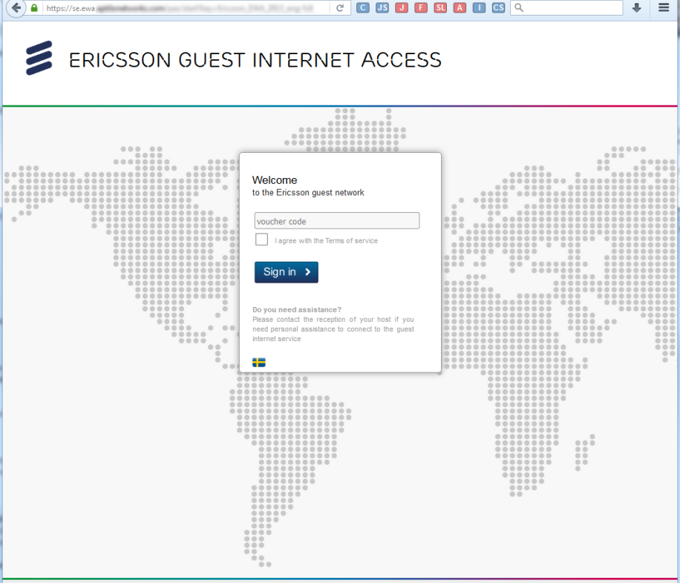
Captive Portal usage
Mostly for guests
  Hotel, airport, lounge, restaurant …
  Widely applied
Simple to use, access through webpage
  Provision of credentials or acknowledgment of terms

Slide 6
Threats in unencrypted WLANs
ARP
  Glue between IP & L2
  Caches can be poisoned
  Man in the middle attack to redirect traffic
DNS
  Privacy issues with overheard DNS requests
  Severe attacks with malicious DNS responses
  Even DNSSec is unencrypted
Pervasive monitoring
  Eavesdropping
  E.g. common PSK may reveal individual PTK
Only encryption allows for PMF
  PMF (Protected management frames) needed to prevent disassociation attacks
  PMF mandatory with WFA 802.11ac

Slide 7
OWE implementation aspects
Minor software changes
  Can be added with driver updates
  OWE adds Diffie-Hellmann key exchange prior to existing RSNA operation
No hardware changes needed
  No new encryption methods needed
  No additional frames need to be exchanged
  No changes to RSNA process

Slide 8
RSNA authentication
At least ten frames needed to securely associate with AP
  Probe frames are optional
Credentials can be provided as pre-shared key or through EAP (Extensible Authentication Protocol)
  EAP may require up to 14 additional messages

Slide 9
OWE based authentication
OWE requires no additional frames to be exchanged
  On the fly, generate secret, random credentials
  Used as input to unmodified RSNA process
    Standard generation of depending keys: PTK, GTK …

Slide 10
OWE based authentication (zoom in)

Slide 11
Conclusion
Security is one of 802.11’s key topics
  No other topic related to 802.11 attracts so much attention than broken security
A huge number of WLANs operates unencrypted
  Introducing security in this important market segment is important
OWE comes at no cost
  No over the air overhead
  Diffie-Hellmann widely implemented with EAP key exchange, e.g. EAP-TLS
    No new encryption code needed
OWE & Open access may operate concurrently on same AP
  Even during such a legacy transitioning period OWE implementations will already benefit from being protected

Slide 12
Recommendation
Integrate OWE into IEEE P802.11-REVmc/D5.1 resp. IEEE 802.11-2016
Apply the changes proposed in 802.11-15/1184r7

Slide 13
References
V. Dukhovni, “Opportunistic Security: Some Protection Most of the Time,” IETF RFC 7435, Dec. 2014.

