Slide 1
Results for Beacon Collisions
Date: 2016-03-16
Authors:
Name | Affiliation | Address | Phone | Email
Evgeny Khorov | IITP RAS |  |  | khorov@frtk.ru
Dmitry Bankov | IITP RAS |  |  | bankov@iitp.ru
Anton Kiryanov | IITP RAS |  |  | kiryanov@iitp.ru
Sigurd Schelstraete | Quantenna |  |  | sigurd@quantenna.com
Huizhao Wang | Quantenna |  |  | hwang@quantenna.com

Slide 2
Motivation
At Jan’16 meeting we have proposed the beacon collision avoidance mechanism [1]
The feedback from the group:
  The problem existence shall be proved in simulation scenarios [2]

Slide 3
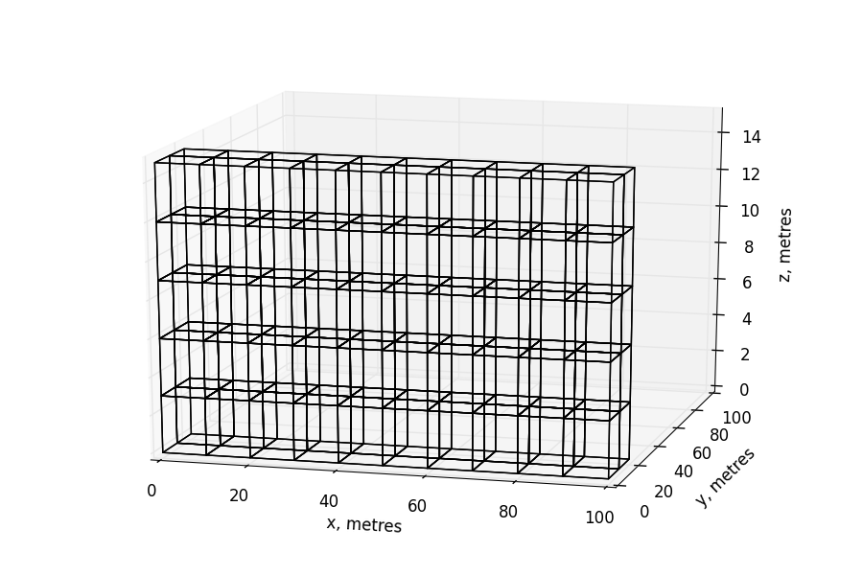
Residential Scenario
10 flats in a row
5 floors
2 rows

Slide 4
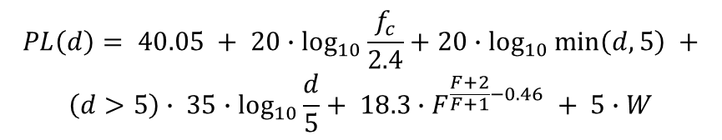
Path Loss Model
$$PL\left(d\right)= 40.05 + 20∙\log_{10}{\frac{f_{c}}{2.4}}+20∙\log_{10}{\min\left(d,5\right)} +$$
$$\left(d>5\right)∙ 35∙\log_{10}{\frac{d}{5}}+ 18.3∙F^{\frac{F+2}{F+1}−0.46} + 5∙W$$
W: number of walls traversed in x-direction plus number of walls
traversed in y-direction
F: number of floors traversed
f_{c}: frequency [GHz]
d: distance [m]
d

Slide 5
Beacon Collisions
Beacon collision is collision at a STA between a beacon from its own AP and a beacon from an alien AP.
It occurs when all the following conditions are met:
Time condition: beacons overlap in time
Channel condition: both APs send beacons in the same channel
Location condition: the STA receives an alien beacon, while its own AP does not.

Slide 6
Time Condition (1/3)
Time condition: beacons overlap in time
The signal from its own AP is typically much higher than the signal from an alien AP (located in another flat).
If the intra-BSS beacon (beacon from STA’s own AP) starts earlier, the alien beacon is just a small noise and cannot damage intra-BSS beacon.
If the alien beacon starts earlier, the STA starts receiving this beacon and does not sync at the intra-BSS beacon.
In our analysis we consider time condition:
Beacons overlap in time, and an alien beacon starts earlier than an intra-BSS beacon (preamble duration is neglected).
Intra-BSS beacon
Alien beacon

Slide 7
Time Condition (2/3)
What is the probability for a STA that a beacon from one hidden AP overlaps with its own AP’s beacon and alien beacon starts earlier?
Assuming that beacon duration is 500 us and BI=500 ms, i.e. BI is 1000 longer, we obtain that for one hidden AP the probability of time condition is 0.1%.
Since AP transmits data packets in addition to beacons, the probability that a beacon is damaged increases.
For how long will beacons collide?
While the standard states that the clock drifting shall be less than 100ppm, in real devices it is less than 10ppm.
If the clock drifting of the APs is in opposite directions and it is 10 ppm (relative drifting is 20ppm), beacons will collide for 25 seconds.
  Note that constant clock drifting in opposite directions is the best case. In fact, the clock drifting is a random process, so beacons will collide for much longer time.
  Such continuous beacon collisions can cause disassociation from the AP.

Slide 8
Time Condition (3/3)
The probability that beacons of two APs overlap in time is small, however because of clock drifting sooner or later the problem arises.
* Beacon interval = 500 ms, duration = 500 us (collision probability = 0.1%)
Even probability of 0.1% can cause “inexplicable” occasional malfunction, which may make users continuously reboot the AP.
Different beacon intervals cannot solve the problem, since APs transmit data packets in addition to beacons.
Relative Clock Drifting | Collision Duration | Collision Period
1 ppm | ~ 8 min | ~ 6 days
5 ppm | ~1.5 min | ~1 day
10 ppm | 50 s | 14 hours
20 ppm | 25 s | 7 hours

Slide 9
Channel Condition
In 2.4 GHz, there are 3 non-overlapping 20 MHz channels.
In 5 GHz there are more than 20 non-overlapping 20 MHz channels
TGax Simulation Scenarios document considers “3 or 5 80MHz non-overlapping channels, with random selection of primary channel per operating channel”, i.e. 9 or 15 non-overlapping primary-20 channels.
Note. In real situation, if two APs are hidden from each other (our case!), they are more likely to select the same channel, rather than if they are direct neighbors.

Slide 10





Location Condition
Beacon collision is possible,
if the STA hears the beacons from an alien AP,
while its own AP does not
$$P_{TX}=18 dBm$$
d₁
$$P_{STA}=P_{TX}−PL(d_{1})$$
$$P_{thr}$$
AP
$$P_{AP}=P_{TX}−PL(d_{2})$$
STA
d₂
Location Condition:
$$P_{AP}< P_{thr}< P_{STA}$$
AP

Slide 11

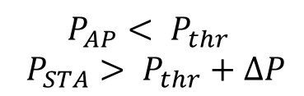
Beacon Collision Location Condition
Beacon collision is possible,
if the STA hears the beacons from an alien AP,
while its own AP does not.
d₁
AP
$$∆P$$
Taking into account fading
and different antenna gain
STA
d₂
$$P_{AP}< P_{thr}$$
$$P_{STA}> P_{thr}+∆P$$
AP

Slide 12
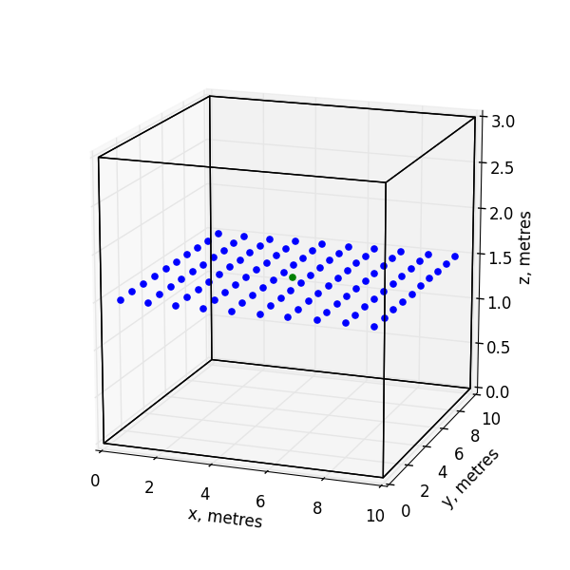
Locations of STAs and APs in the Flats
Possible STA locations
AP

Slide 13
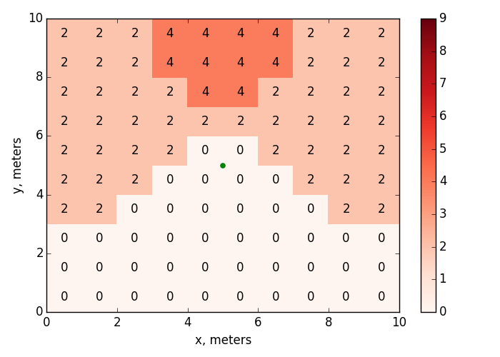
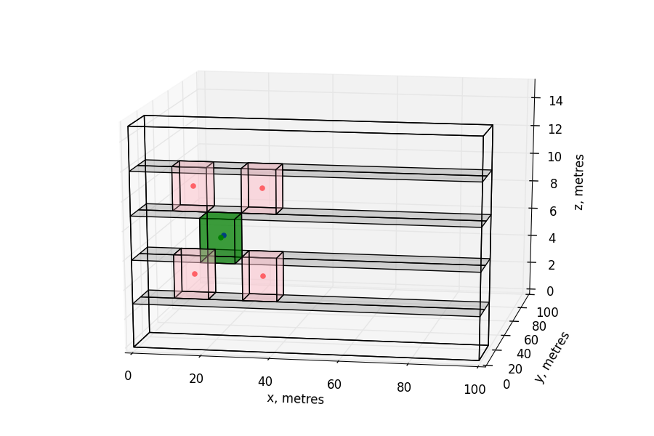


Number of Hidden APs for Which Location Condition is Met in a Non-edge Flat With APs in the Center
$$P_{thr}=−86 dBm$$
$$∆P=0$$
AP
Killing APs are located in 4 flats,
which is more than the number
of 20 MHz channels in 2.4 GHz

Slide 14
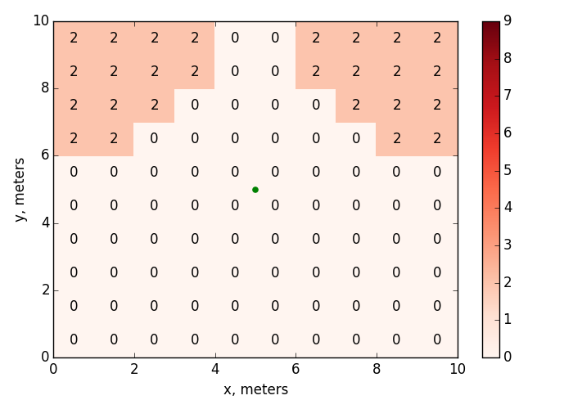
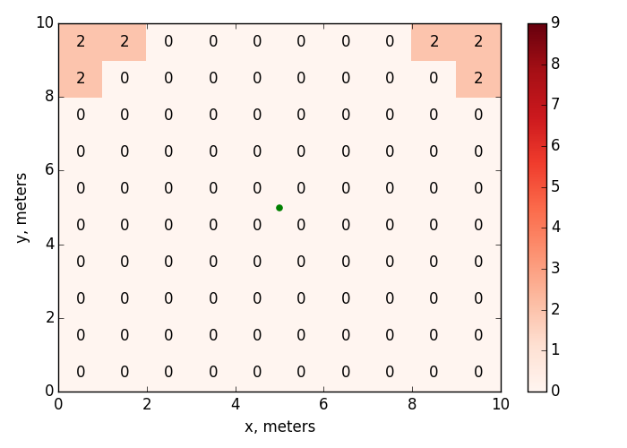



Influence of $∆P$
$$∆P=3 dB$$
$$∆P=6 dB$$
AP
AP
Killing APs are located in 4 flats

Slide 15
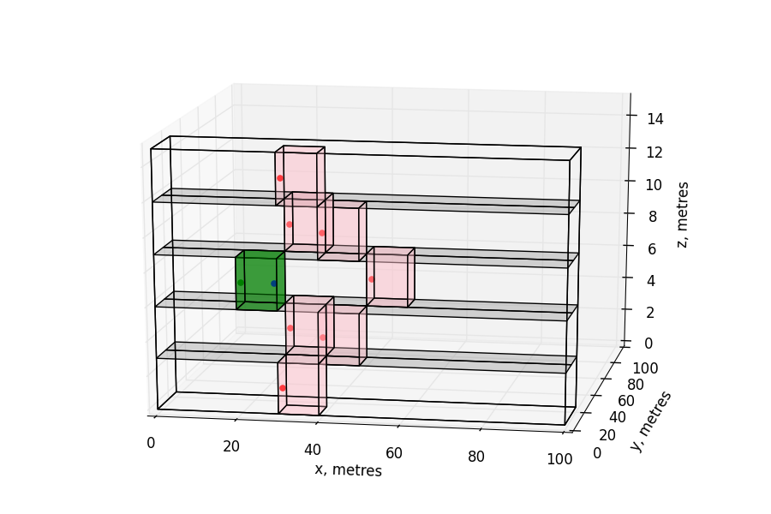
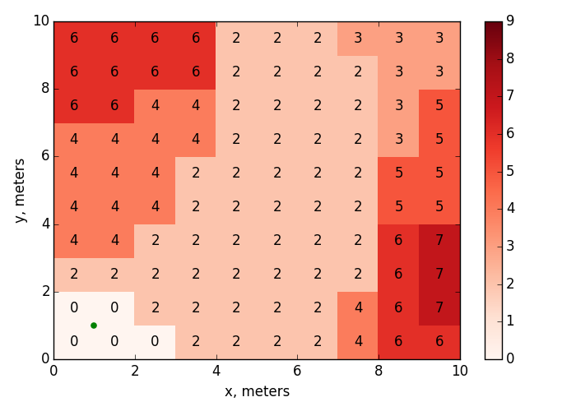
Number of Hidden APs for Which Location Condition is Met in a Non-edge Flat With APs in the Corner
$$P_{thr}=−86 dBm$$
$$∆P=0$$
AP
7 alien APs can kill the beacon.
They are not direct neighbors
Killing APs are located in 11 flats

Slide 16
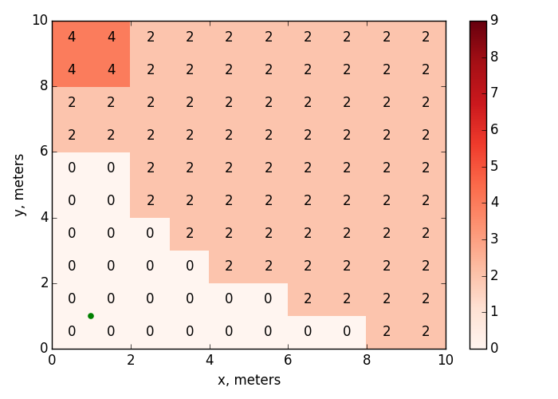
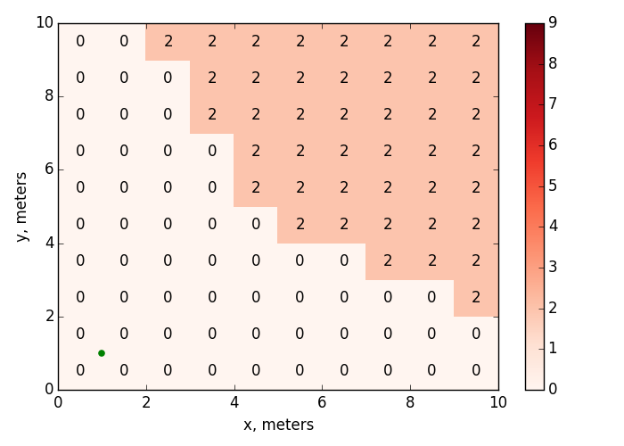
Influence of $∆P$
$$∆P=3 dB$$
$$∆P=6 dB$$
AP
AP
Killing APs are located in 4 flats
Killing APs are located in 2 flats

Slide 17
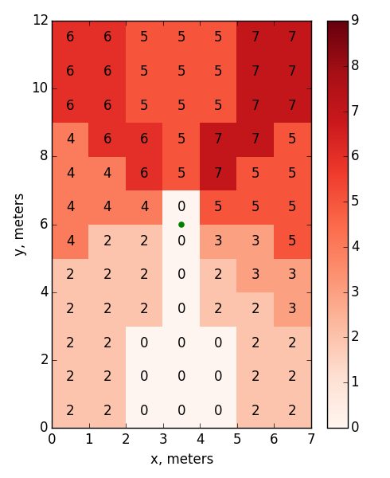
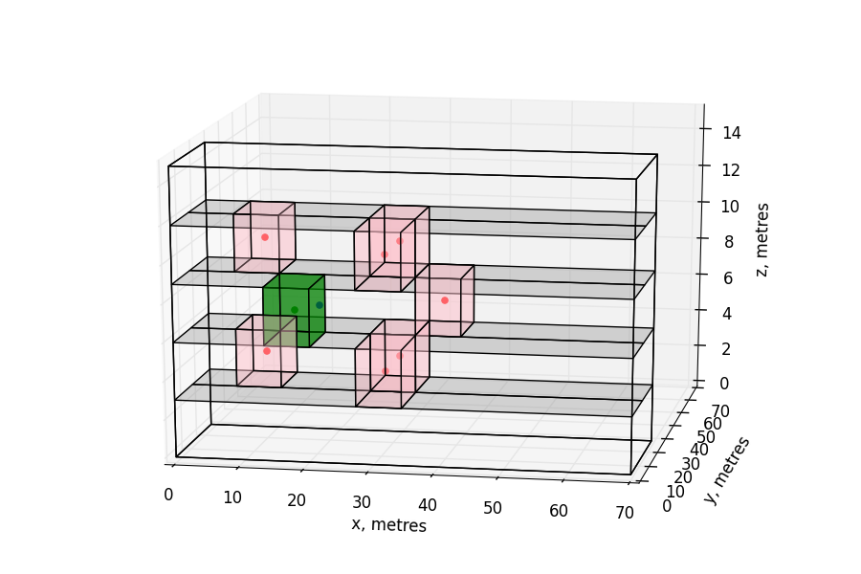
Number of Hidden APs for Which
Location Condition is Met in a Non-edge Flat
With APs in the Center of Non-square Rooms
$$P_{thr}=−86 dBm$$
$$∆P=0$$
AP
7 alien APs can kill the beacon.
They are not direct neighbors
Killing APs are located in 9 flats

Slide 18
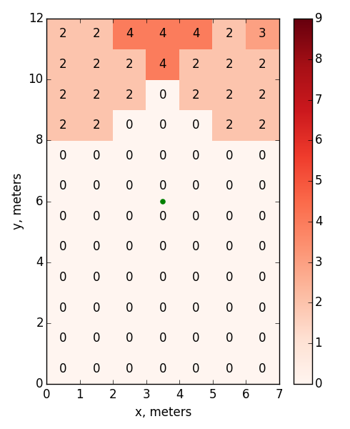
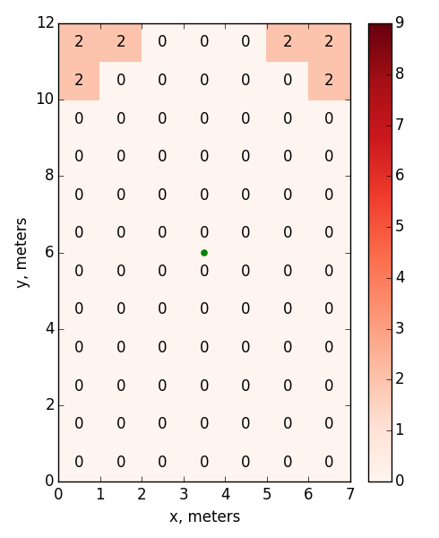


Influence of $∆P$
$$∆P=3 dB$$
$$∆P=6 dB$$
AP
AP
Killing APs are located in 5 flats
Killing APs are located in 4 flats

Slide 19
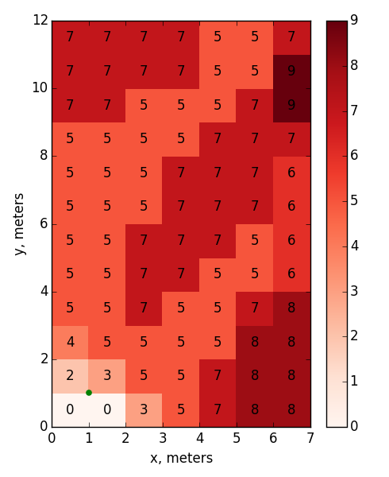
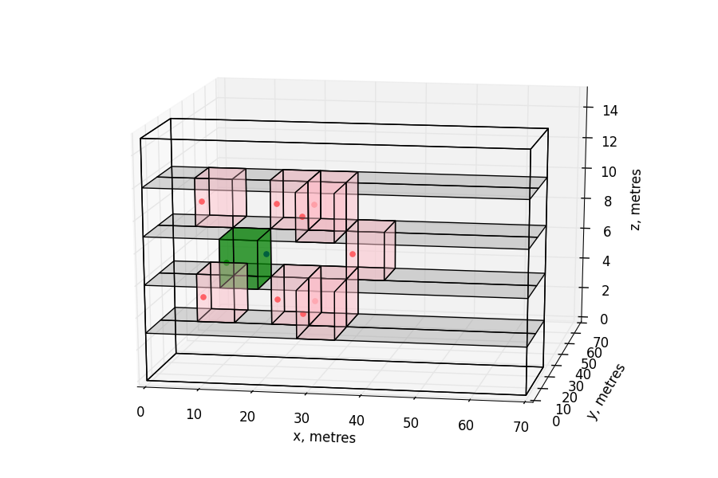


Number of Hidden APs for Which
Location Condition is Met in a Non-edge Flat With APs in the Corner of Non-square Rooms
$$P_{thr}=−86 dBm$$
$$∆P=0$$
AP
9 alien APs can kill the beacon.
They are not direct neighbors
Killing APs are located in 14 flats

Slide 20
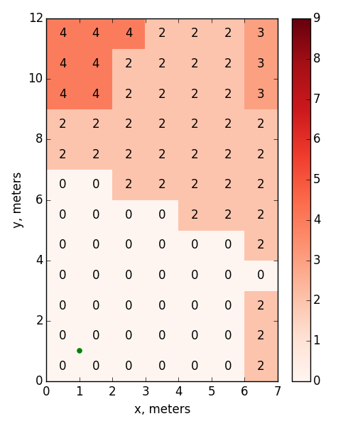
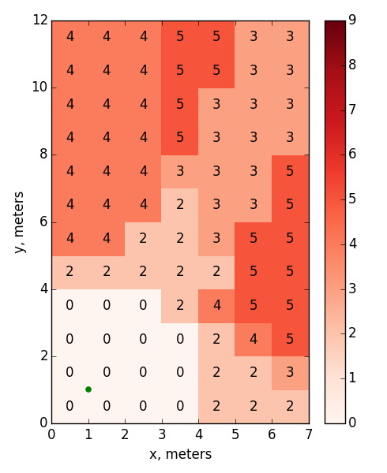



The influence of $∆P$
$$∆P=3 dB$$
$$∆P=6 dB$$
AP
AP

Slide 21
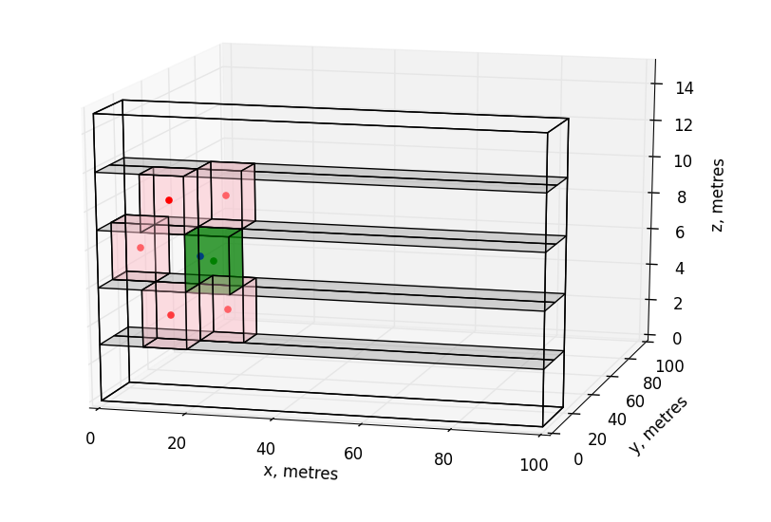
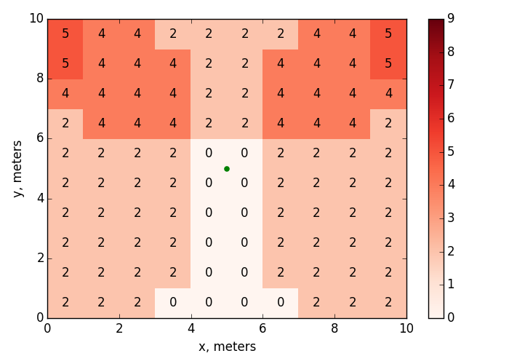


Number of Hidden APs for Which
Location Condition is Met in a Non-edge Flat
Corner neighbor
of a neighbor
$$P_{thr}=−76 dBm$$
$$∆P=0$$
AP
5 alien APs can kill the beacon
Killing APs are located in 8 flats

Slide 22
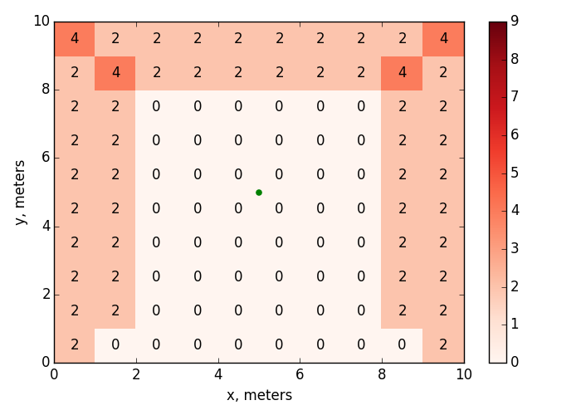
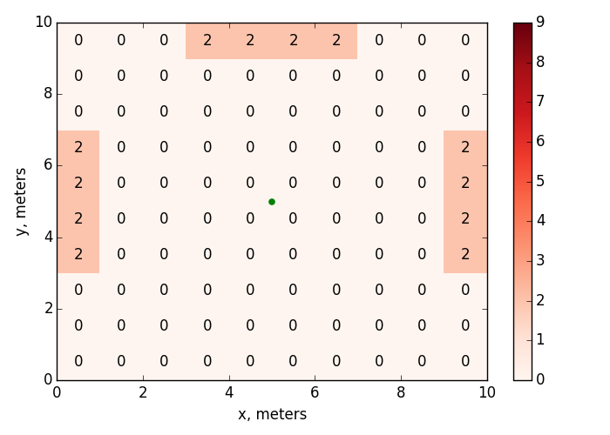


Influence of $∆P$
$$∆P=3 dB$$
$$∆P=6 dB$$
Killing APs are located in 6 flats

Slide 23
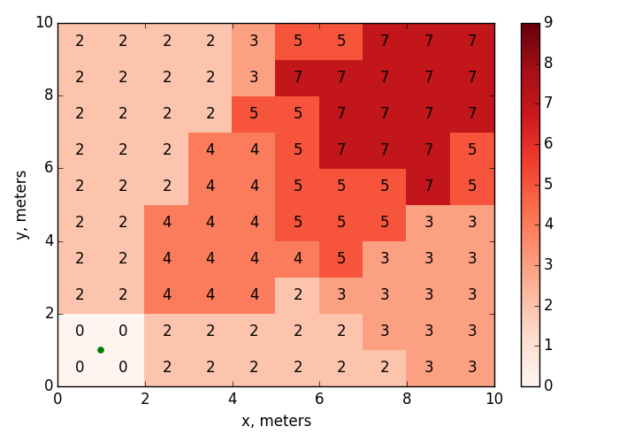
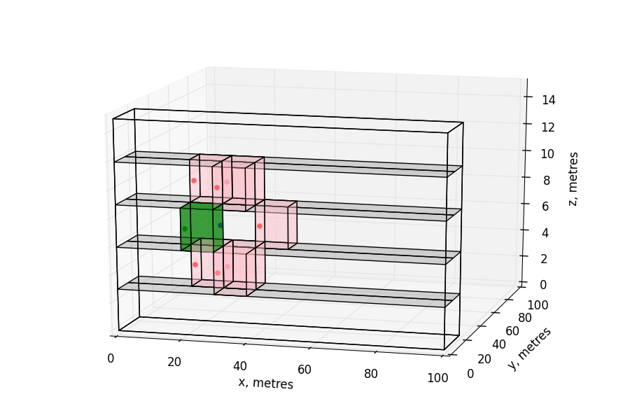


Number of Hidden APs for Which Location Condition is Met in a Non-edge Flat With APs in the Corner
$$P_{thr}=−76 dBm$$
$$∆P=0$$
AP
Killing APs are located in 7 flats

Slide 24
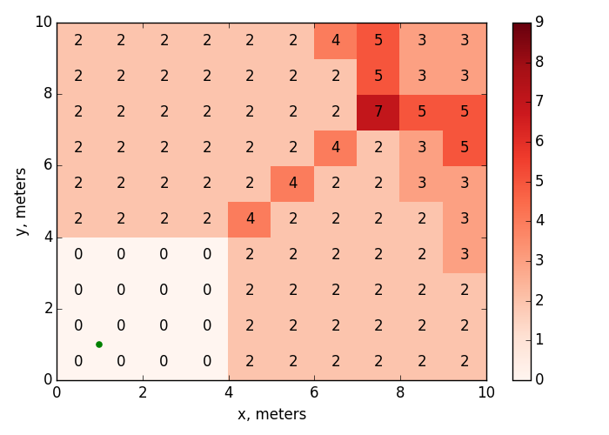
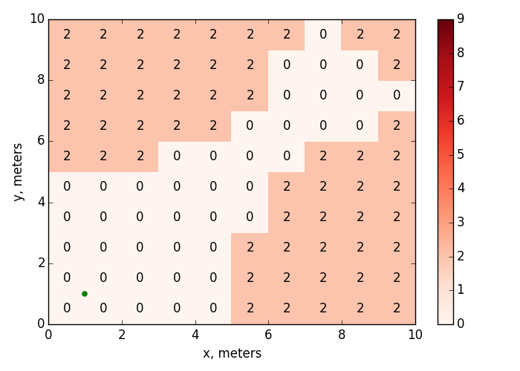
Influence of $∆P$
$$∆P=3 dB$$
$$∆P=6 dB$$
AP
AP
Killing APs are located in 7 flats
Killing APs are located in 6 flats

Slide 25
Conclusion
Collisions of beacons sent by hidden APs are typical for the residential scenario, which is a key scenario for 802.11ax.
Though time condition probability is low, because of clock drifting sooner or later it can cause “inexplicable” occasional malfunction (e.g. disassociation). The value of clock drifting affects the period (typically, hours or days) and duration (minutes) of such malfunction.
Location and channel conditions: The number of APs which kill the beacon in a particular point depends on the scenario parameters, reaching the value of 9 in the considered residential scenario. This value is three times more than the number of 20 MHz channels in 2.4 GHz, and comparable with the number of primary-20 channels in 5 GHz. The number of APs that can kill the beacon sent by the AP in a flat is up to 14.
Different beacon intervals cannot solve the problem, since apart from beacons APs also transmit data.

Slide 26
Straw Poll
Do you agree that TGax should address beacon collision problem?
  Y
  N
  A

Slide 27
References
[1] Results for beacon collisions. IEEE 802.11-16/0017r0
[2] Simulation Scenarios. IEEE 802.11-14/0980r16

Slide 28
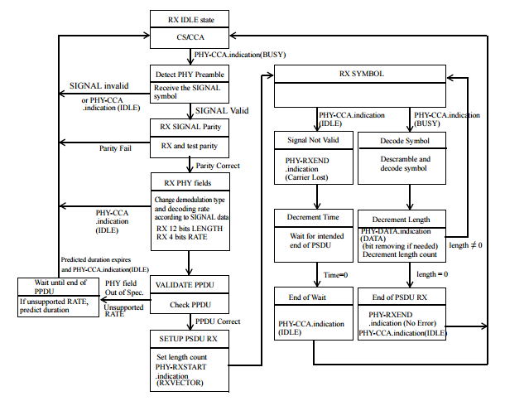
Receive State Machine

