Slide 1
Results for Beacon Collisions
Date: 2016-03-14
Authors:
Name | Affiliation | Address | Phone | Email
Evgeny Khorov | IITP RAS |  |  | khorov@frtk.ru
Dmitry Bankov | IITP RAS |  |  | bankov@iitp.ru
Anton Kiryanov | IITP RAS |  |  | kiryanov@iitp.ru
Sigurd Schelstraete | Quantenna |  |  | sigurd@quantenna.com
Huizhao Wang | Quantenna |  |  | hwang@quantenna.com

Slide 2
Motivation
At Jan’16 meeting we have proposed the beacon collision avoidance mechanism [1]
The feedback from the group:
  The problem existence shall be proved in simulation scenarios [2]

Slide 3
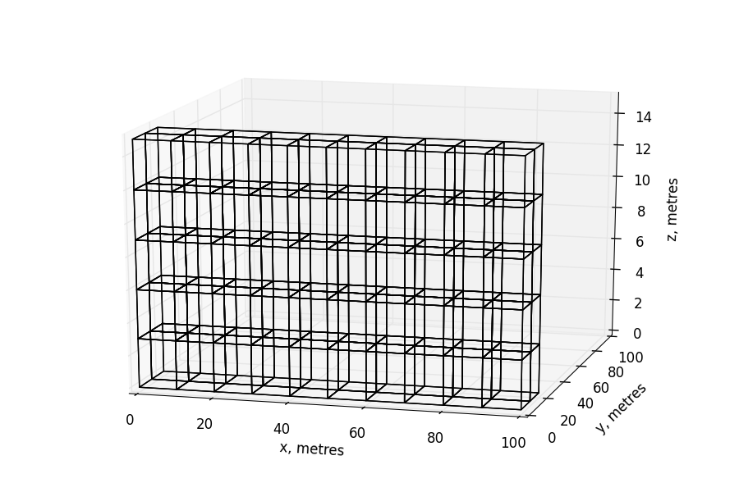
Residential Scenario
10 flats in a row
5 floors
2 rows

Slide 4
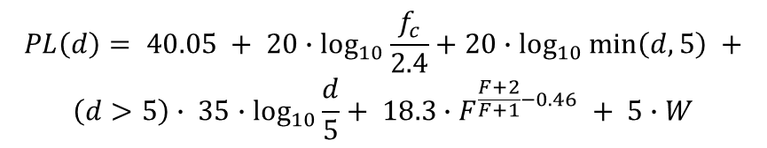
Path Loss Model
$$PL\left(d\right)= 40.05 + 20∙\log_{10}{\frac{f_{c}}{2.4}}+20∙\log_{10}{\min\left(d,5\right)} +$$
$$\left(d>5\right)∙ 35∙\log_{10}{\frac{d}{5}}+ 18.3∙F^{\frac{F+2}{F+1}−0.46} + 5∙W$$
W: number of walls traversed in x-direction plus number of walls
traversed in y-direction
F: number of floors traversed
f_{c}: frequency [GHz]
d: distance [m]
d

Slide 5
Beacon Collisions
Beacon collision is collision at a STA between a beacon from its own AP and a beacon from an alien AP.
It occurs when all the following conditions are met:
Channel condition: both APs send beacons in the same channel
Time condition: beacons overlap in time
Location condition: the STA receives an alien beacon, while its own AP does not.

Slide 6
Channel Condition
In 2.4 GHz, there are 3 non-overlapping 20 MHz channels.
In 5 GHz there are more than 20 non-overlapping 20 MHz channels
TGax Simulation Scenarios document considers “3 or 5 80MHz non-overlapping channels, with random selection of primary channel per operating channel”, i.e. 9 or 15 non-overlapping primary-20 channels.
If two APs are hidden from each other, they are more likely to select the same channel, rather than if they are direct neighbors.

Slide 7
Time Condition (1/3)
Time condition: beacons overlap in time
The signal from its own AP is typically much higher than the signal from an alien AP (located in another flat).
If the intra-BSS beacon (beacon from STA’s own AP) starts earlier, the alien beacon is just a small noise and cannot damage intra-BSS beacon.
If the alien beacon starts earlier, the STA starts receiving this beacon and does not sync at the intra-BSS beacon.
In our analysis we consider time condition:
Beacons overlap in time, and an alien beacon starts earlier than an intra-BSS beacon.
Intra-BSS beacon
Alien beacon

Slide 8
Time Condition (2/3)
What is the probability for a STA that a beacon from one hidden AP overlaps with its own AP’s beacon and alien beacon starts earlier?
Assuming that beacon duration is 500 us and BI=500 ms, i.e. BI is 1000 longer than the beacon, than for one hidden AP the probability of time condition is 0.1%.
Since AP transmits data packets in addition to beacons, the probability that a beacon is damaged increases.
For how long will the beacons collide?
While the standard states that the clock drifting shall be less than 100ppm, in real devices it is less than 10ppm.
If the clock drifting of the APs is in opposite directions and it is 10 ppm (relative drifting is 20ppm), the beacons will collide for 25 seconds.
  Note that constant clock drifting in opposite directions is the best case. In fact, the clock drifting is a random process, so beacons will collide for much longer time.
  Such continuous beacon collisions can cause disassociation from the AP.

Slide 9
Time Condition (3/3)
The probability that the beacons of two APs overlap in time is small, however because of clock drifting sooner or later the problem arises.
* Beacon interval = 500 ms, duration = 500 us (collision probability = 0.1%)
Even probability of 0.1% can cause “inexplicable” occasional malfunction, which makes users to continuously reboot the AP.
Different beacon intervals cannot solve the problem, since APs transmit data packets in addition to beacons.
Relative Clock Drifting | Collision Duration | Collision Period
1 ppm | ~ 8 min | ~ 6 days
5 ppm | ~1.5 min | ~1 day
10 ppm | 50 s | 14 hours
20 ppm | 25 s | 7 hours

Slide 10





Beacon Collision Location Condition
Beacon collision is possible,
if the STA hears the beacons from an alien AP,
while its own AP does not
$$P_{TX}=18 dBm$$
d₁
$$P_{STA}=P_{TX}−PL(d_{1})$$
$$P_{thr}$$
AP
$$P_{AP}=P_{TX}−PL(d_{2})$$
STA
d₂
Location Conditions:
$$P_{AP}< P_{thr}< P_{STA}$$
AP

Slide 11

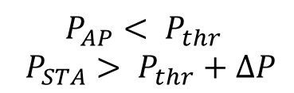
Beacon Collision Location Condition
Beacon collision is possible,
if the STA hears the beacons from an alien AP,
while its own AP does not.
d₁
AP
$$∆P$$
Taking into account fading
and different antenna gain
STA
d₂
$$P_{AP}< P_{thr}$$
$$P_{STA}> P_{thr}+∆P$$
AP

Slide 12
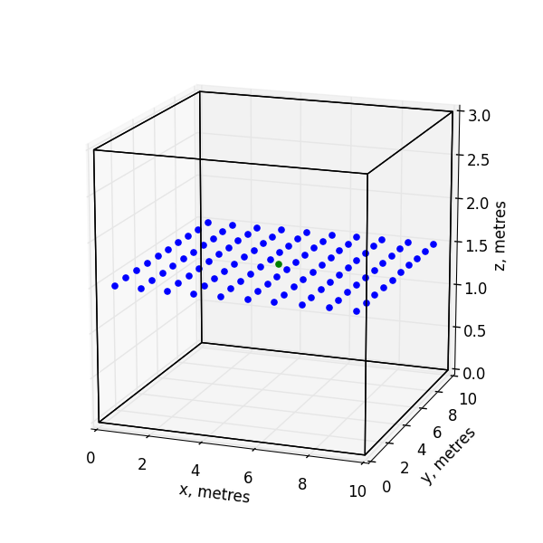
Locations of STAs and APs in the Flats
Possible STA locations
AP

Slide 13
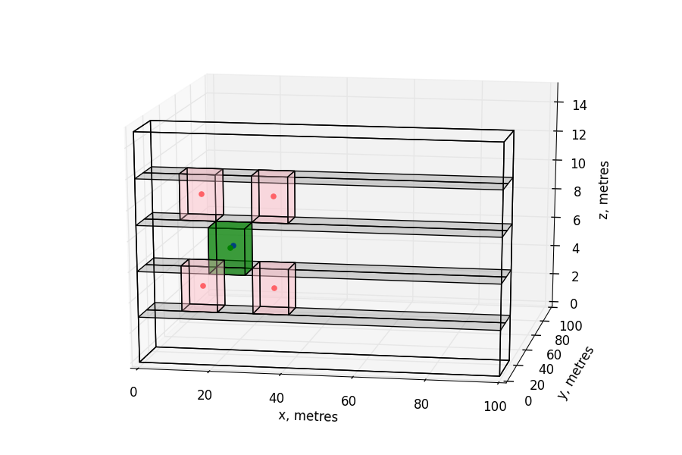
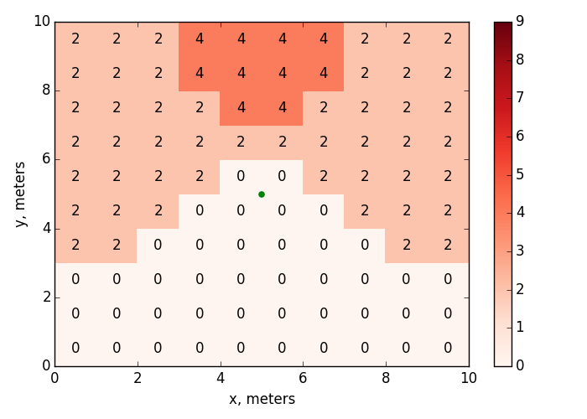


Number of Hidden APs for Which Location Condition is Met in a Non-edge Flat With APs in the Center
AP
4 alien APs can kill the beacon.
They are not direct neighbors
$$P_{thr}=−86 dBm$$
$$∆P=0$$

Slide 14
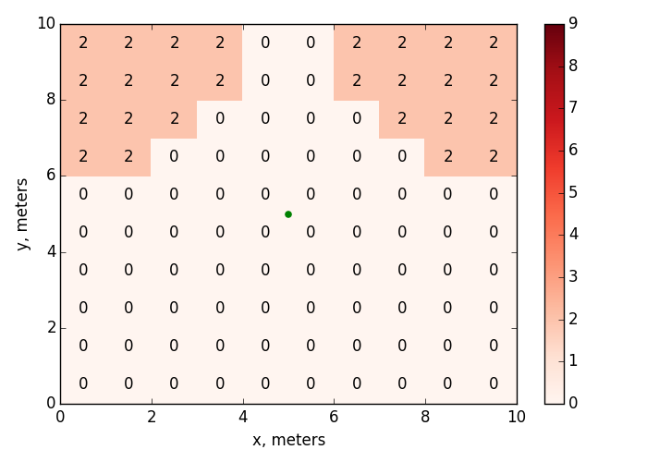
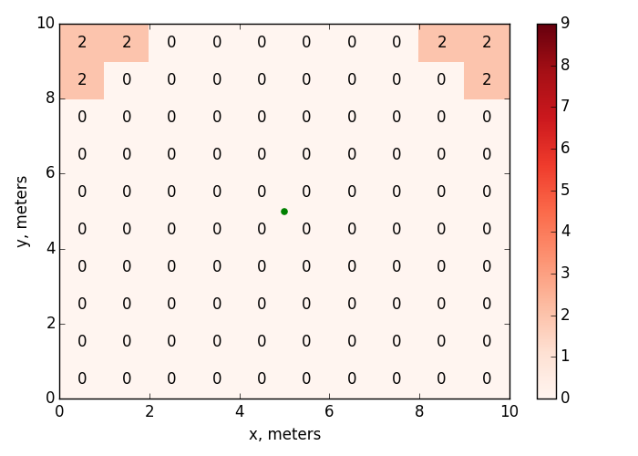



Influence of $∆P$
$$∆P=3 dB$$
$$∆P=6 dB$$
AP
AP

Slide 15
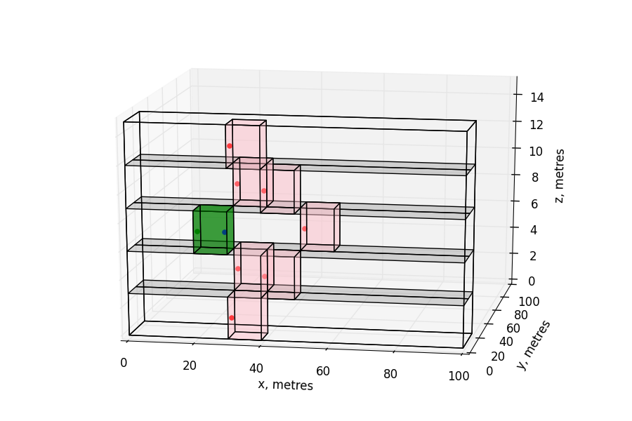
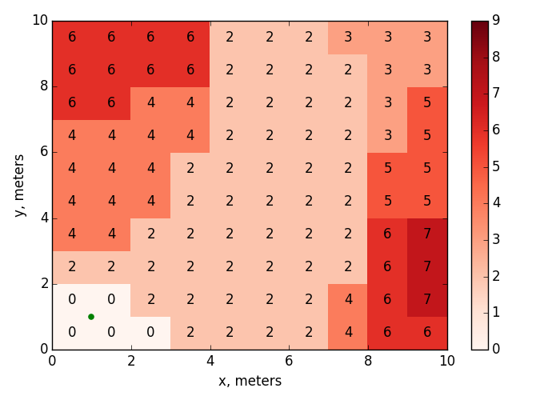
Number of Hidden APs for Which Location Condition is Met in a Non-edge Flat With APs in the Corner
7 alien APs can kill the beacon.
They are not direct neighbors
AP
$$P_{thr}=−86 dBm$$
$$∆P=0$$

Slide 16
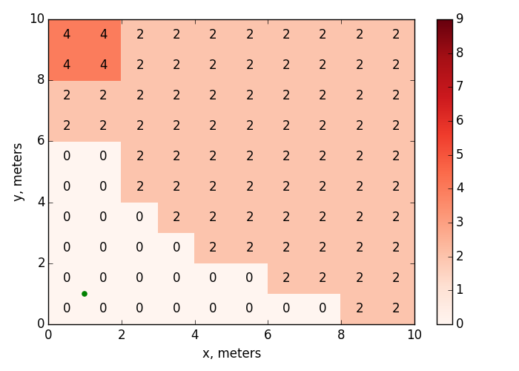
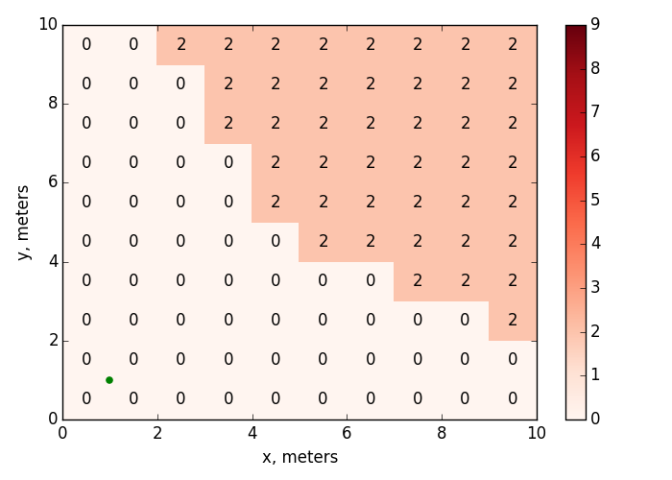
Influence of $∆P$
$$∆P=3 dB$$
$$∆P=6 dB$$
AP
AP

Slide 17
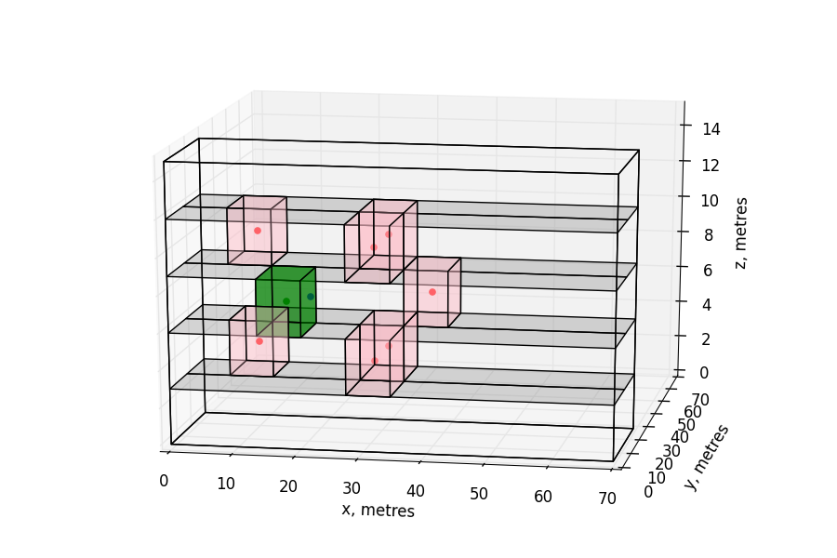
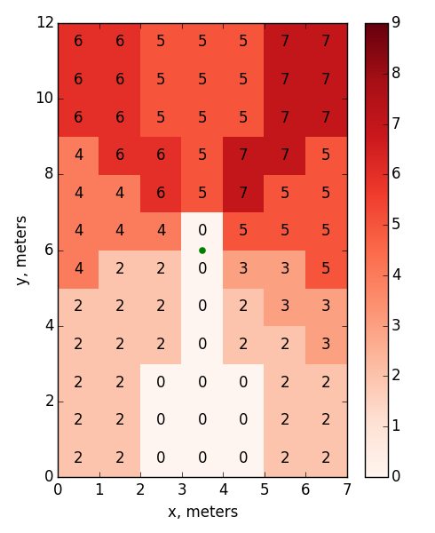


Number of Hidden APs for Which
Location Condition is Met in a Non-edge Flat
With APs in the Center of Non-square Rooms
AP
7 alien APs can kill the beacon.
They are not direct neighbors
$$P_{thr}=−86 dBm$$
$$∆P=0$$

Slide 18
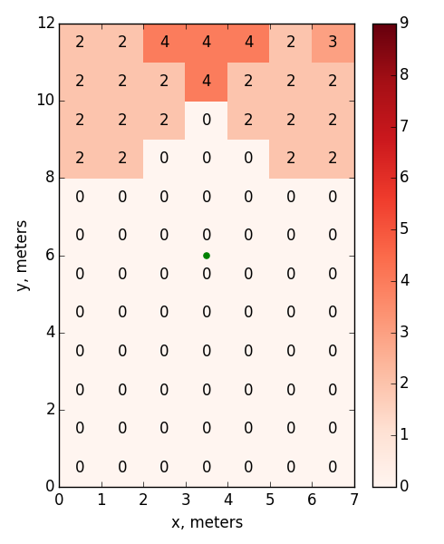
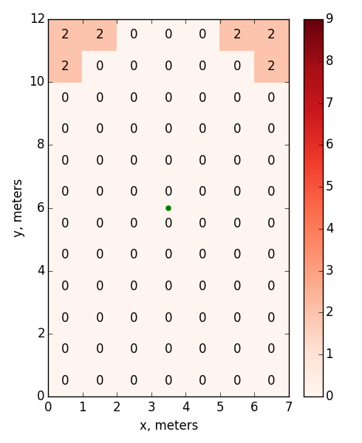


Influence of $∆P$
$$∆P=3 dB$$
$$∆P=6 dB$$
AP
AP

Slide 19
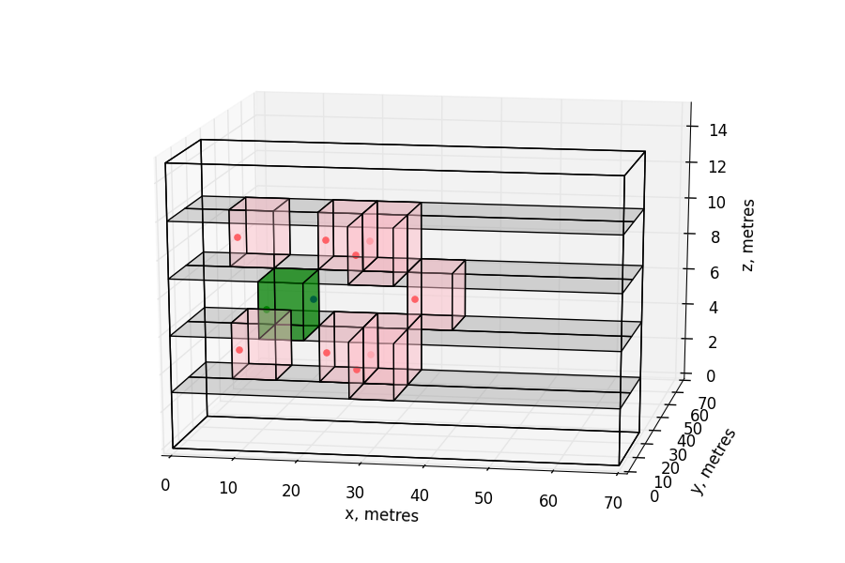
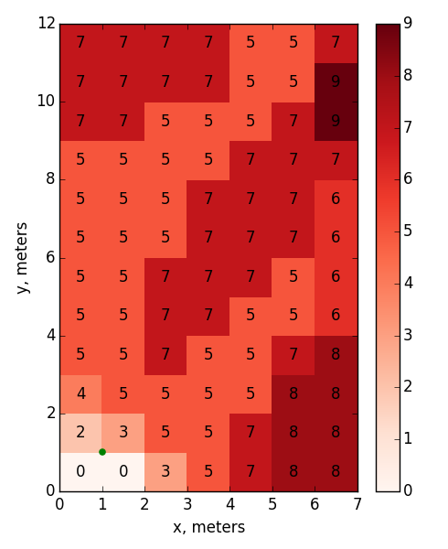


Number of Hidden APs for Which
Location Condition is Met in a Non-edge Flat With APs in the Corner of Non-square Rooms
9 alien APs can kill the beacon.
They are not direct neighbors
AP
$$P_{thr}=−86 dBm$$
$$∆P=0$$

Slide 20
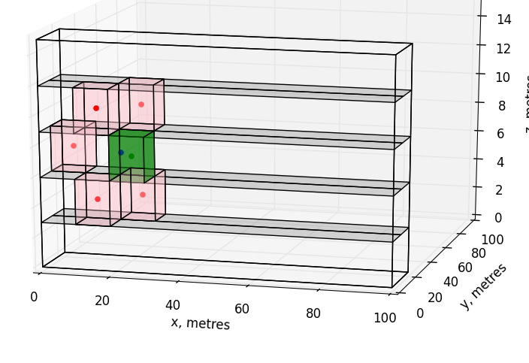
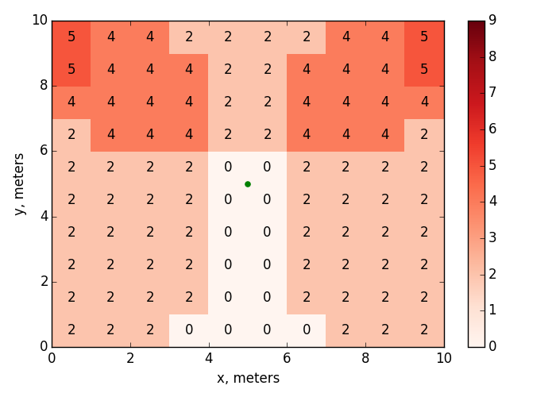


Number of Hidden APs for Which
Location Condition is Met in a Non-edge Flat
Corner neighbor
of a neighbor
AP
5 alien APs can kill the beacon
$$P_{thr}=−76 dBm$$
$$∆P=0$$

Slide 21
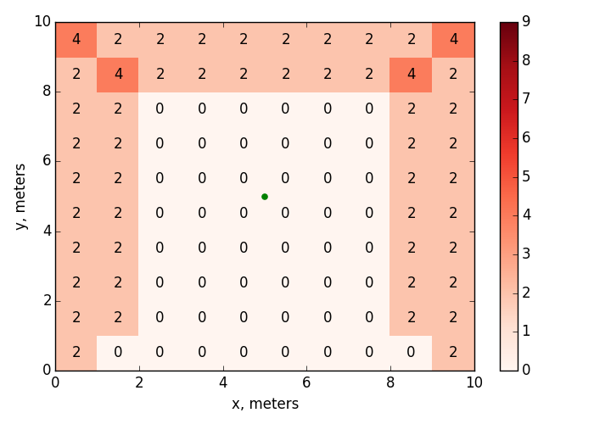
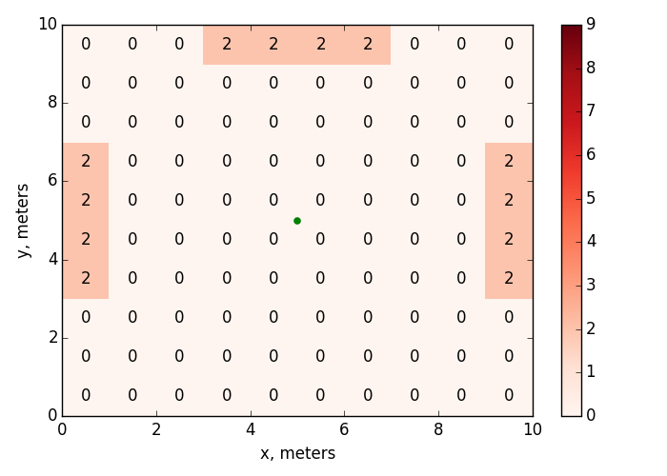


Influence of $∆P$
$$∆P=3 dB$$
$$∆P=6 dB$$

Slide 22
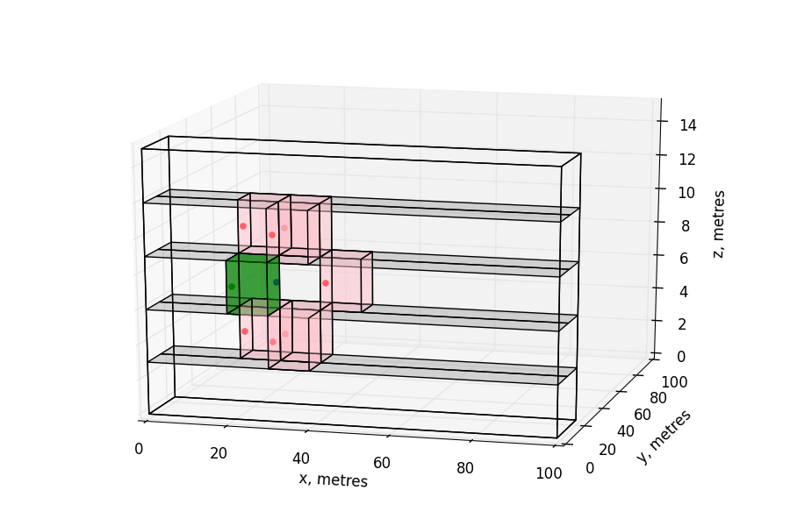
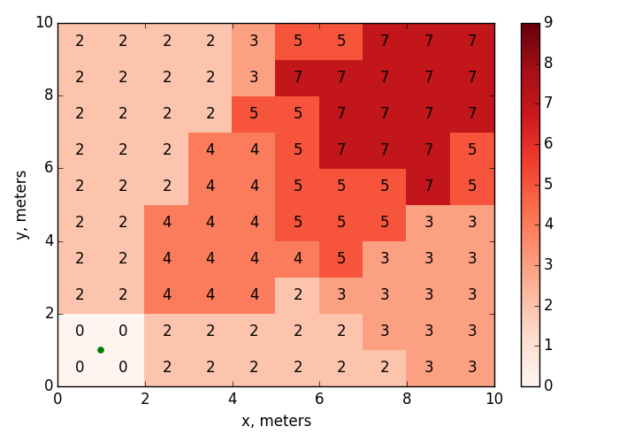

Number of Hidden APs for Which Location Condition is Met in a Non-edge Flat With APs in the Corner
7 alien APs can kill the beacon.
They are not direct neighbors
AP
$$P_{thr}=−76 dBm$$
$$∆P=0$$

Slide 23
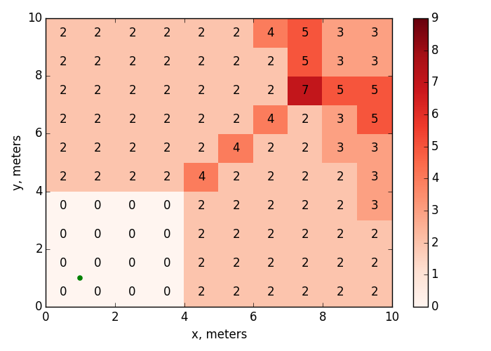
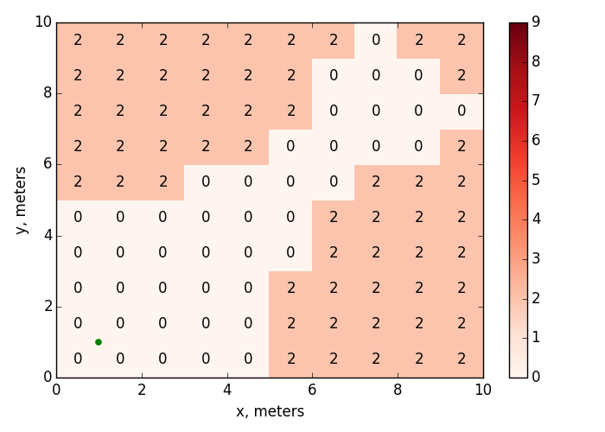
Influence of $∆P$
$$∆P=3 dB$$
$$∆P=6 dB$$
AP
AP

Slide 24
Conclusion
Collisions of beacons sent by hidden APs are typical for the residential scenario, which is a key scenario for 802.11ax.
The probability of a beacon collision depends on a particular scenario. In the residential scenario, up to 9 alien APs can send beacons which collide with the beacons send by the AP in the flat.
Different beacon intervals cannot solve the problem, since apart from beacons APs also transmit data.

Slide 25
Straw Poll
Do you agree that TGax should address beacon collision problem?

Slide 26
References
[1] Results for beacon collisions. IEEE 802.11-16/0017r0
[2] Simulation Scenarios. IEEE 802.11-14/0980r16

