Slide 1
TGax March 2016 Meeting Agenda
Date: 2016-02-05
Authors:

Slide 2
IEEE 802.11 TGax:
High Efficiency WLAN
Task Group
Macau
March 13-18, 2016
Chair: Osama Aboul-Magd (Huawei Technologies)
Vice Chair: Simone Merlin (Qualcomm)
Vice Chair: Ron Porat (Broadcom)
Secretary: Yasuhiko Inoue (NTT)
Technical Editor: Robert Stacey (Intel)

Slide 3
Meeting Protocol
Please announce your affiliation when you first address the group during a meeting slot
Slide 3

Slide 4
Attendance
http://newton.meeting.verilan.com
Register
Indicate attendance
Slide 4

Slide 5
Attendance, Voting & Document Status
Make sure your badges are correct
If you plan to make a submission be sure it does not contain company logos or advertising
Questions on Voting status, Ballot pool, Access to Reflector, Documentation, member’s area
  see Jon Rosdahl – jrosdahl@ieee.org
Cell Phones Silent or Off
Slide 5

Slide 6
Patent Policy
Following 5 slides

Slide 7
Instructions for the WG Chair
The IEEE-SA strongly recommends that at each WG meeting the chair or a designee:
  Show slides #1 through #4 of this presentation
  Advise the WG attendees that:
    The IEEE’s patent policy is described in Clause 6 of the IEEE-SA Standards Board Bylaws;
    Early identification of patent claims which may be essential for the use of standards under development is strongly encouraged;
    There may be Essential Patent Claims of which the IEEE is not aware. Additionally, neither the IEEE, the WG, nor the WG chair can ensure the accuracy or completeness of any assurance or whether any such assurance is, in fact, of a Patent Claim that is essential for the use of the standard under development.
  Instruct the WG Secretary to record in the minutes of the relevant WG meeting:
    That the foregoing information was provided and that slides 1 through 4 (and this slide 0, if applicable) were shown;
    That the chair or designee provided an opportunity for participants to identify patent claim(s)/patent application claim(s) and/or the holder of patent claim(s)/patent application claim(s) of which the participant is personally aware and that may be essential for the use of that standard
    Any responses that were given, specifically the patent claim(s)/patent application claim(s) and/or the holder of the patent claim(s)/patent application claim(s) that were identified (if any) and by whom.
  The WG Chair shall ensure that a request is made to any identified holders of potential essential patent claim(s) to complete and submit a Letter of Assurance.
  It is recommended that the WG chair review the guidance in IEEE-SA Standards Board Operations Manual 6.3.5 and in FAQs 14 and 15 on inclusion of potential Essential Patent Claims by incorporation or by reference.
  Note: WG includes Working Groups, Task Groups, and other standards-developing committees with a PAR approved by the IEEE-SA Standards Board.
(Optional to be shown)

Slide 8
Participants, Patents, and Duty to Inform
All participants in this meeting have certain obligations under the IEEE-SA Patent Policy.
  Participants [Note: Quoted text excerpted from IEEE-SA Standards Board Bylaws subclause 6.2]:
    “Shall inform the IEEE (or cause the IEEE to be informed)” of the identity of each “holder of any potential Essential Patent Claims of which they are personally aware” if the claims are owned or controlled by the participant or the entity the participant is from, employed by, or otherwise represents
    “Should inform the IEEE (or cause the IEEE to be informed)” of the identity of “any other holders of potential Essential Patent Claims” (that is, third parties that are not affiliated with the participant, with the participant’s employer, or with anyone else that the participant is from or otherwise represents)
  The above does not apply if the patent claim is already the subject of an Accepted Letter of Assurance that applies to the proposed standard(s) under consideration by this group
  Early identification of holders of potential Essential Patent Claims is strongly encouraged
  No duty to perform a patent search
Slide #1

Slide 9
Patent Related Links
  All participants should be familiar with their obligations under the IEEE-SA Policies & Procedures for standards development.
  Patent Policy is stated in these sources:
  IEEE-SA Standards Boards Bylaws
  http://standards.ieee.org/develop/policies/bylaws/sect6-7.html#6
  IEEE-SA Standards Board Operations Manual
  http://standards.ieee.org/develop/policies/opman/sect6.html#6.3
  Material about the patent policy is available at
  http://standards.ieee.org/about/sasb/patcom/materials.html
If you have questions, contact the IEEE-SA Standards Board Patent Committee Administrator at patcom@ieee.org or visit http://standards.ieee.org/about/sasb/patcom/index.html
This slide set is available at https://development.standards.ieee.org/myproject/Public/mytools/mob/slideset.ppt
Slide #2

Slide 10
Call for Potentially Essential Patents
If anyone in this meeting is personally aware of the holder of any patent claims that are potentially essential to implementation of the proposed standard(s) under consideration by this group and that are not already the subject of an Accepted Letter of Assurance:
  Either speak up now or
  Provide the chair of this group with the identity of the holder(s) of any and all such claims as soon as possible or
  Cause an LOA to be submitted
Slide #3

Slide 11
Other Guidelines for IEEE WG Meetings
All IEEE-SA standards meetings shall be conducted in compliance with all applicable laws, including antitrust and competition laws.
  Don’t discuss the interpretation, validity, or essentiality of patents/patent claims.
  Don’t discuss specific license rates, terms, or conditions.
    Relative costs, including licensing costs of essential patent claims, of different technical approaches may be discussed in standards development meetings.
      Technical considerations remain primary focus
  Don’t discuss or engage in the fixing of product prices, allocation of customers, or division of sales markets.
  Don’t discuss the status or substance of ongoing or threatened litigation.
  Don’t be silent if inappropriate topics are discussed … do formally object.
---------------------------------------------------------------
See IEEE-SA Standards Board Operations Manual, clause 5.3.10 and “Promoting Competition and Innovation: What You Need to Know about the IEEE Standards Association's Antitrust and Competition Policy” for more details.
Slide #4

Slide 12
Agenda Items for the Week
Approve TG and Telecons minutes since January meeting.
Continue to advance task group documents.
  Simulation Scenarios
  Evaluation Methodology
  Channel Model
  Function Requirements
  Specification Framework
Ad Hoc group meetings
Technical Presentations and related straw polls and/or motions
Approve draft D0.1 and start a comment collection process.
Schedule Telecon times.

Slide 13
General Flow of the Meeting
Monday March 14, 13:30 – 15:30
  Call Meeting to order
  IEEE 802 and 802.11 IPR Policy and procedure.
  Review from November 2014 meeting
  Call for submissions
  Agenda setting and approval
  TG Motions
  Presentations
  Recess
Monday March 14, 19:30 – 21:30
  Ad Hoc Group Meetings
Tuesday March 15, 10:30 – 12:30
  Ad Hoc Group Meetings
Tuesday March 15, 16:00 – 18:00
  Ad Hoc Group Meetings
Tuesday March 15, 19:30 – 21:30
  Call Meeting to order
  IEEE 802 and 802.11 IPR Policy and procedure.
  Presentations
  Recess
Wednesday March 16, 13:30 – 15:30
  Ad Hoc Group Meetings
Wednesday March 16, 16:00 – 18:00
  Ad Hoc Group Meetings
Thursday March 17, 10:30 – 12:30
  Call Meeting to order
  IEEE 802 and 802.11 IPR Policy and procedure.
  Presentations
  TG Motions
  Recess
Thursday March 17, 16:00 – 18:00
  Call Meeting to order
  IEEE 802 and 802.11 IPR Policy and procedure.
  Presentations
  TG Motions
  Goals for May 2016
  Telecon Schedule
  Adjourn

Slide 14
TGax Schedule in a Glance
 | Monday |  | Tuesday |  | Wednesday |  | Thursday
AM1
AM2 |  |  | PHY | MAC |  |  | TGax
PM1 | TGax |  |  |  | PHY | MAC
PM2 |  |  | SR | MAC | MAC | MU | TGax
EVE | SR | MU | TGax

Slide 15
Submissions (PHY)
DCN | Title | Author | Ad Hoc
11-16/0319 | I-Q Decoupled OFDM: A Solution To I/Q Imbalance | Shouxing Simon Qu | PHY
11-16/0335 | HE-STF sequences for 160/80+80MHz | Eunsung Park | PHY
11-16/0343 | Spectral Mask Discussion | Hongyuan Zhang | PHY
11-16/0344 | PHY Padding Related Issues | Hongyuan Zhang | PHY
11-15/1354r2 | SIGA fields and Bitwidths | Ron Porat | PHY
11-16/0346 | 11ax Pilot Sequence | Bin Tian | PHY
11-16/0349 | HE-SIG-B Compression Mode | Kaushik Josiam | PHY
11-16/0367 | Power Scaling of L-LTF and L-STF | Yakun Sun | PHY
11-16/0389 | Sounding Design | Sriram Venkateswaran | PHY
11-16/0397 | HE-SIG-B Signaling Discussions | John Son | PHY
11-16/0395 | Preamble transmission for Uplink OFDMA | GanMing | PHY
Please add 11-16/0203 to the agenda.
11 Submisions

Slide 16
Submissions (MAC)
DCN | Title | Author | Ad Hoc
11-16/0345 | Simultaneous NAK for MU GCR-BA | Jinsoo Ahn | MAC
11-16/0347 | Fragmentation for MU frames-Follow up on parameters | Alfred Asterjadhi | MAC
11-16/0352 | Considerations on MU initial link setup | Woojin Ahn | MAC
11-16/0353 | MU-RTS/CTS for TWT Protection | Hanseul Hong | MAC
11-16/0358 | maximal A-MPDU size | Liwen Chu | MAC
11-16/0359 | management ack | Liwen Chu | MAC
11-16/0361 | Ack Policy of UL MU frame | Jeongki Kim | MAC
11-16/0362 | Multi-TID Aggregation Limit | Chittabrata Ghosh | MAC
11-16/0365 | Multi-STA BA Design | Xiaofei WANG | MAC
11-16/0368 | MAC padding options for legacy trigger frame | Zhou Lan | MAC
11-16/0369 | M-BA aggregated trigger frame | Zhou Lan | MAC
11-16/0377 | Sounding Sequences Clarifications | Simone Merlin | MAC
11-16/0378 | Extended BA Bitmap | Simone Merlin | MAC
11-16/0383 | RU Signaling in Trigger Frame | Yunbo Li | MAC
11-16/0404 | BlockAck-Bitmap | Dengyu Qiao | MAC
11-16/0297 | Results for beacon collisions | Evgeny Khorov | MAC
11-16/0399 | Considerations on Trigger Frame for Random Access Procedure | Evgeny Khorov | MAC
11-16/0396 | Issues on BSS Color Bits Collision | John Son | MAC
18 Submissions

Slide 17
Submissions (SR)
DCN | Title | Author | Ad Hoc
11-16/0212r4 | Enterprise Scenario DSC and Color | Graham Smith | SR
11-16/0310 | DSC Proposed Text | Graham Smith | SR
11-16/0350 | Enterprise Scenario TPC and DSC | Graham Smith | SR
11-16/0360 | Simulation results of spatial reuse with various MCSs | Junichi Iwatani | SR
11-16/0382 | Discussion on Spatial Reuse Operations in 11ax | Yunbo Li | SR
11-16/0414 | Adjustment Rules for Adaptive CCA and TPC | james Wang | SR
11-16/0403 | Spatial Re-Use with Adaptive CCA and TPC Simulation | Frank HSU | SR
7 submissions

Slide 18
Submissions (MU)
DCN | Title | Author | Ad Hoc
11-16/0331 | Power Control for Multi-User Transmission in 802.11ax | Kome Oteri | MU
11-16/0333 | Issue related to unused UL OFDMA RUs | Stephane Baron | MU
11-16/0340 | Random Access UL MU Resource Allocation and Indication | Leonardo Lanante | MU
11-16/0371 | Further consideration for MU-RTS/CTS | Jing Ma | MU
11-16/0379 | Trigger Frame Format | Simone Merlin | MU
11-16/0413 | Power Control for UL MU | Arjun Bharadwaj | MU
6 submissions

Slide 19
Submissions (TG)
DCN | Title | Author | Ad Hoc
11-15/1095r6 | OFDMA performance in 11ax | Suhwook Kim | TG
11-16/066r5 | Views on UL-MU Features | Joonsuk Kim | TG
11-16/0355 | Snapshot of Residential Use 2016 | Carol Ansley | TG
11-16/0364 | AID Assign Rules Based on BSS Color and HE Operation Element | Jianhan Liu | TG
11-16/0394 | Achieving High Efficiency in Medium Access via Roster Mode | Sean Coffey | TG
5 Submissions

Slide 20
Agenda for Monday March 14, 13:30 – 15:30
Call meeting to order
Patent policy, etc.
Call for submissions
Set Ad Hoc Groups schedule and approve agenda
Summary from January 2016 meeting
SFD review – Editor
TG motions
  Approve TG meeting and Telecon minutes since November meeting.
  Approve the latest SFD revision
Timeline
Ad Hoc group Rules
Presentations
  11-16/0066r5, “Views on UL MU Features” Joonsuk Kim
  11-15/1095r6, “OFDMA Performance in 11ax” Suhwook Kim
Recess

Slide 21
Summary since January 2016 Meeting
Passed a number of affecting aspects of the TG Specification Framework.
  PHY
  MAC
  MU
Latest revisions of the Specification Framework is available at:
  https://mentor.ieee.org/802.11/dcn/15/11-15-0132-15-00ax-spec-framework.docx
Presentation on draft TG specification 11-16/0024r0
The TG conducted a couple of Telecons (Feb 4th , and March 3rd )
  https://mentor.ieee.org/802.11/dcn/16/11-16-0212-00-00ax-enterprise-scenario-dsc-and-color.pptx
  https://mentor.ieee.org/802.11/dcn/16/11-16-0024-01-00ax-proposed-draft-specification.docx

Slide 22
Approval of TG Minutes (January 2016 Meeting and Telecon Minutes)
Approve TGax minutes of meetings and teleconferences from January 2016 interim meeting to today:
  https://mentor.ieee.org/802.11/dcn/16/11-16-0096-02-00ax-tgax-january-2016-atlanta-meeting-minutes.docx
  https://mentor.ieee.org/802.11/dcn/16/11-16-0262-01-00ax-tgax-teleconference-minutes-february-4th-2016.docx
  https://mentor.ieee.org/802.11/dcn/16/11-16-0301-01-00ax-tgax-teleconference-minutes-march-3rd-2016.docx
  https://mentor.ieee.org/802.11/dcn/16/11-16-0150-00-00ax-tgax-mu-ad-hoc-meeting-minutes-january-2016.docx
  https://mentor.ieee.org/802.11/dcn/16/11-16-0110-00-00ax-jan-2016-atlanta-tgax-mac-ad-hoc-meeting-minutes.docx
  https://mentor.ieee.org/802.11/dcn/16/11-16-0119-00-00ax-ieee-802-11-tgax-january-2016-atlanta-phy-ad-hoc-meeting-minutes.docx
Move: Al Petrick Second: Yasu Inoue
Accepted with no objection

Slide 23
SFD Review
Editor
https://mentor.ieee.org/802.11/dcn/15/11-15-0132-15-00ax-spec-framework.docx

Slide 24
SFD Motion
Move to accept document 11-16/0132r15 as the current revision of the TG Specification Framework document
Move: Robert Stacey
Second: Rakesh Taori
Y/N/A
accepted with no objection

Slide 25
Timeline
May 2014
HEW TG (IEEE 802.11ax)
Nov 2014 First TG SFD draft was approved
January 2016 Proposed TG Draft
July 2016
Draft 1.0
WG LB
March 2017
Draft 2.0
Recirculation
March 2019
Publication
March 2016 Draft 0.1 Approval and start of comment collection
May 2013
HEW SG
We are Here

Slide 26
Ad Hoc Group Rules
A straw poll needs to achieves at least 75% at the ad-hoc level to be converted to a motion at the TG level.
In the case a consensus can not be reached within an Ad Hoc group (a stalemate that prohibits further progress), the subject is moved to the Task group, if an Ad Hoc straw poll vote to move the subject to the Taskgroup achieves > 50% approval.
A straw poll affecting the Spec Framework has to start with,
  Do you agree to add to the TG Specification Frame work document?
    x.y.z. <feature description>
For further details, please see 11-15-0075r0
Minutes of the Ad Hoc group meetings will be available on mentor.

Slide 27
Agenda for Monday March 14, 19:30 – 21:30
Ad Hoc Group Meetings
  SR → Venetian Ballroom A/B (L3)
  MU → Florence 2305 and 2306 (L1)

Slide 28
Agenda for Tuesday March 15, 10:30 – 12:30
Ad Hoc Group Meetings
  PHY → Venetian Ballroom A/B (L3)
  MAC → Florence 2202+2203+2302+2303 (L1)

Slide 29
Agenda for Tuesday March 15, 16:00 – 18:00
Ad Hoc Group Meetings
  SR → Venetian Ballroom AB (L3)
  MAC → Florence 2202+2203+2302+2303 (L1)

Slide 30
Agenda for Tuesday March 15, 19:30 – 21:30
TG Meeting
Call Meeting to order
IEEE 802 and 802.11 IPR Policy and procedure
Progress from ad hoc groups
Presentations
  https://mentor.ieee.org/802.11/dcn/16/11-16-0364-01-00ax-aid-assign-rules-based-on-bss-color-and-he-operation-element.pptx
  https://mentor.ieee.org/802.11/dcn/16/11-16-0394-00-00ax-achieving-high-efficiency-in-medium-access-via-roster-mode.pptx
Draft Approval and Comment Collection Process
Recess

Slide 31
Draft Approval and Comment Collection Process
Approval of document 11-16/0024r1 as draft D0.1
Start a comment collection (CC) period for 21 days on the draft (D0.1)
Draft D0.1 will be modified as a result of two inputs:
  Resolution of comments received during the CC period.
  New features (can be part of the CC, i.e new features can be submitted as part of the comment resolution).
A new draft (D0.2) will be generated in YYYY and may go to another CC period (??)
Draft 1.0 in September 2016.

Slide 32
Agenda for Wednesday March 16, 13:30 – 15:30
Ad Hoc Group Meetings
  PHY → Venetian AB (L3)
  MAC → Florence 2202+2203+2302+2303 (L1)

Slide 33
Agenda for Wednesday March 16, 16:00 – 18:00
Ad Hoc Group Meeting
  MAC → Venetian AB (L3)
  MU → Florence 2202+2203+2302+2303 (L1)

Slide 34
Agenda for Thursday March 17, AM2 and PM2
TG Meeting
Call Meeting to order
IEEE 802 and 802.11 IPR Policy and procedure.
Presentations (if any)
TG Motions
Timeline Update
Goals for May 2016
Telecon Schedule
Adjourn

Slide 35
Draft 0.1 Motion
Move to accept document 11-16/0024r1 as the TG draft specification D0.1, and start a 21 day comment collection period.
  https://mentor.ieee.org/802.11/dcn/16/11-16-0024-01-00ax-proposed-draft-specification.docx
Move: Robert Stacey
Second: Simone Merlin
Y/N/A: 75/0/5
Motion passes

Slide 36
PHY Motion #132
Move to add the following 1x/2x HE-STF sequences for 160/80+80MHz to the 11ax SFD
  1x HE-STF_{160MHz}(-1008:16:1008) = [M, 1, -M, 0, -M, 1, -M, 0, -M, -1, M, 0, -M, 1, -M] *(1+j)/sqrt(2)
    M = {-1 -1 -1 +1 +1 +1 -1 +1 +1 +1 -1 +1 +1 -1 +1}
  1x HE-STF_{80+80MHz} = [1x HE-STF_{80MHz,Prime}, 1x HE-STF_{80MHz,Second}]
    1x HE-STF_{80MHz,Prime}(-496:16:496) = [M, 1, -M, 0, -M, 1, -M] *(1+j)/sqrt(2)
    1x HE-STF_{80MHz, Second}(-496:16:496) = [-M, -1, M, 0, -M, 1, -M] *(1+j)/sqrt(2)
  2x HE-STF_{160MHz}(-1016:8:1016) = [M, -1, M, -1, -M, -1, M, 0, -M, 1, M, 1, -M, 1, -M, 0,
  -M, 1, -M, 1, M, 1, -M, 0, -M, 1, M, 1, -M, 1, -M] *(1+j)/sqrt(2)
    2x HE-STF_{160MHz}(±1016) = 0
    2x HE-STF_{160MHz}(±8) = 0
  2x HE-STF_{80+80MHz} = [2x HE-STF_{80MHz,Prime}, 2x HE-STF_{80MHz,Second}]
    2x HE-STF_{80MHz,Prime}(-504:8:504) = [M, -1, M, -1, -M, -1, M, 0, -M, 1, M, 1, -M, 1, -M] *(1+j)/sqrt(2)
      2x HE-STF_{80MHz,Prime}(±504) = 0
    2x HE-STF_{80MHz, Second}(-504:8:504) = [-M, 1, -M, 1, M, 1, -M, 0, -M, 1, M, 1, -M, 1, -M] *(1+j)/sqrt(2)
      2x HE-STF_{80MHz,Second}(±504) = 0
Move: Eunsung Park Second: Ron Porat Y/N/A
DCN 11-16/0335r0 SP Result: 28/0/13
Accepted with no objection

Slide 37
PHY Motion #133
Move to add the following text in SFD chapter 3.4
  For 20MHz PPDU, the transmit spectrum shall not exceed the maximum of the interim transmit spectral mask and –53 dBm/MHz at any frequency offset, for both 2.4GHz and 5GHz bands.
  For 40MHz PPDU, the transmit spectrum shall not exceed the maximum of the interim transmit spectral mask and –56 dBm/MHz at any frequency offset, for both 2.4GHz and 5GHz bands.
  For 80MHz and 160MHz PPDUs, the transmit spectrum shall not exceed the maximum of the interim transmit spectral mask and –59 dBm/MHz at any frequency offset.
Move: Hongyuan Zhang Second: Ron Porat
Y/N/A
DCN: 11-16/0343r0 SP Result: 41/0/3
Accepted with no objection

Slide 38
PHY Motion #134
Move to replace Table-3 NSD.short in 3.3.5 Padding and packet extension of SFD to the following table
Move: Hongyuan Zhang Second: Ron Porat
Y/N/A
DCN: 11-16/0344r0 SP Result: 40/0/5
Accepted with no objection
RU Size | DCM=0: NSD.short | DCM=1: NSD.short
26 | 6 | 2
52 | 12 | 6
106 | 24 | 12
242 | 60 | 30
484 | 120 | 60
996 | 240 | 120
996x2 | 492 | 246

Slide 39
PHY Motion #135
Move to add the following text in SFD 3.3.5
  The post-FEC bits are un-specified by 11ax spec
  The content of PE field is un-specified by 11ax spec
Move: Hongyuan Zhang Second: Ron Porat
Y/N/A
Accepted with no objection
DCN: 11-16/0344 SP Result: 41/0/5

Slide 40
PHY Motion #136
Move to add a Doppler bit in SIGA for HE SU and HE SU extended range, in TBD location for HE MU and in the trigger frame.
Move: Ron Porat
Second: Yasu Inoue
Y/N/A
Accepted with no objection
DCN: 11-15/1354r2 SP Result: 37/0/5

Slide 41
PHY Motion #137
Move to add to the spec framework : 1bit is added for STBC indication in SIGA of the MU PPDU
  This bit indicates STBC for all users in the payload and doesn’t apply to SIGB
  STBC is not applied in MU-MIMO Rus
Move: Ron Porat
Second: Yasu Inoue
Y/N/A
DCN: 11-15/1354r2 SP Count: 30/0/4
Accepted with no objection

Slide 42
PHY Motion #138
Move to add to the TG Specification Frame work document:
  in trigger based UL PPDUs, multiple SR fields (>=2) are signaled, where each SR field corresponds to a different subband of the PPDU
Move: Ron Porat
Second: Yasu Inoue
Y/N/A
Accepted with noobjection
DCN: 11-15/1354r2 SP Result: 38/0/5

Slide 43
PHY Motion #139
Move to agree that 11ax pilot sequences shall reuse the 11ac/ah pilot sequences as shown in slides 13 and 14 in the document 11-16/0346r0.
Move: Bin Tian
Second: Ron Porat
Y/N/A
Accepted with no objection
DCN 11-16/0346r0 SP Result: 43/0/3

Slide 44
PHY Motion #140
Move to agree that 11ax pilot sequence shall be applied in the same way as in 11ac SSP
  Pilot values are shifted on pilot tones from symbol to symbol for each RU
  Overlaying pilot polarity value: same as in 11ac
Move: Bin Tian
Second: Ron Porat
Y/N/A
Accepted with no objection
DCN: 11-16/0346 SP Result: 46/0/3

Slide 45
PHY Motion #141
  Move to add the following description to the SIGB number of symbols fields in Table 2 in the SFD: HE-SIG-A fields for the HE MU PPDU of the SFD.
  Move: Kaushik Josiam
  Second: Ron Porat
  Y/N/A
  Accepted with noobjection
  DCN: 11-16/0349 r1 SP Result: 40/0/4
Field | Length (bits) | Description | Encoding
SIGB Number Of Symbols | 4 | When SIGB compression mode is enabled, the number of symbols are re-purposed to indicate the number of MU-MIMO users

Slide 46
PHY Motion #142
Move to modify the HE-SIG-B compression mode description in the SFD [Page 9, line 2-4 in 11-15-0132-15-00ax-spec-framework.docx] as follows:
  In an HE MU PPDU the HE-SIG-A field shall indicate the number of STAs when full bandwidth MU-MIMO compressed SIG-B mode is indicated. Details are TBD. When SIGB compression mode is enabled, the SIGB number of symbols are re-purposed to indicate the number of MU-MIMO users
  [PHY Motion 111, Janaury 2016, see [26]]
Move: Kaushik Joasim Second: Ron Porat
Accepted with no objection
DCN 11-16/0349 SP Result: 43/0/3

Slide 47
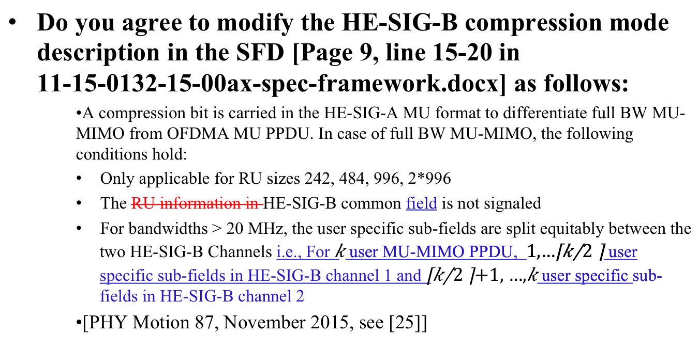
PHY Motion #143
Move
Mobe: Kaushik Josiam
Second: Ron Porat
Y/N/A
Accepted with no objection
DCN : 11-16/0349r1 SP Result: 43/0/3

Slide 48
PHY Motion #144
Move to modify the current SFD as following
  The L-SIG, RL-SIG, HE-SIG-A and HE-SIG-B fields are always transmitted with same total power per tone as L-LTF field (in cases when L-LTF is not being boosted). The L-STF has the same total power as the L-LTF
Move: Lei Wang
Second: Ron Porat
Y/N/A
Accepted with no objection
DCN: 11-16/0367 SP: 44/0/3

Slide 49
PHY Motion #145
Move to add to the spec framework that
The tones used for channel feedback shall be a subset of the sets given below:
NDP bandwidth 20 MHz:
Ng = 4 → [-120:4:-4, 4:4:120] + edge(±2,±122)
Ng = 16 → [-116:16:-4, 4:16:116] + edge(±2,±122)
NDP bandwidth 40 MHz:
Ng = 4/16 → [-244:Ng:-4, 4:Ng:244]
NDP bandwidth 80 MHz:
Ng = 4/16 → [-500:Ng:-4, 4:Ng:500]
Move: Sriram Venkateswaran Second: Ron Porat Y/N/A
Accepted with no objection
DCN:11-16/0389 SP result: 43/0/4

Slide 50
PHY Motion #146
Move to add to the spec framework that
  2X HE-LTF sequence shall be the only mandatory mode for NDP. 4X HE-LTF shall not be supported in NDP.
Move: Sriram Venkateswaran
Second: Ron Porat
Y/N/A
Accepted with no objection
DCN:11-16/0389 SP Results: 39/0/4

Slide 51
PHY Motion #147
Move to add to the spec framework that
  The NDP always has extension of 4uS
  The NDP shall support the CP values 0.8 us and 1.6 us
Move: Sriram Venkateswaran
Second: Ron Porat
Y/N/A
Accepted with no objection
DCN: 11-16/0389 SP Result: 40/0/2

Slide 52
PHY Motion #148
Move to add to the spec framework that
  AP can request beamforming feedback over partial BW which is less than the NDP BW. The indication of the feedback BW goes in NDPA.
Move: Sriram Venkateswaran
Second: Ron Porat
Y/N/A
Accepted with no objection
DCN: 11-16/0389 SP Result: no objection

Slide 53
PHY Motion #149
Move to add to the spec framework that
  The granularity of channel feedback requested by the AP is a 26 tone RU. The AP signals start and end 26 tone RUs requested for feedback.
Move: Sriram Venkateswaran
Second: Ron Porat
Y/N/A
Accepted with no objection
DCN: 11-16/0389 SP Result: no objection

Slide 54
PHY Motion #150
Move to add to the spec framework that
  The max Nc for sounding feedback that a BFee can support shall be negotiated through a capability exchange at association
Move: Sriram Venkateswaran
Second: Ron Porat
Y/N/A
Accepted with no objection
DCN: 11-16/0389 SP Result: no objection

Slide 55
PHY Motion #151
Move to add to the spec framework that
  AP shall control the Ng, quantization, and Nc of the sounding FB in NDPA except in the special case of a NDPA addressed to a single STA which requests SU type feedback. In the aforementioned special case, the STA controls these quantities.
Move: Sriram Venkateswaran
Second: Ron Porat
Y/N/A
DCN: 11-16/0389 SP Result: no objection

Slide 56
PHY Motion #152
Move to add to the spec framework that
  A channel quality indicator only (CQI-only) feedback (exact metric TBD) will be supported by the sounding protocol in 11ax. The request for CQI-only feedback goes in NDPA.
Move: Sriram Venkateswaran
Second: Ron Porat
Y/N/A
Accepted with no objection
DCN: 11-16/0389 SP Result: No objection

Slide 57
PHY Motion #153
Move to add the following text into 11ax SFD
  3.1 General
  The non-contiguous channel bonding will be supported in 802.11ax by:
    Transmitting using OFDMA PPDU format by nulling the tones of one or more secondary channels in 80 MHz and 160 (80+80) MHz;
    Modes for non-contiguous channel bonding are TBD;
    Non-contiguous channels within primary or secondary 80 MHz only exists at AP side.
    Signaling for non-contiguous channel bonding is contained in BW subfield of HE-SIG-A and/or HE-SIG-B. Details are TBD.
Move: John Son Second: Greg Ko
Y/N/A: 40/14/31 → Motion fails
DCN: 11-16/0397 SP Result: 10/2/many

Slide 58
PHY Motion #154
Move to add the following text to the IEEE 802.11ax SFD
  UL pre-HE-STF preamble is sent only on the 20MHz- CH(s) where the HE modulated fields are located.
    The UL pre-HE-STF preamble includes legacy preamble, RL-SIG and HE-SIG-A and HE modulated fields refer to HE-STF, HE-LTF and data fields.
Move: Ming Gan
Second: Yunbo Li
Accepted with no objection
Y/N/A
DCN: 11-16/0395 SP Result: 38/0/7

Slide 59
MAC Motion #67
Move to add the following text to 11ax SFD:
  A HE STA can announce its maximum A-MPDU length limits to 2²¹ or 2²²
Move: Liwen Chu
Second: Simone Merlin
Y/N/A
Accepted with no objection
DCN:11-16/0358 SP Result: 29/0/13

Slide 60
MAC Motion #68
Move to add to the 11ax SFD
  the recipient indicates the maximum number of TIDs of the MPDUs that the originator can aggregate in a multi-TID A-MPDU in MU PPDU
Move: Robert Stacey
Second: Simone Merlin
Y/N/A
Accepted with no objection
DCN: 11-16/0362 SP Results: 38/0/11

Slide 61
MAC Motion #69
Move to add to the 11ax SFD
  Within a single A-MPDU containing MPDUs with different value of TIDs, the MPDUs with the same TID value are not required to be in contiguous A-MPDU subframes
Move: Robert Stacey
Second: Simone Merlin
Y/N/A
Accepted with no objection
DCN: 11-16/0362 SP Results: 33/0/10

Slide 62
MAC Motion #70
Move to add to the SFD the definition of a variant of the Compressed BA frame format with a 256-bits BA Bitmap field
Move: Simone Merlin
Second: George Cherian
Y/N/A
Accepted with no objection
DCN: 11-16/0378r1 SP Result: 42/0/7

Slide 63
MAC Motion #71
Move to add to the SFD:
  Reserved bit(s) in Fragment Number field are used to indicate the length of the BA Bitmap within the same BA Information field
Move: Simone Merlin
Second: George Cherian
Y/N/A
Accepted with no objection
DCN:11-16/0378r1 SP Result:37/1/7

Slide 64
MAC Motion #72
Move to add the following text into the SFD
  The spec shall define a length indication of Block Ack Bitmap subfield included in Fragment Number subfield of the Block Ack Starting Sequence Control field for a multi-STA BA frame, if the Block Ack Bitmap and the Block Ack Starting Sequence Control subfields are present.
Move: Dengyu Qiao
Second: Simone Merlin
Accepted with no objection
DCN: 11-16/0404 SP Result:36/0/5

Slide 65
MAC Motion #73
Move to insert into the 802.11ax SFD
  “The RA field of a Multi-STA BA for a single STA should be set to the MAC address of that STA.”
Move: Xiaofei Wang
Second: Kome Oteri
Y/N/A
Accepted with no objection
DCN:11-16/0365r1 SP Result: 7/0/28

Slide 66
MAC Motion #74
Do you support to add to SFD
9.3.1.23 Trigger frame
Use 8 bits to signal the RU allocation for each STA in per user info field of Trigger frame.
  The first bit indicates the allocated RU is located in the primary or non-primary 80MHz.
  The mapping of the subsequent 7 bits indices to the RU allocation is defined in the table below.

Slide 67
7 bits indices | Message | Number of entries
0000000 ~ 0100100 | Possible 26 RU cases in 80MHz | 37
0100101 ~ 0110100 | Possible 52 RU cases in 80MHz | 16
0110101 ~ 0111100 | Possible 106 RU cases in 80MHz | 8
0111101 ~ 1000000 | Possible 242 RU cases in 80MHz | 4
1000001 ~ 1000010 | Possible 484 RU cases in 80MHz | 2
1000011 | 996 RU cases in 80MHz | 1
1000100 | 160MHz/80+80MHz case | 1
Total |  | 69
Move: Yunbo Li
Second: Simone Merlin
Y/N/A
Accepted with no objection
DCN:11-16/0383r0 SP Result: 28/0/6

Slide 68
MAC Motion #75
Move to add to the SFD
  the draft specification shall specify that when a Trigger needs to be padded to allow sufficient UL PPDU transmission preparation time, the padding shall be at the MAC layer and the padding shall not include an FCS
Move: Matt Fischer
Second: Simone Merlin
Y/N/A
Accepted with no objection
DCN:11-16/0368r1 SP Result: 44/0/10

Slide 69
MAC Motion #76
Move to add to the SFD:
  The draft specification shall specify that M-BA/BA/ACK may be aggregated with a trigger frame in an A-MPDU without accompanying Data
Move: Matt Fisher
Second: Simone Merlin
Y/N/A
Accepted with no objection
DCN:11-16/0369r1 SP Results: 48/0/2

Slide 70
MAC Motion #77
Move to add to SFD
  The ACK Policy of the QoS data frame(s) sent in an HE trigger-based PPDU shall be set to 00 (Normal Ack or Implicit BAR) when the QoS data frame requires to be acknowledged (i.e., the Ack Policy cannot be set to 11 (Block Ack)).
Move: Jeongki Kim
Second: Simone Merlin
Y/N/A
Accepted with no objection
DCN: 11-16/0361r0 SP Result: 37/0/7

Slide 71
MAC Motion #78
Move to add to the SFD:
  An HE STA specifies the following parameters related to fragmentation:
  Minimum Fragment Size: The minimum payload size for the first fragment of an MSDU supported by the STA
    Possible values: 128, 256, 512, Unspecified/No Limit
  Maximum Number of F-MSDUs: The maximum number of fragmented MSDUs/MMPDUs that can be concurrently received by the STA
    Possible values: 1, 2, 4, 8, 16, 32, Unspecified/No Limit
    Note: Whether the counter is per <RA, TA> or per <RA, TA, TID> is currently TBD.
Move: Alfred Asterjadhi Second: Simone Merlin – accepted with no objection
DCN:11-16/0347r0 SP Result:25/0/8

Slide 72
MAC Motion #79
Move to add the following text to 11ax SFD:
  A value of 15 in the TID subfield in the Per STA Info field of the M-BA frame indicate the successful acknowledgement of a management frame that requires an immediate response and is carried in the soliciting A-MPDU
Move: Liwen Chu
Second: Simone Merlin
Y/N/A
Accepted with no objection
DCN: 11-16/0359 SP Result: 40/0/9

Slide 73
MAC Motion #80
Move to add to the SFD the following sounding sequence
      HE NDPA is addressed to 1 STA
Move: Simone Merlin Second: Jianhan Liu
Y/N/Y
Accepted with no objection
DCN:11-16/0377r1 SP Result: 46/0/4
HE
NDPA
HE
NDP
SU PPDU
CSI From HE STA
SIFS
SIFS

Slide 74
MAC Motion #81
Move to replace the sounding sequence figure in SFD section 4.6 with following one
  NDPA addressed to multiple STAs
  Move: Simone Merlin Second: George Cherian
  Accepted with no objection
  DCN: 11-16/0377r1 SP Result: 42/0/3
HE
NDPA
HE
NDP
Trigger
UL TRIG PPDU
CSI From HE STAs
Trigger
UL TRIG PPDU
CSI From HE STAs
SIFS
SIFS
SIFS
SIFS
SIFS
0..N times

Slide 75
MAC Motion #82
Move to add to the TG Specification Framework document
  Spec shall define a mechanism to protect TWT SP.
  A TWT requesting STA sets the TWT Protection subfield to 1 in TWT Request frame to request the AP to provide protection of the set of TWT SPs using a NAV protection mechanism defined in 802.11ax (e.g. (MU)RTS/CTS or CTS-to-self, etc)
Move: Jinsoo Ahn Second: Woojin Ahn
Accepted with no objection
DCN:11-16/0353 SP Result: 8/2/37

Slide 76
MAC Motion #83
Move to add the following AID assign rule to the IEEE 802.11ax SFD:
The AP may send a TBD IE that includes a field 'N‘. If the value indicated by the field N is greater than 0, then the AP shall allocate AIDs according to the formula
  The TBD IE contains the number of partial BSS color bits used and the partial BSS color bits
Move: Jianhan Liu Second: Simone Merlin
Accepted with no objection
DCN:11-16/0364r3 SP Result: 57/0/13

Slide 77
MU Motion #47
Move to add following text in SFD
  A non-AP STA that is UL MU-MIMO Tx capable shall support DL MU-MIMO Rx
Move: Joonsuk Kim
Second: Reza Hedayat
Y/N/A
Accepted with no objection
DCN: 11-16/0066r5 SP Result: 67/0/12

Slide 78
MU Motion #48
Move to add following text in SFD
  A non-AP STA that is UL OFDMA Tx capable shall support DL OFDMA Rx
Move: Joonsuk Kim
Second: Reza Hedayat
Y/N/A
Accepted with no objection
DCN:11-16/0066r5 SP Result: 66/0/9

Slide 79
MU Motion #49
Move to add the following to the TGax SFD
In an HE trigger-based PPDU transmission, a power pre-correction mechanism is needed.
Move: Kome Oteri
Second: Allan Jones
Y/N/A
Accepted with no objection
DCN: 11-16/0331r2 SP Result: 32/0/4

Slide 80
MU Motion #50
Move to add the following to the TGax SFD
The power control mechanism shall be flexible enough to allow for scheduling both class A and class B devices in the same HE trigger-based PPDU transmission.
Move: Kome Oteri
Second: Allan Jones
Y/N/A
Accepted with no objection
DCN: 11-16/0331r2 SP Result: 34/0/1

Slide 81
MU Motion #51
Move to add the following to the TGax SFD
In a DL HE-MU-PPDU, the AP may set different transmit powers for different resource units.
Move: Kome Oteri
Second: Allan Jones
Y/N/A
Accepted with no objection
DCN: 11-16/0331r1 SP Result: 17/0/13

Slide 82
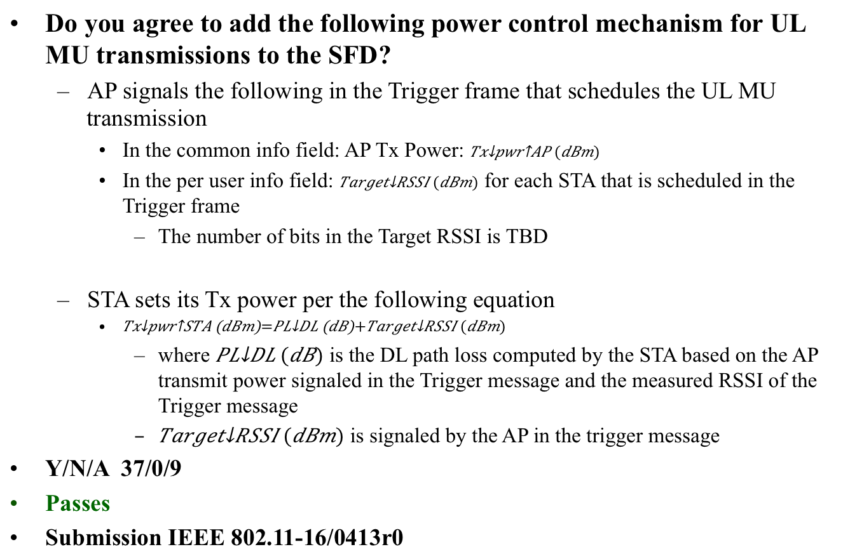
MU Motion #52
Move: Arjun Bharadwaj Second: Kaushik Josiam → accepted with no objection Y/N/A
DCN:11-16/413r0 SP Result: 37/0/9

Slide 83
MU Motion #53
Move to add the following text to the SFD
  STAs that participate in HE trigger-based PPDU transmit the power headroom in triggered UL MU transmissions to assist in the AP’s MCS selection
    Details of STA headroom definition are TBD
Move: Arjun Bharadwaj
Second: Kaushik Josiam
Y/N/A
Accepted with no objection
DCN: 11-16/413r0 SP Result: 35/0/7

Slide 84
MU Motion #54
Move to add the following text to the SFD
  STAs that participate in HE trigger-based PPDU shall support +/-3dB Relative Tx power requirements for Class B devices.
    Relative Tx power accuracy is defined as the accuracy of the change of the transmit power in consecutive UL MU transmissions
Move: Arjun Bharadwaj
Second: Kaushik Josiam
Y/N/A
Accepted with no objection
DCN:11-16/0413r0 SP Result: 29/1/7

Slide 85
MU Motion
Move to add the following text to the SFD
  STAs that participate in HE trigger-based PPDU transmit the power headroom in triggered UL MU transmissions to assist in the AP’s MCS selection
    Details of STA headroom definition are TBD
Move: Arjun Bharadwaj
Second:
Y/N/A
DCN:11-16/0413 SP Result: 35/0/7

Slide 86
MU Motion #55
Move to amend the Trigger Frame format in the SFD as shown in document IEEE802.11-16/0379r0
Move: Simone Merlin
Second: George Cherian
Y/N/A
Accepted with no objection
DCN: 11-16/0379r0 SP Result: 27/0/2

Slide 87
SR Motion #6
Move to add to SFD
  Include the “SR_allowed” signaling in HE-SIGA to indicate whether SR operation is allowed or not.
    use a value of Spatial Reuse field to indicate SR is disallowed
    The conditions to disallow SR are TBD
Move: Yunbo Li
Second: Yanchun Li
Y/N/A
Accepted with no objection
DCN: 11-16/0382r0 SP Result: 21/0/17

Slide 88
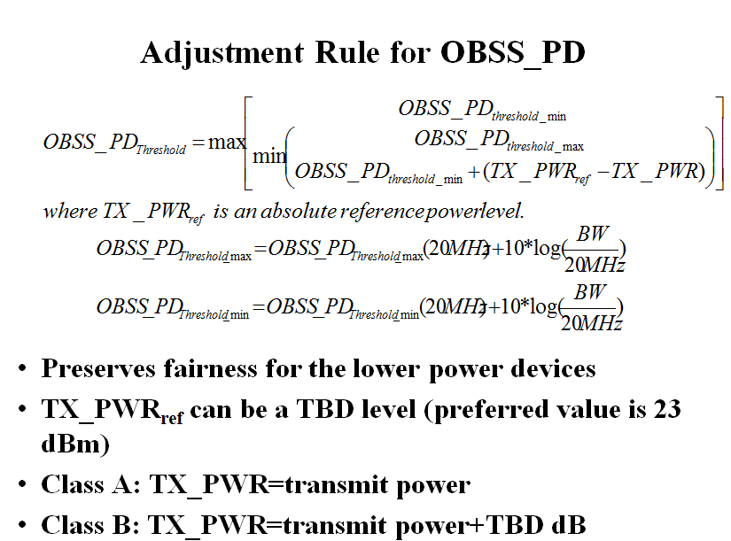
SR Motion #7
Do you support to replace the text in 5.1 of SFD P35L1“and a reduction in the TXPWR may be accompanied by an TBD increase in the OBSS_PD threshold value" with the “following adjustment rules:

Slide 89
Move: Jianhan Liu
Second: Ron Porat
Y/N/A
51/3/24 → Motion Passes
DCN: 11-16/0414r0 SP Result: 22/1/8

Slide 90
Timeline Update
May 2014
HEW TG (IEEE 802.11ax)
Nov 2014 First TG SFD draft was approved
January 2016 Proposed TG Draft
SeptemberNovember 2016
Draft 1.0
WG LB
March 2017
Draft 2.0
Recirculation
March 2019
Publication
March 2016 Draft 0.1 Approval and start of comment collection
May 2013
HEW SG

Slide 91
Goals for May 2016
Comment Resolution
Technical Presentation.

Slide 92
Conference call times
Thursday April 14/28 10:00 – 12:00 ET
Thursday April 21, May 5 20:00 – 22:00 ET

Slide 93
Other Business
PHY Motion #155
Move to modify the SFD as follows:
There are only three pre-HE-STF preamble format definition
  SU Format(mandatory)/Trigger based UL
  MU format (mandatory)
  Extended range SU format (mandatory)
Move: David Yang Second: Ross Jian Yu
Results: 49/4/23
Motion Passes

