Slide 1
TG ax
Enterprise Scenario, Color and DSC
Date: 2016-03
Authors:

Slide 2
Background
The Enterprise scenario uses four 80MHz channels.
Estimating the relative signal strengths between the APs, APs and STAs and STAs can indicate what to expect with respect to OBSS
Color and DSC are then added to investigate spatial reuse.
Similarly, 9 channel re-use is examined.

Slide 3
Topography
STAs

Slide 4
4 Channel re-use

Slide 5
Interference UL
Most susceptible

Slide 6
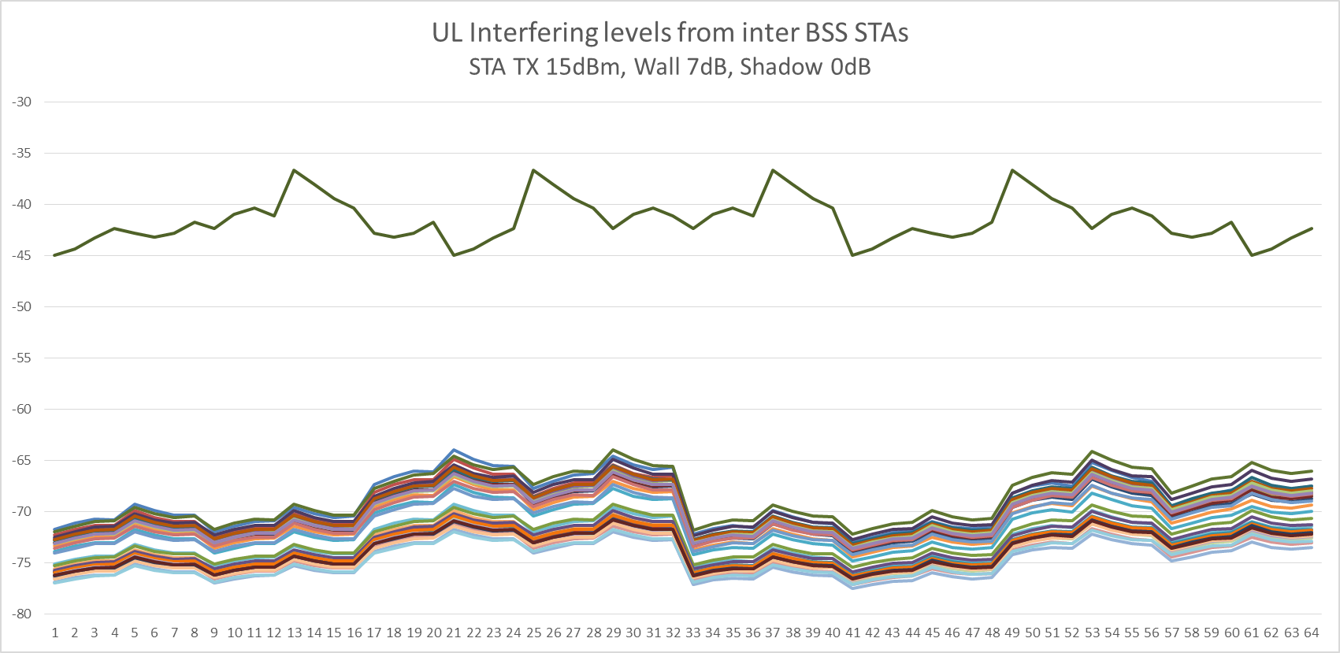
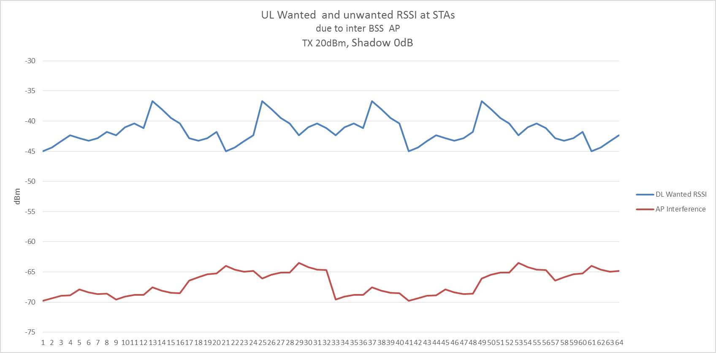
No Shadowing
Wanted signal at each STA (64)
Of all 4096 combinations
Only 6 have SNIR < 20dB
Unwanted signal at each STA from inter BSS STAs (64)
Note that difference between strongest to weakest UL wanted RSSI is only 8dB.
Wanted signal at each STA (64)
Of all 64 combinations
Only 2 have SNIR < 20dB
Unwanted signal at each STA from BSS AP

Slide 7
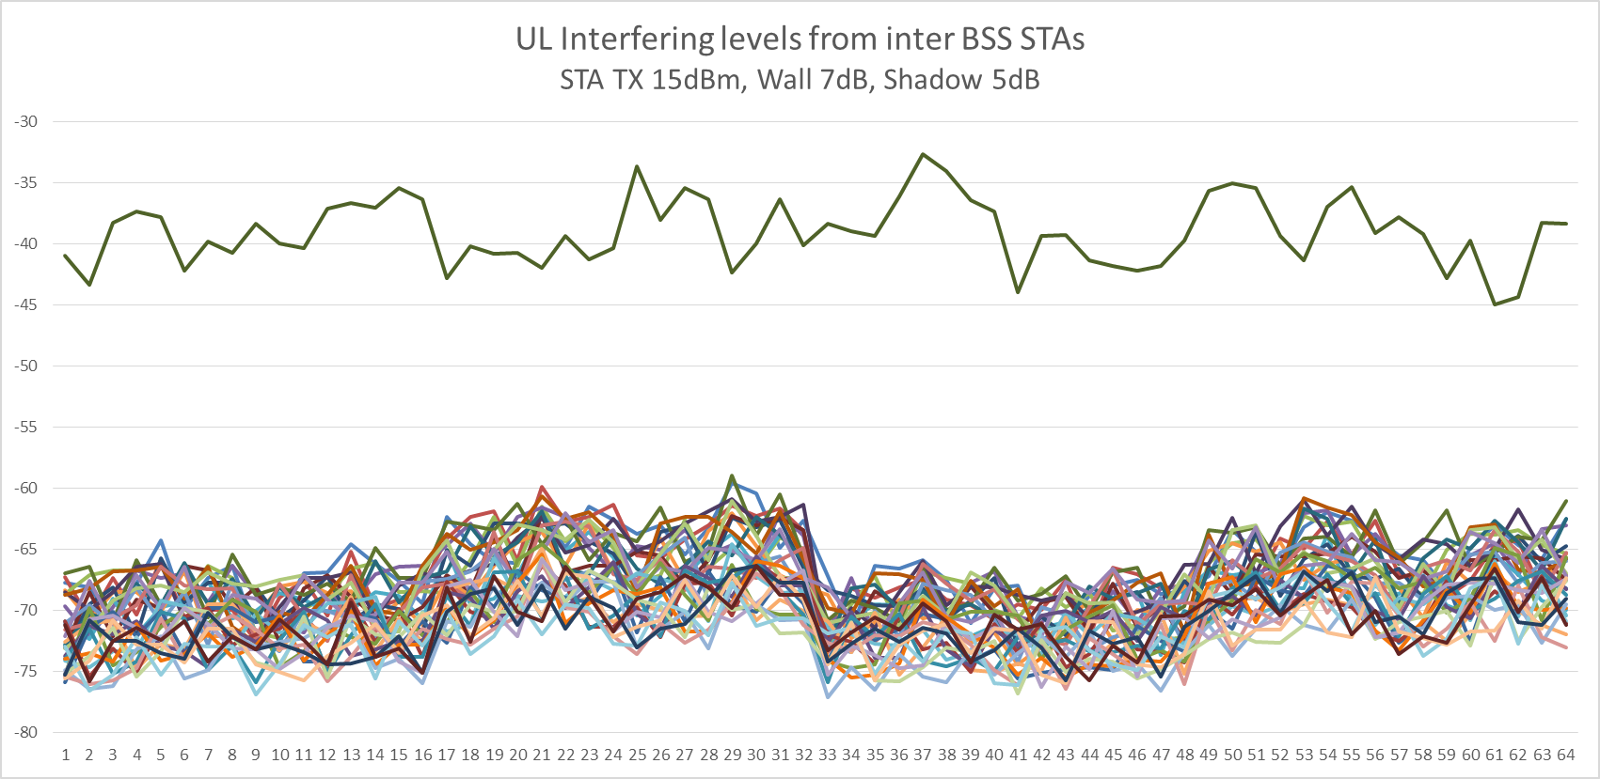
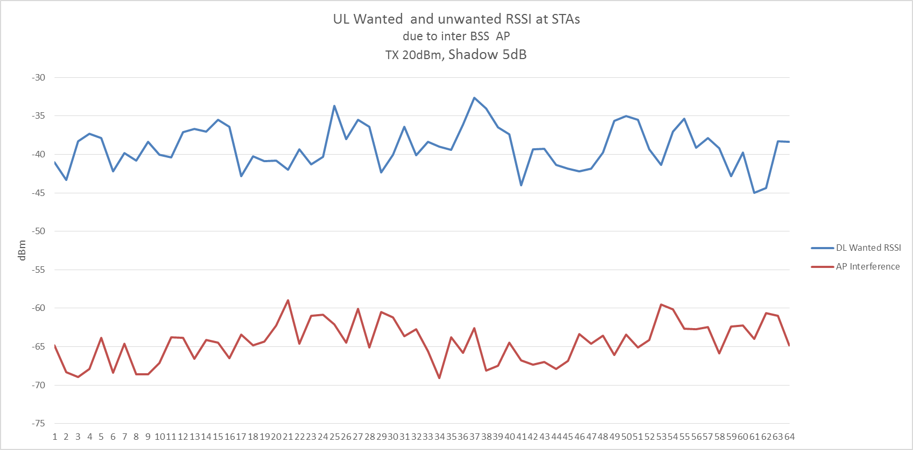
With 5dB Shadowing
Wanted signal at each STA (64)
Of all 4096 combinations
33 have SNIR < 20dB
(varied 14 - 50)
Unwanted signal at each STA from inter BSS STAs (64)
Wanted signal at each STA (64)
Of all 64 combinations
5 have SNIR < 20dB
(varied 3 -7)
Unwanted signal at each STA from BSS AP

Slide 8
Interference DL

Slide 9
Interference DL due to inter BSS STAs

Slide 10
Interference DL due to inter BSS AP

Slide 11
4CH Signal Summary
AP TX 20dBm, STA TX 15dBm, Wall 7dB, Shadow 5dB
UL Traffic
Interference from inter BSS STAs, 4096 combinations
  6 to 50 links <20dB SNIR
Interference from inter BSS AP, 64 combinations
  2 to 7 links <20dB SNIR
DL Traffic
Interference from inter BSS STAs, 4096 combinations
  88 to 490 links <20dB SNIR
Interference from inter BSS AP, 64 combinations
  26 to 39 links <20dB SNIR (36 no shadowing, )
Under legacy conditions, ALL 4096 and 64 combinations SHARE,
Note that inter-STA interference <2% UL actually overlap, ~10% DL
BUT ~ 50% interference from AP to AP on DL

Slide 12
Using DSC or Color should improve OBSS performance in this particular scenario and improve the TOTAL throughput somewhat.
What if we also change the settings slightly?
  STA TX is 15dBm, what if it was 18dBm?
  Wall loss is 7dB, what if it was 3dB?
  BOTH are quite legitimate possibilities.
  Next slides show that the OBSS changes significantly.

Slide 13
4CH Signal Summary
AP TX 20dBm, STA TX 18dBm, Wall 7dB, Shadow 5dB
UL Traffic
Interference from inter BSS STAs, 4096 combinations
  100 to 250 links <20dB SNIR (cf 6-80)
Interference from inter BSS AP, 64 combinations
  2 to 11 links <20dB SNIR (cf 2-7)
DL Traffic
Interference from inter BSS STAs, 4096 combinations
  88 to 400 links <20dB SNIR (cf 88-490)
Interference from inter BSS AP, 64 combinations
  4 to 14 links <20dB SNIR (cf 26-39)

Slide 14
4CH Signal Summary
AP TX 20dBm, STA TX 15dBm, Wall 3dB, Shadow 5dB
UL Traffic
Interference from inter BSS STAs, 4096 combinations
  190 to 400 links <20dB SNIR (cf 6-80)
Interference from inter BSS AP, 64 combinations
  20 to 28 links <20dB SNIR (cf 2-7)
DL Traffic
Interference from inter BSS STAs, 4096 combinations
  1424 to 1634 links <20dB SNIR (cf 88-490)
Interference from inter BSS AP, 64 combinations
  50 to 60 links <20dB SNIR (cf 26-39)
Very susceptible to wall loss!

Slide 15
4CH Signal Summary
AP TX 20dBm, STA TX 18dBm, Wall 3dB, Shadow 5dB
UL Traffic
Interference from inter BSS STAs, 4096 combinations
  768 to 1046 links <20dB SNIR (cf 6-80)
Interference from inter BSS AP, 64 combinations
  19 to 31 links <20dB SNIR (cf 2-7)
DL Traffic
Interference from inter BSS STAs, 4096 combinations
  1340 to 1740 links <20dB SNIR (cf 88-490)
Interference from inter BSS AP, 64 combinations
  37 to 45 links <20dB SNIR (cf 26-39)

Slide 16
What does this tell us?
This investigation shows the amount of OBSS, and how it changes with shadowing and slight changes in settings.
We can use this to check simulation results as we can see the amount of interference that is present.
Under legacy CCA conditions, all STAs and APs are SHARING.
Now we look at how DSC and Color work.
  How close to two independent networks do we get?

Slide 17
DSC and Color
DSC
  STA measures the Beacon signal (wanted DL signal) and sets effective CCA Threshold 20dB lower. (DSC Margin = 20dB)
  AP sets its effective CCA level at 10dB below the lowest received wanted signal.
Color
  STA/AP looks at color bits in preamble to determine if signal is from same or inter BSS.
  If not same BSS, ignore signal.
  (A variation is to only reject if the inter BSS signal is lower than a set threshold)
“Blocked” and “Share” terminology
“Blocked” – Transmission allowed when SNIR < 20dB, then both signals fail.
“Share” – Transmission prevented when SNIR < 20dB, standard contention.

Slide 18
DSC and Color results 4CH – example A
Using a Color threshold can
Result in over protection
Simply reject and correct signals
are blocked, but works.
Color and DSC same result
for DL.
Signals are blocked.
DSC gets it right
And shares OBSS signals

Slide 19
DSC and Color results 4CH – example B
Using a Color threshold can
Result in over protection
Simply reject and correct signals
are blocked but works.
Color and DSC same result
for DL.
Signals are blocked.
DSC gets it right
And shares OBSS signals

Slide 20
DSC and Color Results Comparisons
DSC DL
  “Dynamic” is in use and each STA sets its own effective CCA level (in this scenario STAs are static, but allows for mobility)
  In every case, signals “Share” when the SNIR is <20dB
Color UL
  Setting or finding a threshold level may be a challenge if trying to “share” rather than “block”
  Simplest, and best(?) is to ignore OBSS signal level. BUT result is that this results in blocking.
DSC and Color DL
  Exactly same results.
  DSC AP could adjust its effective CCA according to latest UL signal from the STA but marginal (if any) improvement in this scenario as AP to AP interference is high.

Slide 21
Why we are at it, let’s look at the 9CH case
Under legacy conditions, still 100% overlap,
With color or DSC, two totally independent networks

Slide 22
9 Channel Re-Use

Slide 23
DSC and Color results 9CH – example A
Totally independent networks

Slide 24
DSC and Color results 9CH – example B
Almost totally
independent networks

Slide 25
DSC or Color?
Color
  Provides improved OBSS performance UL and DL
  Will block UL and DL ‘overlapping’ packets rather than share.
  Only works if ALL STAs and APs in OBSSs have the feature
  Will NOT work with legacy OBSS STAs and/or AP.
  Relies on the OTHER DEVICES having the feature as well
DSC
  Provides improved OBSS performance UL and DL
  Shares ‘overlapping’ packets UL, blocks DL
  Works with OBSS legacy STAs and/or legacy AP
    Results presented are for the ‘wanted’ BSS, other BSS can be legacy.
  DSC is implemented by the STA, can be independent

Slide 26
Discussion
Both Color and DSC provide improvements in SR
Color will not work until ALL STA/APs have the feature
  Color is already in the 11ax SFD
DSC works and presents a good incentive for a vendor to adopt. Does not rely on other STAs having it.
DSC is in the SFD?
    “The amendment shall include one or more mechanisms to improve spatial reuse by allowing adjustments to one or more of the CCA-ED, 802.11 Signal Detect CCA, OBSS_PD or TXPWR threshold values. The constraints on selecting threshold values are TBD”
  As the threshold value setting is TBD, is present SFD text sufficient to allow DSC text to be proposed/accepted? DSC proposes a specific (dynamic) method to select the threshold value.

Slide 27
Conclusion
DSC is a simple but powerful scheme that increases Spatial Reuse.
Improvements using DSC do not rely on all devices having DSC.
STRAW POLL
Text describing DSC may be considered for inclusion into the 11ax Amendment.
Y/N/A

