Slide 1
Signalling Support for Full Bandwidth MU-MIMO Compressed SIG-B Mode
Date: 2016-02-10
Authors:

Slide 2
Background
Full bandwidth MU-MIMO compressed SIG-B in SFD [1]
  A compression bit is carried in the SIG-A MU format to differentiate full BW MU-MIMO from OFDMA MU PPDU. In case of full BW MU-MIMO, the following conditions hold:
    Only applicable for RU sizes 242, 484, 996, 2*996
    The RU information in SIG-B common is not signaled
    For bandwidths > 20 MHz, the user specific sub-fields are split equitably between the two SIG-B Channels
  In an HE MU PPDU the HE-SIG-A field shall indicate the number of STAs when full bandwidth MU-MIMO compressed SIG-B mode is indicated. Details are TBD.
This contribution addresses how to signal the number of STAs in SIG-A for full bandwidth MU-MIMO compressed SIG-B.

Slide 3
Background (cont.)
SIG-A signaling regarding SIG-B in the proposed TGax draft specification [2]
Field | Number of Bits | Description
SIGB MCS | 3 | Indication the MCS of SIG-B. Set to “000” for MCS0 Set to “001” for MCS1 Set to “010” for MCS2 Set to “011” for MCS3 Set to “100” for MCS4 Set to “101” for MCS5
SIGB DCM | 1 | Set to 1 indicates that the SIG-B is modulated with dual sub-carrier modulation for the MCS. Set to 0 indicates that the HE-SIB-B is not modulated with dual sub-carrier modulation for the MCS.
SIGB Number Of Symbols | 4 | Indicates the number of SIG-B symbols.
SIGB Compression | 1 | Set to 1 for full BW MU-MIMO. Set to 0 otherwise.
Only a few SIG-A bits for a DL MU PPDU are unused [2]
  Total SIG-A bits: 52
  Used SIG-A bits: 39 + TBD (Spatial Reuse) + TBD (TXOP Duration)

Slide 4
Possible Compressed SIG-B Structures
  $$N_{uss}=8$$
  $$N_{uss}=7$$
  $$N_{uss}=6$$
  $$N_{uss}=5$$
Note: The number of spatially multiplexed users in a DL or UL MU-MIMO transmission is up to 8 [1].

Slide 5
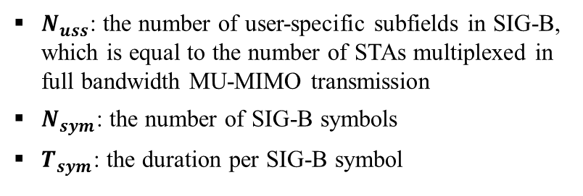



Possible Compressed SIG-B Structures (cont.)
  $$N_{uss}=4$$
  $$N_{uss}=3$$
  $$N_{uss}=2$$
$N_{uss}$: the number of user-specific subfields in SIG-B, which is equal to the number of STAs multiplexed in full bandwidth MU-MIMO transmission
$N_{sym}$: the number of SIG-B symbols
$T_{sym}$: the duration per SIG-B symbol

Slide 6
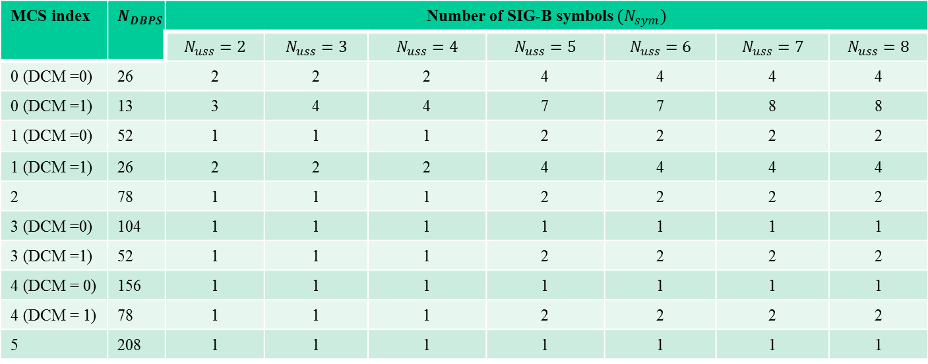
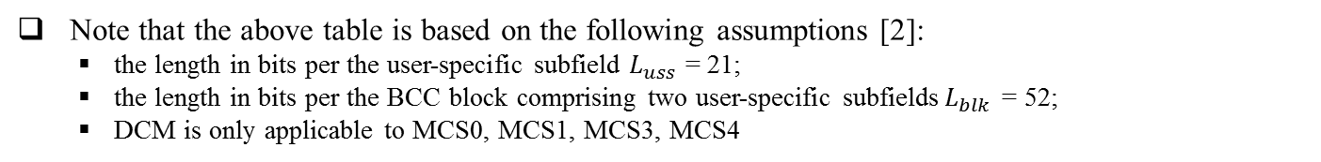
Number of SIG-B Symbols for Compressed SIG-B
For compressed SIG-B, the number of SIG-B symbols depends on the MCS of the SIG-B and the number of STAs multiplexed in full bandwidth MU-MIMO transmission
MCS index | $$N_{DBPS}$$ | Number of SIG-B symbols $(N_{sym})$
 |  | $$N_{uss}=2$$ | $$N_{uss}=3$$ | $$N_{uss}=4$$ | $$N_{uss}=5$$ | $$N_{uss}=6$$ | $$N_{uss}=7$$ | $$N_{uss}=8$$
0 (DCM =0) | 26 | 2 | 2 | 2 | 4 | 4 | 4 | 4
0 (DCM =1) | 13 | 3 | 4 | 4 | 7 | 7 | 8 | 8
1 (DCM =0) | 52 | 1 | 1 | 1 | 2 | 2 | 2 | 2
1 (DCM =1) | 26 | 2 | 2 | 2 | 4 | 4 | 4 | 4
2 | 78 | 1 | 1 | 1 | 2 | 2 | 2 | 2
3 (DCM =0) | 104 | 1 | 1 | 1 | 1 | 1 | 1 | 1
3 (DCM =1) | 52 | 1 | 1 | 1 | 2 | 2 | 2 | 2
4 (DCM = 0) | 156 | 1 | 1 | 1 | 1 | 1 | 1 | 1
4 (DCM = 1) | 78 | 1 | 1 | 1 | 2 | 2 | 2 | 2
5 | 208 | 1 | 1 | 1 | 1 | 1 | 1 | 1
Note that the above table is based on the following assumptions [2]:
  the length in bits per the user-specific subfield $L_{uss}$ = 21;
  the length in bits per the BCC block comprising two user-specific subfields$L_{blk}$ = 52;
  DCM is only applicable to MCS0, MCS1, MCS3, MCS4

Slide 7
Proposal
Use the SIGB Number of Symbols field in SIG-A to indicate the number of STAs instead of the number of SIG-B symbols when the SIGB Compression field sets to 1 (i.e., for full BW MU-MIMO compressed SIG-B mode)
    No extra signaling bit required
    Note: When the SIGB Compression field sets to 1, the number of SIG-B symbols can be calculated according to the values of the SIGB MCS field, the SIGB DCM field and the SIGB Number of Symbols field in SIG-A.
Field | Length (bits) | Description
SIGB Number Of Symbols | 4 | Indicates the number of SIG-B symbols if the SIGB Compression sets to 0; Otherwise indicate the number of STAs. Set to “0000” for 2 STAs Set to “0001” for 3 STAs Set to “0010” for 4 STAs Set to “0011” for 5 STAs Set to “0100” for 6 STAs Set to “0101” for 7 STAs Set to “0110” for 8 STAs

Slide 8
Straw Poll
Do you agree to made the following modifications on TGax SFD?
  In an HE MU PPDU the HE-SIG-A field shall indicate the number of STAs when full bandwidth MU-MIMO compressed SIG-B mode is indicated. Details are TBD. The SIGB Number of Symbols field in the SIG-A shall be used to indicate the number of STAs instead of the number of SIG-B symbols when full bandwidth MU-MIMO compressed SIG-B mode is indicated.
Y/N/A

Slide 9
References
[1] 11-15-0132-15-00ax-spec-framework
[2] 11-16-0024-00-00ax-proposed-draft-specification

