Slide 1
NGP Use Case Template
Date: 2016-01-19
Authors:
Revision 0: Merging 11-15-0388r2 and 11-16-0019r0

Slide 2
Abstract
This document is a proposed template to describe use cases, and some location requirements per use case, for Next Generation Positioning
In this initial version, only one sample use case is included. Additional use cases are expected to be added in future versions of this document
Location requirements are included with each use case to drive focus for the study group
The goal is to come up with a superset of everything potentially needed and then narrow down the field from there on

Slide 3
Terminology
User – The end entity (human) who would use this technology
Use case – A use case is task oriented. It describes the specific step by step actions performed by a user or device. One use case example is a user starting and stopping a video stream.
Environment – The type of place in which a network is deployed, such as home, outdoor, hot spot, enterprise, metropolitan area, etc.
Frequency bands of interest (FBoI): The 802.11 operating frequency bands relevant to this use case. Eg. for a shopping mall’s enterprise wireless it will be 2.4GHz and 5GHz
AP density: Density of AP deployment, e.g. APs deployed every 4000 sq.ft.
AP height: Height, above the floor, at which the APs are deployed, e.g. for shopping mall APs deployed approximately 15-25 ft above the floor
Key Location Requirement-
Expected Horizontal Accuracy: XY accuracy expected for the use case to succeed, <1m@90% is a requirement is that the computed location be within 1m horizontally of the actual location 90% of the time
Expected Vertical Accuracy: Z accuracy expected for the use case to succeed, “same floor@99%” is a requirement is that the computed location be on the same floor as the actual location 99% of the time. “0.5m@90%” is a requirement is that the computed location be within 0.5m vertically of the actual location 90% of the time
Expected Latency: Expected time taken to complete a single atomic location process. The location process begins with initiating a location request, then computing location, and ends with returning the computed location. E.g. 10 ms latency would indicate that it takes 10 ms after the request is transmitted to gather measurements, compute a location, and transfer any parameters such that the requester has a location within 10 ms.
Expected Refresh Rate: This defines how frequently is the computation expected when client moving. E.g. a refresh rate of 10 locations per second would indicate that location needs to be refreshed 10 times in a second
Expected number of simultaneous users

Slide 4
1. Micro location in store
User: Person with a smartphone which has the store app installed
Environment: A store has APs for 802.11 coverage. The store may have APs at the store entrance. The expected AP density is about 1 AP per 4000 sq. ft. with APs supporting HT, VHT and NGP
Use case:
The user enters the store with their phone
As soon as user enters, the phone notifies the user about the store promotions
The user can query details about a product on the app
The app and smartphone can then help the user navigate to the particular shelf containing the product
The user stands in queue and as they reaches the checkout counter, their loyalty number is brought up on the system
Expected:
Horizontal accuracy: <0.5 m@90%, vertical accuracy: same floor@99%
Latency: <500ms
Refresh Rate: > 1 location/sec

Slide 5
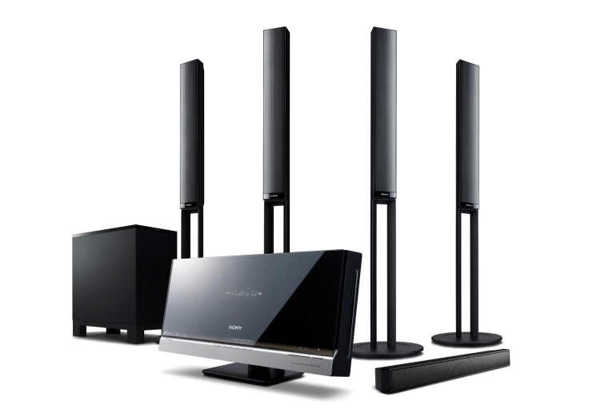
2. Positioning for Home Audio
Background: Advanced audio formats with immersive sound experience require exact position estimates of listener and speakers
User: Person with WLAN based home audio system
WLAN is employed for both sound transfer and positioning
Environment: Smart home with 802.11 coverage.
1 AP per floor supporting .11n, .11ac, and NGP
1 AP in close vicinity supporting .11ad, .11ay, and NGP
Optional: multiple APs from neighboring apartments
Use case “speaker system calibration”
The user installs his home audio system including various WLAN speakers
The speaker placement and position is automatically determined
The home audio system adjusts the speaker settings for best sound experience
Use case “follow-me sound”
The user has a wearable WLAN device
The device’s position is continuously monitored
The home audio system adjusts the speaker settings according to the user’s position and movement for immersive sound experience
In a simple case, the sound may only follow in neighboring rooms

Slide 6
2. Positioning for Home Audio (cont.)
Positioning requirements
The user may accept further APs for high fidelity
¹) orientation between wearable device and ear must be known (e.g. smart eyeglasses)
Use case | ”speaker system calibration” | “follow-me sound”
Horizontal accuracy | < 10cm @ 90% | same room @ 99% (simple)
 |  | < 50cm @ 90% (typ.)
 |  | < 10cm @ 90% (high fidelity) ¹
Vertical accuracy | not required | same floor @ 99% (simple)
 |  | < 50cm @ 90% (typ.) ¹
 | < 10cm @ 90% (high fidelity) | < 10cm @ 90% (high fidelity) ¹
Latency | < 10ms | < 10ms
Refresh rate | < 0.1 locations/s | > 2 … > 10 locations/s (depending on accuracy)
Exp. number of simultaneous users | 1 | <= 5

Slide 7
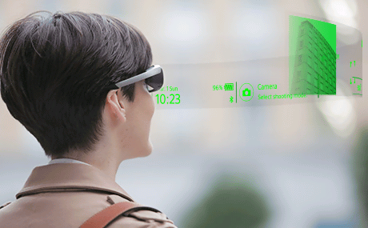
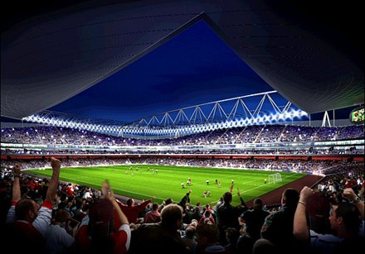
3. Navigation in Public Buildings
User: Person with smartphone, smart wear, smart eyeglasses with navigation app
Environment: Public building with 802.11 coverage. The expected AP environment is
1 AP per < 200 users or < 400m² / 4000 sq. ft.
APs support .11n, .11ac, .11ax, and NGP
Use case
The user enters a public building like stadium, concert hall, airport, museum, fair, parking deck
The smart device navigates the user to a particular seat, gate, point of interest, contact person, or empty parking spot

Slide 8
3. Navigation in Public Buildings (cont.)
Positioning requirements:
Horizontal accuracy: < 1m @ 90%
Vertical accuracy: same floor/tier @ 99%
Latency: < 250ms
Refresh rate: > 1 locations/s
Expected number of simultaneous users: < 1000 (within AP coverage area)
Impact on Network Bandwidth: low, the impact should be independent on the number of users

Slide 9
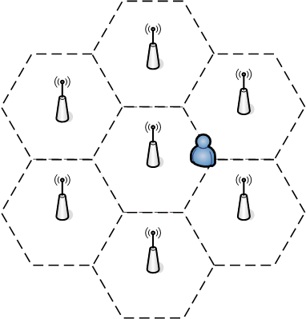
4. Positioning for Spectrum Management
User: Persons with a WiFi-device which has the corresponding app installed.
Environment: An areas (e.g. a large office, an university…) where there multi-APs for 802.11 coverage. The expected AP density is about 1 AP per TBD sq. ft. The APs providing data service to the STAs within their coverage supporting HT, VHT, DMG and NGP.
Use case:
The user enters the area with their WiFi-device.
As soon as user enters this area, the position of the user is determined through the NGP.
With the position information of the user, the APs can suggest the user which AP to associate with and which channel to use, a.k.a. the load balance process, which can greatly improve the user experience especially in high density case.
As the user travels in this area, the APs keep on tracking the position of the user. The traveling path of the user can help a lot in the hand over process, so the service(such as WiFi call, facetime etc.) is not interrupted when user is traveling.

Slide 10
4. Positioning for Spectrum Management(Cont’d)
Key Performance and Attributes:
Horizontal accuracy: <0.5 m@90%, vertical accuracy: same floor@99%
Latency: <500ms
Refresh Rate: > 1 location/sec

Slide 11
5. Positioning for Medical Applications
User: Patient under medical surveillance in a hospital or care home.
Environment: Building with 802.11 coverage. The expected AP environment is
1 AP per < 25 users or < 100m² / 1000 sq. ft.
APs support .11ac, .11ax, and .11az
Use case:
Patient is connected to a portable medical device with WLAN interface (e.g. heart rate monitor) which continuously monitors medical parameters.
When the patient moves around, his/her position is tracked and recorded.
If monitored medical parameters get severe, a nurse or a doctor is informed including the patient’s position for first aid assistance.
The medical parameters can be linked with an activity profile which is retrieved from the tracked data.
If the patient leaves a certain area, a nurse gets informed (fencing feature).
Positioning requirements:
Horizontal accuracy: < 1m @ 90%
Vertical accuracy: same floor @ 99.9%
Latency: < 200ms
Refresh rate: 1 locations/s
Expected number of simultaneous users: < 40 (within AP coverage area)
Impact on Network Bandwidth: low, the impact should be independent on the number of users

Slide 12
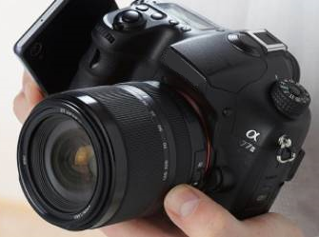
6. Indoor Geotagging
User: Person with digital camera, smart phone, tablet, or smart eyeglasses
Environment: Building (e.g. museum, exhibits, fair, restaurant) with 802.11 coverage. The expected AP environment is
1 AP per < 25 users or < 100m² / 1000 sq. ft. (large buildings)
1 AP per floor, optional: multiple APs from neighboring apartments (small buildings)
APs support .11ac, .11ax, and .11az
Use case:
Person takes a picture with a digital camera.
Digital camera estimates its position using .11az and tags the picture with its geolocation (like GPS geotagging for outdoor applications)
Positioning requirements:
Horizontal accuracy: < 1m @ 90%
Vertical accuracy: < 1m @ 90%
Latency: < 400ms
Refresh rate: < 1 locations/s
Expected number of simultaneous users: < 10 (within AP coverage area)
Impact on Network Bandwidth: low

Slide 13
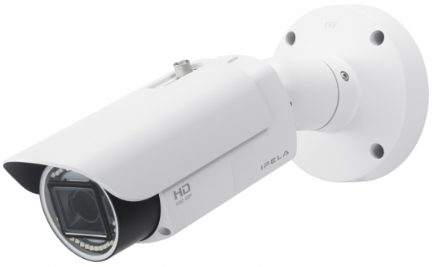
7. Positioning for Video Cameras
User: Enterprise (e.g. shop) installing video surveillance cameras with WLAN connection capability
WLAN is used for video transmission, camera control, and positioning of the camera
Environment:
Building with 802.11 infrastructure. The expected AP environment is
1 AP per < 10 cameras or < 100m² / 1000 sq. ft.
In some environments P2P is applied
APs and STAs support .11ac, .11ax and .11az
Use case:
A technician installs the surveillance cameras at arbitrary positions.
After the setup is done, each camera is triggered to determine its position.
The absolute (infrastructure) or relative (P2P) position is fed back to the control room, where the position of all cameras is denoted on a map of the building.
The camera position is crucial for a continuous tracking of moving persons (picture handover between cameras).
Positioning requirements:
Horizontal / Vertical accuracy: both < 1m @ 90% (infrastructure)
Distance / Angular accuracy: < 1m @ 90% / < 2° @ 90% (P2P)
Latency: < 1s
Refresh rate: < 1 locations/day
Impact on Network Bandwidth: as low as possible, video dominates

Slide 14
8. UAV Use Case Description
User: A person controlling a commercial/consumer-level drone, with the controller in his/her hands.
Environment: Indoor and outdoor environment where a commercial- or consumer-level drone is permitted to fly. There is no requirement for APs in the area, but both the drone and the controller need to equip with Wi-Fi.
Use case:
The user controls his/her drone with a controller using Wi-Fi.
The user defines an area (e.g. by defining the distance between the drone and the controller) that the drone should fly within;
The user controls the drone to move 30 degree to the left/right, with the same radius.
The user controls the drone to circle around him/her with the same radius (Orbit Mode - think of the user as a skier, biker or a surfer);
The user controls the drone to fly along a straight line, towards him/her (zoom in) or away from him/her (zoom out).
The user controls the drone to follow him/her at certain distance (Follow Mode)
Allan Zhu/Huawei Technologies

Slide 15
8. UAV Use Case Description (cont.)
Horizontal accuracy: <0.5 m@90%,
Vertical accuracy: <0.5m @90%
Angular accuracy: bearing error < TBD@90%
Latency: <10ms
The 3DRobotics Solo can reach top speed of 25m/s. An interval of 10ms translates to 0.25m
The DJI Inspire 1 can reach top speed of 22m/s. An interval of 10ms translates to 0.22m.
Refresh Rate: <10ms
This depends on the drone flying speed. For precise control, this can be made smaller.
Number of Simultaneous Users
1
Impact on the Wireless Network
No impact – The drone and the controller form their own network.
Allan Zhu/Huawei Technologies

Slide 16
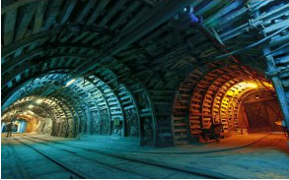
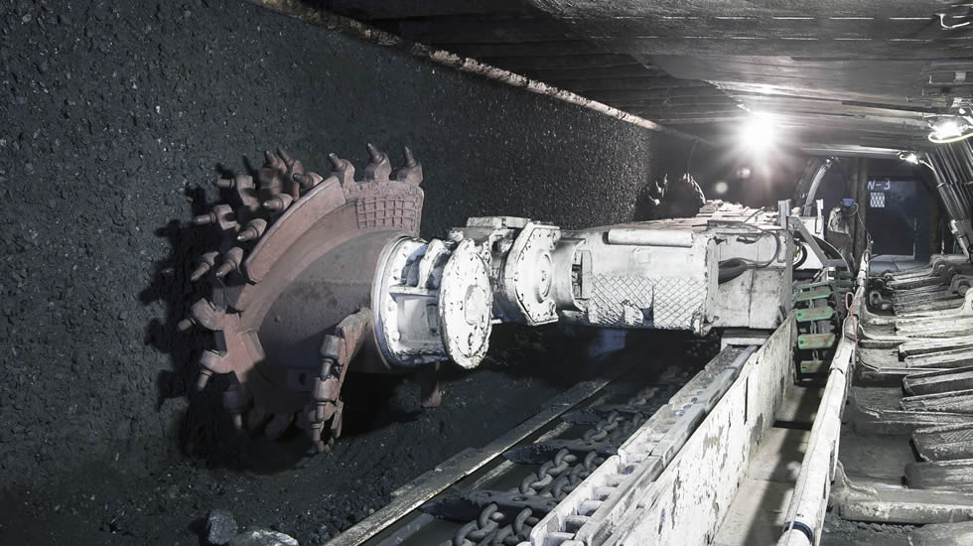
9. Location services of underground mining
User:
The mining administrator tracks the personnel and valuable assets underground.
The miners locate other personnel or equipment in the pits.
Automated vehicles are navigated to the specified position.
Mining machines use accurate under ground position information to make decision, for example, heading positioning of bucket-wheel excavator machines.
Environment: Underground mines use WiFi networks for data transmission and personnel, vehicle and asset tracking.
1 AP could cover 100~200 meters range
APs support 11n, ac, ax, ay, az
1 AP could support <50 STAs
Use case:
Mining administrator is alarmed that an underground machine is working abnormally.
Administrator locates the specific machine on the central control station
Administrator locates the engineer who is close to the machine and let him go to check.
The engineer locates the machine on the display of his handset and is guided to the position.
P2P cooperative positioning should be enabled to facilitate accurate positioning.

Slide 17
9. Location services of underground mining (cont)
Linear accuracy along a narrow tunnel
For personnel: <1m@90%
For digging/drilling heads: TBD
Horizontal accuracy with respect to local reference system (larger tunnels):
For personnel: <1 m@90%,
For digging/drilling heads: TBD
Vertical accuracy: correct layer@99% in the pits
Latency: <500ms
Refresh Rate: > 2-5 location/sec
Number of simultaneous users: < 30 per AP
Impact on Network Bandwidth: < 3 additional frames per device/location

Slide 18
10. Pipe/Vault Robot Positioning
User: companies which maintain the pipes
Environment: Pipe/vault is equipped with WiFi enabled sensors or APs. Pipe robots work in the pipes.
1 AP per < 10 users
Use case:
Pipe /vault robots go through the pipe to detect leakage or breakage. It may carry cameras and sensors to record the status of pipes and the environmental conditions.
When the robot detects a leakage or breakage point, it needs to locate the position and report the location to the AP directly or through wifi enabled sensors.
The robots may need to exchange location information to facilitate positioning when APs or sensors are out of range.
Positioning requirements:
Linear accuracy (metal and buried pipes): < 0.1m @ 90%
Latency: < 500ms
Refresh rate: > 1 location/sec
Expected number of simultaneous users: < 10 (within AP coverage area)
Impact on Network Bandwidth: very low

Slide 19
11. Nano Location in store
User: Person with a smartphone which has the store app installed
Environment: A store has APs for 802.11ad/ay coverage. The store has an AP on every isle
Use case:
The user is going around in the store with their phone
Phone location indicates whether the user is moving, or whether he stopped in front of some product
The AP determines that the user is facing a specific product, and can offer promotional ad for competition (e.g. Pepsi instead of Coca-Cola machine)
Locate specific item (e.g. specific size/model in clothes department)
Power consumption profile: foreground for positioning determination, background for positioning services discovery.
Operating mode: AP2STA
Usage duration: 1 hour (10 minutes of foreground activity).
Expected:
Horizontal + vertical accuracy: <1 cm@90%
Pointing angles (AZ, EL & Roll) accuracy: <10deg
Latency: <10ms, for motion estimation, <100ms for static estimation
Refresh Rate: 10-100Hz (same as GPS)

Slide 20
12. Augmented reality
User: High-end wearable devices
Environment: User wearing glasses with augmented reality features
Use case:
The user is wandering around, wearing glass with augmented reality features
Exact location of the glasses is used for exact augmentation at each eye, per location. Each door which is looked at, is supplemented with an image showing behind the door scene
Power consumption profile: foreground for positioning determination
Operating mode: AP2STA
Expected:
Horizontal + vertical accuracy: <1 cm@90%
Pointing angles (AZ, EL & Roll) accuracy: <2deg
Latency: <10ms: augmentation data is required to be tagged with the exact location
Refresh Rate: 0.5Hz-100Hz

Slide 21
13. Determine dynamic (conference) room setup
User: Presenters in a conference room
Environment: Conference room
Use case:
Determine and track the physical setup of the Laptops and Displays in the room, and make it available to the users in the room.
Use the setup to move windows or other display elements between different laptops display and the room displays
Expected:
Horizontal + vertical accuracy: <20 cm@90%
Pointing angles (AZ, EL & Roll) accuracy: < 20deg
Latency: <0.5s:
Refresh Rate: <2Hz
Number of users – up to 30 users, ≥3 APs

Slide 22
14. Proximity Detection
User: Any 60GHz device
Environment: Any environment
Use case:
The user connects the device to the other device.
Distance between devices is measured.
If the distance is less than a predefined distance (10cm -100cm) special medium access rules may be applied
For example – relaxed CCA requirements
Operating mode: STA2STA or AP2STA
Expected:
Ranging accuracy: <5 cm@90%
Pointing angles (AZ, EL & Roll) accuracy: <15deg (optional)
Latency: <200ms:
Refresh Rate: <2Hz

Slide 23
15. Determining Relative Location to Dock(s)
User: Person with a Laptop/Tablet looking for docking
Environment: Enterprise cubicle environment
Use case:
The user is walking in an enterprise environment
User is presented with a list of docks, with the direction to each dock, and the distance.
Only docks within effective docking range are presented
If the user takes the laptop and walks away, the docking disconnects
Expected:
Horizontal + vertical accuracy: <30 cm@90%
Pointing angles (AZ, EL & Roll) accuracy: <20deg
Latency: <100ms
Refresh Rate: 1-10Hz
Mobility – up to 1meter/sec
Number of simultaneous users – up to 12 users to 7 docking stations.

Slide 24
16. Wearable devices
User: User during sport activity
Environment: Wearable sensors on the person, connected to the mobile phone
Use case:
Monitor movement-trajectory with location-tagging to avoid injury and improve performance
Monitor additional physical data such as heart-rate and electrical activity
Power consumption profile: foreground for positioning determination
Operating mode: AP2STA
Usage duration: 1-24 hour, low duty cycle activity
Up to 8 attached devices
Expected:
Horizontal + vertical accuracy: <1 cm@90%
Pointing angles (AZ, EL & Roll) accuracy: <5deg
Latency: <10ms: sensory data is required to be tagged with the exact location
Refresh Rate: 0.5Hz-100Hz
Note:
Configuration of usage duration, refresh rate and battery are application specific and linked

Slide 25
17. Control consoles
User: User controls TV, or a gaming console by using his phone, using location instead of gestures
Environment: Living room
Use case:
Using the mobile phone to control the TV menus, w/o using its screen
Using the mobile phone as control for gaming
Exact location of the phone is used for game control
Operating mode: AP2STA
Optional operating mode: STA2STA
Expected:
Horizontal + vertical accuracy: <1 cm@90%
Pointing angles (AZ, EL & Roll) accuracy: <2deg
Latency: <100ms:
Refresh Rate: 10Hz-100Hz

Slide 26
References
11-07-2988-04-0000-liaison-from-wi-fi-alliance-to-802-11-regarding-wfa-vht-study-group-consolidation-of-usage-models.ppt
11-14-1464-02-0wng-ng-positioning-overview-and-chalanges.pptx
Use case 2 and 3: 11-15-561r2
Use case 4: 11-15-902r0
Use case 5,6,7: 11-15-1061r0
Use case 8: 11-15-907r4
Use case 9, 10: 11-15-1159r2
Use case 11-17: 11-16-0019r0

