Slide 1
IEEE 802.11 activities related to NGMN
Date: 18 January 2016
Authors:

Slide 2
Agenda for Monday PM1
NGMN Ad Hoc Session in Atlanta, Georgia
Overview of 802.11 Activities related to NGMN Liaison
Next Steps within 802.11
Draft 3rd Liaison Response Letter
Straw Polls

Slide 3
Timeline
2 September 2014:
NGMN Liaison Letter sent to the IEEE
27 October 2014:
IEEE 802.11 posts NGMN Liaison on 5G
https://mentor.ieee.org/802.11/dcn/14/11-14-1366-00-0000-liaison-from-ngmn-on-5g.pdf
16 January 2015:
IEEE 802.11 sends 1st Liaison Response to the NGMN
https://mentor.ieee.org/802.11/dcn/15/11-15-0191-01-0000-ngmn-liaison-response.docx
17 February 2015:
The NGMN publishes the “NGMN 5G White Paper”
6 March 2015:
IEEE 802.11 posts link to the NGMN 5G White Paper
https://mentor.ieee.org/802.11/dcn/15/11-15-0322-01-0reg-ngmn-5g-white-paper.docx
25 March 2015:
NGMN sends 2nd Liaison Letter to the IEEE (similar in content as the 2 September 2014 Liaison Letter)
https://mentor.ieee.org/802.11/dcn/15/11-15-0503-00-0reg-march-25-2015-liaison-from-ngmn-on-5g.docx

Slide 4
Timeline
5 May 2015:
IEEE 802.11 presents an tutorial overview of the NGMN 5G White paper to a large audience as part of its Wireless Next Generation Standing Committee sessions
https://mentor.ieee.org/802.11/dcn/15/11-15-0547-00-0wng-ngmn-5g-white-paper-overview.pptx
14 May 2015:
IEEE 802.11 sends 2nd Liaison Response to the NGMN
https://mentor.ieee.org/802.11/dcn/15/11-15-0673-02-0reg-draft-of-2nd-liaison-response-to-ngmn.docx
9 November 2015:
A panel discussion on the NGMN 5G White Paper is presented as a tutorial at the Wireless Next Generation Standing Committee sessions.
Panel Discussion on Perspectives on IEEE 802.11 in 5G/NGMN
https://mentor.ieee.org/802.11/dcn/15/11-15-1266-01-0000-tutorial-panel-discussion-perspectives-on-ieee-802-11-in-5g.ppt

Slide 5
Timeline
14 December 2016:
Jeorge Hurtarte had a conference call with the NGMN on December 14, 2015 and presented his view on the progress made so far by the IEEE 802.11 in reviewing the NGMN "5G White Paper"
Jeorge's presentation has been posted at:
https://mentor.ieee.org/802.11/dcn/16/11-16-0055-00-0reg-report-to-ngmn-december-14-2015.pptx

Slide 6
Intention and Required Actions of the NGMN Liaison Letter *
1. The intention of the liaison is to introduce to the IEEE on the scope and objectives of the NGMN 5G initiative. 2. The NGMN would like to invite IEEE to provide feedback on the activities and to make proposals on potential aspects to be considered in their work. 3. The NGMN wants to inform the IEEE that it is their intention to keep IEEE updated on their activities in the area of 5G at major milestones. 4. Furthermore, NGMN would like to understand and to receive information on IEEE’s current and potential future activities in the area of 5G. 5. It would be of particular interest for NGMN if there is input required from the NGMN 5G initiative and the dates and milestones by which the input from NGMN would be required. 6. The NGMN would like a representative at the NGMN Industry Conference & Exhibition in Frankfurt/Germany on 24-25 March 2015, where the NGMN 5G White Paper will be publicly introduced and distributed for the first time. 7. The NGMN looks forward to deeper and further collaboration with the IEEE on 5G related activities.
* Source: https://mentor.ieee.org/802.11/dcn/14/11-14-1366-00-0000-liaison-from-ngmn-on-5g.pdf

Slide 7
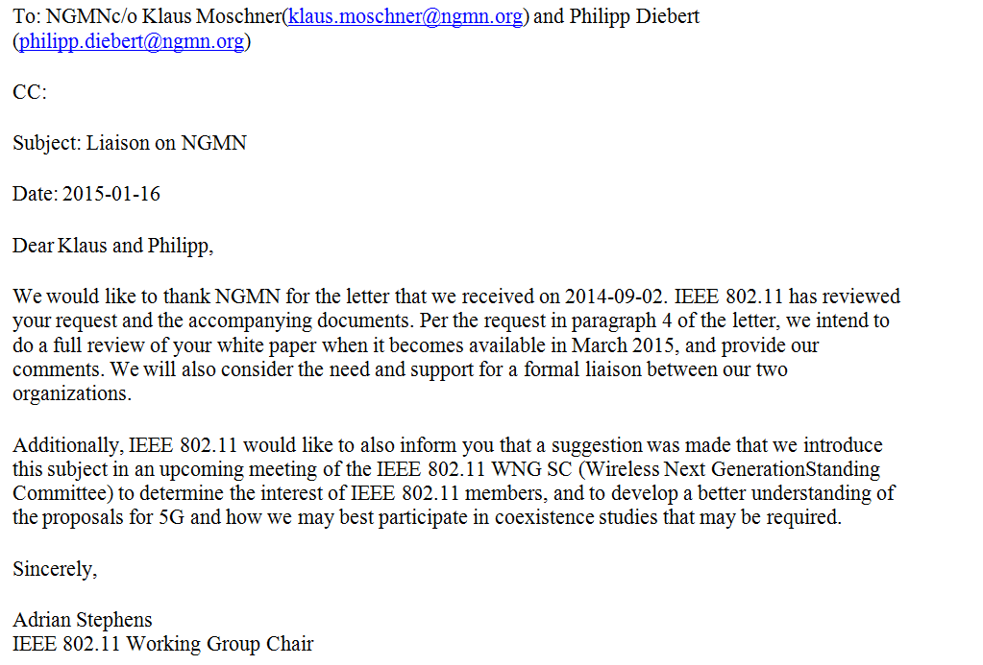
IEEE 802.11 1st Liaison Response to NGMN

Slide 8
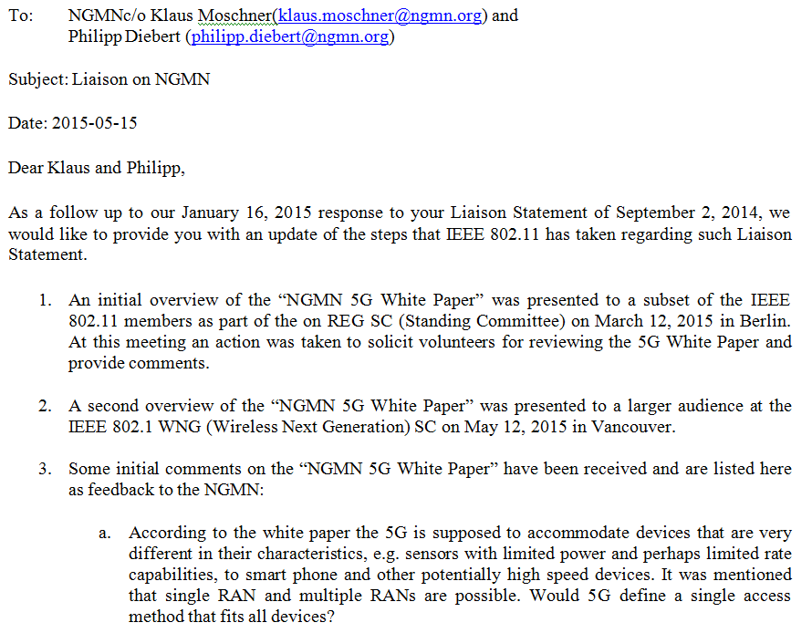
IEEE 802.11 2nd Liaison Response to NGMN

Slide 9
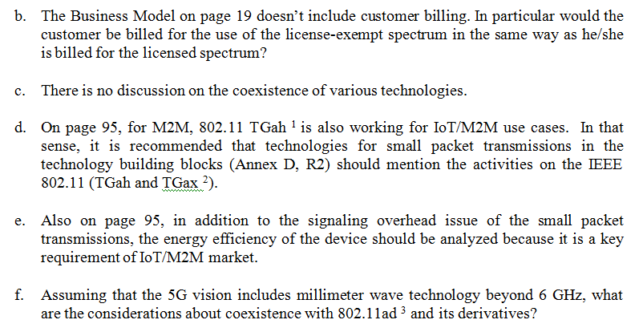
IEEE 802.11 2nd Liaison Response to NGMN (continued)

Slide 10
IEEE 802.11 2nd Liaison Response to NGMN (continued)

Slide 11
Next Steps within 802.11
3rd NGMN Liaison Response Letter
A draft for the 3rd Liaison Response Letter to the NGMN was produced during the Atlanta PM1 NGMN Ad Hoc session, which included the following questions to the NGMN:
Would you kindly advise on any feedback on the questions submitted by the 802.11 on its 2nd Liaison letter response of 14 May 2015?
At a future time, the 802.11 may have additional inputs to the NGMN that may warrant sending a representative to the NGMN; in which case, would the NGMN consider inviting our representative as a guest to one of its future meetings?
It was suggested to hold sending the letter pending a reply from the NGNM to the 2nd Liaison letter.
Straw Polls (next slide)

Slide 12
Straw Polls
#1: Do you believe it will be beneficial for the 802/802.11 to engage in the IMT-2020 process and 5G in general (NGMN/3GPP)?
Yes: 14, No: 1, Not Sure: 12
#2: Would you participate in a 802/802.11 activity to engage in the IMT-2020 process and communications with NGMN and 3GPP?
Yes: 7 No: 2, Not sure: 16
#3: We believe that at this time there is value to continue to liaise with the NGMN.
Yes: 0 No: 3 Not sure: 20
#4: We agree to reconvene the NGNM liaison activity if and when NGNM replies, or if and when we have substantive information to provide to them that could be of mutual benefit.
Yes: 21 No: 0 Not sure: 3

