Slide 1
Dwell Time In Probe Request Presentation
Date: 2016-01-18
Authors:

Slide 2
Abstract
Communication of client channel dwell time in a probe request would help decrease the amount of airtime consumed by management frames particularly in a congested environment.

Slide 3
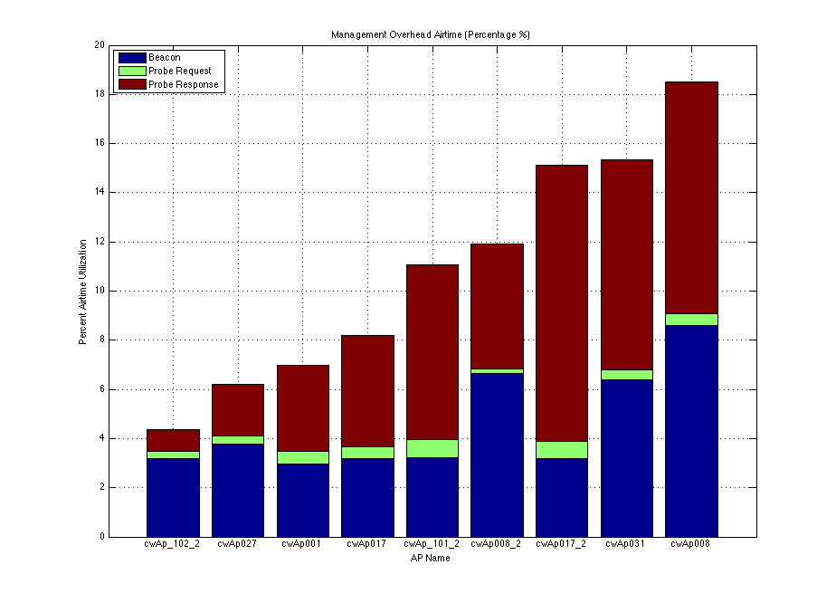
Airtime Utilization in High Density Environment
Management Traffic can consume substantial amounts of airtime.
  Beacons up to 8-9%
  Probe Responses up to 9-10%

Slide 4
Probe Response Problem in Congested Network
If an AP cannot successfully transmit a Probe Response in the client Off Channel Scan dwell time, MinChannelTime, a significant amount of airtime may be consumed for Probe Response management traffic by APs transmitting to a client that has changed channels.

Slide 5
Probe Request Solution to Problem
Problem is solved by the transmission of dwell time, MinChannelTime and MaxChannelTime, in the broadcast Probe Request. AP2 will not send Probe Responses unnecessarily.

