Slide 1
High Efficiency Medium Access via Rosters
Date: 2016-01-18

Slide 2
Abstract
Using rosters reduces medium access overhead, by providing 11ax devices with predictable and unique backoff slots [1, 2].
This presentation provides further information on roster operation, including: A—fundamentals of roster operation and contrast with polling methods; B—effect of OBSS hidden nodes and a contrast with OFDMA; and C—ensuring legacy fairness

Slide 3
Abstract
Using rosters reduces medium access overhead, by providing 11ax devices with predictable and unique backoff slots [1, 2].
This presentation provides further information on roster operation, including: A—fundamentals of roster operation and contrast with polling methods; B—effect of OBSS hidden nodes and a contrast with OFDMA; and C—ensuring legacy fairness

Slide 4
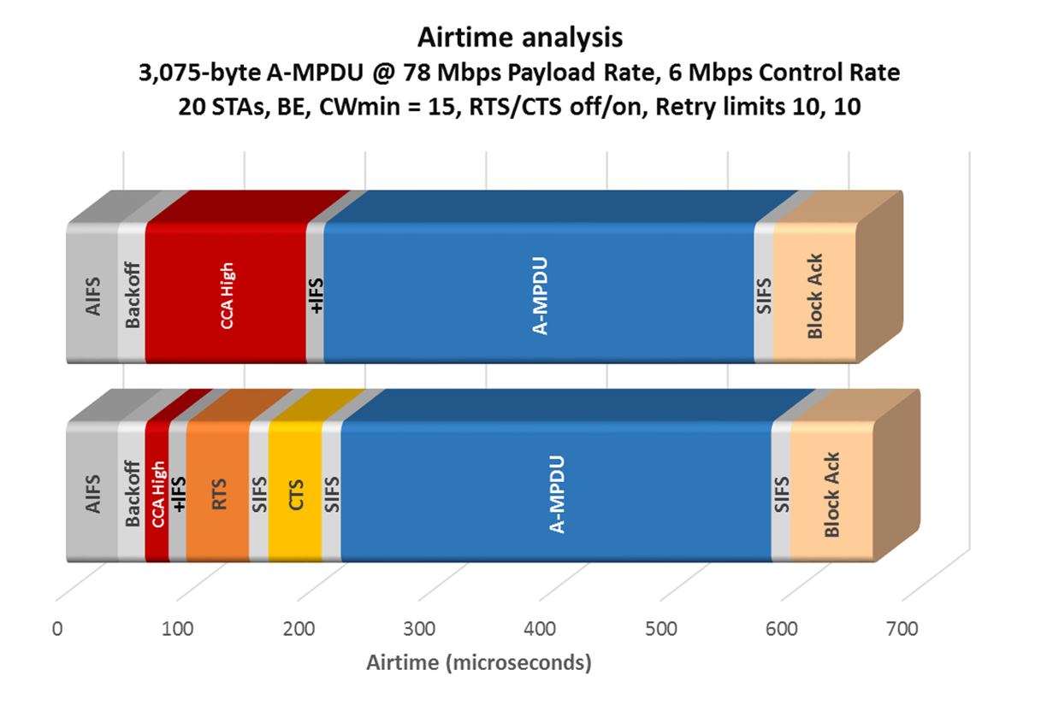
Motivation—I
Cf. [1]
AIFS
Backoff
CCA
+IFS
. . .
43
22
133
15
AIFS
Backoff
CCA
+IFS
RTS
SIFS
CTS
SIFS
A-MPDU
SIFS
BA
43
23
20
15
52
15
44
16
356
16
68

Slide 5
Motivation
Baseline EDCA medium access overhead = the lower of the two quantities shown
Both quantities are usually significant [1]
It is possible to achieve much lower medium access overhead than either of these, by re-using well-proven components that are already part of the protocol

Slide 6
Approach
Arrange matters so that each STA may obtain a unique backoff slot
Two phases:
Build a roster
Use the roster

Slide 7
Using a roster
(A)
[2, slide 9]
④ AP invokes a roster (now in usage mode):
NAV set for legacy devices (say 5 ms)
AP
…
…
If the assigned slot is reached
within TXOP, STA may transmit
Other devices set NAV and
freeze countdown as usual
Depicted STA will have frozen
its own countdown for each
preceding transmission by
others
STA
Roster invoked:
Roster number
Roster length
Current NAV
Offset within roster length
STA / traffic stream uses its assigned slot(s) modulo offset within roster length

Slide 8
Using a roster
(A)
Fundamental operation, step 1/3:
AP
…
?
…
STA
On detecting L-STF during 9 μs
slot time, other devices freeze
backoff decrement and prepare
for rest of PPDU
At beginning, other devices do not know duration of PPDU

Slide 9
Using a roster
(A)
Fundamental operation, step 2/3:
AP
…
…
STA
Other STAs read further and extract duration from L-SIG, set NAV

Slide 10
Using a roster
(A)
Fundamental operation, step 3/3:
AP
…
…
STA
STA transmits for signaled duration, and other device defer

Slide 11
Using a roster
(A)
Corollary 1: No duration scheduling required at AP
AP
…
?
…
STA
AP takes care of order only; STA will announce duration later

Slide 12
Using a roster
(A)
Corollary 2: No data to transmit causes only ≈ 9 μs loss
AP
…
Other STAs continue countdown
May transmit when their turn arrives, earliest ≈ 9 μs later
…
STA
STA’s turn arrives but no data to transmit
STA doesn’t start transmitting

Slide 13
Summary—A
A—Fundamentals of roster operation and differences with polling methods:
Polling methods require specific duration in advance
Polling methods waste airtime (for the full polled duration) if the polled device has no data to transmit
Polling methods require extra PPDU(s) when allocated duration is insufficient, wasting airtime from extra preambles & other overhead
Rosters have none of these drawbacks

Slide 14
Abstract
Using rosters reduces medium access overhead, by providing 11ax devices with predictable and unique backoff slots [1, 2].
This presentation provides further information on roster operation, including: A—fundamentals of roster operation and contrast with polling methods; B—effect of OBSS hidden nodes and a contrast with OFDMA; and C—ensuring legacy fairness

Slide 15
Hidden nodes from OBSS
(B)
[2, slide 15]
AP
A-MPDU / Block Ack
VIFS + slot time
(if AP bitmap signaled 0)
Later slot:
STA
(after a busy slot)
VIFS + CTS time + SIFS + slot time
(if AP bitmap signaled 1)
VIFS = Vestigial IFS, say 4 μs: for CCA, Rx-to-Tx and Tx-to-Rx turnaround times

Slide 16
Hidden nodes from OBSS
(B)
AP
A-MPDU / Block Ack
CCA checks for OBSS hidden nodes
STA gives up slot if CCA high
VIFS + slot time
(if AP bitmap signaled 0)
Later slot:
STA
(after a busy slot)
VIFS + CTS time + SIFS + slot time
(if AP bitmap signaled 1)
VIFS = Vestigial IFS, say 4 μs: for CCA, Rx-to-Tx and Tx-to-Rx turnaround times

Slide 17
Using a roster
(B)
Corollary 3: OBSS hidden node causes only ≈ 9 μs loss
AP
…
Other STAs continue countdown
May transmit when their turn arrives, earliest ≈ 9 μs later
(i.e., VIFS + 9 μs later)
…
STA
STA’s turn arrives but CCA is high: OBSS hidden node
STA doesn’t start transmitting

Slide 18
Summary—B
B—Effect of OBSS hidden nodes and a contrast with OFDMA:
Roster methods automatically reallocate airtime if there is an OBSS hidden node
Roster methods lose only a minimum airtime (IFS + slot time) when OBSS hidden node transmits
Roster moves on to next roster slot—which may not have CCA high
OFDMA loses full allocated duration with OBSS hidden node

Slide 19
Abstract
Using rosters reduces medium access overhead, by providing 11ax devices with predictable and unique backoff slots [1, 2].
This presentation provides further information on roster operation, including: A—fundamentals of roster operation and contrast with polling methods; B—effect of OBSS hidden nodes and a contrast with OFDMA; and C—ensuring legacy fairness

Slide 20
Legacy fairness
(C)
Previously a method was provided to ensure that devices participating in the roster do not achieve an unfair advantage over legacy devices
―devices defer for an appropriate time after roster use in order to equalize medium access [2, slide x2]
Question arose on how the fairness works at AP
―how does the AP judge when to use roster mode? Using roster mode without guidelines would disadvantage legacy devices
―key is to have roster mode itself defer after use

Slide 21
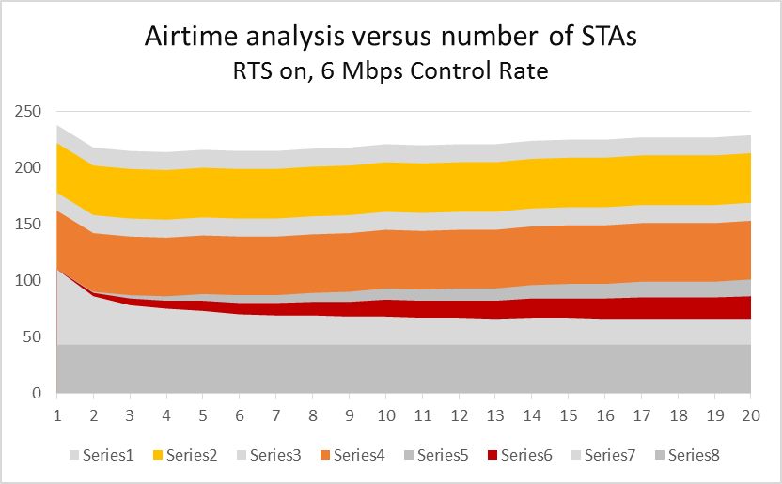
(C)
[1, slide 9]
Microseconds
Subtract 40 μs for 24 Mbps Control Rate (RTS 28 μs vs. 52; CTS 28 μs v. 44)

Slide 22
(C)
Microseconds
Backoff time quickly converges to a mean of 21-22 μs

Slide 23
Legacy-fair operation
(C)
Rosters access the medium under EDCA rules, with high priority
VI access category
Low CWmax
Low retry limit (say 4)
Every use of any roster by that AP falls under a single state for EDCA access purposes
After a successful roster use, AP defers next use
AP does not use any new roster until N x 2.5 backoff slots have expired
N = AP’s estimate of number of legacy devices that should be allowed to transmit, to equalize channel access

Slide 24
References
[1] IEEE doc. 11/15-1114r1, “Airtime Analysis of EDCA”, S. Coffey, D.Z. Liu (Realtek), September 2015
[1] IEEE doc. 11/15-1115r1, “High Efficiency in Accessing the Medium”, S. Coffey, D.Z. Liu (Realtek), September 2015

