Slide 1
11ay MIMO BF Training Enhancements
Date: 2016-01-18
Authors:

Slide 2
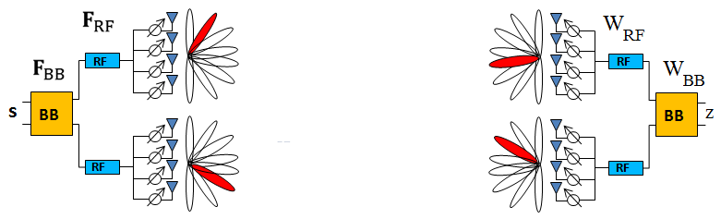
Hybrid Beamforming for 11ay
Y = Hx +n
x=Fs = F_{RF} F_{BB} s
z=W_{BB}W_{RF}y
11ad employs Analog RF beamforming only
11ay might employ hybrid two step (suboptimal) beamforming for reduced complexity
  Analog RF BF Training:
    F_{RF} and W_{RF} are chosen from codebook-based sector selection
  Digital MIMO/BF Processing (after Analog BF training is completed):
    (Closed Loop) Channel sounding and feedbacks + Transmitter pre-coding
    (Open Loop) Receiver ML, MMSE, ZF, SVD type of processing (W_{BB})
    Note that closed loop operation might not be reliable at 60GHz due to fast channel aging.

Slide 3
Multiple Antenna Operations for 11ay
TX beamforming: Multiple TX antennas transmit a single spatial stream to a single RX antenna
RX beamforming: A single TX antenna transmits a single spatial stream to multiple RX antennas
TX beamforming and RX beamforming: Multiple TX antennas transmit a single spatial stream to multiple RX antennas
SU-MIMO: multiple TX antennas transmit multiple spatial streams to multiple RX antennas
MU-MIMO: multiple TX antennas transmit multiple spatial streams to multiple devices
Transceiver
Transceiver
Transceiver
Transceiver
Transceiver
Transceiver
Transceiver
Transceiver
Transceiver
Transceiver
Transceiver
Transceiver
Transceiver
Transceiver
Transceiver
Transceiver
Transceiver
Transceiver

Slide 4
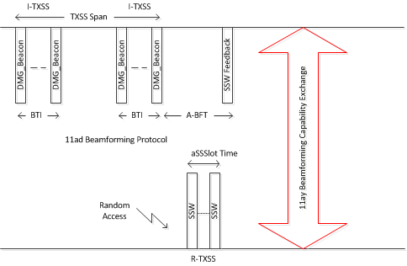
Typical 11ad Beamforming Training - BTI
11ad adopts a modular, flexible beamforming protocol.
  Different parts of protocol can be individually invoked and executed.
SLS during BTI:
  Transmit antenna/sector selection
  Receive Antenna Selection
A-BFT
  Responder antenna/sector selection via limited-slot random access

Slide 5
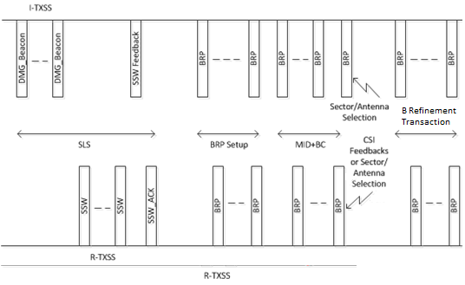
Typical 11ad Beamforming Training - DTI
SLS:
  Transmit antenna/sector selection,
  Receive Antenna Selection
  Responder transmit antenna/sector selection
(Optional) TX sector down-selection:
  CSI feedbacks
(Optional) MID operation:
  RX sector selection (using quasi-omni tx beam)
(Optional) BC operation:
  TX/RX sector Pairings
Beam Refinement Transaction:
  RX sector training
  Refine TX/RX sectors
Beam Tracking

Slide 6
11ay MIMO/Beamforming Operation
E-SLS (EDMG TXSS and/or EDMG RXSS)
  Select a single transmit antenna/sector
  Select a single receive antenna/sector
  Responder return link training
TX Sector down selection per antenna
  To reduce the number of TX sectors per TX antenna
  CSI feedbacks (initiator selects), or responder recommends sectors
RX sector down-selection per antenna
  Using quasi-omni TX antenna beam (11ad MID) to train RX beam
  Utilizing using antenna pattern reciprocity and TX BF training results
MIMO TX-RX antenna pairing and sector selection
  One-to-one TX/RX antenna/Sector mapping for MIMO,
  Select one sector per antenna
Digital MIMO (Closed Loop and Open Loop) Operation for MIMO or MISO
  For support of TX digital beamforming and MIMO precoding operation
MIMO, SIMO, MISO Transmission
Beam Tracking

Slide 7
11ay BF Training Enhancement 1:
Simultaneous Receiving via Multiple RX Antennas
In 11ad, a training field is transmitted for each transmit sector and receive sector pair. For each transmit sector, a total of NxS training fields is needed, where N is number of receive antennas and S is the number of receive sector
For MIMO receive, N receive antennas can receive simultaneously, the BF training time can be reduced. Thus, for each transmit sector, a total of S training fields is needed, where S is the maximum number of sectors of a receive antenna for the N receive antennas.
Do not need new training field/frame waveform to support this operation
The number of training fields/frames is reduced by a factor of N in E-SLS and MIMO TX-RX antenna pairing

Slide 8
11ay BF Training Enhancement 2:
TX Sector Down Selection
For MIMO BF training, it is necessary to perform TX antenna/sector and RX antenna/sector pairing.
  Number of training fields/frames are N_{TX} * S_{TX} * N_{RX} * S_{RX} (/S_{RX} , if simultaneously RX antenna training is employed), where N_{TX} and N_{RX} are the numbers of TX antennas and RX antennas, respectively and S_{TX} and S_{RX} are the numbers of TX sectors per antenna and RX sector per antenna, respectively
TX Sector Down Selection is to use subset of TX sector in MIMO antenna/sector pairing (Reduced S_{TX} to a small number)

Slide 9
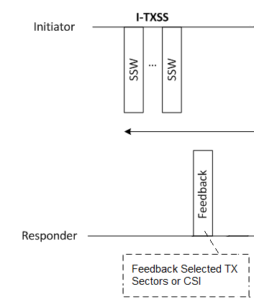
11ay BF Training Enhancement 2:
TX Sector Down Selection
For SU-MIMO and MU-MIMO, some TX sectors are received with little energy (i.e., low MIMO capacity) and should be removed from BF training to significantly reduce medium usage.
TX sector down selection is achieved via receiver feedback selected TX sectors or CSI after TX SLS

Slide 10
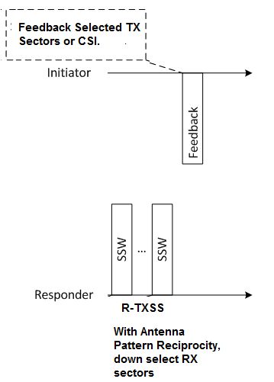
11ay BF Training Enhancement 3:
RX Sector Down Selection
RX Sector Down Selection is to use subset of RX sector in MIMO antenna/sector pairing to reduce medium usage
One approach is to utilize quasi-omni TX antenna to training RX antenna/sector (similar 11ad MID) and based on the BF training results down select RX sector.
Another approach is to exploit the antenna pattern reciprocity, e.g., in responder TX BF training, the results can be used as RX Sector Down Selection as illustrated.

Slide 11
Conclusions
An overview of 11ad and 11ay BF Training operation is provided.
BF training enhancements for 11ay are introduced.
  simultaneous RX antenna training
  TX-Sector Down-Selection
  RX-Sector Down-Selection for device with antenna pattern reciprocity
Note that other BF Training enhancements are possible

Slide 12
Straw Poll 1
11ay BF Training shall support using simultaneous RX antenna training
  Yes
  No
  Abstain

Slide 13
Straw Poll 2
11ay shall provide means to enable TX-Sector Down-Selection in the BF training
  Yes
  No
  Abstain

Slide 14
Straw Poll 3
11ay should support, for device with antenna pattern reciprocity, RX-Sector Down-Selection (use subset of RX sector in MIMO antenna/sector pairing) in BF training
  Yes
  No
  Abstain

