Slide 1
Scalable Beamforming for 11ay
Date: 2016-01-18
Authors:

Slide 2
Scalability
11ad BF training and refinement complexity increases linearly with the number of devices. Difficult to scale to many devices. It is important to be able to support BF training to a large number of devices for many 11ay use cases.
WFA No 1 Mainstream use case “Wireless Office Docking (proposed new use case)” →Need to support multiple peripheral devices.
WFA No 2 Mainstream use case “Mobile Offloading and Multi-Band Operation (MBO)” -> Limitations in the number of clients supported by the protocols may prevent effective offloading.
Other usage models 4(Data center inter-rack), 5 (VoD, video distribution), 7(front-hauling) and docking all need to deal with a large number of devices.
PCP
STA2
STA3
STA1

Slide 3
Latency, Jitter, and Interference
BF training is needed for establishing the initial communication and subsequent communication, for mobility support and adapting to changing channel conditions, between two devices.
Tx Sector sweep during BF training creates interference to neighboring devices
BF training is an overhead which creates latency jitter, affecting QoS.
Difficult to support multicast.
Latency Jitter
High Gain/High Rate Link
High Gain/High Rate Link
Idle time ( if too long, requires retraining)
BF Training

Slide 4
Antenna Pattern Reciprocity
Antenna pattern reciprocity (Antenna pattern reciprocity=1) is defined as a device capable of transmitting and receiving with same antenna pattern, via implicit or explicit calibration or other means.
Antenna pattern reciprocal devices provides the following benefits :
A antenna pattern reciprocal device can use its knowledge derived the receiver BF training in its TX BF training or vice versa
It reduces the overhead of the over-the-air calibration if a device has already been calibrated.
Many implementations have antenna pattern reciprocity (shared TX and RX antenna elements)
STA1

Slide 5
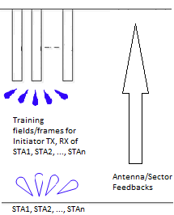
Scalable Training
Scalable training exploits the antenna pattern reciprocity to achieve one-to-multiple STAs antenna training.
Initiator engages in BF training with multiple responders simultaneously in which
Initiator transmits BF training frames or fields for transmits its transmit antenna/sector and the responder’s receiver antenna/sector
multiple responders perform receive antennas/sectors training.
The responder STAs are required to have antenna pattern reciprocity.
The responder STAs do not perform R-TXSS, instead they derive results from their receive BF training utilizing the antenna pattern reciprocity.
Since only the initiator transmits training frames, which are received simultaneously by multiple responders. The training time is independent on the number of responders.
How the responders feeding back their BF feedbacks is yet to be defined.

Slide 6
Applications of BF Training
A (I)BSS with a large number of STAs
STAs require low latency and jitter
PCP/AP does not have the ability to engage in BF training with many STAs
PCP/AP advertises BF training schedule and performs periodic scalable training with a large number of STAs.
STAs feedback TX sectors to PCP/AP if the TX sectors are different from the last BF training.

Slide 7
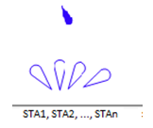
Why is it Scalable
Total number of training fields/frames is
independent of the number of STAs.
STA1
RX sectors
STA1
STA2
RX sectors
STA2
STAn
RX sectors
STA1

Slide 8
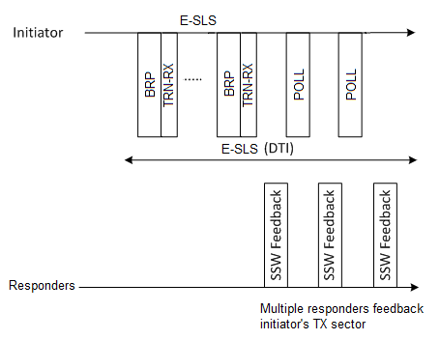
Scalable Group Training using BRP
Scheduled SP
Appends TRN-RX training fields for training RX sectors.
Allows multiple responders (with reciprocal antenna) to do BF train together.
Number of TRN-RX training fields = max(number of RX sectors) of multiple responder STAs
Detailed protocol and waveform TBD

Slide 9
Proposed BTI BF Training - 1
A PCP/AP can use PLCP header to indicate the RX sector training in the beacon by setting
beam tracking request field = Beam Tracking Requested
Training length field = max length of all RX sector training STAs
Packet type = 0 (BRP-RX)
The Duration field of beacon frame is set to the end of BTI.
PLCP Header
TRN-R
BI
BTI
Duration

Slide 10
Proposed BTI BF Training - 2
PCP performs TX Sector training during beacon transmissions (BTI) with all STAs
PCP indicates (in PHY header) TRN-R is appended to the beacon or RX sector training.
Multiple STAs can perform “RX sector training” at the end of the beacon. (Use RX sector training to replace TX sector training for devices with antenna pattern reciprocity)
“Beam Combination Training (TX-RX sector pairing)” can also be accomplished simultaneously (for supporting Su-MIMO or Mu-MIMO operation)
STAs can feedback TX sector (or selected TX sectors) either unsolicited, when being polled, or when it attempts to initiate a link.
Proposed training method is independent of how many STAs being trained simultaneously (scalable to large number of devices).
Beacon(s)
RX Sector Training
Beacon(s)
TX Sector Training
BTI
BI
BTI

Slide 11
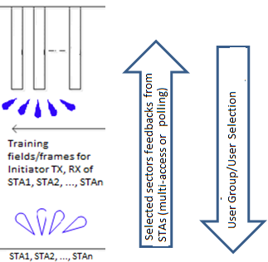
DL MU-MIMO BF Training using Scalar BF training
Scalable training can be used to training multiple STAs with antenna pattern reciprocity in MU-MIMO SLS.
Initiator transmits training fields/frames to train PCP/AP’s TX antennas/sectors and STAs’ RX antennas/sectors
No R-TXSS is performed by STAs
The antenna/sector feedbacks are transmitted by STAs in polling fashion or using random multiple contention. (Note that STAs know which TX antenna/sector to use, initiator uses omni-beam to receive. The ACK can be send using specific antenna/sector based on feedbacks).
Note that PCP/AP can train a large number of STAs and down-select STAs for MU-MIMO transmission
Scalable beamforming for MU-MIMO BF: PCP/AP transmit sector sweep, in each TX sector transmits training fields for STA RX training (No R-TXSS)

Slide 12
Conclusions
Scalable training utilizes the antenna pattern reciprocity to allow for multiple devices to perform BF training simultaneously.
Applications:
To train a large number of STAs in BSS simultaneously
Efficient MU-MIMO SLS.
Detailed waveform and protocol are TBD

Slide 13
Straw Poll 1
11ay shall support a mode of operation in which, in single phase, the initiator trains its transmit antennas/sectors and multiple responders train their receive antennas/sectors
Yes
No
Abstain

