Slide 1
Multi-Beamforming in Polarized Channels for 11ay
Date: 2016-01-21
Authors:
Name | Company | Address | Phone | Email
Kyungtae Jo | LG Electronics |  |  | kyungtae.jo@lge.com
SungJin Park |  |  |  | allean.park@lge.com
HanGyu Cho |  |  |  | hg.cho@lge.com
JinMin Kim |  |  |  | jinmin1230.kim@lge.com
Saehee Bang |  |  |  | saehee.bang@lge.com
Sang G. Kim |  |  |  | sanggook.kim@lge.com

Slide 2
Introduction
This contribution intends to investigate how the beamforming (BF) training procedures in 11ad is modified to support the simultaneous steering of the multiple sectors using dual-polarization.

Slide 3
Motivation
In 60GHz, MIMO system exhibits a reduced performance since the LOS channel has high spatial correlation.
In order to improve the performance of MIMO systems in LOS scenario, techniques such as antenna polarization have been employed to obtain higher rank.
Moreover, “multi-beamforming (multi-BF)” which is simultaneously multi-sector steering in the polarized directions could be used to reduce the time for BF operation

Slide 4
Scenario 1: Multi-beamforming for STA with dual-polarized antenna
Simultaneous beam-steering for STA with dual polarization
Initiator/responder transmits/receives the BF frames (e.g. SSW frame) with horizontal and vertical polarization domain, simultaneously.
Polarization diversity can be achieved when the BF frames are transmitted through both polarization domains.
On the other hand, it can enable to reduce the time for BF operation when half of the total BF frames are sent by H-pole and the remaining frames are sent by V-pole, dividedly.
H Pol.
H Pol.
I-TXSS
FBCK
Initiator
H Pol .
R-TXSS
ACK
Responder
V Pol.
V Pol .
I-TXSS
FBCK
V Pol . R-TXSS
ACK

Slide 5
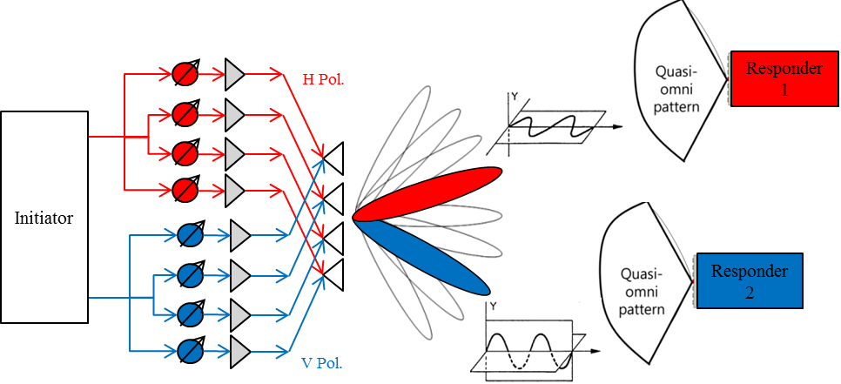
Scenario 2: Multi-beamforming for STAs with single-polarized antenna
Simultaneous beam-steering for STAs with single polarization
A initiator transmits the BF frames with horizontal and vertical polarization domain, simultaneously.
Each STA receives the signal with only one of horizontal and polarization domain depending on own antenna characteristics.
So, it can simply enable BF operation for multiple STAs regardless of antenna characteristics of responder.

Slide 6
Summary
In this contribution, multi-BF with dual polarization is proposed for 11ay.
Multi-BF can be considered to reduce the time for BF operation.
Also, it can support BF operation for multiple STAs regardless of antenna characteristics.
The detailed protocol and field design are going to be implemented afterward (TBD).

Slide 7
Straw poll/motion
Insert the following in the SFD:
“The 11ay beamforming protocol supports multi-beamforming for multiple array antennas. Multi-beamforming means that a transmitter simultaneously sends SSW frames in multiple polarized directions.”

