Slide 1
SU-MIMO and MU-MIMO link access
Date: 2016-01-18
Authors:

Slide 2
Goals/Solutions – SU-MIMO
Prior to SU-MIMO transmission in a TxOP, we need:
1 - To indicate to the receiver that they will be the recipient of an SU-MIMO Tx and that they have to set its Rx Antennas ready for SU-MIMO
Why: AWVs for SISO and SU-MIMO can be different (nulling)
Why: switch from SISO to SU-MIMO, It is expensive (power-wise) to be open to SU-MIMO (similarly to channel bonding) all the time
This indication should be able to be done at the beginning of the TxOP
MIMO setup frame (enhanced RTS)
This indication should be able to be included in a frame transmitted before the TxOP, which sets a rendez-vous point around the beginning of the TxOP
frame to schedule a rendez-vous point
2 - To ensure protection
Protection is very important at 60GHz because of hidden nodes
RTS to protect the Tx
CTS feedbacks to protect the receiver
MIMO setup (enhanced RTS)

Slide 3
Goals/Solutions – MU-MIMO
Prior to MU-MIMO transmission in a TxOP, we need:
1 - To indicate to the receivers that they will be the recipient of a DL MU-MIMO Tx and that they have to set its Rx Antennas in the direction of the AP/PCP
This indication should be able to be done at the beginning of the TxOP
MIMO setup frame (enhanced RTS)
This indication should be able to be included in a Grant frame transmitted before the TxOP, which sets a MU-MIMO rendez-vous point around the beginning of the TxOP
frame to schedule a rendez-vous point
2 - To ensure protection
Protection is very important at 60GHz because of hidden nodes
RTS to protect the Tx
CTS feedbacks to protect the receiver
MIMO setup frame (enhanced RTS)

Slide 4
MIMO setup frame
Both for SU-MIMO and DL MU-MIMO, we need a frame to setup the receivers
We call it “MIMO setup frame”

Slide 5
MIMO setup frame
We propose to send a MIMO setup frame before a SU-MIMO PPDU and before a DL MU-MIMO PPDU
This single frame allows to:
Reach destination STAs even if their Rx antennas are not beamformed toward the AP/PCP
Indicate to the destination STAs that they will be addressed by a SU-MIMO (single SISO/MIMO or number of spatial streams/antennas) or a DL MU-MIMO frame (i.e., AID of each destination STA in MU-MIMO setup frame)
Enable other STAs in the directions of the transmission to set their NAV (duration field in MU-MIMO setup frame and DMG PHY mode)
Solicit CTS feedbacks

Slide 6
How to design the MIMO setup frame
Single frame that carries the information for all destination STAs in the case of MU-MIMO
Transmitted in the direction of all destination STAs, with control PHY
What information do we want to include in this frame:
Address of the each destination STA that will be scheduled in the TxOP
Whether CTS feedbacks are solicited
Bandwidth information
Whether the following PPDU is a SISO or MIMO, (possibly the number of SSs or antennas)
TBD
This frame can be an RTS, a CTS-to-self or a new frame, assuming we can include all such information

Slide 7
CTS responses to the MIMO setup frame
Protection is very important at 60GHz.
To enable receiver protection for DL MU-MIMO, we propose that the MU-MIMO setup frame can solicit a CTS (or Ack) response by the targeted STAs.
MIMO setup frame is only transmitted in the directions of destination STAs
Destination STAs respond with CTS, in a TBD manner
Other STAs that receive MIMO setup frame or any CTS set NAV

Slide 8
Rendez-vous concept

Slide 9
Multi-STA rendez-vous
Informing the destination STAs that they will be targeted by a SU-MIMO or DL MU-MIMO transmission can also done in advance by setting a rendezvous point to one or multiple STAs.
At this rendezvous point,
Destination STAs are expected that the AP/PCP will send them a SU-MIMO or DL MU-MIMO PPDU and can set their Rx antennas in the direction of the AP/PCP.
Similarly, it can set the bandwidth (see channel bonding link access)
The AP/PCP has to perform contention before accessing the channel, so the start of its transmission can be delayed.
Once the AP/PCP got channel access,
If the AP/PCP doesn’t want specific protection on the receiver side, it can directly transmit the SU-MIMO or DL MU-MIMO PPDU.
If the AP/PCP wants protection on the receiver side, it can transmit a MIMO setup frame to the different destination STAs, requesting a response with a protection frame like CTS. After that MIMO setup frame/CTS response phase, the AP/PCP can transmit the SU-MIMO or DL MU-MIMO PPDU.

Slide 10
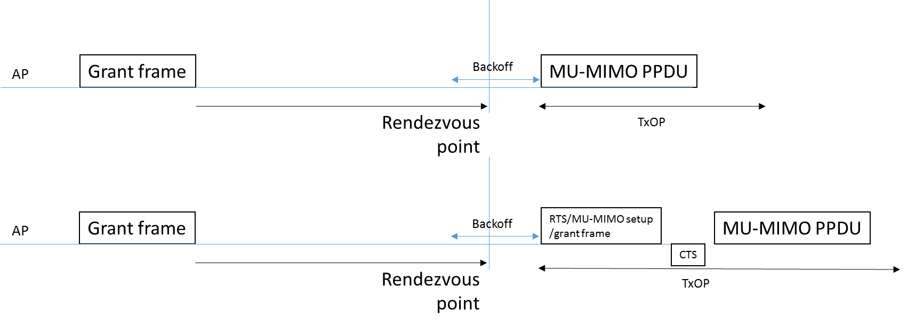
Multi-STA rendez-vous
AP/PCP can transmit a frame to multiple destination STAs, which contains the addresses of the destination STAs and the indication of the target time for the rendez-vous point.
Frame
Frame
MIMO setup

Slide 11
Conclusion
We need solutions to:
Ensure protection of a SU-MIMO and DL MU-MIMO PPDU transmission
Provide ways to inform multiple destination STAs of an upcoming MU-MIMO PPDU ahead of the MU-MIMO PPDU transmission, in order to give them time to set their Rx antennas in the best Rx sector
Provide ways to inform destination STAs of an upcoming SU-MIMO PPDU ahead of the transmission, to switch from SISO to SU-MIMO
We propose:
- A MIMO setup frame, that may solicit CTS feedbacks
- A frame that sets a multi-STA rendez-vous point for MU-MIMO transmission

Slide 12
Straw poll 1
Do you agree to add the following in section 5 of the SFD:
“An EDMG STA may transmit a “MIMO Setup frame” prior to the transmission of a SU or MU MIMO PPDU. The “MIMO Setup frame” indicates the destination STA(s) addressed by the PPDU.”

Slide 13
Straw poll 2
Do you agree to insert the following in section 5 of the SFD:
“A "MIMO Setup frame" transmission may trigger a response (e.g., DMG CTS or Ack) from destination STA(s)”

Slide 14
Straw poll 3
Do you agree to add to insert the following in section 5 of the SFD:
“An EDMG STA may transmit a frame to one or more EDMG STAs to indicate a target time in which the transmitting STA intends to contend for the channel to send a MIMO PPDU to the STA(s)”

