Slide 1
Modelling of Spatial Separation in the 11ay Channel Model
Date: 2016/01/17
Authors:

Slide 2
Abstract
This contribution summarizes the existing proposal for the extension of legacy IEEE 802.11ad channel models to cover future MIMO use cases in 802.11ay. Further concepts are proposed for modelling spatial separation of phased array antennas (PAA).

Slide 3
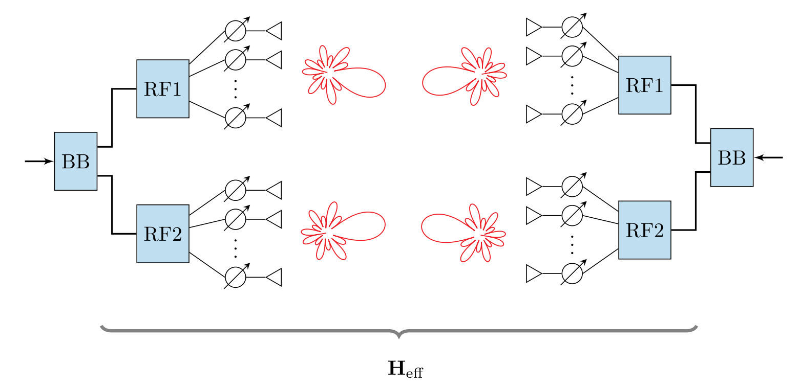
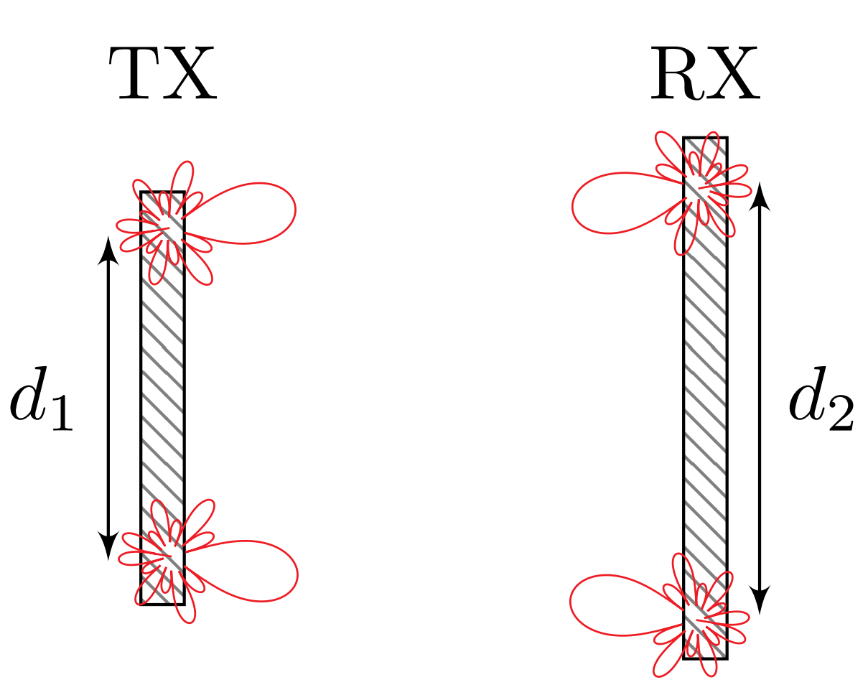

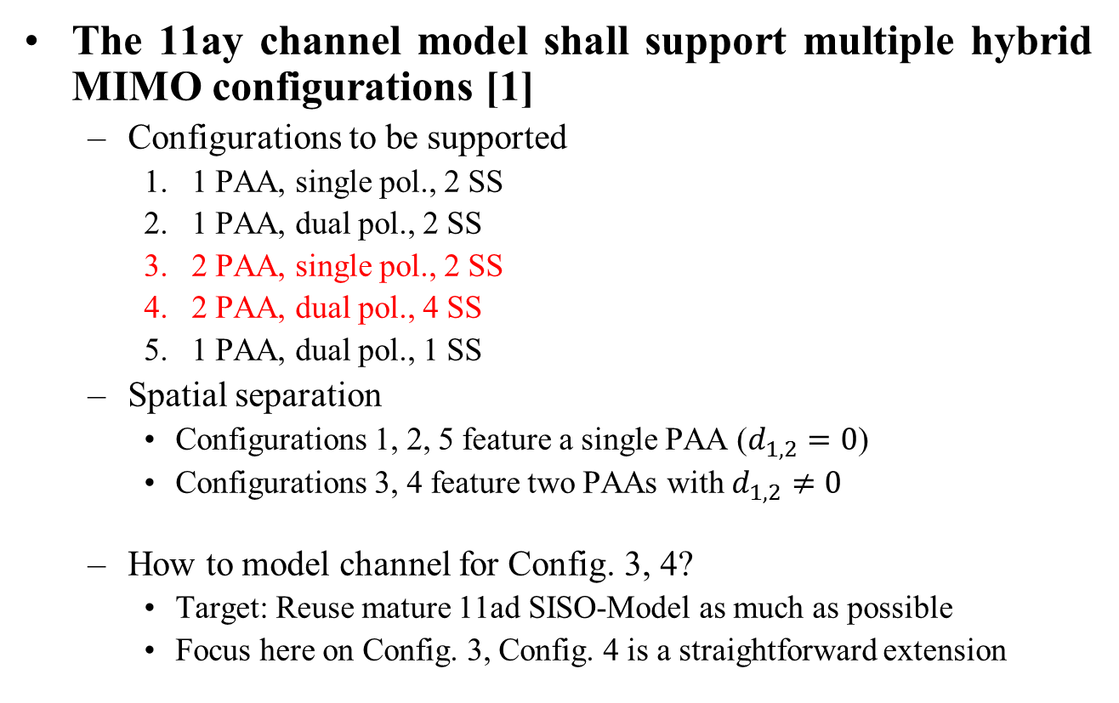
Introduction
The 11ay channel model shall support multiple hybrid MIMO configurations [1]
  Configurations to be supported
    1 PAA, single pol., 2 SS
    1 PAA, dual pol., 2 SS
    2 PAA, single pol., 2 SS
    2 PAA, dual pol., 4 SS
    1 PAA, dual pol., 1 SS
  Spatial separation
    Configurations 1, 2, 5 feature a single PAA ($d_{1,2}=0$)
    Configurations 3, 4 feature two PAAs with $d_{1,2}≠0$
  How to model channel for Config. 3, 4?
    Target: Reuse mature 11ad SISO-Model as much as possible
    Focus here on Config. 3, Config. 4 is a straightforward extension
$$d_{1,2}≠0$$

Slide 4
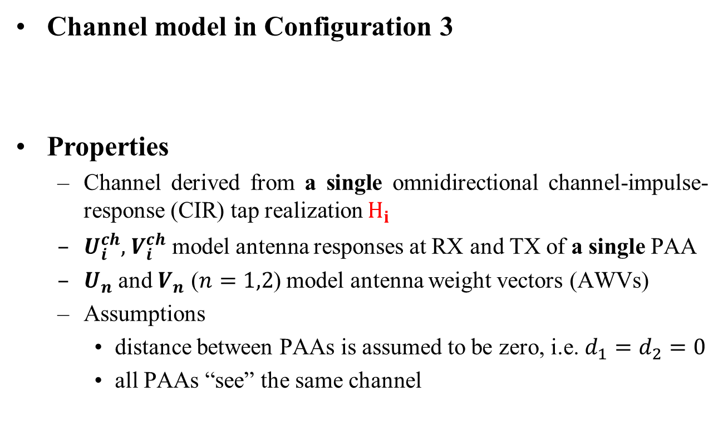
Review of submission [1] (Intel)
Channel model in Configuration 3
Properties
  Channel derived from a single omnidirectional channel-impulse-response (CIR) tap realization $H_{i}$
  $U_{i}^{ch},$ $V_{i}^{ch}$ model antenna responses at RX and TX of a single PAA
  $U_{n}$ and $V_{n}$ ($n=1,2$) model antenna weight vectors (AWVs)
  Assumptions
    distance between PAAs is assumed to be zero, i.e. $d_{1}=d_{2}=0$
    all PAAs “see” the same channel
from [1]:

Slide 5
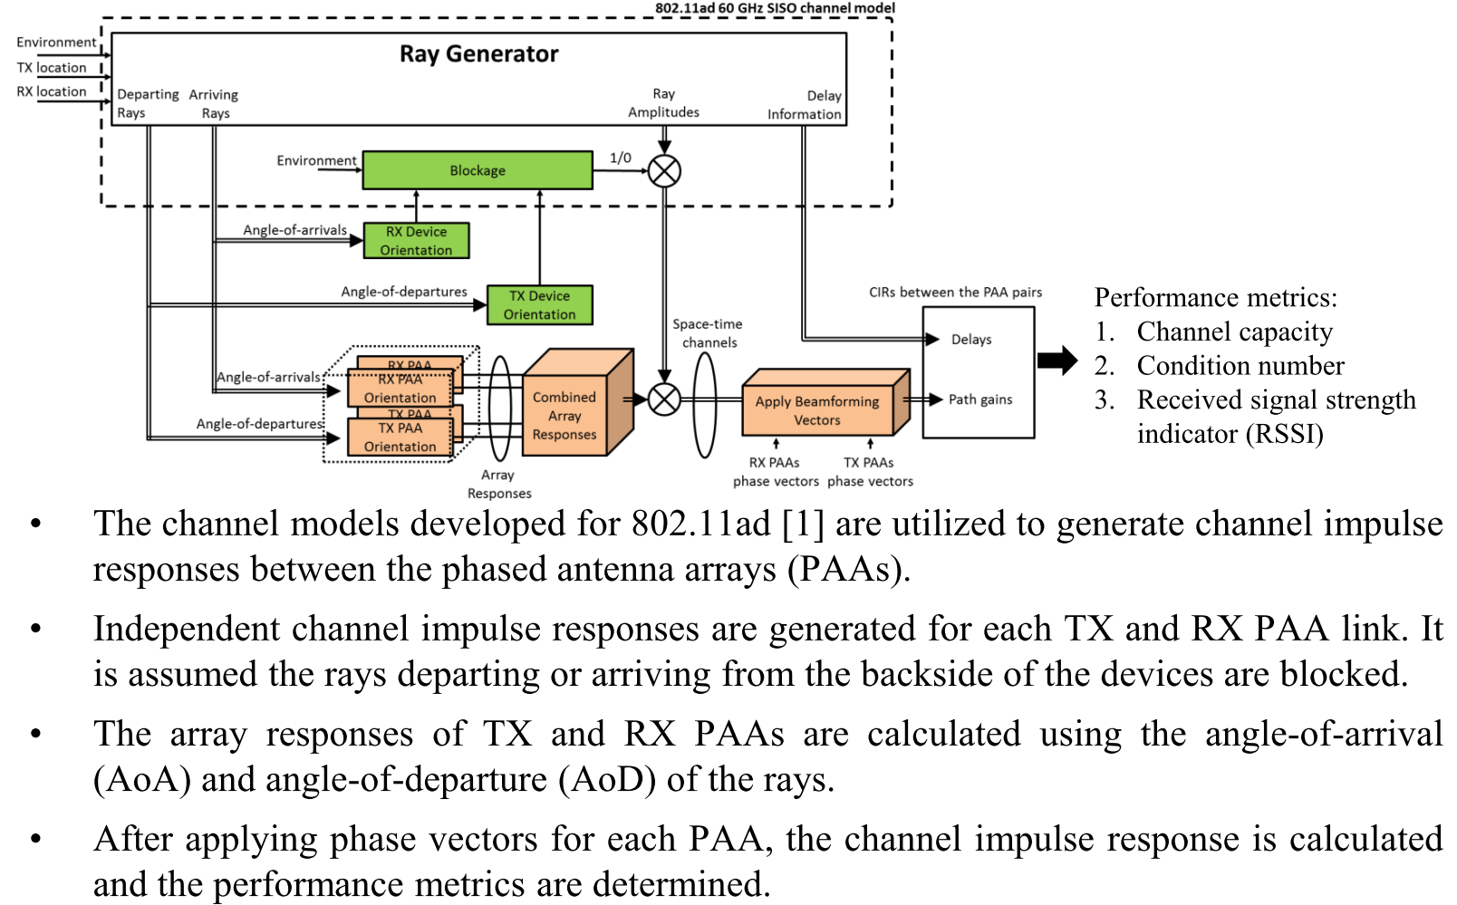
Review of submission [2] (InterDigital)

Slide 6
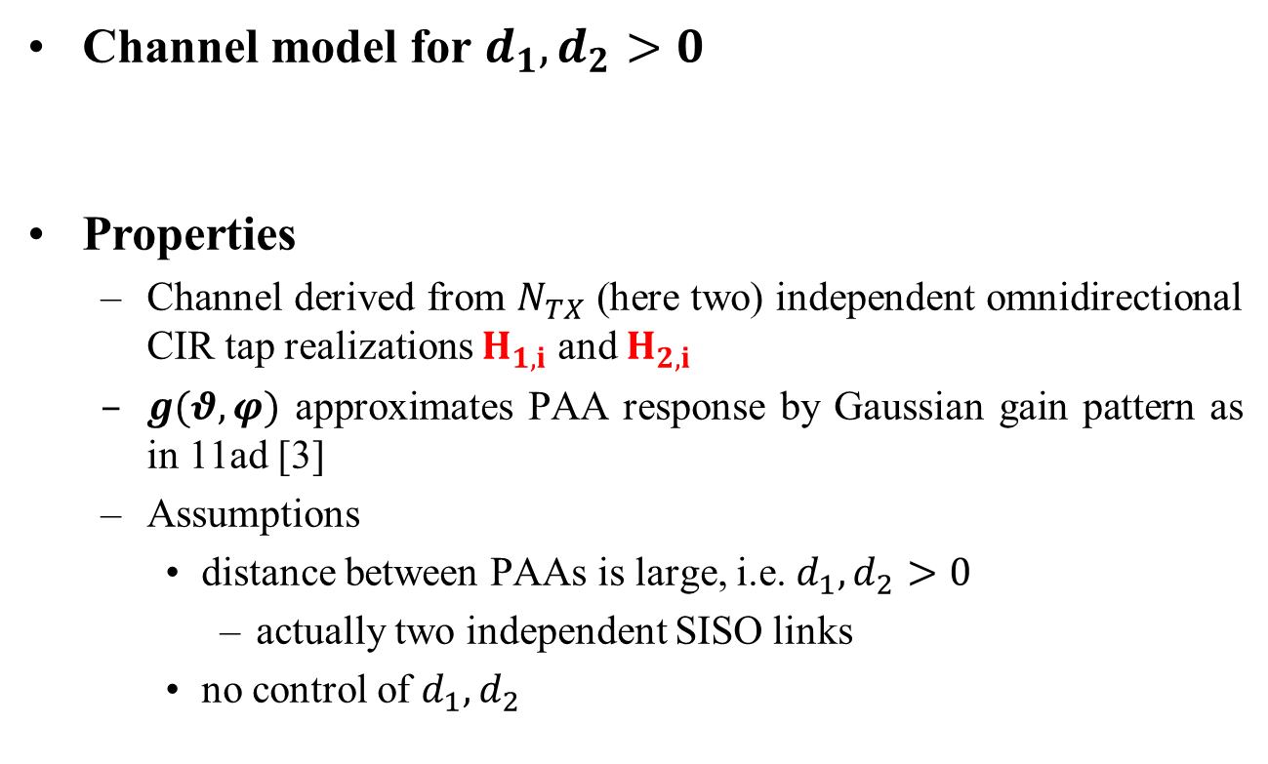
Direct link based approach
Channel model for $d_{1}, d_{2}>0$
Properties
  Channel derived from $N_{TX}$ (here two) independent omnidirectional CIR tap realizations $H_{1,i}$ and $H_{2,i}$
  $g(θ,φ)$ approximates PAA response by Gaussian gain pattern as in 11ad [3]
  Assumptions
    distance between PAAs is large, i.e. $d_{1},d_{2}>0$
      actually two independent SISO links
    no control of $d_{1}, d_{2}$

Slide 7
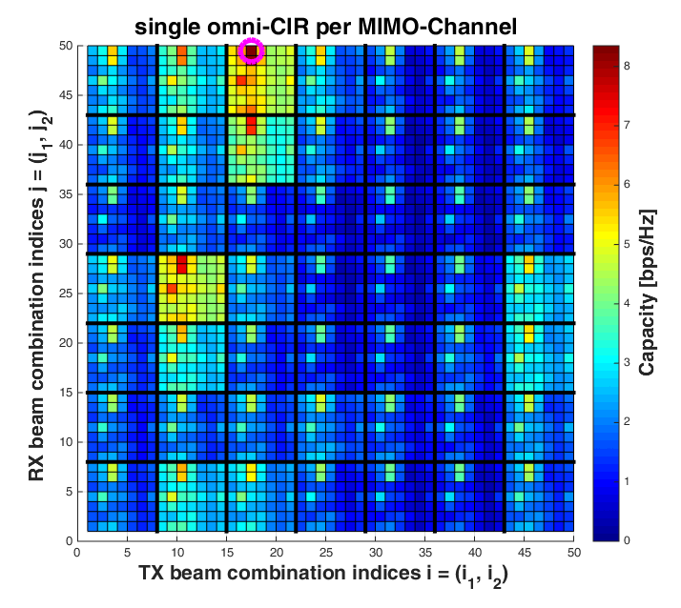
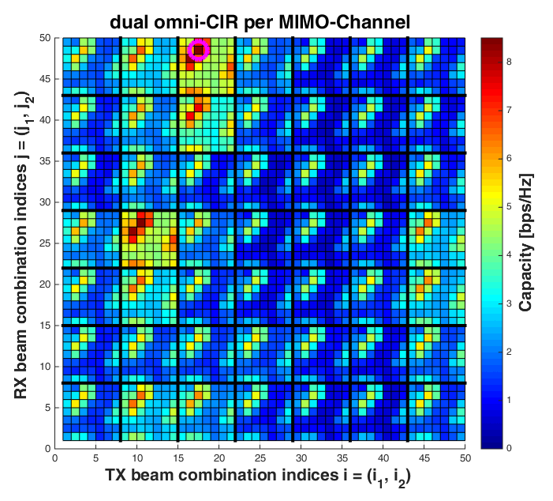
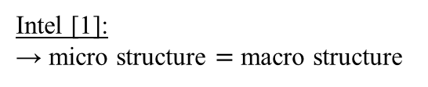
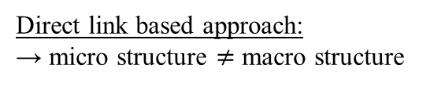
Comparison of channel models
Intel [1]:
→ micro structure $=$ macro structure
Direct link based approach:
→ micro structure $≠$ macro structure
Scenario:
Conference Room STA-AP, NLOS, 2x2 MIMO, 90° beamwidth → 49 beams per TX / RX, equal seeds for both graphs, SNR=20dB

Slide 8


Options for modeling spatial separation
Channel model
Options
  Modify $U_{i}^{ch}$ and $V_{i}^{ch}$
    Consider response of complete array of subarrays, instead of response of a single subarray
      e.g., for an antenna with two ULAs, inter-ULA separation $d$ and intra-ULA separation $d_{x}$ (equal for TX & RX) and number of total sub-elements
    Amplitudes of rays + polarization, AoAs and AoDs can be reused from .11ad model
    $U_{n}^{}$ and $V_{n}^{}$shaped to fit the dimensions of $U_{i}^{ch}$ and $V_{i}^{ch}$

Slide 9
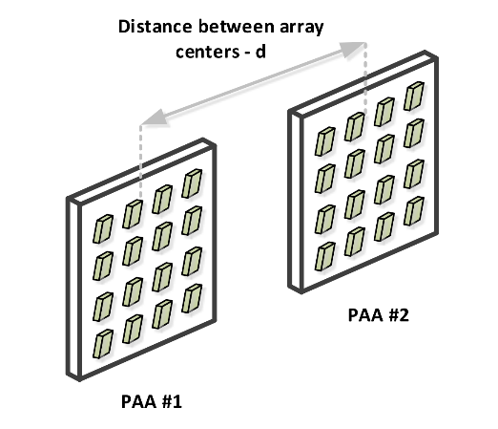

Options for modeling spatial separation
Channel model
Options
  Modify $U_{i}^{ch}$ and $V_{i}^{ch}$ (cont.)
    For 2 rectangular arrays
The phase variations for elements of first PAA
The phase variations for elements of second PAA
Figure from [1]
$N_{x}$the number of subantenna elements of the first PAA
With the phase variations as above, the phasors can be
written as in [1]

Slide 10
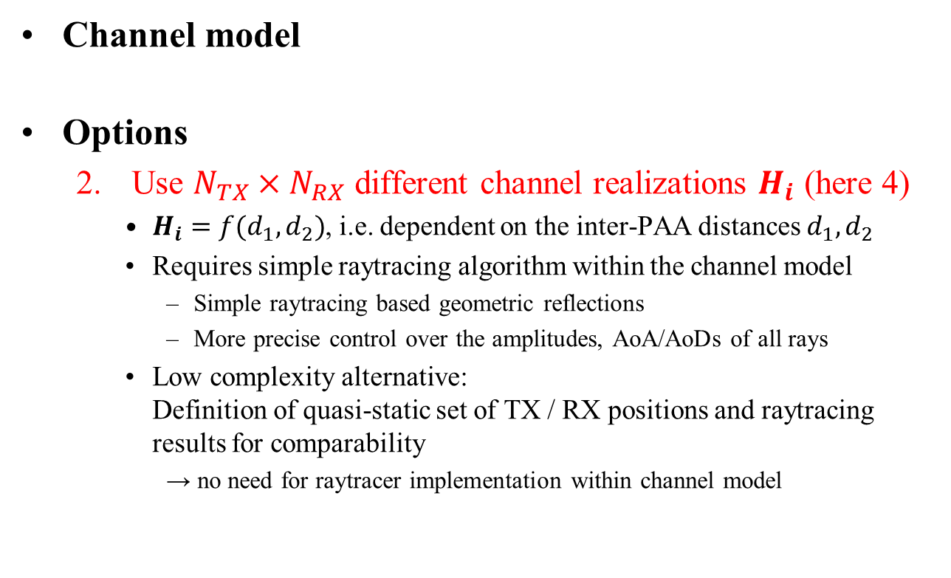
Options for modeling spatial separation
Channel model
Options
  2. Use $N_{TX}×N_{RX}$ different channel realizations $H_{i}$ (here 4)
    $H_{i}=f(d_{1},d_{2})$, i.e. dependent on the inter-PAA distances $d_{1}, d_{2}$
    Requires simple raytracing algorithm within the channel model
      Simple raytracing based geometric reflections
      More precise control over the amplitudes, AoA/AoDs of all rays
    Low complexity alternative:
    Definition of quasi-static set of TX / RX positions and raytracing results for comparability
      → no need for raytracer implementation within channel model

Slide 11
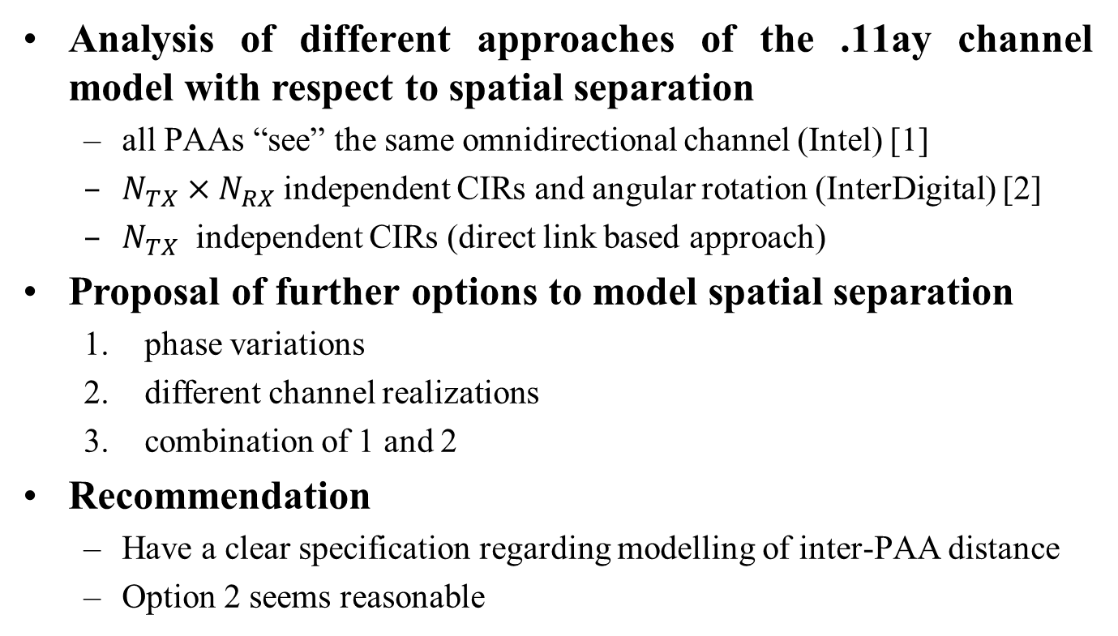
Conclusion
Analysis of different approaches of the .11ay channel model with respect to spatial separation
  all PAAs “see” the same omnidirectional channel (Intel) [1]
  $N_{TX}×N_{RX}$ independent CIRs and angular rotation (InterDigital) [2]
  $N_{TX}$ independent CIRs (direct link based approach)
Proposal of further options to model spatial separation
  phase variations
  different channel realizations
  combination of 1 and 2
Recommendation
  Have a clear specification regarding modelling of inter-PAA distance
  Option 2 seems reasonable

Slide 12
References
A. Maltsev et al, “Extension of Legacy IEEE 802.11ad Channel Models for MIMO and Channel Bonding”, IEEE doc. 11-15/1356r1.
R. Yang and A. Sahin, “Feasibility of SU-MIMO under Array Alignment Method”, IEEE doc. 11-15/1333r0.
A. Maltsev et al, “Channel Models for 60 GHz WLAN Systems”, IEEE doc. 11-09/0334r8.

Slide 13
Appendix

Slide 14
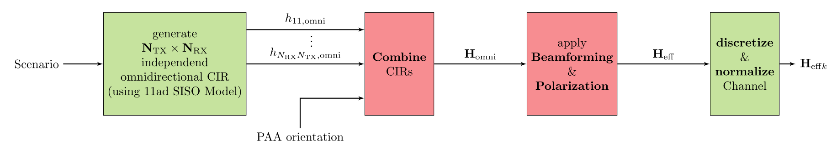
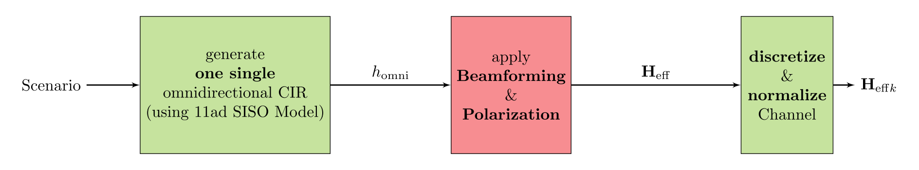
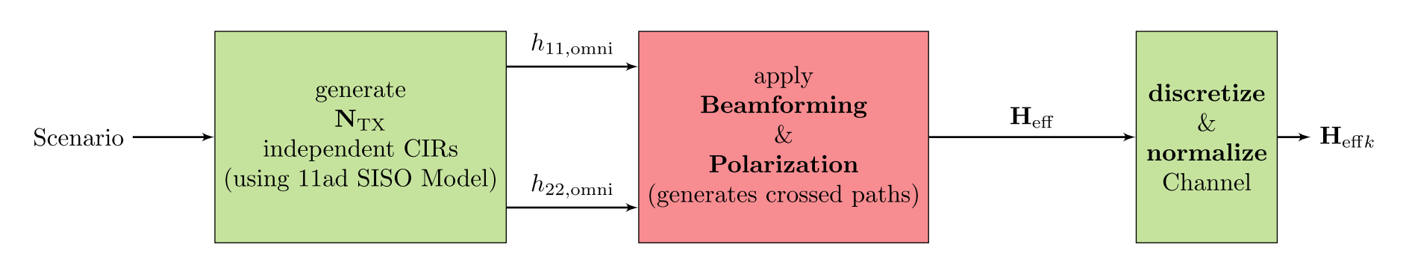
Comparison of approaches
InterDigital [2]:
Intel [1]:
Direct link based Approach:
red: changes with respect to 11ad SISO channel model implementation

