Slide 1
PHY Frame Format proposal for 11ay
Date: 2016-01-18
Authors:
Name | Company | Address | Phone | Email
Alecsander Eitan | Qualcomm |  |  | eitana@qti.qualcomm.com
Basson Gal | Qualcomm |  |  | bgal@qti.qualcomm.com
Amichai Sanderovich | Qualcomm |  |  | amichais@qti.qualcomm.com
Carlos Cordeiro | Intel Corporation |  |  | carlos.cordeiro@intel.com
Assaf Kasher | Intel Corporation |  |  | assaf.kasher@intel.com

Slide 2
Introduction
We propose a PHY frame format for 11ay
To increase 11ad data rates and meet the PAR requirements, two mechanisms proposed to 11ay have been MIMO and channel bonding
Therefore, the PHY frame format:
  Needs to be flexible to be able to accommodate for such mechanisms
  Should reuse as much as possible from the PHY frame format used in other .11 amendments (11n/ac)

Slide 3
Preamble modes
Greenfield mode
  Improves acquisition, but does not support legacy devices
Mixed mode
  Higher overhead, but provides for a single format for both 11ay and legacy 11ad devices
  Legacy devices need to decode the header and the duration of the 11ay payload; payload itself is not decoded by legacy
11n uses greenfield, but it is hardly used (if at all) in real deployments
Therefore, we propose 11ay to adopt mixed mode preamble only

Slide 4
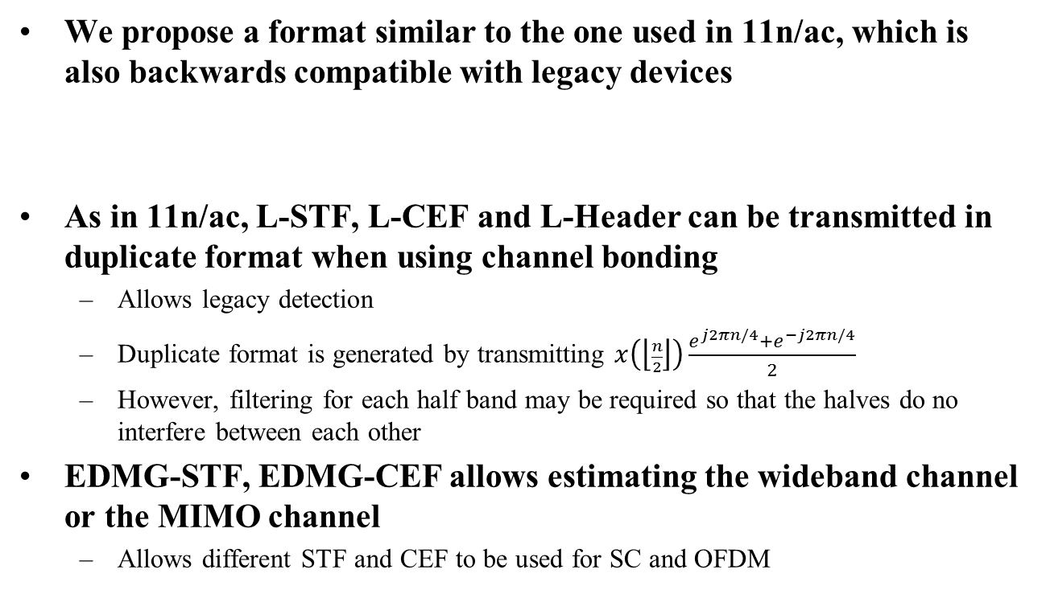
Proposed PHY format (1/2)
We propose a format similar to the one used in 11n/ac, which is also backwards compatible with legacy devices
As in 11n/ac, L-STF, L-CEF and L-Header can be transmitted in duplicate format when using channel bonding
  Allows legacy detection
  Duplicate format is generated by transmitting $x\left(\left\lfloor \frac{n}{2}\right\rfloor \right)\frac{e^{j2πn/4}+e^{−j2πn/4}}{2}$
  However, filtering for each half band may be required so that the halves do no interfere between each other
EDMG-STF, EDMG-CEF allows estimating the wideband channel or the MIMO channel
  Allows different STF and CEF to be used for SC and OFDM
L-STF | L-CEF | L-Header | EDMG-Header-A | EDMG-STF | EDMG-CEF | EDMG-Header-B | Data | AGC | TRN

Slide 5
Proposed PHY format: examples (1/2)
Not all fields need to be present in all transmission modes
One channel
Two channels
Same can be expanded for other number of channels
As in 11ac, EDMG-Header-B would only be transmitted when MU-MIMO is employed and is per STA
L-STF | L-CEF | L-Header | EDMG-Header-A | Data | AGC | TRN
L-STF | L-CEF | L-Header | EDMG-Header-A | EDMG-STF | EDMG-CEF | Data | AGC | TRN
L-STF | L-CEF | L-Header | EDMG-Header-A

Slide 6
11ay signaling in L-Header
CPHY
There are 2 reserved bits
11ay will be signaled by setting both to 1
SC & OFDM PHY
SC L-Header is used
There are 4 reserved bits
11ay will be signaled by setting bit 46 to 1

Slide 7
Summary
We propose to reuse the same, proven mixed mode PHY format as used in other .11 amendments (11n/ac)
The PHY format is flexible to support various mechanisms, including channel bonding and MIMO

Slide 8
Straw poll/motion
Insert the following in section 7.2.2 of the SFD “A single PPDU format is defined for all EDMG PHYs: the EDMG PPDU format. Figure Y1 shows the EDMG PPDU format and all possible fields. Not all fields are transmitted in an EDMG PPDU depending on whether the PPDU is a SU PPDU or is a MU PPDU.
The fields of the EDMG PPDU format are summarized in Table T1.
The EDMG-Header-A, EDMG-STF, EDMG-CEF and EDMG-Header-B fields exist only in EDMG PPDUs.”
L-STF | L-CEF | L-Header | EDMG-Header-A | EDMG-STF | EDMG-CEF | EDMG-Header-B | Data | AGC | TRN
Field | Description
L-STF | Non-EDMG Short Training field
L-CEF | Non-EDMG Channel Estimation field
L-Header | Non-EDMG Header field
EDMG-Header-A | EDMG Header A field
EDMG-STF | EDMG Short Training field
EDMG-CEF | EDMG Channel Estimation field
EDMG-Header-B | EDMG Header B field
Data | The Data field carriers the PSDU(s)
AGC | Automatic Gain Control field
TRN | Training sequences field

Slide 9
Straw poll/motion
Insert the following in section 7.2.3.2 of the SFD:
”The structure of the L-Header field is defined as follows:
1) For a control mode PPDU, the L-Header field is the same as the DMG control mode header field (see Table 21-11) with the following change: the reserved bits 22 and 23 shall be both set to 1 to indicate the presence of the EDMG-Header-A field. This implies that the PPDU is an EDMG PPDU.
2) For a SC mode PPDU or an OFDM mode PPDU, the L-Header field is the same the DMG SC mode PHY header (see Table 21-17) with the following change: the reserved bit 46 shall be set to 1 to indicate the presence of the EDMG-Header-A field. This implies that the PPDU is an EDMG PPDU."

