Slide 1
Recipient-aware Spatial Reuse
Date: 2016-01-17
Authors:
Name | Affiliations | Address | Phone | email
Reza Hedayat Amin Jafarian Young Hoon Kwon Yongho Seok Minho Cheong | Newracom | 9008 Research Drive, Irvine, CA 92618 |  | reza.hedayat at newracom.com amin.jafarian at newracom.com younghoon.kwon at newracom.com yongho.seok at newracom.com minho.cheong at newracom.com
Reza Hedayat, Newracom

Slide 2
Outline
The spatial reuse debate has focused mostly on
(a) altering the CCA threshold,
(b) special treatment of OBSS frames, …
This contribution focuses on:
(a) shortcoming of OBSS PD rule
(b) the over-protection that legacy CCA rule has, and
(b) proposes how to increase spatial reuse on top of OBSS PD rule
Reza Hedayat, Newracom

Slide 3
Background on Color field and OBSS PD Rule
Spatial reuse (SR) motions passed in September 2015 meeting:
  “The STA determines whether the detected frame is an inter-BSS or an intra-BSS frame by using BSS color or MAC address in the MAC header. If the detected frame is an inter-BSS frame, under TBD condition, uses TBD OBSS PD level that is greater than the minimum receive sensitivity level. NOTE–Maybe extra rules need to be added to ensure that all 11ax STAs can make the decision in a consistent manner.” [15/1063r1]
  “A STA should regard an Inter-BSS PPDU with a valid PHY header and that has a receive power/RSSI below the OBSS PD level used by the receiving STA and that meets additional TBD conditions, as not having been received at all (e.g., should not update its NAV), except that the medium condition shall indicate BUSY during the period of time that is taken by the receiving STA to validate that the PPDU is from an Inter-BSS, but not longer than the time indicated as the length of the PPDU payload. The OBSS PD level is greater than the minimum receive sensitivity level.” [15/1109r1]
  “An 11ax STA regards a valid OBSS PPDU as not having been received at all (e.g., should not update its NAV), except that the medium condition shall indicate BUSY during the period of time that is taken by the receiving STA to validate that the PPDU is from an Inter-BSS, but not longer than the time indicated as the length of the PPDU payload if the RXPWR of the received PPDU is below the OBSS_PD threshold and TBD conditions are met, noting that the OBSS_PD threshold is accompanied by a TXPWR value and a reduction in the TXPWR may be accompanied by an TBD increase in the OBSS_PD threshold value.” [15/1069r3]
Reza Hedayat, Newracom

Slide 4
BSS Color and OBSS PD Rule
Recently 11ax SFD adopted presence of a Color field in HE SIG-A where STAs can use it to distinguish BSS and OBSS (intra-BSS and inter-BSS) frames
Based on the Color field/OBSS PD rule, a STA may apply a less sensitive CCA threshold (OBSS PD) to OBSS frames where if the OBSS frame RSSI is below OBSS PD threshold, the STA may ignore the frame
Above procedure is most effective when coverage of OBSSs overlap minimally and boundary STAs back off often unnecessarily
However, if overlap of the two OBSS is significant, applying less sensitive CCA (OBSS PD) may cause additional interference
Reza Hedayat, Newracom

Slide 5
BSS Color and OBSS PD Rule
OBSS PD rule allows STAs to ignore ongoing frame exchange, possibly increasing interference at the recipients, beyond the level that is expected
STA A
Frame
From A to B
Response frame From B to A
RSSI_AC < OBSS_PD
STA B
A
B
C
RSSI_BC > OBSS_PD
STA C
RSSI_AC < OBSS_PD
RSSI_BC > OBSS_PD
STA C ignores STA A’s frame and starts BO timer to access the medium
Since STA A’s frame is short it is less likely that STA C BO timer expires before arrival of the response frame from STA B, hence STA C may set the NAV according to the response frame
OBSS_PD range, e.g. -72dBm
STA A
Frame
From A to B
PD range, e.g. -82dBm
STA B
Response frame From B to A
STA C
RSSI_AC < OBSS_PD
RSSI_BC > OBSS_PD
STA C ignores STA A’s frame and starts BO timer to access the medium
Since STA A’s frame is long, it is more likely that STA C BO timer expires in the middle of STA A’s frame, and STA C accesses the medium causing interference at STA B
Reza Hedayat, Newracom

Slide 6
BSS Color and OBSS PD Rule
If STA A and B exchange a short frame or RTS/CTS, it is more likely that STA C’s BO timer does not expire before the start of the response frame
However, it is still possible that STA C’s BO expires before the start of the response frame and STA C starts transmission, causing interference at STA B.
  For instance, even if STA A sends a RTS frame there is still a chance that STA C accesses the medium and sends a frame that could interference to STA B
    RTS frame duration = 48us and 36us for MCS 0 and MCS 1
    If STA C attempts accessing the medium for VO/VI, there is a chance that BO=34us, 43us, 52us … which indicates that possibility of BO expiration before end of the STA A’s frame
    If the first frame is longer than RTS, then there is a larger chance that STA C’s BO gets expired in the middle of STA A’s frame
Above shows that in some cases OBSS PD rule would increase collision and the STAs’ BO timers often grow exponentially, diminishing the SR benefits
Reza Hedayat, Newracom

Slide 7
Legacy CCA Rule
Considering DL frames in BSS1 (AP A, STA B; Blue color) and BSS2 (AP C, STA D; Red color) shown here, the legacy CCA rule offers:
  Right protection for the DL frames whose recipients, e.g. STA B1, are in the cross-coverage areas (both colors are present)
  Unnecessary protection for the DL frames whose recipients, e.g. STA B2, are outside of cross-coverage area (one color is present)
Note that above statements are true even if OBSS PD rule is used
A’s coverage
BSS1
B2
A
B1
C
D
BSS2
C’s coverage
Reza Hedayat, Newracom

Slide 8
Evaluation of Interference to Frames’ Recipients
Legacy CCA rule compares the RSSI of a received frame to a threshold to set medium status
  This rule limits the level of interference made to the transmitter of the frame
  What is missing is the level of interference made to the recipient of a frame
With a single frame exchange, it is difficult to obtain any info about the interference made to the recipient of the frame
However, considering a frame and its response frame, e.g. RTS and CTS, it is possible to measure the RSSI of both frames and infer the potential interference made to the recipient of a frame
Based on above, the following motion adopted in SFD:
  “The specification to consider a procedure that may revise the NAV depending on TBD conditions at the recipient of the ongoing OBSS frame.” [15/1104r3]
Reza Hedayat, Newracom

Slide 9
Response Frame CCA Rule for Spatial Reuse
STA A and B exchange RTS and CTS. STA C receives the frames and record the RSSI of the RTS and CTS frames
  During the frame exchange, STA C observes the legacy CCA rules and sets the NAV accordingly
Given RSSI_BC, STA C finds out if STA B is nearby, and whether to update NAV
BSS1
B
RTS
CTS
A
RSSI_AC
TXOP
RTS
Data
…
RSSI_BC
STA A
C
STA B
CTS
ACK/BA
RSSI_AC
D
RSSI_BC
STA C
Legacy CCA rule
Given RSSI_AC and RSSI_BC, should RTS/CTS(NAV) be ignored?
BSS2
Reza Hedayat, Newracom

Slide 10
Response Frame CCA Rule for Spatial Reuse
The condition that allows for enhanced SR in addition to OBSS PD rule is: if an unintended STA (STA C) measures the RSSI of the first OBSS frame (RSSI_AC) larger than OBSS PD, but measures the RSSI of the response frame (RSSI_BC) less than TH, then the unintended STA may ignore the NAV from the pair of the frames
  In above threshold TH could be OBSS PD
  Note that OBSS PD rule states that if RSSI_AC of the frames is less than OBSS PD then the first OBSS frame gets ignored
To put above in a perspective:
  The Color field/OBSS PD rule only considers a shrunken coverage (e.g. -72dBm instead of -82dBm) while it would still assesses the medium availability based on transmitters’ RSSI. If a frame RSSI is above OBSS PD, regardless of the recipient, the OBSS PD rule does not offer any SR
  Above additional rule suggests that if the response frame RSSI is less than a threshold, e.g. OBSS PD, then ignoring the NAV from the pair of frames would not cause significant interference at the actual recipient receiver
Reza Hedayat, Newracom

Slide 11
Response Frame CCA Rule for Spatial Reuse
To put above in a perspective:
  The Color field/OBSS PD rule would allow SR in the left case only, while in the right case the actual recipient is out of OBSS PD coverage
  The additional rule would allow SR in the right case because it’d identify that the actual recipient is outside of OBSS PD coverage
RSSI_AC < OBSS_PD
RSSI_AC > OBSS_PD
A
C
B
A
C
RSSI_BC < OBSS_PD
RSSI_BC < OBSS_PD
B
OBSS_PD range
OBSS_PD range
PD range, e.g. -82dBm
PD range, e.g. -82dBm
Reza Hedayat, Newracom

Slide 12
Simulation Setup
Consider an OBSS situation with BSS1 (STA A, STA B) and BSS2 (STA C), where STA A and STA C are always within coverage of each other.
Considering STA B’s RSSI into account, we simulate in what percentage of STA A’s coverage, both STA A and STA C can simultaneously utilize the medium
Simulation parameters
  Path-loss exponent = 2 and after 5-meter breakpoint 3.5
  TX power = 15dBm
  Antenna loss = 2dBi
  -82dBm coverage = 40 meter
Location of STA C is anywhere within STA A’s coverage
Reported measures
  Average spectral efficiency with/without spatial reuse
  Percentage of STA A’s coverage that would be allowed to do spatial reuse
Reza Hedayat, Newracom

Slide 13
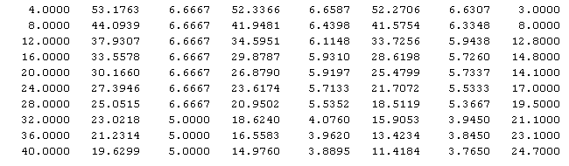
Simulation Results
Condition to allow SR:
  Assume OBSS PD = -72dBm
  -62dBm > RSSI(RTS) > -72dBm
  -72dBm > RSSI(CTS)
Reported metrics: average spectral efficiency and averaged increased SR
STA A or STA B
STA B (CTS sender)
STA A (RTS sender)
distance
AB (meter)
SNR
wo SR
Spectral Eff.
wo SR
SNR
with SR
Spectral Eff.
with SR
SNR
with SR
Spectral Eff.
with SR
Increased
SR (%)
Reza Hedayat, Newracom

Slide 14
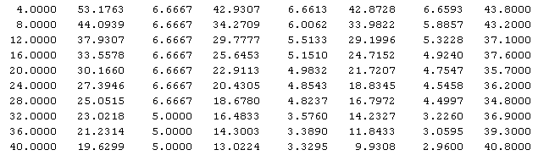
Simulation Results
Condition to allow SR:
  Assume OBSS PD = -82dBm
  -72dBm > RSSI(RTS) > -82dBm
  -72dBm > RSSI(CTS)
Reported metrics: average spectral efficiency and averaged increased SR
STA A or STA B
STA B (CTS sender)
STA A (RTS sender)
distance
AB (meter)
SNR
wo SR
Spectral Eff.
wo SR
SNR
with SR
Spectral Eff.
with SR
SNR
with SR
Spectral Eff.
with SR
Increased
SR (%)
Reza Hedayat, Newracom

Slide 15
Protection of Response Frames
Spatial reuse solutions brings up the issue of protecting the response frames
  For instance, a fair and robust spatial reuse need to make sure that the response frames (such as ACK, BA) at STA A is minimally affected
One solution is to use transmit power control (TPC) to reduce the amount of interference to STA A (and to STA B)
Another solution is to use robust MCS for response frames (e.g. CTS, ACK, BA etc) which is a common practice
  E.g. MCS 0-2 offer larger than 10dB interference tolerance compared to MCS 6-9
Regarding UL MU, since the response frame to a Trigger frame is the UL MU PPDU, it is best if a more the original OBSS PD rule is applied since the actual recipient is the recipient of the response frame.
Reza Hedayat, Newracom

Slide 16
TX Power Imbalance
In Nov 2015, the Spatial Reuse (SR) field was accepted in HE SIG-A, where it was stated that one example of its content is TX power (TP)
Presence of TP in SIG-A is useful for the STAs to refine their CCA thresholds, particularly when STAs have different TP
  AP/STAs have different TP, e.g. AP TP=20dBm and STA TP=17dBm
Imbalanced TX power could cause a STA on the border of coverage to back off for another STA with higher power, but not the opposite. This is an unfair situation due to imbalance of TP.
A STA that receives a frame with CCA=-82dBm, may consider its own TP with the TP indicated in the SIG-A of the received frame to refine PD and OBSS PD
Reza Hedayat, Newracom

Slide 17
Conclusion
The optimum CCA level has been debated within TGax extensively and it seems it’d depend on the topology of the BSS and presence of OBSS
A different treatment of OBSS frames vs BSS frames, e.g. based on Color field, might be a good solution but it’d also depend on topology and over of BSS and OBSS
Current CCA rule offers needed protection when a set of STAs are within reach of each of each other. But it offers overprotection when some of the recipient STAs are farther from the rest
This contribution proposes to evaluate the status of the medium based on RSSI from a frame and its response frame and revise the status of the medium or NAV
Reza Hedayat, Newracom

Slide 18
Strawpoll
Do you agree that the following text in 11ax SFD to be modified?
5.1: Features for operation in dense environments
The specification to consider a procedure that may revise the NAV depending on TBD conditions at the recipient of the ongoing OBSS frame.
A STA that receives an inter-BSS frame with RSSI more than OBSS PD threshold and receives the response frame less than a TBD threshold (e.g. OBSS PD) may set back the NAV to the value before receiving the inter-BSS frame. Above rule does not apply if the inter-BSS frame is a Trigger frame.
Reza Hedayat, Newracom

Slide 19
Appendix
Reza Hedayat, Newracom

Slide 20
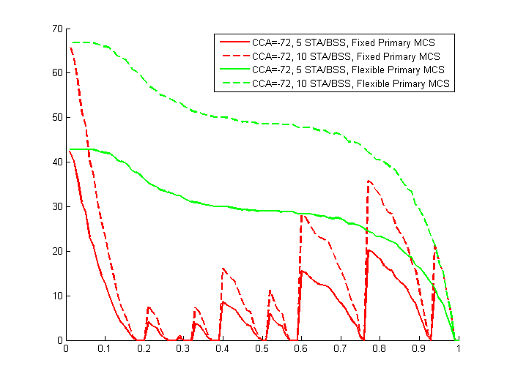
Legacy CCA Rule
Our previous contribution, 15/588r0, shows that there is a large percentage of reuse that current CCA rule prevents
Even with CCA=-72dBm, there is significant spatial reuse that due to current CCA rule (being based on the received RSSI from the transmitter) is left unachieved
Percentage of spatial reuse that CCA prevents
Normalized distance between primary STAs
Reza Hedayat, Newracom

