Slide 1
Usage Scenarios and Applications For Long Range WiFi
Date: 2015-12-13
Authors:
Name | Affiliation | Address | Phone | Email
Jianhan Liu | Mediatek |  |  | jianhan.Liu@mediatek.com
Russell Huang
Tianyu Wu
Thomas Pare
Yakun Sun | Marvell
Hongyuan Zhang
Jianhan Liu (Mediatek)

Slide 2
Abstract
This presentation provides new applications and usage scenarios for consideration in the development of requirements in LRLP.
Jianhan Liu (Mediatek)

Slide 3
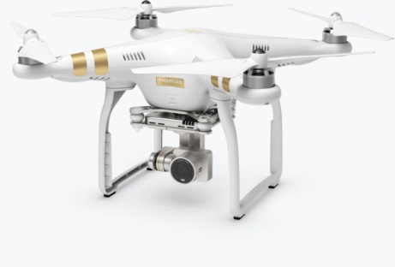
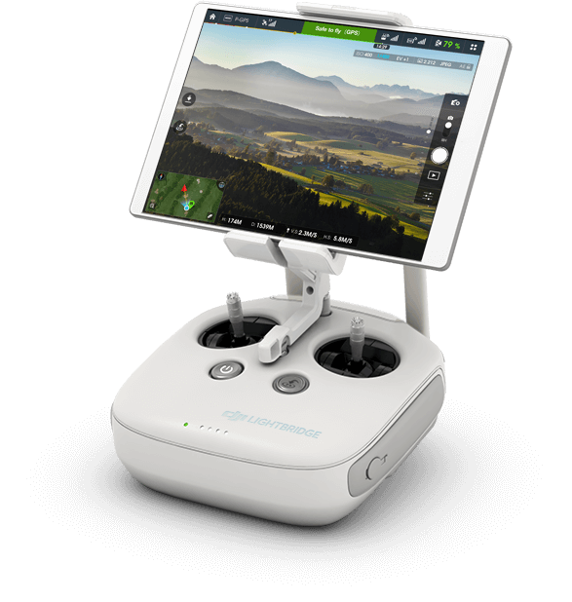
Drone for aerial imaging
Drone for aerial imaging
4K video is recorded in the droid
Low-resolution video/image sends back to remote from droid
Control signal sends to droid from remote
Requirements:
Distance: line of sight (LOS), 1 to 2 kilometer
Data rate: 2 to 4 Mbps
Current WiFi using 20MHz and MCS0 can reach about 400 meters LOS.
About 15dB enhancement for range is required.
Drone
Remote
Jianhan Liu (Mediatek)

Slide 4
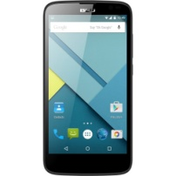
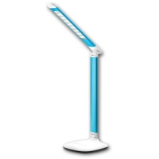
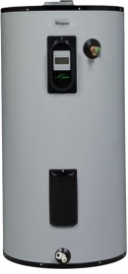
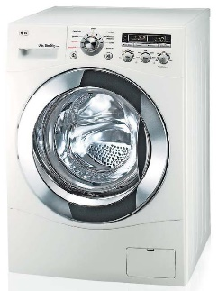
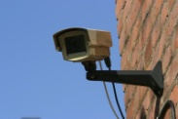
Whole House WiFi Coverage
Current WiFi signal coverage is not enough for the following residents
Large houses of 3000 square feet or more, with over more than 8000sf yard
Apartments over 900squre feet built by concretes
Application
One device, such as smart phone, can be used to monitor and control all IoT devices in the whole house.
Requirements:
About 10dB enhancement for range is required.
Rate is about 5 to 10Mbps

Slide 5
Summary
We present two applications and scenarios for long range WiFi
Propose to enhance 10-15dB for range extension.

