Slide 1
On QPSK DCM Modulation and LDPC Tone Mapper for DCM
Date: 2016-01-17
Authors:
Name | Affiliation | Address | Phone | Email
Jianhan Liu | Mediatek USA | 2860 Junction Ave, San Jose, CA 95134, USA | +1-408-526-1899 | jianhan.Liu@mediatek.com
Thomas Pare |  |  |  | thomas.pare@mediatek.com
ChaoChun Wang |  |  |  | chaochun.wang@mediatek.com
James Wang |  |  |  | james.wang@mediatek.com
Tianyu Wu |  |  |  | tianyu.wu@mediatek.com
Russell Huang |  |  |  | russell.huang@mediatek.com
James Yee | Mediatek | No. 1 Dusing 1st Road, Hsinchu, Taiwan | +886-3-567-0766 | james.yee@mediatek.com
Alan Jauh |  |  |  | alan.jauh@mediatek.com
Frank Hsu |  |  |  | frank.hsu@mediatek.com

Slide 2
Authors (continued)
Name | Affiliation | Address | Phone | Email
Peter Loc | Huawei |  |  | peterloc@iwirelesstech.com
Le Liu |  | F1-17, Huawei Base, Bantian, Shenzhen | +86-18601656691 | liule@huawei.com
Jun (Rossi) Luo |  | 5B-N8, No.2222 Xinjinqiao Road, Pudong, Shanghai |  | jun.l@huawei.com
Yi Luo |  | F1-17, Huawei Base, Bantian, Shenzhen | +86-18665891036 | Roy.luoyi@huawei.com
Yingpei Lin |  | 5B-N8, No.2222 Xinjinqiao Road, Pudong, Shanghai |  | linyingpei@huawei.com
Jiyong Pang |  | 5B-N8, No.2222 Xinjinqiao Road, Pudong, Shanghai |  | pangjiyong@huawei.com
Zhigang Rong |  | 10180 Telesis Court, Suite 365, San Diego, CA 92121 NA |  | zhigang.rong@huawei.com
Rob Sun |  | 303 Terry Fox, Suite 400 Kanata, Ottawa, Canada |  | Rob.Sun@huawei.com
David X. Yang |  | F1-17, Huawei Base, Bantian, Shenzhen |  | david.yangxun@huawei.com
Yunsong Yang |  | 10180 Telesis Court, Suite 365, San Diego, CA 92121 NA |  | yangyunsong@huawei.com
Zhou Lan |  | F1-17, Huawei Base, Bantian, SHenzhen | +86-18565826350 | Lanzhou1@huawei.com
Junghoon Suh |  | 303 Terry Fox, Suite 400 Kanata, Ottawa, Canada |  | Junghoon.Suh@huawei.com
Jiayin Zhang |  | 5B-N8, No.2222 Xinjinqiao Road, Pudong, Shanghai | +86-18601656691 | zhangjiayin@huawei.com

Slide 3
Authors (continued)
Name | Affiliation | Address | Phone | Email
Alice Chen | Qualcomm | 5775 Morehouse Dr. San Diego, CA, USA |  | alicel@qti.qualcomm.com
Albert Van Zelst |  | Straatweg 66-S Breukelen, 3621 BR Netherlands |  | allert@qti.qualcomm.com
Alfred Asterjadhi |  | 5775 Morehouse Dr. San Diego, CA, USA |  | aasterja@qti.qualcomm.com
Arjun Bharadwaj |  | 5775 Morehouse Dr. San Diego, CA, USA |  | arjunb@qti.qualcomm.com
Bin Tian |  | 5775 Morehouse Dr. San Diego, CA, USA |  | btian@qti.qualcomm.com
Carlos Aldana |  | 1700 Technology Drive San Jose, CA 95110, USA |  | caldana@qca.qualcomm.com
George Cherian |  | 5775 Morehouse Dr. San Diego, CA, USA |  | gcherian@qti.qualcomm.com
Gwendolyn Barriac |  | 5775 Morehouse Dr. San Diego, CA, USA |  | gbarriac@qti.qualcomm.com
Hemanth Sampath |  | 5775 Morehouse Dr. San Diego, CA, USA |  | hsampath@qti.qualcomm.com
Lin Yang |  | 5775 Morehouse Dr. San Diego, CA, USA |  | linyang@qti.qualcomm.com
Menzo Wentink |  | Straatweg 66-S Breukelen, 3621 BR Netherlands |  | mwentink@qti.qualcomm.com
Naveen Kakani |  | 2100 Lakeside Boulevard Suite 475, Richardson TX 75082, USA |  | nkakani@qti.qualcomm.com
Raja Banerjea |  | 1060 Rincon Circle San Jose CA 95131, USA |  | rajab@qit.qualcomm.com
Richard Van Nee |  | Straatweg 66-S Breukelen, 3621 BR Netherlands |  | rvannee@qti.qualcomm.com

Slide 4
Authors (continued)
Name | Affiliation | Address | Phone | Email
Rolf De Vegt | Qualcomm | 1700 Technology Drive San Jose, CA 95110, USA |  | rolfv@qca.qualcomm.com
Sameer Vermani |  | 5775 Morehouse Dr. San Diego, CA, USA |  | svverman@qti.qualcomm.com
Simone Merlin |  | 5775 Morehouse Dr. San Diego, CA, USA |  | smerlin@qti.qualcomm.com
Tao Tian |  | 5775 Morehouse Dr. San Diego, CA, USA |  | ttian@qti.qualcomm.com
Tevfik Yucek |  | 1700 Technology Drive San Jose, CA 95110, USA |  | tyucek@qca.qualcomm.com
VK Jones |  | 1700 Technology Drive San Jose, CA 95110, USA |  | vkjones@qca.qualcomm.com
Youhan Kim |  | 1700 Technology Drive San Jose, CA 95110, USA |  | youhank@qca.qualcomm.com

Slide 5
Authors (continued)
Name | Affiliation | Address | Phone | Email
Robert Stacey | Intel | 2111 NE 25th Ave, Hillsboro OR 97124, USA | +1-503-724-893 | robert.stacey@intel.com
Eldad Perahia |  |  |  | eldad.perahia@intel.com
Shahrnaz Azizi |  |  |  | shahrnaz.azizi@intel.com
Po-Kai Huang |  |  |  | po-kai.huang@intel.com
Qinghua Li |  |  |  | quinghua.li@intel.com
Xiaogang Chen |  |  |  | xiaogang.c.chen@intel.com
Chitto Ghosh |  |  |  | chittabrata.ghosh@intel.com
Laurent cariou |  |  |  | laurent.cariou@intel.com
Rongzhen Yang |  |  |  | rongzhen.yang@intel.com
Ron Porat | Broadcom |  |  | rporat@broadcom.com
Sriram Venkateswaran |  |  |  | mfischer@broadcom.com
Matthew Fischer
Zhou Lan
Leo Montreuil
Andrew Blanksby
Vinko Erceg

Slide 6
Authors (continued):
Name | Affiliation | Address | Phone | Email
Hongyuan Zhang | Marvell | 5488 Marvell Lane, Santa Clara, CA, 95054 | 408-222-2500 | hongyuan@marvell.com
Yakun Sun |  |  |  | yakunsun@marvell.com
Lei Wang |  |  |  | Leileiw@marvell.com
Liwen Chu |  |  |  | liwenchu@marvell.com
Jinjing Jiang |  |  |  | jinjing@marvell.com
Yan Zhang |  |  |  | yzhang@marvell.com
Rui Cao |  |  |  | ruicao@marvell.com
Bo Yu |  |  |  | jiehuang@marvell.com
Sudhir Srinivasa |  |  |  | sudhirs@marvell.com
Saga Tamhane |  |  |  | sagar@marvell.com
Mao Yu |  |  |  | my@marvel..com
Edward Au |  |  |  | edwardau@marvell.com
Hui-Ling Lou |  |  |  | hlou@marvell.com
Joonsuk Kim | Apple |  |  | joonsuk@apple.com
Aon Mujtaba |  |  |  | mujtaba@apple.com
Guoqing Li |  |  |  | guoqing_li@apple.com
Eric Wong |  |  |  | ericwong@apple.com
Chris Hartman |  |  |  | chartman@apple.com

Slide 7
Authors (continued)
Name | Affiliation | Address | Phone | Email
Hyeyoung Choi | LG Electronics | 19, Yangjae-daero 11gil, Seocho-gu, Seoul 137-130, Korea |  | hy0117.choi@lge.com
Kiseon Ryu |  |  |  | kiseon.ryu@lge.com
Jinyoung Chun |  |  |  | jiny.chun@lge.com
Jinsoo Choi |  |  |  | js.choi@lge.com
Jeongki Kim |  |  |  | jeongki.kim@lge.com
Giwon Park |  |  |  | giwon.park@lge.com
Dongguk Lim |  |  |  | dongguk.lim@lge.com
Suhwook Kim |  |  |  | suhwook.kim@lge.com
Eunsung Park |  |  |  | esung.park@lge.com
HanGyu Cho |  |  |  | hg.cho@lge.com
Thomas Derham | Orange |  |  | thomas.derham@orange.com
Bo Sun | ZTE | #9 Wuxingduan, Xifeng Rd., Xi'an, China |  | sun.bo1@zte.com.cn
Kaiying Lv |  |  |  | lv.kaiying@zte.com.cn
Yonggang Fang |  |  |  | yfang@ztetx.com
Ke Yao |  |  |  | yao.ke5@zte.com.cn
Weimin Xing |  |  |  | xing.weimin@zte.com.cn
Brian Hart | Cisco Systems | 170 W Tasman Dr, San Jose, CA 95134 |  | brianh@cisco.com
Pooya Monajemi |  |  |  | pmonajem@cisco.com

Slide 8
Authors (continued)
Name | Affiliation | Address | Phone | Email
Fei Tong | Samsung | Innovation Park, Cambridge CB4 0DS (U.K.) | +44 1223 434633 | f.tong@samsung.com
Hyunjeong Kang |  | Maetan 3-dong; Yongtong-Gu Suwon; South Korea | +82-31-279-9028 | hyunjeong.kang@samsung.com
Kaushik Josiam |  | 1301, E. Lookout Dr, Richardson TX 75070 | (972) 761 7437 | k.josiam@samsung.com
Mark Rison |  | Innovation Park, Cambridge CB4 0DS (U.K.) | +44 1223 434600 | m.rison@samsung.com
Rakesh Taori |  | 1301, E. Lookout Dr, Richardson TX 75070 | (972) 761 7470 | rakesh.taori@samsung.com
Sanghyun Chang |  | Maetan 3-dong; Yongtong-Gu Suwon; South Korea | +82-10-8864-1751 | s29.chang@samsung.com
Yasushi Takatori | NTT | 1-1 Hikari-no-oka, Yokosuka, Kanagawa 239-0847 Japan | +81 46 859 3135 | takatori.yasushi@lab.ntt.co.jp
Yasuhiko Inoue |  |  | +81 46 859 5097 | inoue.yasuhiko@lab.ntt.co.jp
Shoko Shinohara |  |  | +81 46 859 5107 | Shinohara.shoko@lab.ntt.co.jp
Yusuke Asai |  |  | +81 46 859 3494 | asai.yusuke@lab.ntt.co.jp
Koichi Ishihara |  |  | +81 46 859 4233 | ishihara.koichi@lab.ntt.co.jp
Junichi Iwatani |  |  | +81 46 859 4222 | Iwatani.junichi@lab.ntt.co.jp
Akira Yamada | NTT DOCOMO | 3-6, Hikarinooka, Yokosuka-shi, Kanagawa, 239-8536, Japan | +81 46 840 3759 | yamadaakira@nttdocomo.com

Slide 9
Authors (continued)
Kazuyuki Sakoda | Sony Electronics |  |  | Kazuyuki.Sakoda@am.sony.com
Yusuke Tanaka |  |  |  | YusukeC.Tanaka@jp.sony.com
Eisuke Sakai |  |  |  | Eisuke.Sakai@jp.sony.com
Yuichi Morioka |  |  |  | Yuichi.Morioka@jp.sony.com
Masahito Mori |  |  |  | Masahito.Mori@jp.sony.com

Slide 10
Introduction
DCM has been adopted as a mode for HE-SIGB and Data in 11ax SFD.
  DCM is used with BPSK/QPSK/16QAM modulations.
DCM can also be beneficial in many scenarios.
  Range extension
  Robust to narrow band interferences.
DCM Modulation schemes and LDPC tone mapping parameters have not yet been defined in 11ax SFD.
  We propose QPSK DCM modulation scheme and LDPC tone mapper in this contribution.

Slide 11
QPSK DCM modulation scheme
We propose the QPSK DCM modulation scheme for 11ax directly reuse the QPSK DCM modulation scheme in IEEE 802.11ad specification.
  The coded/interleaved bits are modulated as QPSK and mapped to the lower half frequency segment:
    [d₁, d₂, … d_{N_SD/2}]
  The modulated symbols of the lower frequency segment are repeated and conjugated and then mapped to the upper half frequency segment:
  [d_{N_SD/2+1}, d_{N_SD/2+2}, … d_{N_SD}] = conj([d₁, d₂, … d_{N_SD/2}])

Slide 12
Transmission diagram for DCM modulations
FEC
Interleaver
(if BCC)
LDPC Tone Mapper
(if LDPC)
DCM Constellation Mapper
IDFT
When BCC is used, each modulated signal are mapped to a pair of DCM tones, which are data tone n and n+N/2 respectively.
When LDPC is used, the LDPC tone mapper for the lower frequency segment and the LDPC tone mapper for the upper frequency segment are exactly same.
  We need define LDPC tone mapper (i.e., D_{TM,DCM}) for DCM.

Slide 13
LDPC Tone Mapper
LDPC tone mapper maps the k-th complex number generated by the constellation mappers to the t(k)-th subcarrier.
  where NSD is Number of complex data numbers per frequency segment
  where D_{TM,DCM} is LDPC tone mapping distance for DCM, the values are discussed later.
The tone mapping for the lower half frequency segment and the upper half frequency segment should be identical.
  Maintain the maximum distance between the repeated (and remapped) symbols.

Slide 14
Propose LDPC Tone Mapper for DCM
Comparison of #of SD for DCM and non-DCM for different RU sizes.
RU size (tones) | N_{SD} | N_{SD} for DCM
26 | 24 | 12
52 | 48 | 24
106 | 102 | 51
242 | 234 | 117
484 | 468 | 234
996 | 980 | 490
We propose another LDPC tone mapper scheme for DCM (the green-colored column).
RU size (tones) | LDPC | LDPC (with (DCM)
 | D_{TM} | D_{TM}
26 | 1 | 1
52 | 3 | 1
106 | 6 | 3
242 | 9 | 9
484 | 12 | 9
996 | 20 | 14

Slide 15
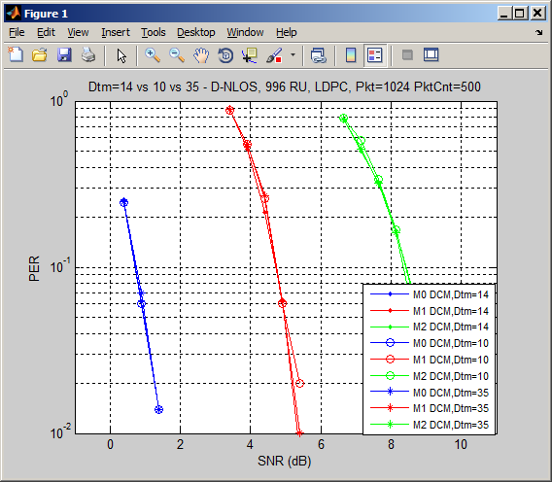
Performance of LDPC Tone Mapper for DCM

Slide 16
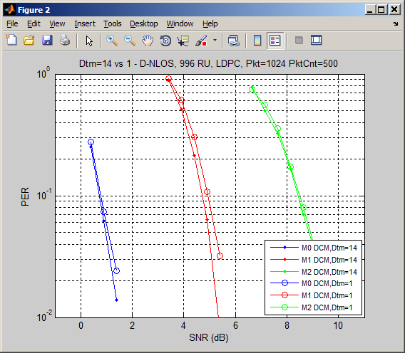
Performance of LDPC Tone Mapper for DCM (cont’s)

Slide 17
Performance comparison with whole band LDPC Tone Mappers
  Simulations show using the whole symbol tone mappers degrade PER about 1-2dB compared to our proposed schemes
    This is due to loss of the maximum frequency diversity

Slide 18
Conclusion
QPSK DCM modulation scheme is proposed.
  Same as 11ad
LDPC tone mapping parameters for DCM is proposed.
  Achieves the best performance

Slide 19
Straw Poll #1
Do you agree to add the following QPSK DCM modulation scheme to the IEEE802.11ax SFD?
The coded/interleaved bits are modulated as QPSK and mapped to the lower half frequency segment: [d₁, d₂, … d_{N_SD/2}];
The modulated symbols of the lower half frequency segment are repeated and conjugated and then mapped to the upper half frequency segment: [d_{N_SD/2+1}, d_{N_SD/2+2}, … d_{N_SD}] = conj([d₁, d₂, … d_{N_SD/2}])
_{Y/N/Abs}

Slide 20
Straw poll #2
Do you agree to add the following LDPC Tone Mapping parameters D_{TM} for DCM modulations to the IEEE802.11ax SFD?
RU size (tones) | LDPC | LDPC (with (DCM)
 | D_{TM} | D_{TM}
26 | 1 | 1
52 | 3 | 1
106 | 6 | 3
242 | 9 | 9
484 | 12 | 9
996 | 20 | 14
_{Y/N/Abs}

