Slide 1
IEEE 802.11 activities related to NGMN
Date: 14 December 2015
Authors:

Slide 2
Introduction
This report represent the views of the author regarding the 802.11 activities related to NGNM Liaison Letter to the IEEE.

Slide 3
Timeline
2 September 2014:
NGMN Liaison Letter sent to the IEEE
27 October 2014:
IEEE 802.11 posts NGMN Liaison on 5G
https://mentor.ieee.org/802.11/dcn/14/11-14-1366-00-0000-liaison-from-ngmn-on-5g.pdf
16 January 2015:
IEEE 802.11 sends 1st Liaison Response to the NGMN
https://mentor.ieee.org/802.11/dcn/15/11-15-0191-01-0000-ngmn-liaison-response.docx
17 February 2015:
The NGMN publishes the “NGMN 5G White Paper”
6 March 2015:
IEEE 802.11 posts link to the NGMN 5G White Paper
https://mentor.ieee.org/802.11/dcn/15/11-15-0322-01-0reg-ngmn-5g-white-paper.docx
25 March 2015:
NGMN sends 2nd Liaison Letter to the IEEE (similar in content as the 2 September 2014 Liaison Letter)
https://mentor.ieee.org/802.11/dcn/15/11-15-0503-00-0reg-march-25-2015-liaison-from-ngmn-on-5g.docx

Slide 4
Timeline
5 May 2015:
IEEE 802.11 presents an tutorial overview of the NGMN 5G White paper to a large audience as part of its Wireless Next Generation Standing Committee sessions
https://mentor.ieee.org/802.11/dcn/15/11-15-0547-00-0wng-ngmn-5g-white-paper-overview.pptx
14 May 2015:
IEEE 802.11 sends 2nd Liaison Response to the NGMN
https://mentor.ieee.org/802.11/dcn/15/11-15-0673-02-0reg-draft-of-2nd-liaison-response-to-ngmn.docx
9 November 2015:
A panel discussion on the NGMN 5G White Paper is presented as a tutorial at the Wireless Next Generation Standing Committee sessions.
Panel Discussion on Perspectives on IEEE 802.11 in 5G/NGMN
https://mentor.ieee.org/802.11/dcn/15/11-15-1266-01-0000-tutorial-panel-discussion-perspectives-on-ieee-802-11-in-5g.ppt

Slide 5
Intention and Required Actions of the NGMN Liaison Letter *
1. The intention of the liaison is to introduce to the IEEE on the scope and objectives of the NGMN 5G initiative. 2. The NGMN would like to invite IEEE to provide feedback on the activities and to make proposals on potential aspects to be considered in their work. 3. The NGMN wants to inform the IEEE that it is their intention to keep IEEE updated on their activities in the area of 5G at major milestones. 4. Furthermore, NGMN would like to understand and to receive information on IEEE’s current and potential future activities in the area of 5G. 5. It would be of particular interest for NGMN if there is input required from the NGMN 5G initiative and the dates and milestones by which the input from NGMN would be required. 6. The NGMN would like a representative at the NGMN Industry Conference & Exhibition in Frankfurt/Germany on 24-25 March 2015, where the NGMN 5G White Paper will be publicly introduced and distributed for the first time. 7. The NGMN looks forward to deeper and further collaboration with the IEEE on 5G related activities.
* Source: https://mentor.ieee.org/802.11/dcn/14/11-14-1366-00-0000-liaison-from-ngmn-on-5g.pdf

Slide 6
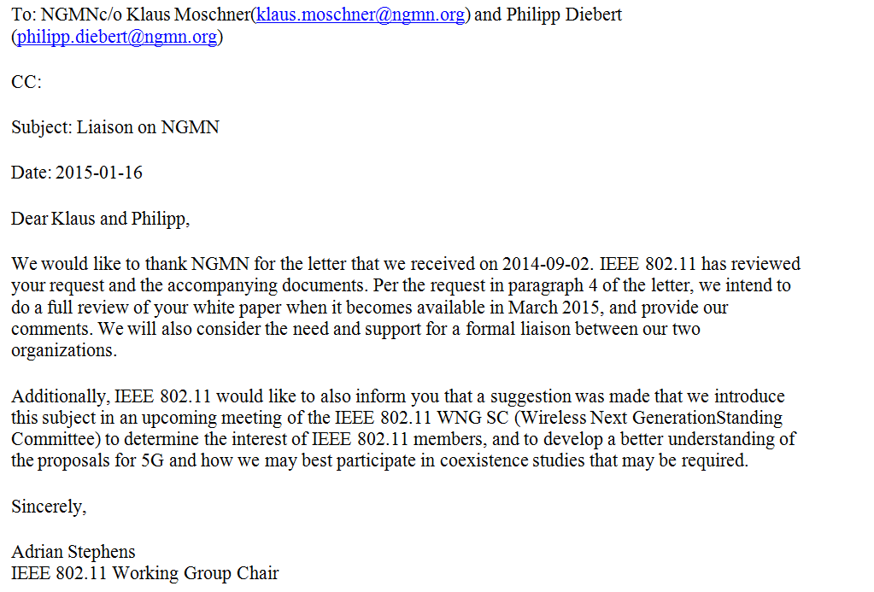
IEEE 802.11 1st Liaison Response to NGMN

Slide 7
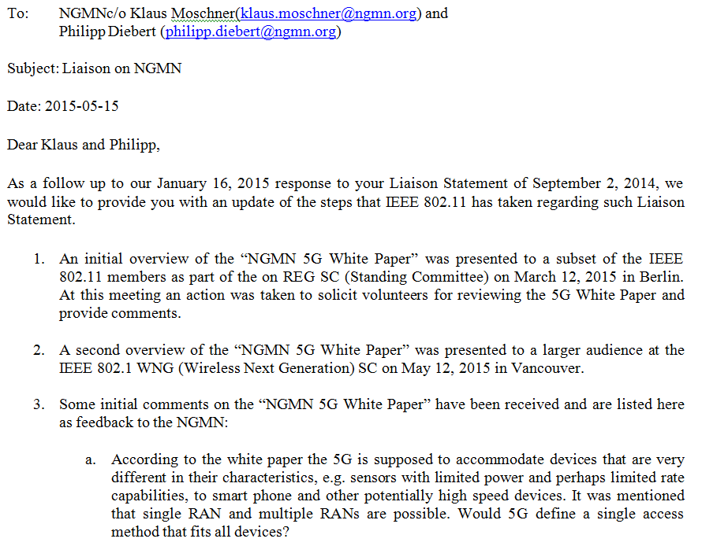
IEEE 802.11 2nd Liaison Response to NGMN

Slide 8
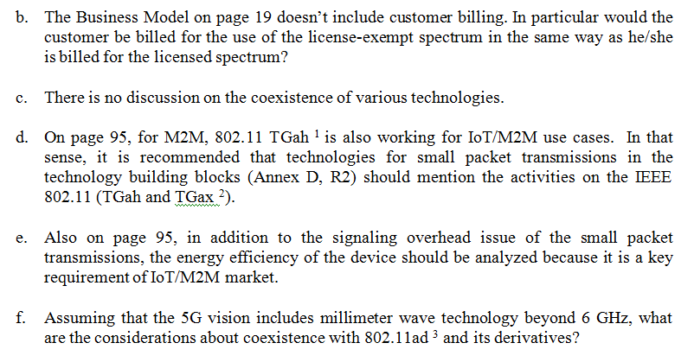
IEEE 802.11 2nd Liaison Response to NGMN (continued)

Slide 9
IEEE 802.11 2nd Liaison Response to NGMN (continued)

Slide 10
Next Steps
The 802.11 Working Group will be drafting its 3rd Liaison Response Letter to the NGMN during its Atlanta Plenary Meeting in January 2016.
* Source: https://mentor.ieee.org/802.11/dcn/14/11-14-1366-00-0000-liaison-from-ngmn-on-5g.pdf

