Slide 1
Discussion on HE Extended Range
SU PPDU
Date: 2016-01-18
Authors:
Name | Affiliation | Address | Phone | Email
Jiayin Zhang | Huawei | No 200 Jinsu Road, Shanghai China |  | zhangjiayin@huawei.com
Jun Zhu |  |  |  | zhujun75@huawei.com
Le Liu |  | F1-17, Huawei Base, Bantian, Shenzhen |  | liule@huawei.com
Jun Luo |  | 5B-N8, No.2222 Xinjinqiao Road, Pudong, Shanghai |  | jun.l@huawei.com
Yi Luo |  | F1-17, Huawei Base, Bantian, Shenzhen | +86-18665891036 | Roy.luoyi@huawei.com
Yingpei Lin |  | 5B-N8, No.2222 Xinjinqiao Road, Pudong, Shanghai |  | linyingpei@huawei.com
Jiyong Pang |  | 5B-N8, No.2222 Xinjinqiao Road, Pudong, Shanghai |  | pangjiyong@huawei.com
Zhigang Rong |  | 10180 Telesis Court, Suite 365, San Diego, CA 92121 NA |  | zhigang.rong@huawei.com
Rob Sun |  | 303 Terry Fox, Suite 400 Kanata, Ottawa, Canada |  | Rob.Sun@huawei.com
David X. Yang |  | F1-17, Huawei Base, Bantian, Shenzhen |  | david.yangxun@huawei.com

Slide 2
Authors (continued)
Name | Affiliation | Address | Phone | Email
Yunsong Yang | Huawei | 10180 Telesis Court, Suite 365, San Diego, CA 92121 NA |  | yangyunsong@huawei.com
Junghoon Suh |  | 303 Terry Fox, Suite 400 Kanata, Ottawa, Canada |  | Junghoon.Suh@huawei.com
Peter Loc |  |  |  | peterloc@iwirelesstech.com
Hongyuan Zhang | Marvell | 5488 Marvell Lane, Santa Clara, CA, 95054 | 408-222-2500 | hongyuan@marvell.com
Yakun Sun |  |  |  | yakunsun@marvell.com
Lei Wang |  |  |  | Leileiw@marvell.com
Liwen Chu |  |  |  | liwenchu@marvell.com
Jinjing Jiang |  |  |  | jinjing@marvell.com
Yan Zhang |  |  |  | yzhang@marvell.com
Rui Cao |  |  |  | ruicao@marvell.com
Sudhir Srinivasa |  |  |  | sudhirs@marvell.com
Bo Yu |  |  |  | boyu@marvell.com
Saga Tamhane |  |  |  | sagar@marvell.com
Mao Yu |  |  |  | my@marvel..com
Xiayu Zheng |  |  |  | xzheng@marvell.com
Christian Berger |  |  |  | crberger@marvell.com
Niranjan Grandhe |  |  |  | ngrandhe@marvell.com
Hui-Ling Lou |  |  |  | hlou@marvell.com

Slide 3
Authors (continued)
Name | Affiliation | Address | Phone | Email
Alice Chen | Qualcomm | 5775 Morehouse Dr. San Diego, CA, USA |  | alicel@qti.qualcomm.com
Albert Van Zelst |  | Straatweg 66-S Breukelen, 3621 BR Netherlands |  | allert@qti.qualcomm.com
Alfred Asterjadhi |  | 5775 Morehouse Dr. San Diego, CA, USA |  | aasterja@qti.qualcomm.com
Arjun Bharadwaj |  | 5775 Morehouse Dr. San Diego, CA, USA |  | arjunb@qti.qualcomm.com
Bin Tian |  | 5775 Morehouse Dr. San Diego, CA, USA |  | btian@qti.qualcomm.com
Carlos Aldana |  | 1700 Technology Drive San Jose, CA 95110, USA |  | caldana@qca.qualcomm.com
George Cherian |  | 5775 Morehouse Dr. San Diego, CA, USA |  | gcherian@qti.qualcomm.com
Gwendolyn Barriac |  | 5775 Morehouse Dr. San Diego, CA, USA |  | gbarriac@qti.qualcomm.com
Hemanth Sampath |  | 5775 Morehouse Dr. San Diego, CA, USA |  | hsampath@qti.qualcomm.com
Lin Yang |  | 5775 Morehouse Dr. San Diego, CA, USA |  | linyang@qti.qualcomm.com
Menzo Wentink |  | Straatweg 66-S Breukelen, 3621 BR Netherlands |  | mwentink@qti.qualcomm.com
Naveen Kakani |  | 2100 Lakeside Boulevard Suite 475, Richardson TX 75082, USA |  | nkakani@qti.qualcomm.com
Raja Banerjea |  | 1060 Rincon Circle San Jose CA 95131, USA |  | rajab@qit.qualcomm.com
Richard Van Nee |  | Straatweg 66-S Breukelen, 3621 BR Netherlands |  | rvannee@qti.qualcomm.com

Slide 4
Authors (continued)
Name | Affiliation | Address | Phone | Email
Rolf De Vegt | Qualcomm | 1700 Technology Drive San Jose, CA 95110, USA |  | rolfv@qca.qualcomm.com
Sameer Vermani |  | 5775 Morehouse Dr. San Diego, CA, USA |  | svverman@qti.qualcomm.com
Simone Merlin |  | 5775 Morehouse Dr. San Diego, CA, USA |  | smerlin@qti.qualcomm.com
Tao Tian |  | 5775 Morehouse Dr. San Diego, CA, USA |  | ttian@qti.qualcomm.com
Tevfik Yucek |  | 1700 Technology Drive San Jose, CA 95110, USA |  | tyucek@qca.qualcomm.com
VK Jones |  | 1700 Technology Drive San Jose, CA 95110, USA |  | vkjones@qca.qualcomm.com
Youhan Kim |  | 1700 Technology Drive San Jose, CA 95110, USA |  | youhank@qca.qualcomm.com

Slide 5
Authors (continued)
Name | Affiliation | Address | Phone | Email
James Yee | Mediatek | No. 1 Dusing 1st Road, Hsinchu, Taiwan | +886-3-567-0766 | james.yee@mediatek.com
Alan Jauh |  |  |  | alan.jauh@mediatek.com
Chingwa Hu |  |  |  | chinghwa.yu@mediatek.com
Frank Hsu |  |  |  | frank.hsu@mediatek.com
Thomas Pare | Mediatek USA | 2860 Junction Ave, San Jose, CA 95134, USA | +1-408-526-1899 | thomas.pare@mediatek.com
ChaoChun Wang |  |  |  | chaochun.wang@mediatek.com
James Wang |  |  |  | james.wang@mediatek.com
Jianhan Liu |  |  |  | Jianhan.Liu@mediatek.com
Tianyu Wu |  |  |  | tianyu.wu@mediatek.com
Zhou Lan |  |  |  | Zhou.lan@mediaTek.com
Russell Huang |  |  |  | russell.huang@mediatek.com
Joonsuk Kim | Apple |  |  | joonsuk@apple.com
Aon Mujtaba |  |  |  | mujtaba@apple.com
Guoqing Li |  |  |  | guoqing_li@apple.com
Eric Wong |  |  |  | ericwong@apple.com
Chris Hartman |  |  |  | chartman@apple.com

Slide 6
Authors (continued)
Name | Affiliation | Address | Phone | Email
Ron Porat | Broadcom |  |  | rporat@broadcom.com
Sriram Venkateswaran |  |  |  | mfischer@broadcom.com
Matthew Fischer
Leo Montreuil
Andrew Blanksby
Vinko Erceg
Robert Stacey | Intel | 2111 NE 25th Ave, Hillsboro OR 97124, USA | +1-503-724-893 | robert.stacey@intel.com
Shahrnaz Azizi |  |  |  | shahrnaz.azizi@intel.com
Po-Kai Huang |  |  |  | po-kai.huang@intel.com
Qinghua Li |  |  |  | quinghua.li@intel.com
Xiaogang Chen |  |  |  | xiaogang.c.chen@intel.com
Chitto Ghosh |  |  |  | chittabrata.ghosh@intel.com
Laurent Cariou |  |  |  | laurent.cariou@intel.com
Yaron Alpert |  |  |  | yaron.alpert@intel.com
Assaf Gurevitz |  |  |  | assaf.gurevitz@intel.com
Ilan Sutskover |  |  |  | ilan.sutskover@intel.com

Slide 7
Authors (continued)
Name | Affiliation | Address | Phone | Email
Jinmin Kim | LG Electronics | 19, Yangjae-daero 11gil, Seocho-gu, Seoul 137-130, Korea |  | Jinmin1230.kim@lge.com
Kiseon Ryu |  |  |  | kiseon.ryu@lge.com
Jinyoung Chun |  |  |  | jiny.chun@lge.com
Jinsoo Choi |  |  |  | js.choi@lge.com
Jeongki Kim |  |  |  | jeongki.kim@lge.com
Dongguk Lim |  |  |  | dongguk.lim@lge.com
Suhwook Kim |  |  |  | suhwook.kim@lge.com
Eunsung Park |  |  |  | esung.park@lge.com
JayH Park |  |  |  | Hyunh.park@lge.com
HanGyu Cho |  |  |  | hg.cho@lge.com
Thomas Derham | Orange |  |  | thomas.derham@orange.com
Bo Sun | ZTE | #9 Wuxingduan, Xifeng Rd., Xi'an, China |  | sun.bo1@zte.com.cn
Kaiying Lv |  |  |  | lv.kaiying@zte.com.cn
Yonggang Fang |  |  |  | yfang@ztetx.com
Ke Yao |  |  |  | yao.ke5@zte.com.cn
Weimin Xing |  |  |  | xing.weimin@zte.com.cn
Brian Hart | Cisco Systems | 170 W Tasman Dr, San Jose, CA 95134 |  | brianh@cisco.com
Pooya Monajemi |  |  |  | pmonajem@cisco.com

Slide 8
Authors (continued)
Name | Affiliation | Address | Phone | Email
Fei Tong | Samsung | Innovation Park, Cambridge CB4 0DS (U.K.) | +44 1223 434633 | f.tong@samsung.com
Hyunjeong Kang |  | Maetan 3-dong; Yongtong-Gu Suwon; South Korea | +82-31-279-9028 | hyunjeong.kang@samsung.com
Kaushik Josiam |  | 1301, E. Lookout Dr, Richardson TX 75070 | (972) 761 7437 | k.josiam@samsung.com
Mark Rison |  | Innovation Park, Cambridge CB4 0DS (U.K.) | +44 1223 434600 | m.rison@samsung.com
Rakesh Taori |  | 1301, E. Lookout Dr, Richardson TX 75070 | (972) 761 7470 | rakesh.taori@samsung.com
Sanghyun Chang |  | Maetan 3-dong; Yongtong-Gu Suwon; South Korea | +82-10-8864-1751 | s29.chang@samsung.com
Yasushi Takatori | NTT | 1-1 Hikari-no-oka, Yokosuka, Kanagawa 239-0847 Japan | +81 46 859 3135 | takatori.yasushi@lab.ntt.co.jp
Yasuhiko Inoue |  |  | +81 46 859 5097 | inoue.yasuhiko@lab.ntt.co.jp
Shoko Shinohara |  |  | +81 46 859 5107 | Shinohara.shoko@lab.ntt.co.jp
Yusuke Asai |  |  | +81 46 859 3494 | asai.yusuke@lab.ntt.co.jp
Koichi Ishihara |  |  | +81 46 859 4233 | ishihara.koichi@lab.ntt.co.jp
Junichi Iwatani |  |  | +81 46 859 4222 | Iwatani.junichi@lab.ntt.co.jp
Akira Yamada | NTT DOCOMO | 3-6, Hikarinooka, Yokosuka-shi, Kanagawa, 239-8536, Japan | +81 46 840 3759 | yamadaakira@nttdocomo.com
Masahito Mori | Sony Corp. |  |  | Masahito.Mori@jp.sony.com
Yusuke Tanaka |  |  |  | YusukeC.Tanaka@jp.sony.com
Yuichi Morioka |  |  |  | Yuichi.Morioka@jp.sony.com
Kazuyuki Sakoda |  |  |  | Kazuyuki.Sakoda@am.sony.com
William Carney |  |  |  | William.Carney@am.sony.com

Slide 9
Background
In [1], performance of extended range SU preamble is evaluated, and it is shown that
  Performance of various sub-fields of pre-HE-STF portion is well balanced.
  Performance of data portion for MCS0 on 20MHz bandwidth is much worse than the preamble, especially for large payload.
In this contribution, we discuss the necessity of HE EXT SU PPDU and propose methods to improve the performance of data portion to enhance reliability of extended range SU PPDU.

Slide 10
HE EXT SU PPDU
In IEEE 11ax SFD[2], extended range SU preamble format is defined as one of the three HE preamble formats.
  L-STF power is boosted by 3 dB in the extended range preamble.
  L-LTF power is boosted by 3 dB in the extended range preamble.
  RL-SIG is repeating the L-SIG content right after the legacy section.
  HE-SIG-A shall have a repetition mode for range extension. In the repetition mode, HE-SIG-A symbols are repeated once in time. The bit interleaver is bypassed in the repeated HE-SIG-A symbols.
  TBD mandatory or optional
  Payload part is TBD

Slide 11
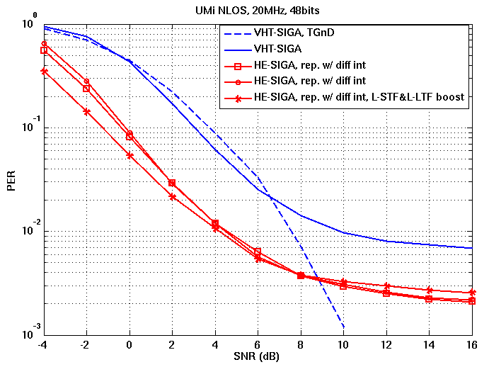
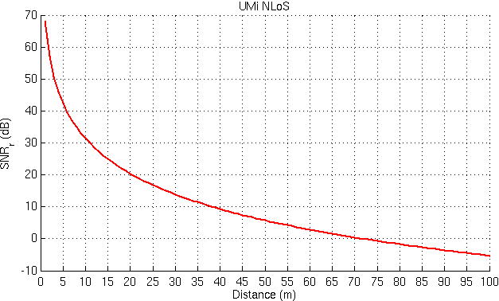
Coverage of HE EXT SU PPDU
Non HE EXT SU PPDU only provide the coverage of 50m in DL and 30m in UL under the assumption of IEEE SS4, considering the SNR of 10%PER.
The preamble of HE EXT SU PPDU can well achieve the coverage of SS4 (around 70m) .
The payload can not achieve similar PER performance as preamble even with DCM MCS0.

Slide 12
BW&SS for HE EXT SU PPDU
The PER relates to the SNR of each modulation constellation.
Considering the limited total transmit power per device, the SNR per constellation decrease when larger BW PPDU and more spatial layers are configured at transmitter.
We propose to transmit HE EXT SU PPDU only transmit on primary 20MHz Ch and with one spatial stream.

Slide 13
MCS for HE EXT PPDU
Higher MCS requires higher SNR which is not necessary in the scenario of range extension. MCS0, MCS1, MCS2 corresponding to reliable BPSK/QPSK modulation enough for HE-EXT-SU-PPDU.
Dual subcarrier modulation(DCM) is also beneficial to extend the coverage.
    Rate of MCS0 with DCM is half of MCS0, which provide additional 3.5dB gain compared with MCS0.

Slide 14
Power boosting of HE-LTF
In order to further enhance the data portion, xdB power boosting of HE-STF/HE-LTF may be provided to improve channel estimation accuracy.
  PAPR of HE-STF/HE-LTF is much lower than data portion.
  HE-STF/HE-LTF power is always boosted 3dB for simplicity.
    About 1.4dB PER performance gain could be achieved. [See next slide]
 | 1.6us HE-STF | 2X HE-LTF | 4X HE-LTF | Data (1%CCDF)
26-tone RU | <4.77dB | <4.2dB | <3.6dB | 7.5dB
52-tone RU | <4.79dB | <3.9dB | <4.8dB | 8dB
106-tone RU | <4.37dB | <4.5dB | <4.9dB | 8.5dB
242-tone RU | <4.4dB | <4.8dB | <4.9dB | 9dB

Slide 15
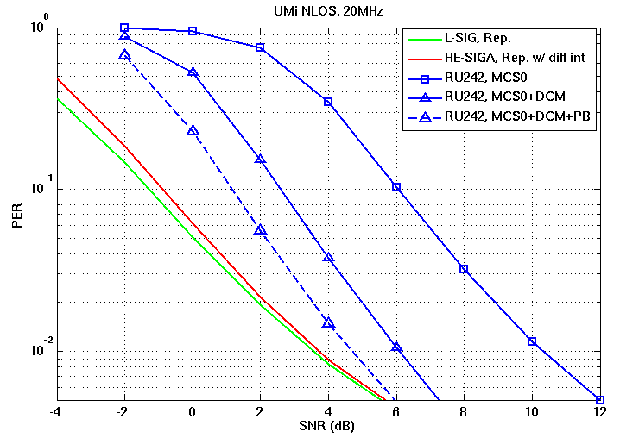
Performance evaluation
Assumptions:
SISO
UMi-NLOS
32 Byte payload
MCS0 with/without DCM
Realistic ChEstimation
real timing sync
No CFO/Phase noise
  With MCS0+DCM and 3dB boosted HE-LTF, performance of extended range SU PPDU is quite close to that of repeated L-SIG and repeated HE-SIGA.

Slide 16
Conclusion
In the presentation, we further evaluate the coverage of HE-EXT-SU-PPDU, which is essential to achieve the requirement of 11ax.
We propose to restrict HE-EXT-SU-PPDU to be transmitted only on primary 20MHz Ch, with MCS0/1/2 and with 1SS.
The HE-STF/HE-LTF in HE-EXT-SU-PPDU are boosted by 3dB.

Slide 17
Straw poll 1
Do you support to modify the SFD as the red text
    There are only three pre-HE-STF preamble formats defined:
    SU format (mandatory) / Trigger based UL
    MU format (mandatory)
    Extended range SU format (mandatory)
    [PHY Motion 68, November 2015, see [6]]
Y/N/A

Slide 18
Straw poll 2
Do you support to add to SFD
  The HE Extended Range SU PPDU is transmitted only on the primary 20Mhz.
Y/N/A

Slide 19
Straw poll 3
Do you support to add to SFD
  The HE Extended Range SU PPDU can only be transmitted with MCS0, MCS1, MCS2 and only with 1 spatial stream.
Y/N/A

Slide 20
Straw poll 4
Do you support to add to SFD
  HE-LTF/HE-STF power is boosted 3dB for BPSK and QPSK including DCM in the HE Extended Range SU PPDU preamble.
Y/N/A

Slide 21
reference
[1] 11-15-0826-03-00ax-he-sig-a-transmission-for-range-extension
[2] 11-15-0132-13-00ax-spec-framework

