Slide 1
Content of the extra tones in LSIG and RLSIG
Date: 2016-01-18
Authors:
Name | Affiliation | Address | Phone | Email
Zhengzheng Xiang | Huawei | No 200 Jinsu Road, Shanghai China |  | xiangzhengzheng@huawei.com
Jiayin Zhang |  | No 200 Jinsu Road, Shanghai China |  | zhangjiayin@huawei.com
Jun Zhu |  |  |  | zhujun75@huawei.com
Le Liu |  | F1-17, Huawei Base, Bantian, Shenzhen |  | liule@huawei.com
Jun Luo |  | 5B-N8, No.2222 Xinjinqiao Road, Pudong, Shanghai |  | jun.l@huawei.com
Yi Luo |  | F1-17, Huawei Base, Bantian, Shenzhen | +86-18665891036 | Roy.luoyi@huawei.com
Yingpei Lin |  | 5B-N8, No.2222 Xinjinqiao Road, Pudong, Shanghai |  | linyingpei@huawei.com
Jiyong Pang |  | 5B-N8, No.2222 Xinjinqiao Road, Pudong, Shanghai |  | pangjiyong@huawei.com
Zhigang Rong |  | 10180 Telesis Court, Suite 365, San Diego, CA 92121 NA |  | zhigang.rong@huawei.com
Rob Sun |  | 303 Terry Fox, Suite 400 Kanata, Ottawa, Canada |  | Rob.Sun@huawei.com
David X. Yang |  | F1-17, Huawei Base, Bantian, Shenzhen |  | david.yangxun@huawei.com

Slide 2
Authors (continued)
Name | Affiliation | Address | Phone | Email
Yunsong Yang | Huawei | 10180 Telesis Court, Suite 365, San Diego, CA 92121 NA |  | yangyunsong@huawei.com
Junghoon Suh |  | 303 Terry Fox, Suite 400 Kanata, Ottawa, Canada |  | Junghoon.Suh@huawei.com
Peter Loc |  |  |  | peterloc@iwirelesstech.com
Hongyuan Zhang | Marvell | 5488 Marvell Lane, Santa Clara, CA, 95054 | 408-222-2500 | hongyuan@marvell.com
Yakun Sun |  |  |  | yakunsun@marvell.com
Lei Wang |  |  |  | Leileiw@marvell.com
Liwen Chu |  |  |  | liwenchu@marvell.com
Jinjing Jiang |  |  |  | jinjing@marvell.com
Yan Zhang |  |  |  | yzhang@marvell.com
Rui Cao |  |  |  | ruicao@marvell.com
Sudhir Srinivasa |  |  |  | sudhirs@marvell.com
Bo Yu |  |  |  | boyu@marvell.com
Saga Tamhane |  |  |  | sagar@marvell.com
Mao Yu |  |  |  | my@marvel..com
Xiayu Zheng |  |  |  | xzheng@marvell.com
Christian Berger |  |  |  | crberger@marvell.com
Niranjan Grandhe |  |  |  | ngrandhe@marvell.com
Hui-Ling Lou |  |  |  | hlou@marvell.com

Slide 3
Authors (continued)
Name | Affiliation | Address | Phone | Email
Alice Chen | Qualcomm | 5775 Morehouse Dr. San Diego, CA, USA |  | alicel@qti.qualcomm.com
Albert Van Zelst |  | Straatweg 66-S Breukelen, 3621 BR Netherlands |  | allert@qti.qualcomm.com
Alfred Asterjadhi |  | 5775 Morehouse Dr. San Diego, CA, USA |  | aasterja@qti.qualcomm.com
Arjun Bharadwaj |  | 5775 Morehouse Dr. San Diego, CA, USA |  | arjunb@qti.qualcomm.com
Bin Tian |  | 5775 Morehouse Dr. San Diego, CA, USA |  | btian@qti.qualcomm.com
Carlos Aldana |  | 1700 Technology Drive San Jose, CA 95110, USA |  | caldana@qca.qualcomm.com
George Cherian |  | 5775 Morehouse Dr. San Diego, CA, USA |  | gcherian@qti.qualcomm.com
Gwendolyn Barriac |  | 5775 Morehouse Dr. San Diego, CA, USA |  | gbarriac@qti.qualcomm.com
Hemanth Sampath |  | 5775 Morehouse Dr. San Diego, CA, USA |  | hsampath@qti.qualcomm.com
Lin Yang |  | 5775 Morehouse Dr. San Diego, CA, USA |  | linyang@qti.qualcomm.com
Menzo Wentink |  | Straatweg 66-S Breukelen, 3621 BR Netherlands |  | mwentink@qti.qualcomm.com
Naveen Kakani |  | 2100 Lakeside Boulevard Suite 475, Richardson TX 75082, USA |  | nkakani@qti.qualcomm.com
Raja Banerjea |  | 1060 Rincon Circle San Jose CA 95131, USA |  | rajab@qit.qualcomm.com
Richard Van Nee |  | Straatweg 66-S Breukelen, 3621 BR Netherlands |  | rvannee@qti.qualcomm.com

Slide 4
Authors (continued)
Name | Affiliation | Address | Phone | Email
Rolf De Vegt | Qualcomm | 1700 Technology Drive San Jose, CA 95110, USA |  | rolfv@qca.qualcomm.com
Sameer Vermani |  | 5775 Morehouse Dr. San Diego, CA, USA |  | svverman@qti.qualcomm.com
Simone Merlin |  | 5775 Morehouse Dr. San Diego, CA, USA |  | smerlin@qti.qualcomm.com
Tao Tian |  | 5775 Morehouse Dr. San Diego, CA, USA |  | ttian@qti.qualcomm.com
Tevfik Yucek |  | 1700 Technology Drive San Jose, CA 95110, USA |  | tyucek@qca.qualcomm.com
VK Jones |  | 1700 Technology Drive San Jose, CA 95110, USA |  | vkjones@qca.qualcomm.com
Youhan Kim |  | 1700 Technology Drive San Jose, CA 95110, USA |  | youhank@qca.qualcomm.com

Slide 5
Authors (continued)
Name | Affiliation | Address | Phone | Email
James Yee | Mediatek | No. 1 Dusing 1st Road, Hsinchu, Taiwan | +886-3-567-0766 | james.yee@mediatek.com
Alan Jauh |  |  |  | alan.jauh@mediatek.com
Chingwa Hu |  |  |  | chinghwa.yu@mediatek.com
Frank Hsu |  |  |  | frank.hsu@mediatek.com
Thomas Pare | Mediatek USA | 2860 Junction Ave, San Jose, CA 95134, USA | +1-408-526-1899 | thomas.pare@mediatek.com
ChaoChun Wang |  |  |  | chaochun.wang@mediatek.com
James Wang |  |  |  | james.wang@mediatek.com
Jianhan Liu |  |  |  | Jianhan.Liu@mediatek.com
Tianyu Wu |  |  |  | tianyu.wu@mediatek.com
Zhou Lan |  |  |  | Zhou.lan@mediaTek.com
Russell Huang |  |  |  | russell.huang@mediatek.com
Joonsuk Kim | Apple |  |  | joonsuk@apple.com
Aon Mujtaba |  |  |  | mujtaba@apple.com
Guoqing Li |  |  |  | guoqing_li@apple.com
Eric Wong |  |  |  | ericwong@apple.com
Chris Hartman |  |  |  | chartman@apple.com

Slide 6
Authors (continued)
Name | Affiliation | Address | Phone | Email
Ron Porat | Broadcom |  |  | rporat@broadcom.com
Sriram Venkateswaran |  |  |  | mfischer@broadcom.com
Matthew Fischer
Leo Montreuil
Andrew Blanksby
Vinko Erceg
Robert Stacey | Intel | 2111 NE 25th Ave, Hillsboro OR 97124, USA | +1-503-724-893 | robert.stacey@intel.com
Shahrnaz Azizi |  |  |  | shahrnaz.azizi@intel.com
Po-Kai Huang |  |  |  | po-kai.huang@intel.com
Qinghua Li |  |  |  | quinghua.li@intel.com
Xiaogang Chen |  |  |  | xiaogang.c.chen@intel.com
Chitto Ghosh |  |  |  | chittabrata.ghosh@intel.com
Laurent Cariou |  |  |  | laurent.cariou@intel.com
Yaron Alpert |  |  |  | yaron.alpert@intel.com
Assaf Gurevitz |  |  |  | assaf.gurevitz@intel.com
Ilan Sutskover |  |  |  | ilan.sutskover@intel.com

Slide 7
Authors (continued)
Name | Affiliation | Address | Phone | Email
Jinmin Kim | LG Electronics | 19, Yangjae-daero 11gil, Seocho-gu, Seoul 137-130, Korea |  | Jinmin1230.kim@lge.com
Kiseon Ryu |  |  |  | kiseon.ryu@lge.com
Jinyoung Chun |  |  |  | jiny.chun@lge.com
Jinsoo Choi |  |  |  | js.choi@lge.com
Jeongki Kim |  |  |  | jeongki.kim@lge.com
Dongguk Lim |  |  |  | dongguk.lim@lge.com
Suhwook Kim |  |  |  | suhwook.kim@lge.com
Eunsung Park |  |  |  | esung.park@lge.com
JayH Park |  |  |  | Hyunh.park@lge.com
HanGyu Cho |  |  |  | hg.cho@lge.com
Thomas Derham | Orange |  |  | thomas.derham@orange.com
Bo Sun | ZTE | #9 Wuxingduan, Xifeng Rd., Xi'an, China |  | sun.bo1@zte.com.cn
Kaiying Lv |  |  |  | lv.kaiying@zte.com.cn
Yonggang Fang |  |  |  | yfang@ztetx.com
Ke Yao |  |  |  | yao.ke5@zte.com.cn
Weimin Xing |  |  |  | xing.weimin@zte.com.cn
Brian Hart | Cisco Systems | 170 W Tasman Dr, San Jose, CA 95134 |  | brianh@cisco.com
Pooya Monajemi |  |  |  | pmonajem@cisco.com

Slide 8
Authors (continued)
Name | Affiliation | Address | Phone | Email
Fei Tong | Samsung | Innovation Park, Cambridge CB4 0DS (U.K.) | +44 1223 434633 | f.tong@samsung.com
Hyunjeong Kang |  | Maetan 3-dong; Yongtong-Gu Suwon; South Korea | +82-31-279-9028 | hyunjeong.kang@samsung.com
Kaushik Josiam |  | 1301, E. Lookout Dr, Richardson TX 75070 | (972) 761 7437 | k.josiam@samsung.com
Mark Rison |  | Innovation Park, Cambridge CB4 0DS (U.K.) | +44 1223 434600 | m.rison@samsung.com
Rakesh Taori |  | 1301, E. Lookout Dr, Richardson TX 75070 | (972) 761 7470 | rakesh.taori@samsung.com
Sanghyun Chang |  | Maetan 3-dong; Yongtong-Gu Suwon; South Korea | +82-10-8864-1751 | s29.chang@samsung.com
Yasushi Takatori | NTT | 1-1 Hikari-no-oka, Yokosuka, Kanagawa 239-0847 Japan | +81 46 859 3135 | takatori.yasushi@lab.ntt.co.jp
Yasuhiko Inoue |  |  | +81 46 859 5097 | inoue.yasuhiko@lab.ntt.co.jp
Shoko Shinohara |  |  | +81 46 859 5107 | Shinohara.shoko@lab.ntt.co.jp
Yusuke Asai |  |  | +81 46 859 3494 | asai.yusuke@lab.ntt.co.jp
Koichi Ishihara |  |  | +81 46 859 4233 | ishihara.koichi@lab.ntt.co.jp
Junichi Iwatani |  |  | +81 46 859 4222 | Iwatani.junichi@lab.ntt.co.jp
Akira Yamada | NTT DOCOMO | 3-6, Hikarinooka, Yokosuka-shi, Kanagawa, 239-8536, Japan | +81 46 840 3759 | yamadaakira@nttdocomo.com
Masahito Mori | Sony Corp. |  |  | Masahito.Mori@jp.sony.com
Yusuke Tanaka |  |  |  | YusukeC.Tanaka@jp.sony.com
Yuichi Morioka |  |  |  | Yuichi.Morioka@jp.sony.com
Kazuyuki Sakoda |  |  |  | Kazuyuki.Sakoda@am.sony.com
William Carney |  |  |  | William.Carney@am.sony.com

Slide 9
Background
IEEE passed a motion that 4 extra tones have been added for each 20MHz for the LSIG,RLSIG,SIGA,SIGB [1]
The added tones in LSIG/R-LSIG are used for channel estimation
We need to determine the content on each added tones in LSIG and RLSIG

Slide 10
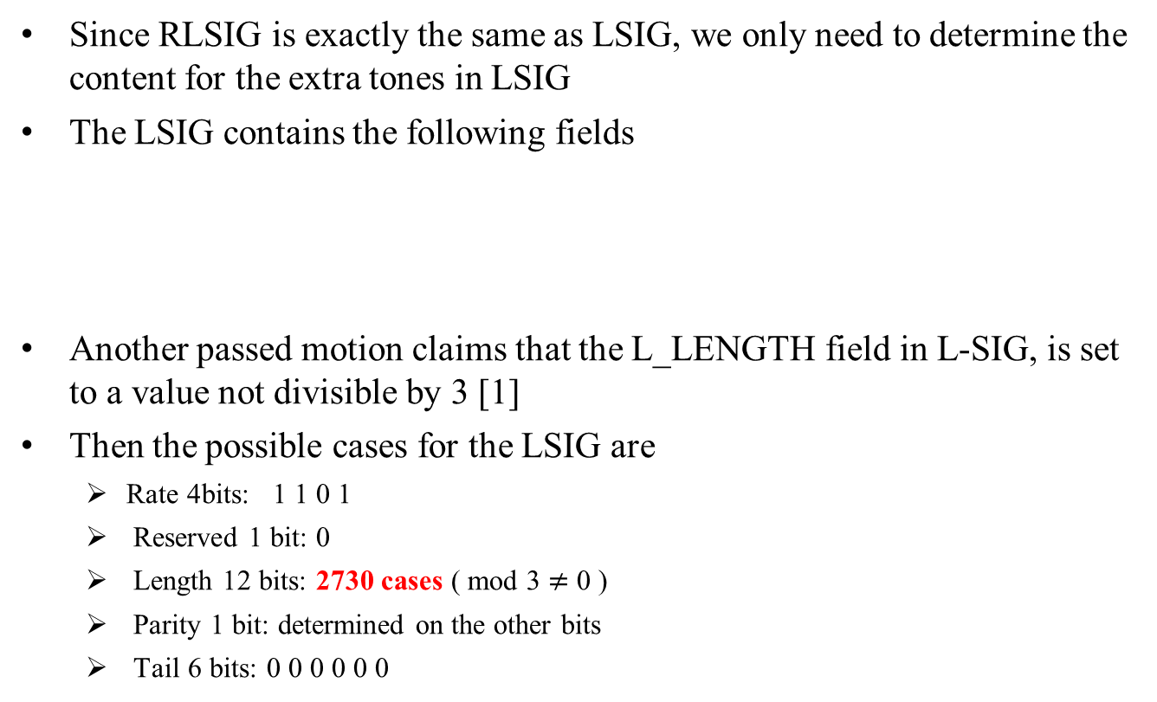
The LSIG
Since RLSIG is exactly the same as LSIG, we only need to determine the content for the extra tones in LSIG
The LSIG contains the following fields
Another passed motion claims that the L_LENGTH field in L-SIG, is set to a value not divisible by 3 [1]
Then the possible cases for the LSIG are
  Rate 4bits: 1 1 0 1
  Reserved 1 bit: 0
  Length 12 bits: 2730 cases ( mod 3 $≠$ 0 )
  Parity 1 bit: determined on the other bits
  Tail 6 bits: 0 0 0 0 0 0

Slide 11
For 20MHz
Choose the content which can achieve the minimum max_PAPR over all the possible Length
  For 20MHz , there are 4 extra ones. Thus, the number of possible sequences is 2^4=16
  The chosen content on the extra tones of index -28,-27,27,28 is
  The max_papr of the worst case among the possible contents of the extra tones is 12.06dB
-1 | -1 | -1 | 1
minimum max_papr=10.45dB

Slide 12
For 40MHz
We propose to duplicate the content in 20MHz and apply phase rotation (follow the 11ac Spec ), the chosen content (before multiplied with Gamma) on the extra tones of index -60，-59，-5，-4，4，5，59，60 is
We also provide the results when directly searching all the cases as in 20MHz scenario, the chosen content (before multiplied with Gamma) on the extra tones of index -60，-59，-5，-4，4，5，59，60 is
  It can be seen that the performance difference between the proposed scheme and the exhaust search method is small
-1 | -1 | -1 | 1 | -1 | -1 | -1 | 1
max_papr=13.14dB
1 | -1 | -1 | 1 | -1 | -1 | -1 | 1
max_papr=12.83dB

Slide 13
For 80MHz
We propose to duplicate the content in 20MHz and apply phase rotation (follow the 11ac Spec ), the chosen content (before multiplied with Gamma) on the extra tones of index -124，-123，-69，-68，-60，-59，-5，-4，4，5，59，60，68，69，123，124 is
We also provide the results when directly searching all the cases as in 20MHz scenario, the chosen content (before multiplied with Gamma) on the extra tones of index -124，-123，-69，-68，-60，-59，-5，-4，4，5，59，60，68，69，123，124 is
  It can be seen that the performance difference between the proposed scheme and the exhaust search method is quite small
-1 | -1 | -1 | 1 | -1 | -1 | -1 | 1 | -1 | -1 | -1 | 1 | -1 | -1 | -1 | 1
max_papr=12.45dB
1 | -1 | -1 | -1 | 1 | -1 | -1 | -1 | -1 | -1 | -1 | 1 | 1 | -1 | -1 | -1
max_papr=12.34dB

Slide 14
For 160MHz
We propose to duplicate the content in 20MHz and apply phase rotation (follow the 11ac Spec ), the chosen content on the extra tones of index -252，-251，-197，-196，-188，-187，-133，-132，-124，-123，-69，-68，-60，-59，-5，-4，4，5，59，60，68，69，123，124，132，133，187，188，196，197，251，242 is
  We also provide the results of the more complicated scheme in which we duplicate the content in 20MHz and search for all the cases when apply different +1/-1 rotation factors to each duplication. The chosen content (before multiplied with Gamma) on the extra tones of index -252，-251，-197，-196，-188，-187，-133，-132，-124，-123，-69，-68，-60，-59，-5，-4，4，5，59，60，68，69，123，124，132，133，187，188，196，197，251，242 is
  Also, the performance difference between the proposed scheme and the exhaust search method is quite small
-1 | -1 | -1 | 1 | -1 | -1 | -1 | 1 | -1 | -1 | -1 | 1 | -1 | -1 | -1 | 1 | -1 | -1 | -1 | 1 | -1 | -1 | -1 | 1 | -1 | -1 | -1 | 1 | -1 | -1 | -1 | 1
max_papr=13.84dB
-1 | -1 | -1 | 1 | -1 | -1 | -1 | 1 | -1 | -1 | -1 | 1 | 1 | 1 | 1 | -1 | -1 | -1 | -1 | 1 | -1 | -1 | -1 | 1 | -1 | -1 | -1 | 1 | -1 | -1 | -1 | 1
max_papr=13.79dB

Slide 15
References
[1] 11-15-0132-13-00ax-spec-framework

Slide 16
Straw poll 1
Do you support to add to the SFD
  The content of 4 extra tones [-28,-27,27,28] of L-SIG and RL-SIG in 20MHz HE PPDU is [-1,-1,-1,1]
  Yes
  No
  Abstain

