Slide 1
Issues with Compressed SIG-B Mode
Date: 2016-01-18
Authors:

Slide 2
Background
SFD states the following [1]:
The encoding structure of each BCC in HE-SIG-B was agreed:
Two users are grouped together and jointly encoded in each BCC block in the user specific section of HE-SIG-B
The common block has a CRC separate from the CRC of the user specific blocks
The last user information is immediately followed by tail bits (regardless of whether the number of users is odd or even) and padding bits are only added after those tail bits
Compressed SIG-B structure was agreed:
A compression bit is carried in the HE-SIG-A MU format to differentiate full BW MU-MIMO from OFDMA MU PPDU. In case of full BW MU-MIMO, the following conditions hold:
Only applicable for RU sizes 242, 484, 996, 2*996
The RU information in HE-SIG-B common is not signaled
For bandwidths > 20 MHz, the user specific sub-fields are split equitably between the two HE-SIG-B Channels

Slide 3
HE SIG-B Encoding Structure
In SIG-B, the RU information in the ‘Common Field’ conveys information regarding number of STA-specific information.
In the compressed SIG-B mode, the RU information in HE-SIG-B common is not signaled to reduce overhead.
Number of STA-specific information conveyed in Common Field
Channel 1
Common Field
STA 1, 2
STA 3, 4
Pad
SIG-B
Channel 2
Common Field
STA 5, 6
STA 7
Pad
How does the receiver determine this?
How does the receiver determine this?
Channel 1
STA 1, 2
STA 3, 4
Pad
STA 1, 2
Pad
Compressed
SIG-B
OR
Channel 2
STA 5, 6
STA 7
Pad
STA 3, 4
Pad

Slide 4
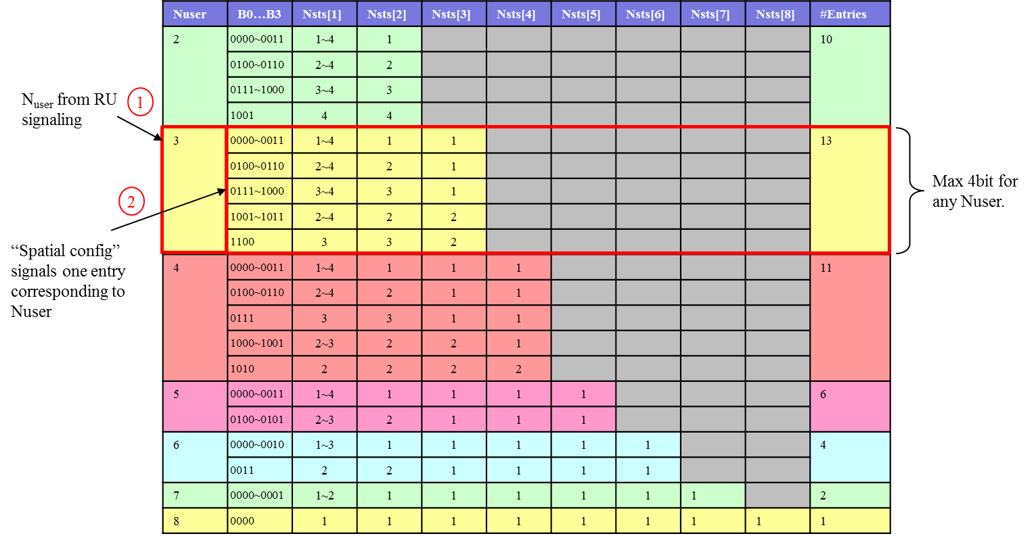
Ambiguity in the STA-Specific Field
Number of scheduled STAs is needed for Parsing ‘Spatial configuration subfield’

Slide 5
Multiple Hypothesis at the Receiver
Blindly determining STA-specific fields
Might be possible with additional receiver complexity.
Assumes that CRC of STA-specific fields all pass.
Detection and implementation challenges exist if CRC length is small such that false positive probability is quite high.
Number of hypothesis depends of number of STAs in compressed SIG-B.
Number of STAs that can be transmitted a function of SIG-B MCS and Number of OFDM SIG-B symbols.
Some MCS and number of OFDM symbol combination does result in unique mapping. However, other combinations may require multiple hypothesis.
We prefer not to blindly detect this. Explicit signaling allows simpler receiver implementation.

Slide 6
Strawpoll #1
Do you agree to include the following text to TGax SFD:
In MU PPDU, the SIG-A shall indicate the number of STAs when compressed SIG-B mode is indicated (i.e. full bandwidth MU-MIMO indicated).
Details TBD
Y/N/A

Slide 7
References
[1] 11-15-0132-13-00ax-spec-framework

Slide 8
Appendix: Multiple Hypothesis
With 2 OFDM symbols in MCS 0 (BPSK ½) 52 bits are available in SIG-B.
Assuming each STA-specific field is approximately 21 bits, 2, 3, or 4 STAs can be multiplexed in 2 OFDM symbols.
To reduce the hypothesis number, the test starts with SIG-B2 decoding .
52 bits
SIG-B1 field
The SIG-B channel 2 field has two possibilities of the information lengths; - Scenario 1) only one STA-specific subfield and CRC/Tail included - Scenario 2) two STA-specific subfields and CRC/Tail included
Case 1
SIG-B2 field
SIG-B1 field
➔ After checking both two scenarios, the format of SIG-B2 determined
Case 2
SIG-B2 field
In scenario 1, the same procedure as above is repeated in SIG-B channel 1 to find the number of users
In scenario 2, SIG-B channel 1 must contain 2 users
SIG-B1 field
Case 3
SIG-B2 field

