Slide 1
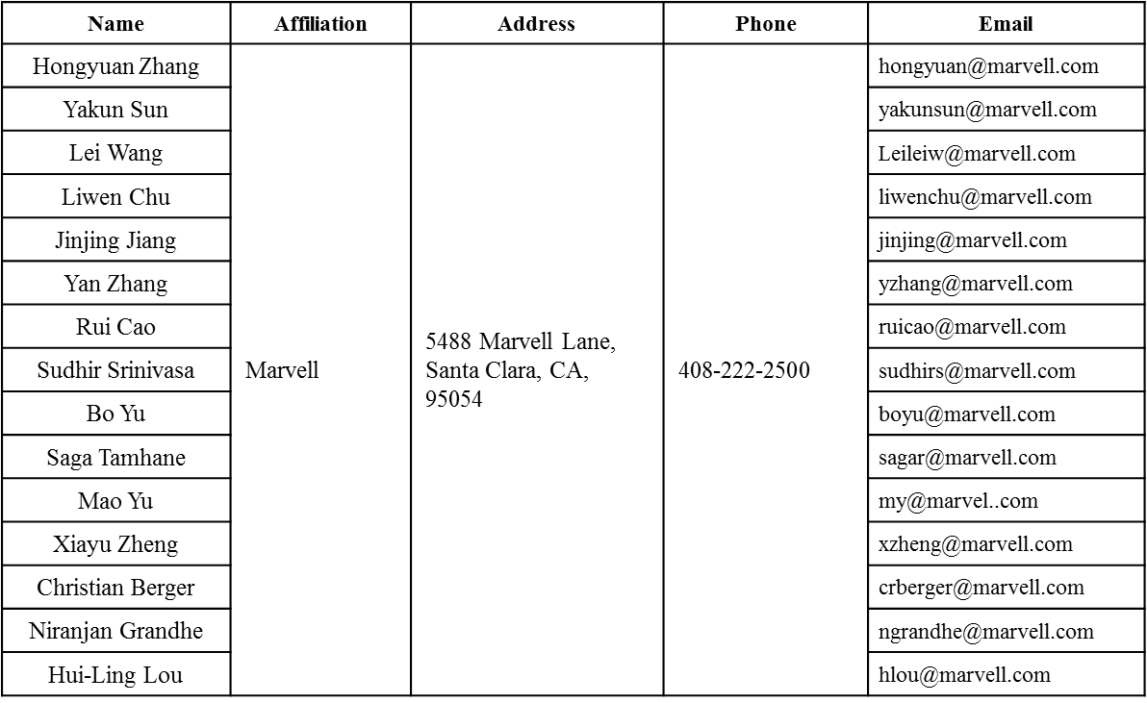
Beamforming with HE-LTF Compression
Date: 2016-01-18
Authors:

Slide 2
Authors (continued)
Name | Affiliation | Address | Phone | Email
Ron Porat | Broadcom |  |  | rporat@broadcom.com
Matthew Fischer |  |  |  | mfischer@broadcom.com
Sriram Venkateswaran
Zhou Lan
Leo Montreuil
Andrew Blanksby
Vinko Erceg
Robert Stacey | Intel | 2111 NE 25th Ave, Hillsboro OR 97124, USA | +1-503-724-893 | robert.stacey@intel.com
Eldad Perahia |  |  |  | eldad.perahia@intel.com
Shahrnaz Azizi |  |  |  | shahrnaz.azizi@intel.com
Po-Kai Huang |  |  |  | po-kai.huang@intel.com
Qinghua Li |  |  |  | quinghua.li@intel.com
Xiaogang Chen |  |  |  | xiaogang.c.chen@intel.com
Chitto Ghosh |  |  |  | chittabrata.ghosh@intel.com
Rongzhen Yang |  |  |  | rongzhen.yang@intel.com
Laurent cariou |  |  |  | laurent.cariou@intel.com

Slide 3
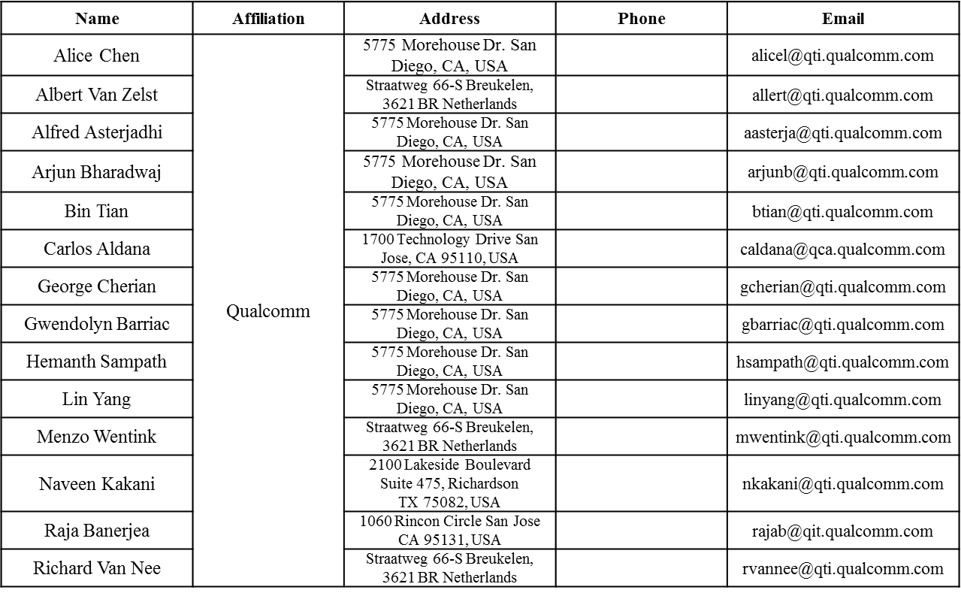
Authors (continued)

Slide 4
Authors (continued)
Name | Affiliation | Address | Phone | Email
James Yee | Mediatek | No. 1 Dusing 1st Road, Hsinchu, Taiwan | +886-3-567-0766 | james.yee@mediatek.com
Alan Jauh |  |  |  | alan.jauh@mediatek.com
Frank Hsu |  |  |  | frank.hsu@mediatek.com
Thomas Pare | Mediatek USA | 2860 Junction Ave, San Jose, CA 95134, USA | +1-408-526-1899 | thomas.pare@mediatek.com
ChaoChun Wang |  |  |  | chaochun.wang@mediatek.com
James Wang |  |  |  | james.wang@mediatek.com
Jianhan Liu |  |  |  | Jianhan.Liu@mediatek.com
Tianyu Wu |  |  |  | tianyu.wu@mediatek.com
Russell Huang |  |  |  | russell.huang@mediatek.com
Brian Hart | Cisco Systems | 170 W Tasman Dr, San Jose, CA 95134 |  | brianh@cisco.com
Pooya Monajemi |  |  |  | pmonajem@cisco.com
Joonsuk Kim | Apple |  |  | joonsuk@apple.com
Aon Mujtaba |  |  |  | mujtaba@apple.com
Guoqing Li |  |  |  | guoqing_li@apple.com
Eric Wong |  |  |  | ericwong@apple.com
Chris Hartman |  |  |  | chartman@apple.com

Slide 5
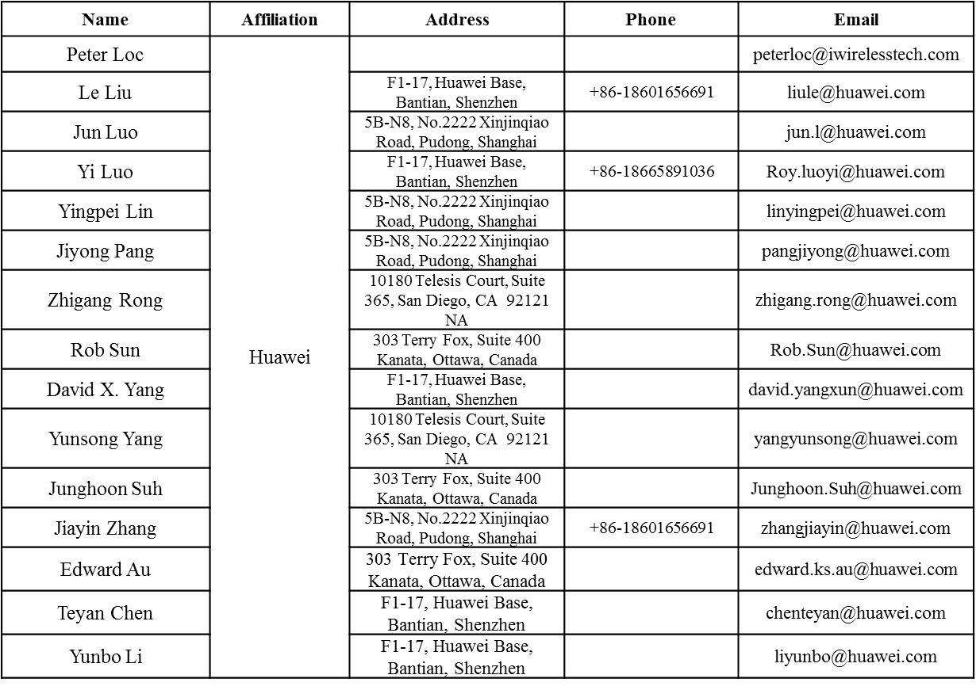
Authors (continued)

Slide 6
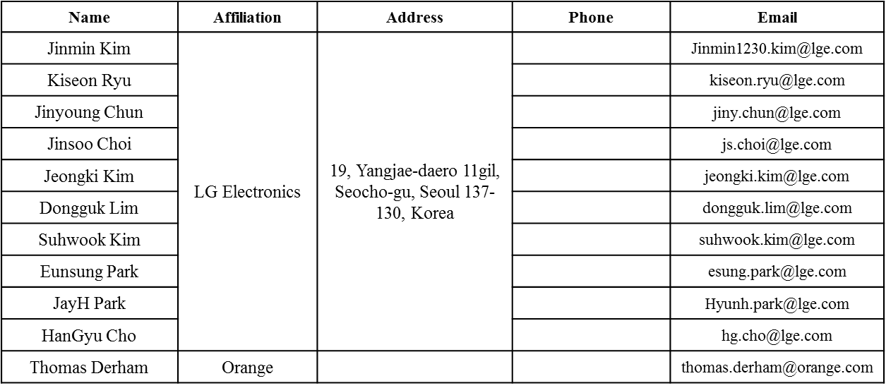
Authors (continued)
Bo SunBo Sun | ZTE | #9 Wuxing duan, Xifeng Rd, Xi’an, China |  | SubSub.bo1@zte.com.cn
Kaiying Lv |  |  |  | lv.kaiying@zte.com.cn
Yonggang Fang |  |  |  | yfang@ztetx.com
Ke Yao |  |  |  | Yao.ke5@zte.com.cn
Weimin Xing |  |  |  | Xing.weimin@zte.com.cn

Slide 7
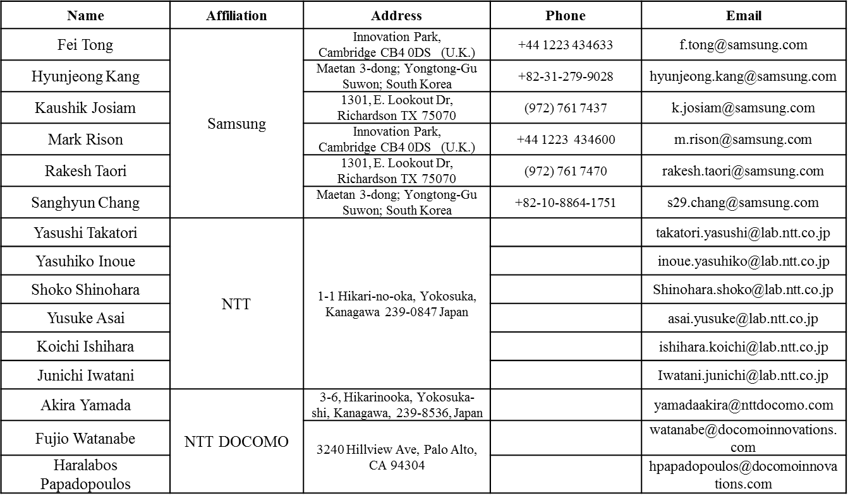
Authors (continued)

Slide 8
Overview
HE TxBF Feedback: assume we will reuse 11ac compressed FB format
Tone Grouping Ng: possible values 2, 4, 8, 16…
In 11n/ac, smoothing is not recommended for BF pkt, because the V matrix or its compression may break the phase continuity across tones (e.g. singular vectors are right-rotational invariant).
Now in 11ax, when 1x or 2x LTF is applied in steered BF packets, receiver has no choice but interpolate—a procedure similar to smoothing effect!
If Beamformer conducts steering arbitrarily tone-by-tone like 11n/ac, phase and/or amp continuity will be broken and 1x/2x LTF performs badly!
This presentation discusses necessary approaches for the spec to ensure the interoperability for HE TxBF when 1x or 2x LTF is applied.

Slide 9
Proposal
If 1x or 2x HE-LTF is used in beamformed packets, prefer the beamformer also interpolate the Q matrix to guarantee the phase continuity!
This is necessary to be stressed by the spec to guarantee the interoperability!

Slide 10
Simulation Setup
HE 80MHz, 4x4, 3SS, MCS9.
NDP uses 4x LTF—sound every tone.
BF Data PPDU with 2xLTF: receiver conducts interpolation for channel estimation.
Compression method: using angle quantization b_phi = 6, b_psi = 4.

Slide 11
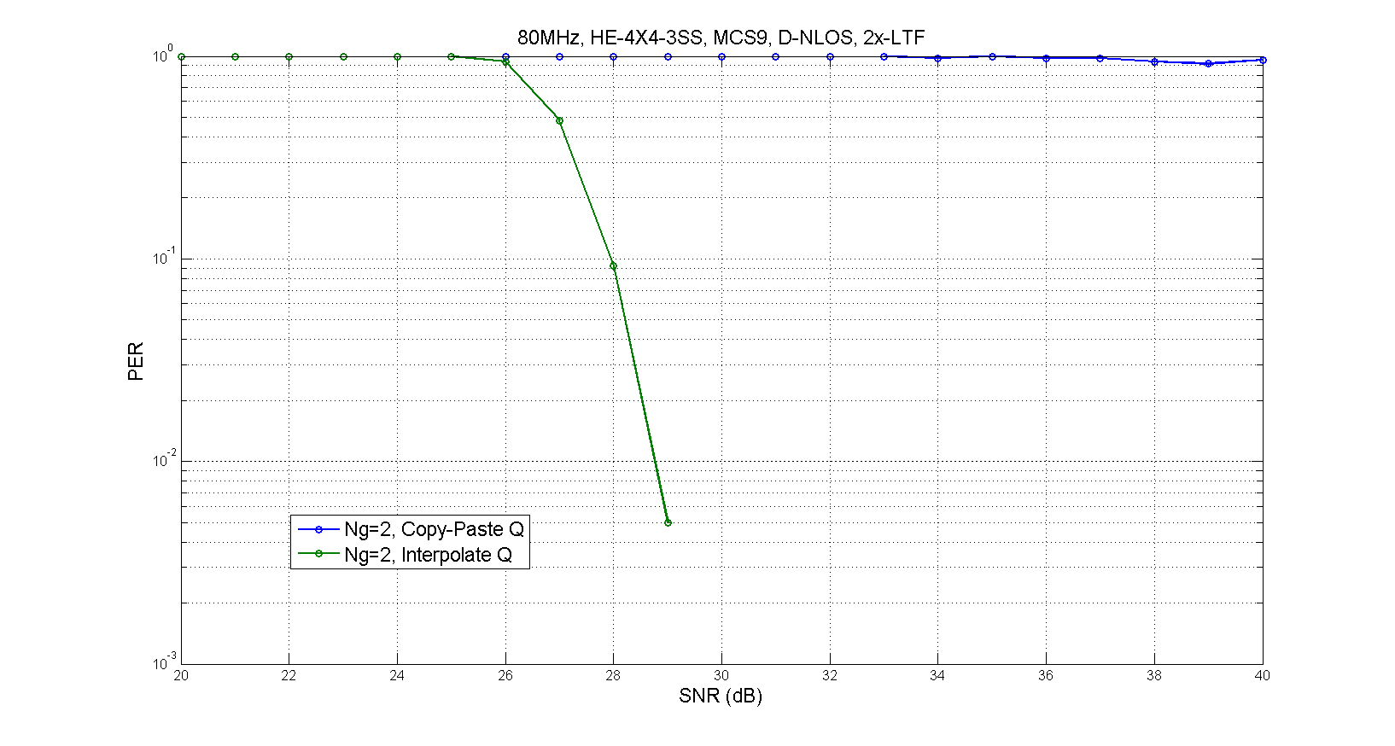
Ng=2, BFMer method comparison
Method-1: Copy-paste adjacent Q.
Method-2: Linearly interpolate adjacent Qs.

Slide 12
Conclusions
From result, it is essential for the beamformer to maintain the Q smoothness.

Slide 13
Straw Poll #1
Do you agree to add the following text in SFD?
When 1x/2x HE-LTF is transmitted, it is recommended that the spatial mapping matrix applied to HE-STF and beyond is chosen such that it preserves the smoothness of the physical channel, achieved by limiting the variation of each element’s real and imaginary values in the spatial mapping matrix across successive tones.

