Slide 1
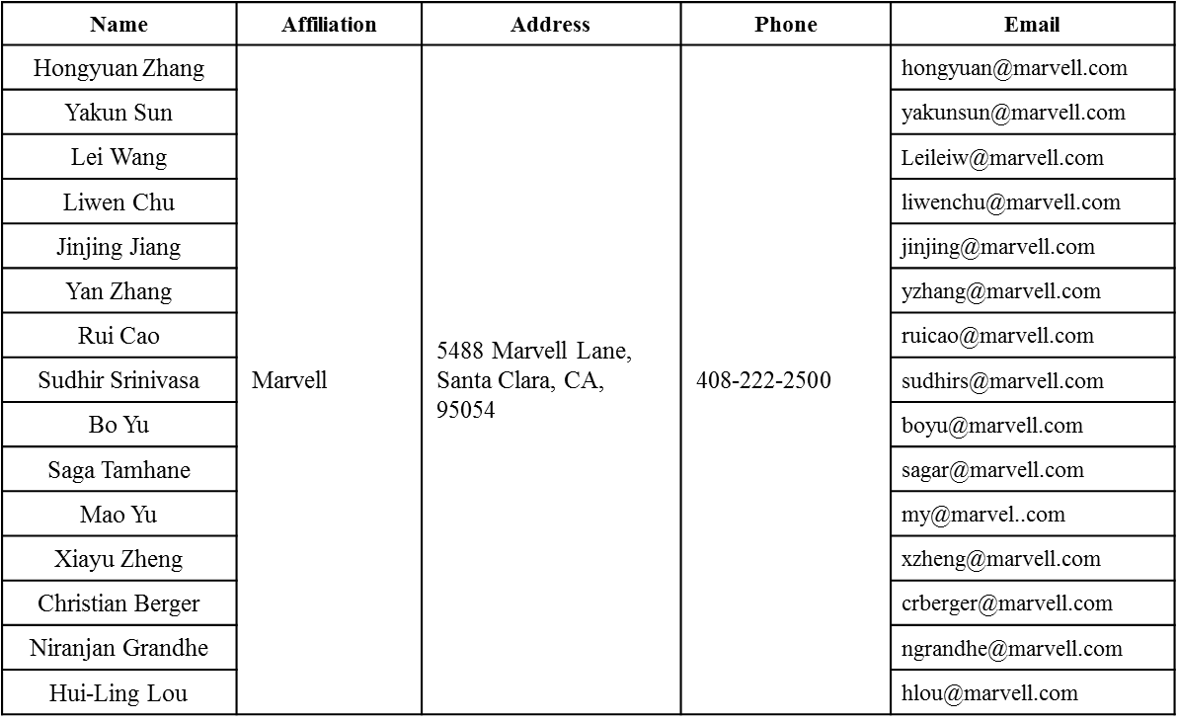
1x HE-LTF For UL-MUMIMO
Date: 2016-01-18
Authors:

Slide 2
Authors (continued)
Name | Affiliation | Address | Phone | Email
Ron Porat | Broadcom |  |  | rporat@broadcom.com
Matthew Fischer |  |  |  | mfischer@broadcom.com
Sriram Venkateswaran
Zhou Lan
Leo Montreuil
Andrew Blanksby
Vinko Erceg
Robert Stacey | Intel | 2111 NE 25th Ave, Hillsboro OR 97124, USA | +1-503-724-893 | robert.stacey@intel.com
Eldad Perahia |  |  |  | eldad.perahia@intel.com
Shahrnaz Azizi |  |  |  | shahrnaz.azizi@intel.com
Po-Kai Huang |  |  |  | po-kai.huang@intel.com
Qinghua Li |  |  |  | quinghua.li@intel.com
Xiaogang Chen |  |  |  | xiaogang.c.chen@intel.com
Chitto Ghosh |  |  |  | chittabrata.ghosh@intel.com
Rongzhen Yang |  |  |  | rongzhen.yang@intel.com
Laurent cariou |  |  |  | laurent.cariou@intel.com

Slide 3
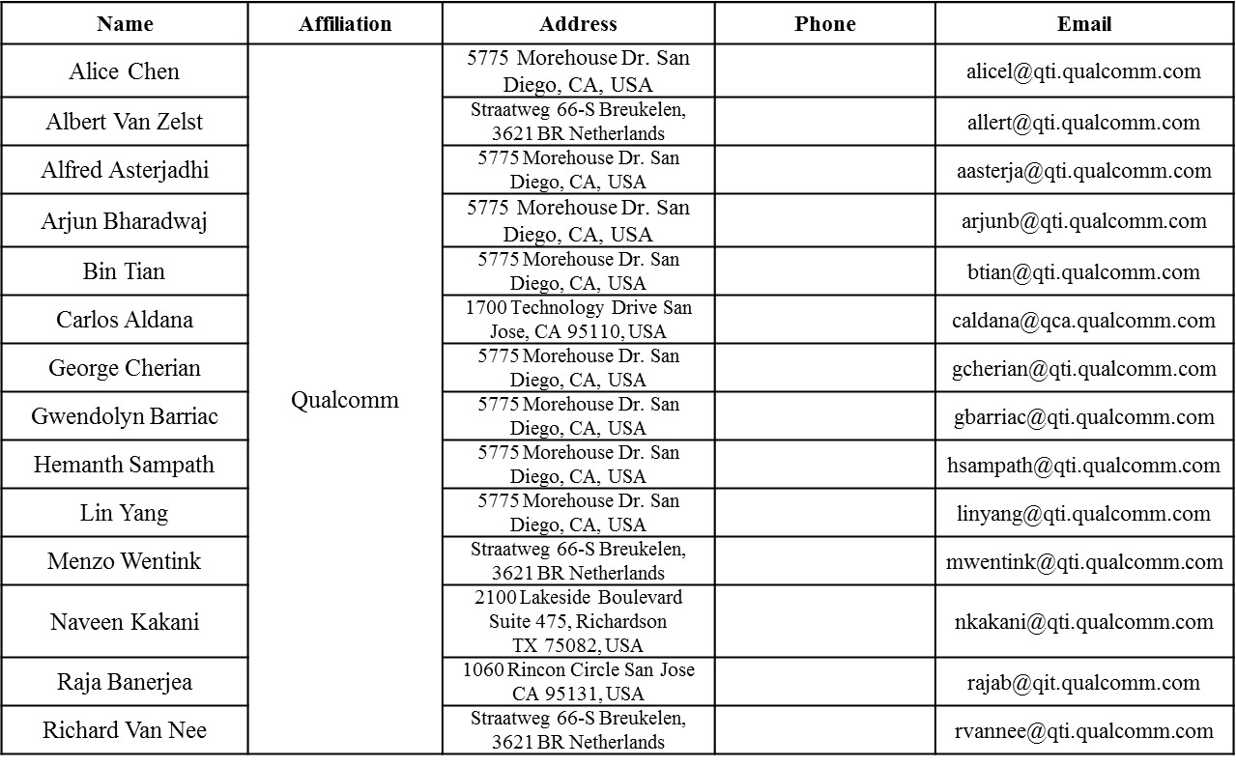
Authors (continued)

Slide 4
Authors (continued)
Name | Affiliation | Address | Phone | Email
James Yee | Mediatek | No. 1 Dusing 1st Road, Hsinchu, Taiwan | +886-3-567-0766 | james.yee@mediatek.com
Alan Jauh |  |  |  | alan.jauh@mediatek.com
Frank Hsu |  |  |  | frank.hsu@mediatek.com
Thomas Pare | Mediatek USA | 2860 Junction Ave, San Jose, CA 95134, USA | +1-408-526-1899 | thomas.pare@mediatek.com
ChaoChun Wang |  |  |  | chaochun.wang@mediatek.com
James Wang |  |  |  | james.wang@mediatek.com
Jianhan Liu |  |  |  | Jianhan.Liu@mediatek.com
Tianyu Wu |  |  |  | tianyu.wu@mediatek.com
Russell Huang |  |  |  | russell.huang@mediatek.com
Brian Hart | Cisco Systems | 170 W Tasman Dr, San Jose, CA 95134 |  | brianh@cisco.com
Pooya Monajemi |  |  |  | pmonajem@cisco.com
Joonsuk Kim | Apple |  |  | joonsuk@apple.com
Aon Mujtaba |  |  |  | mujtaba@apple.com
Guoqing Li |  |  |  | guoqing_li@apple.com
Eric Wong |  |  |  | ericwong@apple.com
Chris Hartman |  |  |  | chartman@apple.com

Slide 5
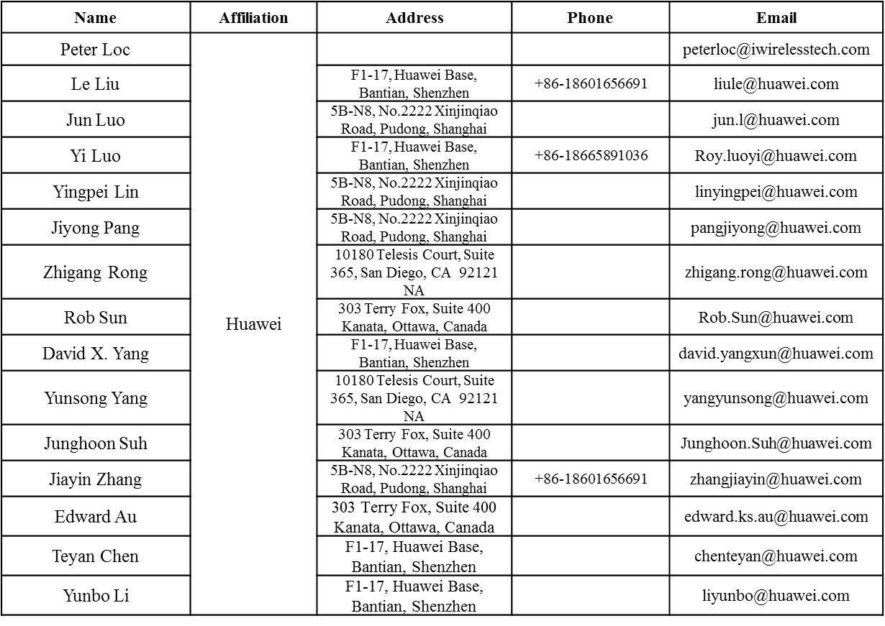
Authors (continued)

Slide 6
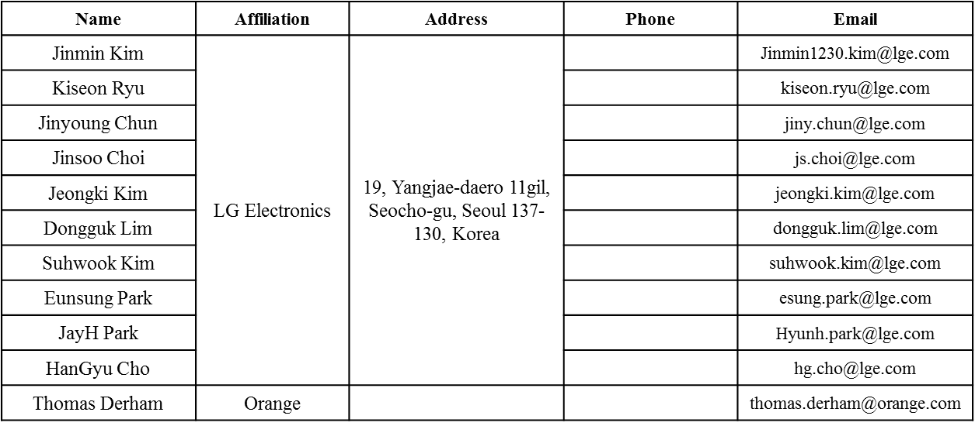
Authors (continued)
Bo SunBo Sun | ZTE | #9 Wuxing duan, Xifeng Rd, Xi’an, China |  | SubSub.bo1@zte.com.cn
Kaiying Lv |  |  |  | lv.kaiying@zte.com.cn
Yonggang Fang |  |  |  | yfang@ztetx.com
Ke Yao |  |  |  | Yao.ke5@zte.com.cn
Weimin Xing |  |  |  | Xing.weimin@zte.com.cn

Slide 7
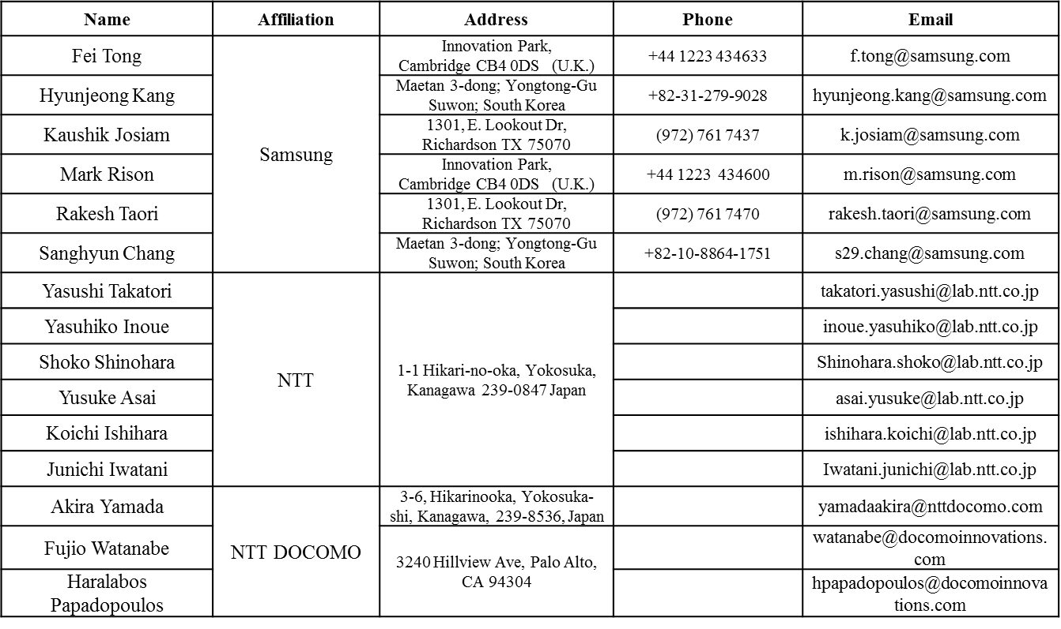
Authors (continued)

Slide 8
Overview
In SFD we added 1x HE-LTF + 0.8us GI as one optional mode for HE PPDU.
  The usage of 1x LTF is not defined.
  Preferably not used for OFDMA cases.
In [1] we focused on SU PPDU case for 1x HE-LTF, in this presentation we focus on 1x HE-LTF+1.6usGI used for full-BW UL-MUMIMO.
We show that 1x HE-LTF performs robustly for UL-MUMIMO, due to its advantage over residue CFO transmitted from different users.
  In a typical high SNR/MCS case, good performance can be achieved without conducting any phase compensation during HE-LTFs.

Slide 9
UL-MUMIMO Simulations
20MHz HE UL-MUMIMO.
D-NLOS channel, GI=1.6us.
3x4 and 6x8 configurations (3 users and 6 users respectively, each with single stream), MCS7 or 9 (high SNR regime).
Global per-stream CSD—11ac value.
Impairments:
  Per-user Timing Offset uniformly distributed in [-400, 400] ns.
  Fixed CFO +-400Hz (a bad case), or actual CFO based on Trigger Frame (normal case).
  All other impairments ON: PN, PA, IQ.
Per-user P-matrix masking for 2x HE-LTF as in current SFD.
    Phase Estimation using P-mat mask during 2x LTF.
For 1x HE-LTF, we try either multi-stream pilot or single-stream pilot.
  For MS pilot, no phase compensation in CE.
  For SS pilot, conduct phase compensation in CE using the single SS pilots [2].

Slide 10
3x4, Actual residue CFO from receiving Trigger
MCS7
MCS9

Slide 11
3x4, Fixed residue CFO +-400Hz
MCS7
MCS9

Slide 12
6x8, Actual residue CFO from receiving Trigger
MCS7
MCS9

Slide 13
6x8, Fixed residue CFO +-400Hz
MCS7
MCS9

Slide 14
Conclusions
Based on the UL-MUMIMO sims, 1xLTF is more robust against per-user residue CFO.
  At high SNR, even without doing any phase compensation on HELTFs, it still performs better than 2xLTF with complex CFO estimation and compensation!
Besides better performance, 1xLTF brings less overhead (for 6SS, saves 19.2 us!), and simpler AP implementation (no phase comp on CE).
  A good “bail-out” solution for the AP.
For 1xLTF, multi-stream pilots have better performance than single stream pilots:
  Better Interpolation
  Better phase tracking during the data portion.
Propose to allow 1xLTF for full-BW UL-MUMIMO, and it should be only combined with GI=1.6us, as well as Multi-stream pilot.
  No need to use additional combination of the “LTF+GI size” field in SIGA, since this is for UL-MUMIMO.
  1xLTF is meaningful mainly for high MCS, therefore low range and GI=1.6us should be sufficient.

Slide 15
Straw Poll #1
Do you agree to add the following text in SFD?
  11ax allows 1xLTF as an optional mode in the following cases:
    SU, with GI = 0.8us only
    Full-BW UL-MUMIMO, with GI=1.6us only?
    Full BW DL-MUMIMO, with GI=0.8us TBD

Slide 16
References
[1] 11-15-1322-00-00ax-channel-estimation-enhancement-and-transmission-efficiency-improvement-using-beam-change-indication-and-1x-he-ltf
[2] 11-16-yyyy-00-00ax Single Stream Pilots in UL MU MIMO

