Slide 1
Maximum Tone Grouping Size for 802.11ax Feedback with MU-MIMO
Date: 2016-01-17
Authors:

Slide 2
Outline
Introduction
Maximum Tone Grouping in 802.11ax
Link Level Simulation assumptions and results
  MU-MIMO
Conclusion

Slide 3
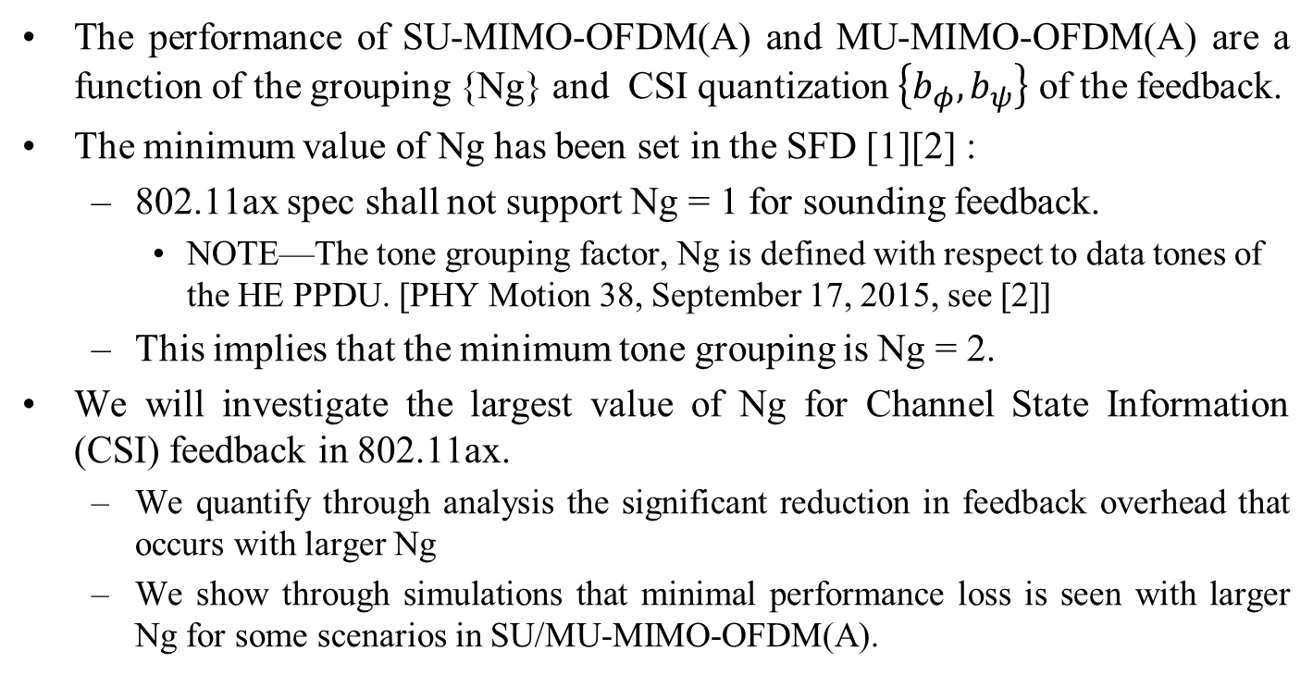
Introduction
The performance of SU-MIMO-OFDM(A) and MU-MIMO-OFDM(A) are a function of the grouping {Ng} and CSI quantization $\left\{b_{φ},b_{ψ}\right\}$ of the feedback.
The minimum value of Ng has been set in the SFD [1][2] :
  802.11ax spec shall not support Ng = 1 for sounding feedback.
    NOTE—The tone grouping factor, Ng is defined with respect to data tones of the HE PPDU. [PHY Motion 38, September 17, 2015, see [2]]
  This implies that the minimum tone grouping is Ng = 2.
We will investigate the largest value of Ng for Channel State Information (CSI) feedback in 802.11ax.
  We quantify through analysis the significant reduction in feedback overhead that occurs with larger Ng
  We show through simulations that minimal performance loss is seen with larger Ng for some scenarios in SU/MU-MIMO-OFDM(A).

Slide 4
Maximum Tone Grouping in 802.11ax
Tone grouping in 802.11ac
  Ng = 1 (312.5 kHz), 2 (625 kHz) and 4 (1250 kHz)
Current tone grouping in 802.11ax
  Ng = 2 (156.25 kHz), and 4 (312.5 kHz)
There are two options to increasing the maximum value of Ng
  Option 1: keep number of grouping parameters the same as 11ac (three values):
      2 (156.25 kHz), 4 (312.5 kHz), 8 (625 kHz)
  Option 2: keep maximum frequency spacing the same as 11ac (four values):
      2 (156.25 kHz), 4 (312.5 kHz), 8 (625 kHz), 16 (1250 kHz)
      Note: The grouping subfield in the VHT MIMO control field uses 2 bits to signal Ng with 1 value reserved.
      Thus, we may use up to 4 values without any changes in the field size.
All we need to demonstrate is that
  there are substantial overhead savings and
  there are some scenarios in which either Ng set at 8 or 16 is beneficial.

Slide 5
Current Status
In [5], we investigated the maximum tone grouping parameter {Ng} for 802.11ax
  We showed that setting the maximum tone grouping parameter {Ng} to 16 resulted in a large savings in feedback overhead.
    up to 70 % savings in feedback data when comparing Ng = 16 to Ng = 4 for 8 x 4 transmission and 242 tone RUs.
  We showed that that minimal PER performance differences are seen with Ng = 8 and 16 compared with Ng = 4 for channel B scenario in SU-MIMO-OFDMA
  We showed that that minimal PER performance differences are seen with Ng = 8 compared with Ng = 4 for channel D scenario in SU-MIMO-OFDMA
  We concluded that TGax should allow Ng = 2, 4, 8, or 16 for SU-MIMO-OFDMA
What about MU-MIMO-OFDM(A) ?
    Should we have a different set of Ng parameters for MU-MIMO-OFDM(A) ?

Slide 6
Feedback Overhead
  Significant savings in feedback overhead as Ng increases even with frame exchange overhead
  Savings depend on feedback configuration:
    MU-MIMO/OFDMA, antenna configuration, MCS of feedback frame etc
  Overhead Calculation Assumptions

Slide 7
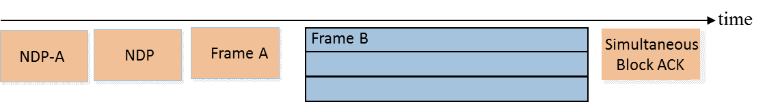
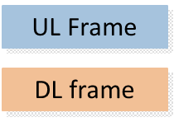
MU-MIMO-OFDM(A) Overhead Savings (1)
Sounding with UL MU-ODMA Feedback [1]
  AP sends NDP-A, NDP and Trigger frame. STAs send UL MU-OFDMA feedback
    TxOP duration savings approximately the same as Bfreport feedback savings

Slide 8
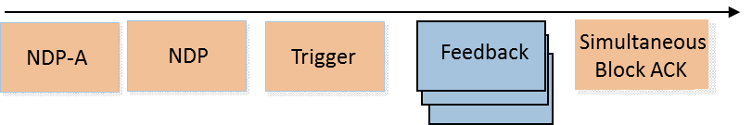
MU-MIMO-OFDM(A) Overhead Savings (2)
Sounding with UL MU-MIMO Feedback [1]
  AP sends NDP-A, NDP and Trigger frame. STAs send UL MU-MIMO feedback
    TxOP duration savings less than as Bfreport feedback savings but still significant

Slide 9
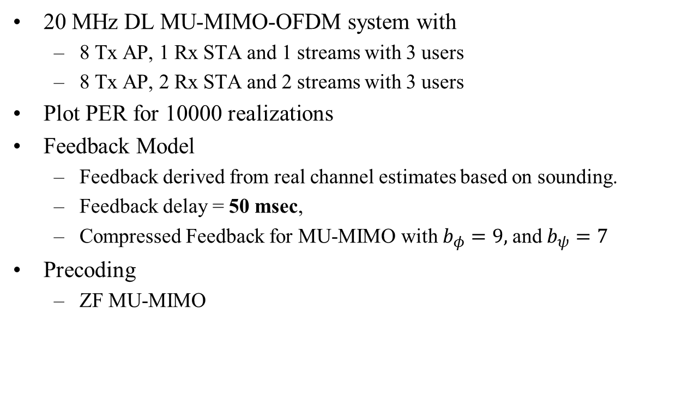
Simulation Assumptions: MU-MIMO-OFDM
20 MHz DL MU-MIMO-OFDM system with
  8 Tx AP, 1 Rx STA and 1 streams with 3 users
  8 Tx AP, 2 Rx STA and 2 streams with 3 users
Plot PER for 10000 realizations
Feedback Model
  Feedback derived from real channel estimates based on sounding.
  Feedback delay = 50 msec,
  Compressed Feedback for MU-MIMO with $b_{φ}=9,$and $b_{ψ}=7$
Precoding
  ZF MU-MIMO

Slide 10
Detailed Assumptions
Parameter | Value
MCS | 4 (16 QAM, 3/4) 7 (64 QAM, 5/6)
Ntx / Nrx /Nss streams/ Nuser | 8 / 1 /1 / 3 8 / 2 / 2 / 3
Number data [1] | [234]
Number tones in LTF | 242 (4x)
Channel Estimation | Realistic (LS):
ChEst Interpolation/smoothing [1] | None
CFO correction | ideal
Packet Size (Bytes) | 1000
Channel [3] | Indoor Channel B, D
Coding | BCC
Timing/Frequency Sync | Realistic
Pilot Tracking | ideal

Slide 11
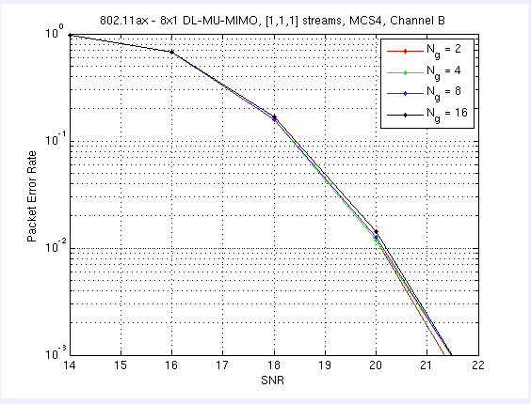
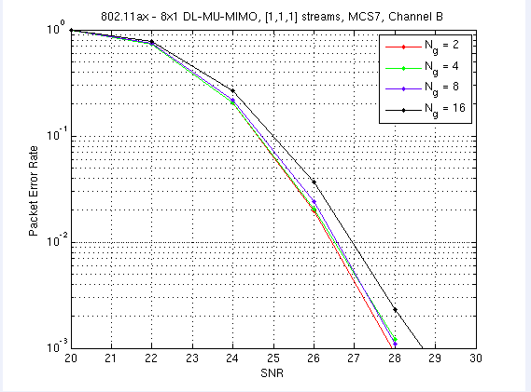
Results for 1 stream, 3 users
(Channel B, MCS4/7)
Channel B:
  May use up to Ng =16 at MCS4 for Channel B
  May use up to Ng = 16 at MCS7 for channel B
  Assumption: < 1 dB of performance loss is acceptable

Slide 12
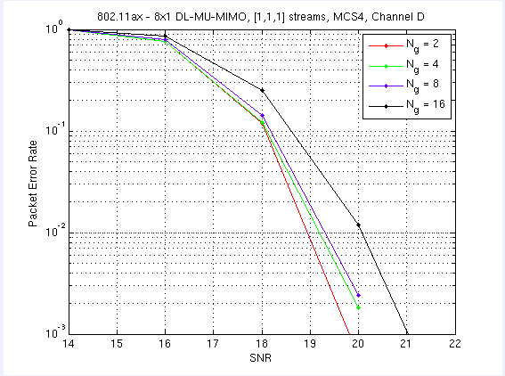
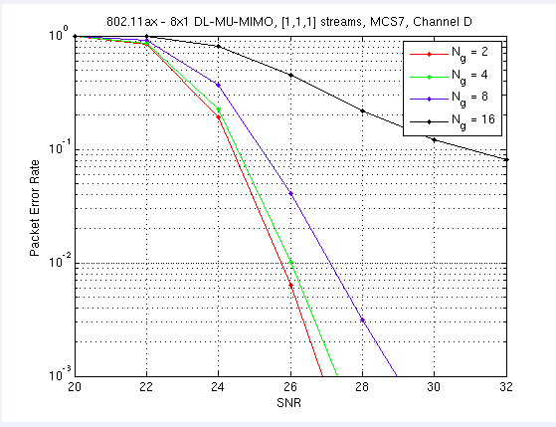
Results for 1 stream, 3 users
(Channel D, MCS4/7)
Channel D:
  May use up to Ng = 8 for MCS4 with Channel D
  May use up to Ng = 4 for MCS7 with Channel D

Slide 13
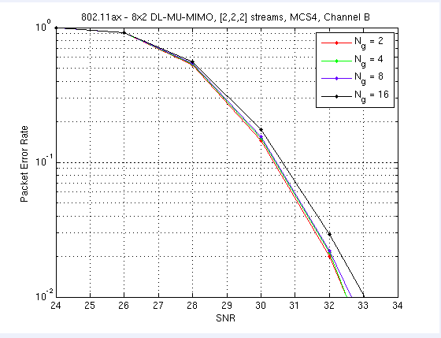
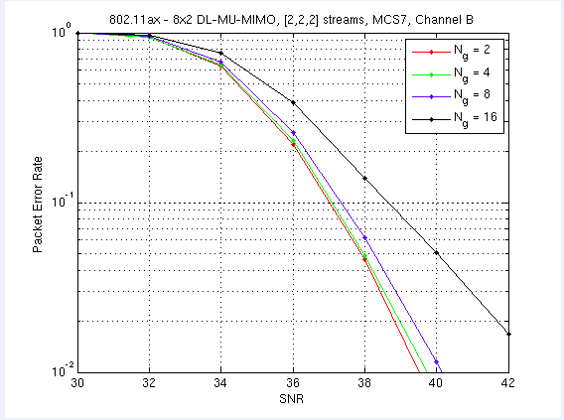
Results for 2 streams, 3 users
(Channel B, MCS4/7)
Channel B:
  May use up to Ng =16 at MCS4 for Channel B
  May use up to Ng = 8 at MCS7 for channel B

Slide 14
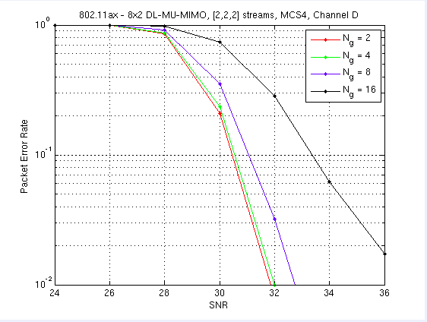
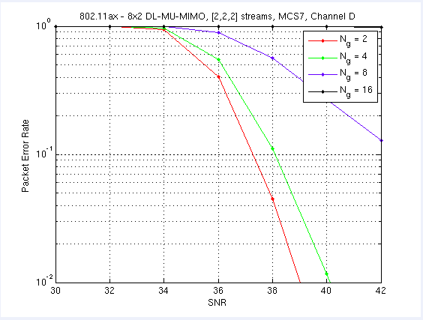
Results for 2 streams, 3 users
(Channel D, MCS4/7)
Channel D:
  May use up to Ng = 4 for MCS4 with Channel D
  May use up to Ng = 2 for MCS7 with Channel D

Slide 15
Conclusions
We investigate the maximum tone grouping parameter {Ng} for 802.11ax
  For low delay spread channels Ng = 16 is viable for low MCS transmission.
  For high delay spread channels or high MCS, Ng = 16 is not usable
Conclusion: there are MU-MIMO configurations that may use up to Ng = 16 as the tone grouping parameter.
TGax should allow Ng = 2, 4, 8, or 16 for SU-MIMO-OFDMA and MU-MIMO

Slide 16
Straw Poll #1
Do you agree to add the following to Section 7.3 of the Tgax SFD ?
802.11ax spec shall support Ng = 4 and 16 for sounding feedback with SU/MU-MIMO-OFDM(A).
NOTE—The tone grouping factor, Ng is defined with respect to data tones of the HE PPDU.
Y/N/A

Slide 17
Straw Poll #2
Do you agree to add the following to Section 7.3 of the Tgax SFD ?
802.11ax spec shall support Ng = 2 and 8 for sounding feedback with SU/MU-MIMO-OFDM(A).
NOTE—The tone grouping factor, Ng is defined with respect to data tones of the HE PPDU.
Y/N/A

Slide 18
References
11-15-0132-09-00ax-spec-framework
11-15-1071-02-00ax-tone-grouping-factors-and-ndp-format-for-802-11ax
11-15-0330-05-00ax-ofdma-numerology-and-structure
Eldad Perahia, Robert Stacey; Next Generation Wireless LANs, 802.11n and 802.11ac,, Cambridge University Press, 2013, Online ISBN:9781139061407, ISBN:9781107016767
11-15-1320-02-00ax-maximum-tone-grouping-size-for-802-11ax-feedback

