Slide 1
TDMA for Eliminating Hidden Station Effect in Dense Networks
Date: 2016-01-16
Authors:
Name | Affiliation | Address | Phone | Email
Evgeny Khorov | IITP |  |  | khorov@frtk.ru
Anton Kiryanov | IITP |  |  | ant456@ya.ru
Sigurd Schelstraete | Quantenna |  |  | sigurd@quantenna.com
Huizhao Wang | Quantenna |  |  | hwang@quantenna.com
Alexander Krotov | IITP |  |  | krotov@iitp.ru
Alexey Kureev | IITP |  |  | kureev@iitp.ru

Slide 2
Hidden STA Problem
AP1
BSS1
Frame
STA1
Collision
AP2
BSS2
Frame
STA2
AP1 and AP2 do not hear each other
Transmissions of AP1 and AP2 can overlap, which results in a collision at STA1

Slide 3
Is RTS/CTS Really Efficient?
AP1
BSS1
RTS
Data
STA1
CTS
ACK
Distance d
AP2
NAV
RTS
BSS2
STA2
The distance between AP1 and STA1, and between AP2 and STA2 is fixed and equals 10 m.
We vary distance d between AP1 and AP2 and measure throughput.
We consider two cases
  With RTS/CTS
  Without RTS/CTS

Slide 4
Physical Layer Parameters
Simulation Scenarios and Assumptions (1/2)
Parameter | Value
Band Width | (Ch 36, 5180) [80MHz]
Shadow fading | No shadowing
Data preamble | IEEE 802.11ac VHT
STA TX Power | 15 dBm
AP TX Power | 20 dBm
AP number of antennas | 1
STA number of antennas | 1
AP antenna gain | 0 dBi
STA antenna gain | -2 dBi
Guard interval | 400ns (short guard interval)
CCA threshold | -76 dBm @ 80MHz
Link Adaptation | Fixed MCS = 5 (234.0 Mbps)
Channel estimation | ideal
Pathloss Model parameters | d₀ = 1, d₁=10, d₂=30, e₀=2, e₁=3.5, e₂=3.5

Slide 5
MAC Layer Parameters
Simulation Scenarios and Assumptions (2/2)
Parameter | Value
Access protocol | [EDCA, AC_BE with default parameters] [CWmin = 15, CWmax = 1023, AIFSn=3 ]
MPDU size | 1538 Bytes (1472 Data + 28 IP header + 8 bytes LLC + 30 MAC header)
BlockACK | On, 32 MPDU aggregated
Max number of retries | 10
Beacons | Disabled
Throughput | Per non-AP station (received bits/sim time)
Simulation Parameters
Parameter | Value
Simulation time | 35 seconds
Distance (AP#-STA#) | 10 m

Slide 6
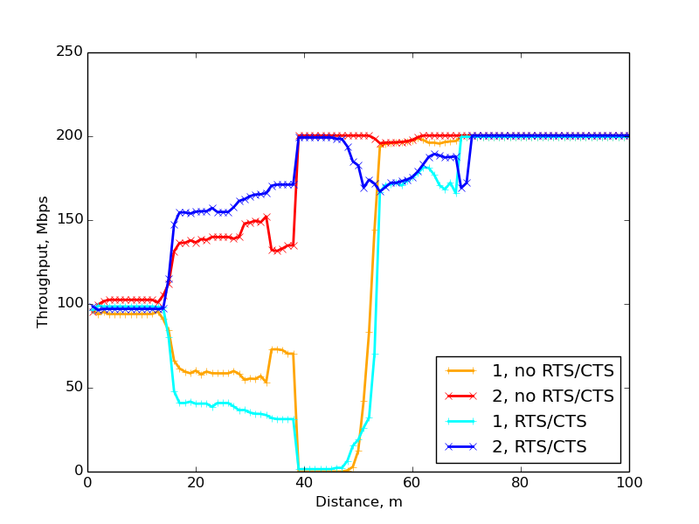
Simulation Results
Fair area
All devices are in range of each other.
Throughput at any link is ~ 50%
Little difference, if any, is caused by starvation during simultaneous transmission
Unfair area
For example, AP1 decodes ACK sent by STA2 incorrectly and waits EIFS instead of DIFS. AP1 has rarer channel access than AP2
Blocking area
AP1 and AP2 do not sense transmissions of each other. All or almost all transmission attempts by AP1 are unsuccessful
Low interference area
For example, the transmissions in BSS1 and BSS2 cannot damage each other, however, the devices may encounter PHY-RXEND indicating errors or Rx frames with CRC errors, causing them to trigger EIFS, much longer delay than DIFS.
No interference area
BSS1 and BSS2 are out of the range of each other.
Throughput at any link is 100%

Slide 7
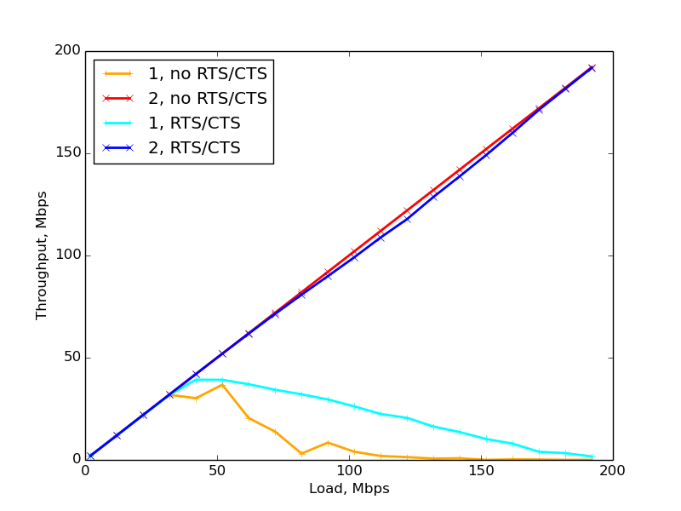
Blocking Area with Non-saturated Traffic
Load at both links follows Poisson distribution with the mean value λ pkt/s.
The problem exists even when the load is low,
i.e. the unfairness appears when the load at both links is ~50Mbps.
When the load increases, the first link experiences hidden station effect, while the second one gets as much channel time as needed.

Slide 8
Deterministic Channel Access Background
Centralized
PCF (IEEE 802.11)
HCCA (IEEE 802.11e)
SP (IEEE 802.11ad)
RAW/PRAW (IEEE 802.11ah)
Distributed
MCCA (IEEE 802.11s)
HCCA TXOP Negotiation
(IEEE 802.11aa)
Beacon
Contention-Free Period
Contention Period
PCF
DCF
DTIM
NAV
Similar to PCF but more flexible. Applicable only for streams with known QoS requirements. No coordination between BSS
Similar to PCF, but the PCP/AP allocates a periodic series of channel times for direct communication between pairs of STAs
Similar to PCF, but channel times are allocated for a group of STAs
Setup
Request
Setup
Response
DTIM Interval
MCCAOP
MCCAOP
DTIM
Period
Offset
Duration
Similar to MCCA, but negotiation occurs between APs. During the reserved time intervals the AP accesses the channel with HCCA.
No signaling protocol for APs that do not hear each other. No protection

Slide 9
Channel Time Reservation for OBSSs (TDMA)
To decrease interference with OBSSs, an AP can reserve channel time for its own BSS
  Similar to MCCA, periodic time intervals are described by offset, duration, period, and TBD (e.g. number)
  Information about reserved channel time can be signaled in beacons
  Starting a transmission in alien intervals is prohibited (the exact behavior is TBD)
  In contrast to HCCA, channel reservation is not assigned to a stream
  In contrast to MCCA, the reservation can belong to a STA, a group of STAs or the whole BSS
  In contrast to HCCA and MCCA, it does not require tight synchronization
Beacon
Reserved
time intervals
Beacon
AP1
Offset
Period
Duration

Slide 10
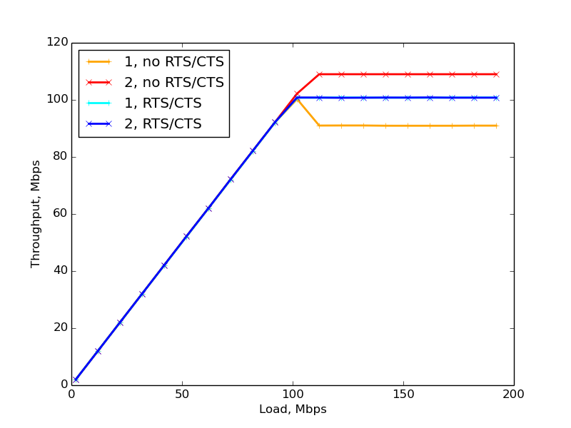
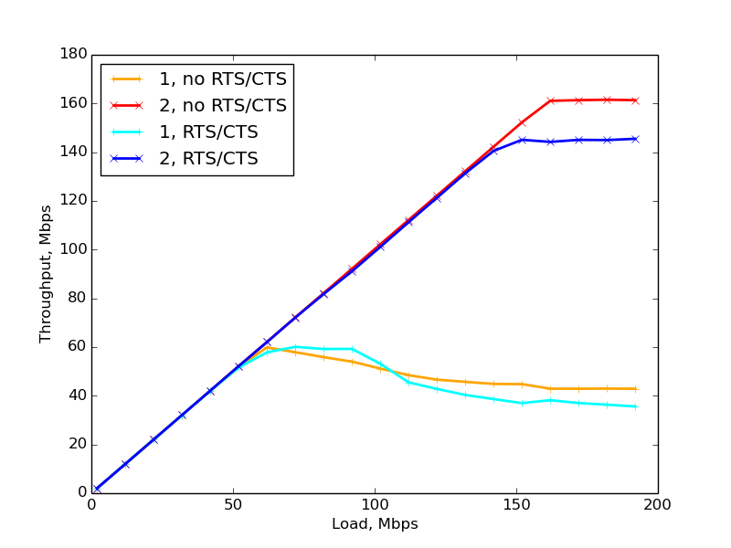
Simulation Results From Blocking Area
BSS1 slot
BSS2 slot
BSS1 slot
BSS2 slot
BSS1 slot
BSS2 slot
BSS1 slot
BSS2 slot
20 ms
20 ms
20 ms
20 ms
20 ms
20 ms
40 ms
20 ms
20 ms
½ for BSS1, ½ for BSS2
¼ for BSS1, ¼ for BSS2
~75%
Diff without RTS/CTS is caused by
collisions at the intervals borders
~25%

Slide 11
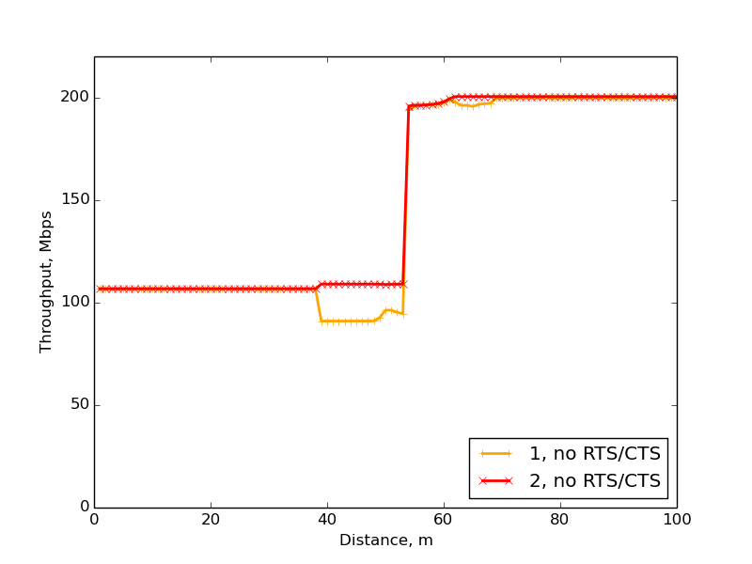
Simulation Results
Legacy
Proposed
Diff without RTS/CTS is caused by
collisions at the intervals borders
2, no RTS/CTS
1, no RTS/CTS
2, RTS/CTS
1, RTS/CTS

Slide 12
How to Inform OBSS STAs about Reservations?
OBSS AP2 receives information about reserved time intervals directly from AP1’s beacon and includes this information in its own beacons.
OBSS STA2a receives information about reserved time intervals directly from alien AP1’s beacon, and relays this information to its AP2. AP2 includes this information in its own beacons.
OBSS AP2 can receive information about reserved time intervals from OBSS STA1 and include this information in its own beacons.
AP1
TX range
AP2
TX range
AP1
AP2
STA2b
AP1
TX range
AP2
TX range
AP1
STA2a
AP2
STA2b
AP1
TX range
AP2
TX range
AP1
STA1
AP2
STA2b
Note: STA2a in cases 2 and STA1 in case 3 shall understand that AP2 is unaware of time intervals reserved by AP1 (see the next slide)

Slide 13
How to Inform OBSS STAs? (cont’d)
AP1
TX range
AP2
TX range
AP1
STA1
AP2
STA2b
If AP2 knows time intervals reserved by AP1, then AP2 includes this information in its own beacons.
STA1 receive both AP1’s and AP2’s beacons.
Having compared information from AP1’s and AP2’s beacons, STA1 understands that AP2 is unaware of time intervals reserved by AP1.
STA1 broadcasts a frame containing information about time intervals reserved by AP1.

Slide 14
Extra Protection
To further protect transmissions within the reserved time intervals the AP may transmit special frame which prohibits frame exchange for its own BSS, alien BSS STAs, or a particular subset of STAs.
This frame is transmitted before the beginning of the reserved time interval.
AP may use prioritized channel access to transmit this frame.

Slide 15
Conclusion
The hidden STA problem leads to packet collisions and throughput degradation.
The problem is more critical in case of dense deployment and overlapped networks, which is a case of .11ax.
We have shown that RTS/CTS mechanism can not always solve the hidden STA problem.
In contrast, periodic reservations do solve this problem.
Such a solution can improve performance of .11ax networks.

Slide 16
Straw Poll
Do you agree to add the following text in SFD:
  x.y.z The spec shall include a mechanism that allows an HE AP to negotiate periodic time intervals for its BSS in advance (not only for an HCCA transmission). During these time intervals, an OBSS or a subset of STAs in the OBSS should not start their transmissions.
  Y
  N
  A

Slide 17
Reference
  [1] Masahito Mori, IEEE 802.11-15-0652r1, Reference simulation model for Dynamic CCA/DSC calibration.
  [2] Chinghwa Yu, IEEE 802.11-15-0886r0, DSC calibration results.

