Slide 1
802.11 January 2016 Closing Reports
Date: 2016-01-22
Authors:

Slide 2
Abstract
This document is a digest of the closing reports of all 802.11 sub-groups for presentation at the January 2016 closing plenary meeting. Attendance information and liaison reports are also included.
r1: adds 802.15 and 802.21 liaison reports

Slide 3
Attendance

Slide 4
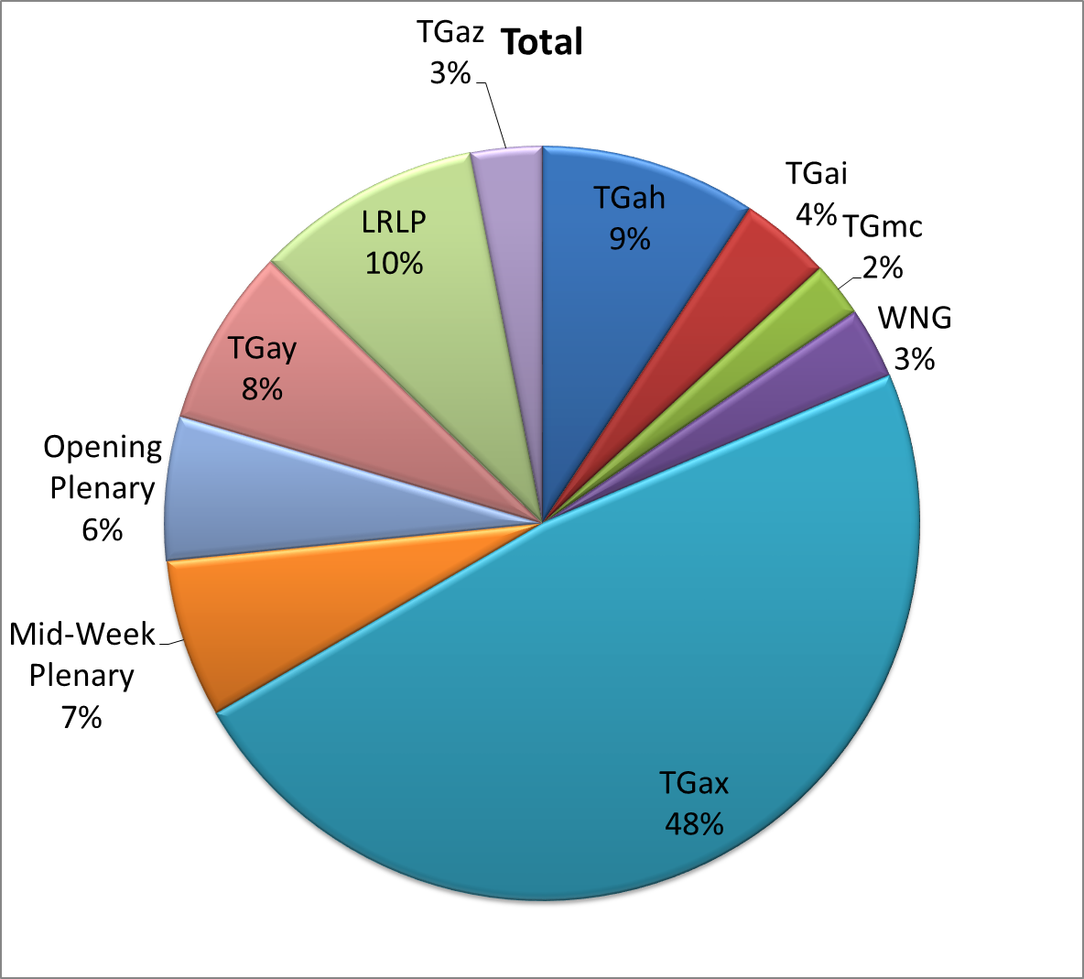
Attendance Total

Slide 5
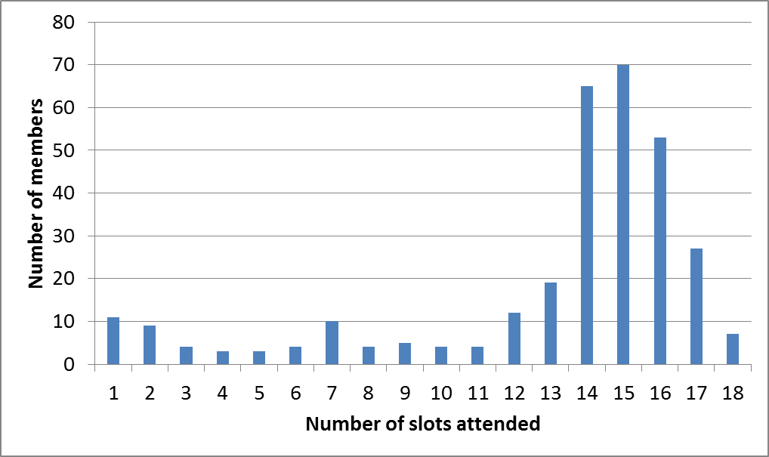
Attendance Histogram (Thu)

Slide 6
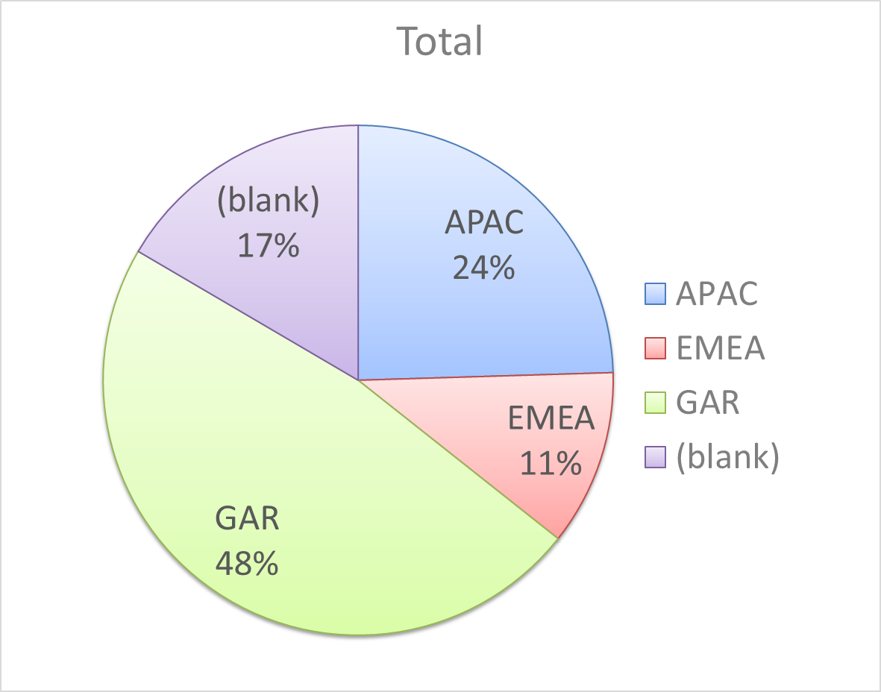
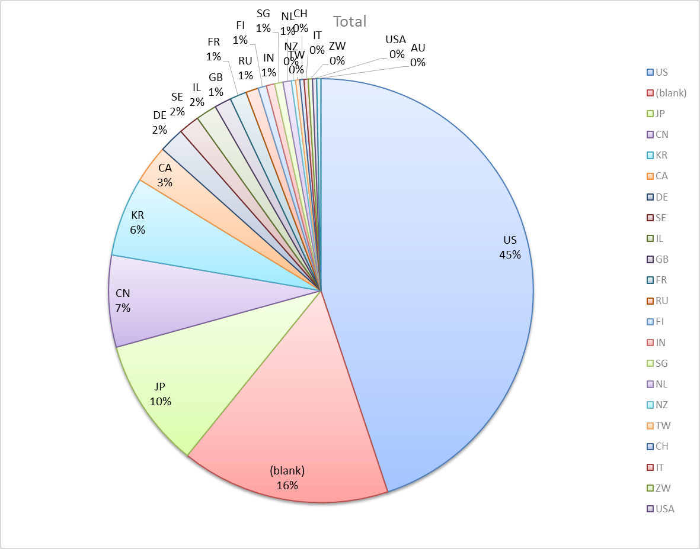
Attendance by Country

Slide 7
802.11 WG Editor’s Meeting (Jan ‘16)
Date: 2016-01-18
Authors:
from slide 1/6 of 11-16-0023 by Peter Ecclesine (Cisco Systems)
Notes:
July 2007

Slide 8
Volunteer Editor Contacts
TGmc – Adrian Stephens – adrian.p.stephens@intel.com, Edward Au – edward.ks.au@huawei.com, Emily Qi – emily.h.qi@intel.com
TGah – Yongho Seok yongho.seok@gmail.com, Alfred Asterjadhi – aasterja@qti.qualcomm.com
TGai – Lee Armstrong – LRA@tiac.net, Ping FANG Ping.FANG@huawei.com
TGaj – Jiamin CHEN – jiamin.chen@mail01.huawei.com , Shiwen He – shiwenhe@seu.edu.cn
TGak – Donald Eastlake – d3e3e3@gmail.com, Norm Finn – nfinn@cisco.com
TGaq – Lee Armstrong – LRA@tiac.net
  TGax – Robert Stacey – robert.stacey@intel.com
  TGay – Carlos Cordeiro – carlos.cordeiro@intel.com
  TGaz – Chao Chun Wang – chaochun.wang@mediatek.com
Editors Emeritus:
  TGaa – Alex Ashley – alex.ashley@hotmail.co.uk
  TGac – Robert Stacey – robert.stacey@intel.com
  TGad – Carlos Cordeiro – carlos.cordeiro@intel.com
  TGae – Henry Ptasinski – henry@LOGOUT.COM
  TGaf – Peter Ecclesine – pecclesi@cisco.com
  TGaq – Dan Gal – ddrgal@gmail.com
from slide 2/6 of 11-16-0023 by Peter Ecclesine (Cisco Systems)
Notes:
July 2007

Slide 9
802.11 Style Guide
See 11-09-1034-11-0000-wg11-style-guide.doc
  We updated 802.11 WG Style Guide based on 2012 IEEE Standards Style Manual and consistency changes in final publication of the 802.11 standard
Editor’s responsibility includes checking the 2014 IEEE Standards Style Manual when creating or updating drafts. https://development.standards.ieee.org/myproject/Public/mytools/draft/styleman.pdf
Submissions with draft text should conform to both the WG11 Style Guide and IEEE Standards Style Manual
Note that the Style Guide evolves with our practice, expect a revision in March
from slide 3/6 of 11-16-0023 by Peter Ecclesine (Cisco Systems)

Slide 10
Editor Amendment Ordering
Data as of Jan 2016
See http://grouper.ieee.org/groups/802/11/Reports/802.11_Timelines.htm
In Nov 2015, Editors changed the running order and will revisit in July 2016, maintaining this order in the interim
Amendment Number | Task Group | Projected REVCOM Date
802.11REVmc | TGmc - 3718 | Jan 2017
802.11-2016 Amendment 1 | TGai - 168 | Jan 2017
802.11-2016 Amendment 2 | TGah - 598 | Jan 2017
802.11-2016 Amendment 3 | TGaq - 30 | Jan 2017
802.11-2016 Amendment 4 | TGak - 79 | Jan 2017
802.11-2016 Amendment 5 | TGaj - 174 | Jun 2017
802.11-2016 Amendment 6 | TGax | Mar 2019
Amendment numbering is editorial! No need to make ballot comments on these dynamic numbers!
from slide 4/6 of 11-16-0023 by Peter Ecclesine (Cisco Systems)
Notes:
July 2007

Slide 11
Draft Development Snapshot
January 2016
Jan 2016
TG | Published or Draft Baseline Documents |  |  |  |  |  |  |  |  |  | Source | MDR | Style Guide | Editor | Snapshot Date
 | Published | mc | ai | ah | aq | ak | aj | ax | ay | az
mc | Y | 5.0 |  |  |  |  |  |  |  |  | Frame 12.0 | Yes | 2012 | Adrian Stephens Edward Au, Emily Qi | 19-Jan
ai | N | 4.0 | 6.3 |  |  |  |  |  |  |  | Frame 12.0 | Yes | 2012 | Lee Armstrong Ping FANG | 20-Jan
ah | N | 4.0 |  | 5.1 |  |  |  |  |  |  | Frame 11.0 | Yes | 2012 | Yongho Seok Alfred Asterjadhi | 20-Jan
aq | N | 4.0 |  |  | 3.1 |  |  |  |  |  | Frame 12.0 | No | 2012 | Lee Armstrong | 20-Jan
ak | N | 4.0 |  |  |  | 1.4 |  |  |  |  | Word | No | 2012 | Donald Eastlake Norm Finn | 19-Jan
aj | N |  |  |  |  |  | 1.0 |  |  |  | Frame 10.0 | No | 2012 | Jiamin Chen Shiwen He | 18-Jan
ax | Y |  |  |  |  |  |  |  |  |  |  | No | 2012 | Robert Stacey | 20-Jan
ay |  |  |  |  |  |  |  |  |  |  |  | No | 2012 | Carlos Cordeiro | 6-Nov
az |  |  |  |  |  |  |  |  |  |  |  |  |  | Chao Chun Wang | 21-Jan
Changes from last report shown in red.
Most current doc shaded green.
from slide 5/6 of 11-16-0023 by Peter Ecclesine (Cisco Systems)
Notes:
July 2009
July 2007
Peter Ecclesine (Cisco Systems)
Page 11

Slide 12
MIB style, Visio and Frame practices
I’m going to suggest going forward we use a single style with appropriately set tabs, and use leading Tabs to distinguish the syntax and description parts. (Adrian Stephens Feb 9, 2010)
Figure in an anchored frame within a table, and use a table caption as a figure caption
Keep embedded figures using visio as long as possible
  Near the end of sponsor ballot, turn these all into .wmf (windows meta file) format files (you can do this from visio using “save as”). Keep separate files for the .vsd source and the .wmf file that is linked to from frame. There is likelihood we should use .emf
Frame templates for 11aa, 11ac, 11af
Text version of MIB is available (2012, ae2012, aa2012, ad2012, acD5.0, afD5.0. mcD3.0)
from slide 6/6 of 11-16-0023 by Peter Ecclesine (Cisco Systems)

Slide 13
ARC Closing Report
Date: 2016-01-21
Authors:
from slide 1/6 of 11-16-0190 by Joseph Levy (Interdigital)

Slide 14
Abstract
This document is the closing report for ARC SC,
January 2016 Meeting in Atlanta GA USA
from slide 2/6 of 11-16-0190 by Joseph Levy (Interdigital)

Slide 15
Work Completed
Agenda is here: https://mentor.ieee.org/802.11/dcn/15/11-15-1519-03-0arc-arc-sc-agenda-jan-2016.ppt
Updated Figures and Text for REVmc section 5.1.5 approved
  https://mentor.ieee.org/802.11/dcn/15/11-15-0540-08-0arc-updates-to-revmc-5-1-5.docx
  Approved by REVmc for roll in to next Draft
Discussed 802.11 as a component/5G/IMT-2020
  Brief review of WNG IMT-2020 presentation, followed by a discussion
IETF/802 Coordination
  Multicast traffic features of 802.11 work is on going in IETF, it is likely that work in ARC SC will start in March or May meeting.
  Request to update 802.11/.15 IETF Tutorial and projects is underway, ARC SC will likely be asked for feedback/review in March meeting.
from slide 3/6 of 11-16-0190 by Joseph Levy (Interdigital)

Slide 16
Work Completed
Discussed Figures and Text for 802.11ak section 5.1.5
  Straw Polls agreed figures and text should be forwarded to TGak
AP/DS/Portal architecture and 802 concepts
  Reviewed and discussed
  Possible area of work: Annex N – AP Description many need to be revised/updated with these concepts.
  Also reviewed the TGak diagrams for: dual mode STAs/IBSS/ ect.
MIB Design Pattern work item
  Discussed, no real progress some progress
  Goal to complete draft and send to the technical editor for inclusion in the MDR
Joint meeting with TGak/802.1
  Discussed TGak diagrams
  Discussed data transport and mobility issues and how to specify, have an agreed way forward
Joint meeting with TGaq
  Discussed TGaq diagrams agreed way forward
from slide 4/6 of 11-16-0190 by Joseph Levy (Interdigital)

Slide 17
Teleconference(s)
Will schedule with 10 days notice, if needed
from slide 5/6 of 11-16-0190 by Joseph Levy (Interdigital)

Slide 18
March 2016 Plans
Two standalone meeting slots planned:
  802.11 as a component/5G/IMT2020
  Design Pattern for MIB attribute use
  DS/AP/Portal architecture discussions
  IETF work anticipated:
    Multicast Traffic features of 802.11
    802.11/.15 IETF Tutorial and Projects Underway and work of joint interest
One joint session with TGak/802.1
  802.11ak architecture discussions:
    GLK ESS concept
    “Where are a DS’s brains?”
from slide 6/6 of 11-16-0190 by Joseph Levy (Interdigital)

Slide 19
IEEE 802.11/15 Regulatory SC
Atlanta Closing Report
Date: 2016-01-22
Authors:
from slide 1/5 of 11-16-0142 by Rich Kennedy, Unlicensed Spectrum Advocates

Slide 20
Abstract
This presentation is the closing report for the January 2016 IEEE 802.11/15 Regulatory Standing Committee meeting in Atlanta.
from slide 2/5 of 11-16-0142 by Rich Kennedy, Unlicensed Spectrum Advocates

Slide 21
Agenda
Introduction
Approve minutes from Dallas
At the start of 2016…
The regulatory summaries
Actions required
  TBD
Adjourn
from slide 3/5 of 11-16-0142 by Rich Kennedy, Unlicensed Spectrum Advocates

Slide 22
Regulatory Updates
Reviewed items in process at the end of 2015
US
  FCC DSRC decisions – Chairman’s letter to DoC, DoT and Congress
  FCC trying to close on Globalstar TLPS
  FCC 14-30 implementation date pushed out to March 2016
EU
  ETSI ERM TG11
  ETSI TC BRAN
  New challenges for 5 GHz band use
WRC-15 Outcomes
Other
  Proposed changes to 802 regulatory
from slide 4/5 of 11-16-0142 by Rich Kennedy, Unlicensed Spectrum Advocates

Slide 23
Teleconferences
Weekly on Thursdays, 12:30 to 13:30 ET
from slide 5/5 of 11-16-0142 by Rich Kennedy, Unlicensed Spectrum Advocates

Slide 24
Closing Report
Date: 2016-01-22
Authors:
from slide 1/4 of 11-16-0180 by Jim Lansford (Qualcomm)

Slide 25
Abstract
Closing report for WNG SC for January 2016 in Atlanta, Georgia USA
from slide 2/4 of 11-16-0180 by Jim Lansford, (Qualcomm)

Slide 26
Final Agenda
https://mentor.ieee.org/802.11/dcn/15/11-15-1518-01-0wng-agenda-for-wng-2016-01.ppt
Presentations at January 2016 meeting
  1. “ITU-R IMT-2020 Status” by Joseph Levy (Interdigital)
    https://mentor.ieee.org/802.11/dcn/16/11-16-0127-00-0wng-itu-r-imt-2020-status.pptx
  2. “Next steps for IMT-2020” by Andrew Myles (Cisco Systems)
    https://mentor.ieee.org/802.11/dcn/16/11-16-0004-00-0000-next-steps-for-imt-2020.pptx
  3. “IMT-2020 Way Forward and Straw Polls” by Joseph Levy (Interdigital)
    https://mentor.ieee.org/802.11/dcn/16/11-16-0128-01-0wng-imt-2020-way-forward-and-straw-polls.pptx
    Straw polls indicated some interest in moving forward with ITU-R engagement, but questions about whether members would receive support from their sponsors
Further discussion in ARC
from slide 3/4 of 11-16-0180 by Jim Lansford, (Qualcomm)

Slide 27
Additional Information
Minutes
  16/162r0
Plans for March 2016
  Presentation on “LiFi”
  Others TBD
from slide 4/4 of 11-16-0180 by Jim Lansford, (Qualcomm)

Slide 28
IEEE 802 JTC1 SC closing report
(Jan 2016)
Date: 2016-01-22
Authors:
from slide 1/5 of 11-16-0177 by Andrew Myles, Cisco

Slide 29
Abstract
Closing report for IEEE 802 JTC1 SC
for Jan 2016 in Atlanta
from slide 2/5 of 11-16-0177 by Andrew Myles, Cisco

Slide 30
The SC did not have a great deal of work this week and only one session was required
Reviewed status of PSDO pipeline
  IEEE 802 has pushed 18 standards completely through the PSDO ratification process
  IEEE 802 has 9 standards in or about to go into the PSDO ratification process
Reviewed latest PSDO activities
  802 through PSDO process
  802.1BA and 802.1BR 60 day pre-ballot responses sent
  802.1Xbx passed FDIS and responses discussed
  802.22a, 802.22b submitted to PSDO process
  802.3bx , 802.3bw, 802.1Qca will be submitted to PSDO soon
from slide 3/5 of 11-16-0177 by Andrew Myles, Cisco

Slide 31
The SC did not have a great deal of work this week and only one session was required
Reviewed agenda for SC6 meeting in Mar 2016
  IEEE 802 will not have any reps
  IEEE 802 will send status reports for each WG
  Agenda is very light so far
  Topics of possible interest
    WG1: Human Body Area Networking proposal
    WG7: WLAN Access Controller (AC) Coordination Technology proposal
    WG7: Convergence Service for Interworking of Heterogeneous Wireless Networks proposal
from slide 4/5 of 11-16-0177 by Andrew Myles, Cisco

Slide 32
The SC will focus in Macau on PSDO processes & reporting on SC6 meeting
Continue executing PSDO processes
Report on SC6 meeting results
from slide 5/5 of 11-16-0177 by Andrew Myles, Cisco

Slide 33
IEEE 802.11mc Closing Report for
January 2016
Date: 2016-01-21
Authors:
from slide 1/6 of 11-16-0185 by Dorothy Stanley, HPE

Slide 34
Abstract
This document contains the TGmc closing report for January 2016.
from slide 2/6 of 11-16-0185 by Dorothy Stanley, HPE

Slide 35
Status
Initial recirculation Sponsor Ballot underway, closes January 26th 2016
Considered available presentations related to comments in initial recirculation ballot
Agenda, includes motions
  https://mentor.ieee.org/802.11/dcn/15/11-15-1522-05-000m-tgmc-agenda-january-2016.pptx
Comment resolution spreadsheet
  https://mentor.ieee.org/802.11/dcn/15/11-15-0532-30-000m-revmc-sponsor-ballot-comments.xls
from slide 3/6 of 11-16-0185 by Dorothy Stanley, HPE

Slide 36
TGmc Plan of Record - modified
20 July 2012 – 12 Sept 2012 – Call for Comment/Input
29-30 Aug 2012 – NesCom, SASB PAR Approval
Sept 2012 – Begin to process CC input, 11aa, 11ae integration
Dec 2012 – March/May 2013 – 11ad integration
Jan 2013 – First WG Letter ballot - without 11ad – on D1.0
Sept 2013 – Letter ballot on D2.0
Dec 2013 – May 2014 – 11ac, 11af integration – D3.0 in May 2014
July 2014 – Mandatory Draft Review
Jan 2015 – D4.0 Recirculation
Form Sponsor Pool: Open Dec 15th or so, close Feb 20, 2015 –good for 6 months (end of July 2015)
Initial Sponsor Ballot 2015-03-27 through 2015-04-26
Jan 2016 Initial SB recirculation
Feb 2016 BRC Ft. Lauderdale meeting
July 2016 – WG/EC Final Approval
September 2016 – RevCom/SASB Approval
from slide 4/6 of 11-16-0185 by Dorothy Stanley, HPE
Notes:
doc.: IEEE 802.11-10/0503r4
May 2010
Michael Montemurro, Research in Motion
Page 36

Slide 37
TGmc SB Planning
Initial Sponsor Ballot 2015-03-27 through 2015-04-26 on D4.0
Jan 11-26 2016 Initial SB recirculation D5.0
  Teleconferences, Feb 22-25 2016 BRC Ft. Lauderdale meeting
  2nd recirculation on D6.0: March 2016
April/May 2016
  Comment resolution
  3rd recirculation April/May 2016 D6.0 unchanged or D7.0
  4th recirculation D7.0 unchanged if needed May/June 2016
  Revcom Submission date: 20 May 2016 for June 28-30 Revcom
  EC telecon approval June 2016
July 2016 – WG/EC Final Approval (if not in June 2016)
September 2016 – RevCom/SASB Approval (if not June 2016)
  Revcom Submission date: 05 Aug 2016 for Sept 16 Revcom teleconference
from slide 5/6 of 11-16-0185 by Dorothy Stanley, HPE
Notes:
doc.: IEEE 802.11-10/0503r4
May 2010
Michael Montemurro, Research in Motion
Page 37

Slide 38
Teleconferences and next steps
January -March
  Initial recirculation Sponsor Ballot comment resolution as Comment Resolution Committee
Conference Calls 10am Eastern (2 hours)
  February 5, 19
BRC meeting Feb 22-25, 2016
  Ft. Lauderdale, SR Technologies hosting
  Teleconference facilities will be provided
from slide 6/6 of 11-16-0185 by Dorothy Stanley, HPE

Slide 39
IEEE 802.11ah Closing Report for
January 2016
Date: 2016-01-21
Authors:
from slide 1/7 of 11-16-0184 by Yongho Seok (NEWRACOM)

Slide 40
Abstract
January 2016
This presentation is the closing report for the Atlanta meeting of the IEEE 802.11 TGah.
from slide 2/7 of 11-16-0184 by Yongho Seok (NEWRACOM)

Slide 41
Activity in TGah
Sponsor Ballot for Draft 5.0 closed November 5
  552 comments received
TGah has completed all comment resolution of the initial Sponsor Ballot for Draft 5.0
  15/1292 SB0 Comment Spreadsheet
  Instructed the editor to generate Draft 6.0 and moved to forward Sponsor Recirculation Ballot
  Agenda of January 2016 meeting: 11-15/1511r9
from slide 3/7 of 11-16-0184 by Yongho Seok (NEWRACOM)

Slide 42
Going forward
Start initial Sponsor Recirculation Ballot and address comments in March F2F meeting
from slide 4/7 of 11-16-0184 by Yongho Seok (NEWRACOM)

Slide 43
Teleconference
Weekly teleconferences between March 22th 2016 and July 19th 2016
  Tuesday 8PM ET for 2.5 hours
from slide 5/7 of 11-16-0184 by Yongho Seok (NEWRACOM)

Slide 44
TGah Timeline – No Change
Internal Task Group Ballot : May 2013
Initial Letter Ballot : September 2013
Initial Recirculation Letter Ballot : September 2014
Initial Sponsor Ballot : October 2015
Initial Recirculation Sponsor Ballot : January 2016
EC Approval : July 2016
Revcom Approval : July 2016
from slide 6/7 of 11-16-0184 by Yongho Seok (NEWRACOM)

Slide 45
Motion 10
Having approved comment resolutions for all of the comments received from an initial Sponsor Ballot on P802.11ah D5.0
Instruct the TGah editor to prepare P802.11ah D6.0 incorporating these resolutions and,
Approve a 15 day Sponsor Recirculation Ballot asking the question “Should P802.11ah D6.0 be forwarded to RevCom?”
Moved: Eugene Baik
Seconded: Matthew Fischer
Result: Motion passed (Yes 10 No 0 Abstain 0)
from slide 7/7 of 11-16-0184 by Yongho Seok (NEWRACOM)

Slide 46
IEEE 802.11TGai
Closing Report
January 2016
Date: 2016-1-21
Authors:
Name | Company | Address | Phone | email
Hiroshi MANO | Koden Techno Info K.K. | Fuji Blg 28 2F, 2-7-26 Kita-Aoyama, Minato-ku, Tokyo, 107-0061, Japan | +81-3-6890-0594 | mano@koden-ti.com hiroshi@manosan.org
from slide 1/11 of 11-16-0179 by Hiroshi Mano (KDTI)

Slide 47
Abstract
This presentation is the closing report for the Atlanta meeting of the IEEE 802.11 TGai.
from slide 2/11 of 11-16-0179 by Hiroshi Mano (KDTI)

Slide 48
IEEE 802.11 FILS TGai – Jan 2016 Atlanta
Goals for the Meeting:
  Approve minutes of past meeting and teleconference
  Comment resolution of 1st sponsor LB
  Approve to forward the Recirc sponsor LB
  Approve Timeline
  Approve Teleconference schedule
  Approve Plan for Mar
from slide 3/11 of 11-16-0179 by Hiroshi Mano (KDTI)

Slide 49
Accomplishments TGai 1/2
9 regular slots
Approve TGai Meeting Minutes for the IEEE 802.11 Dallas meeting:
  15-1482/r1
  https://mentor.ieee.org/802.11/dcn/15/11-15-1482-01-00ai-november-2015-dallas-session-minutes.doc
Approve TGai teleconference meeting minutes of Dallas to Atlanta meeting.
  15-1483/r5
  https://mentor.ieee.org/802.11/dcn/15/11-15-1483-05-00ai-november-january-teleconference-minutes.doc
from slide 4/11 of 11-16-0179 by Hiroshi Mano (KDTI)

Slide 50
Accomplishments TGai 2/2
D6.3 was opened in WG members area.
Received 760 comments by1st SB
  Resolved all of received comment
Approved comment resolutions for all of the comments received from initial Sponosor Ballot on P802.11ai D6.0 as contained in document 11-15/1196r31.
Approved go to a 15 day Sponsor Recirculation Ballot
Approved Plan for Mar and May 2016
Approved Time line
Approved Teleconference schedule
from slide 5/11 of 11-16-0179 by Hiroshi Mano (KDTI)

Slide 51
Motion to Recirc SB
Having approved comment resolutions for all of the comments received from initial Sponosor Ballot on P802.11ai D6.0 as contained in document 11-15/1196r31.
  Instruct the editor to prepare Draft D7.0 incorporating these resolutions and,
  Approve a 15 day Sponsor Recirculation Ballot asking the question “Should P802.11ai D7.0 be forwarded to RevCom?”
Moved: Lee Armstrong
Seconded: Jouni Malinen
Result: y-n-a:8/0/2
from slide 6/11 of 11-16-0179 by Hiroshi Mano (KDTI)

Slide 52
Plan for Mar & May
March
  TGai CRC will not conduct any business during the March plenary.
Goals for the May Meeting:
  Approve minutes of past meeting and teleconference
  Comment resolution of Recirc sponsor LB
  Approve Timeline
  Approve Teleconference schedule
  Approve Plan for July
from slide 7/11 of 11-16-0179 by Hiroshi Mano (KDTI)

Slide 53
Time line of TGai (No Change)
  PAR Approved, Modified, or Extended 2010-12-08
  WG Letter Ballots Initial / Recirc Mar14/Sep14/Jan15/
  Mar15/Jul15/Aug15
  MEC Done Nov14
  Form Sponsor Ballot Pool / Reform Mar15
  IEEE-SA Sponsor Ballots Initial / Recirc Sep 15/Mar 16/Jul 16/Sep 16
  Final 802.11 WG Approval Aug 16
  final or Conditional 802 EC Approval July 16
  RevCom & Standards Board Final or
  Continuous Process Approval Sep 16
  ANSI Approved N/A
from slide 8/11 of 11-16-0179 by Hiroshi Mano (KDTI)

Slide 54
Teleconference Schedule
January 2016
Motion:
  Approve the following schedule of weekly teleconferences between Feb 9 to May 31.
  Tuesdays 10:00 ET
  Duration 1.5 Hour
  Using WEB-EX that will be provided by Task Group Chair
  Moved:Lee Armstrong
  Second:Jouni Malinen
Approved by unanimous consent
from slide 9/11 of 11-16-0179 by Hiroshi Mano (KDTI)

Slide 55
Reference
TGai-Motion-deck (11-13-1186/38)
  https://mentor.ieee.org/802.11/dcn/13/11-13-1186-38-00ai-tgai-motion-deck.pptx
Comments from 1st SB (11-15-1196/31)
  https://mentor.ieee.org/802.11/dcn/15/11-15-1196-31-00ai-tgai-comments-from-1st-sb.xlsx
from slide 10/11 of 11-16-0179 by Hiroshi Mano (KDTI)

Slide 56
Thanks to all who participated!
from slide 11/11 of 11-16-0179 by Hiroshi Mano (KDTI)

Slide 57
TGak January Closing Report
Date: 2016-01-21
Authors:
from slide 1/5 of 11-16-0188 by Donald Eastlake, Huawei Technologies

Slide 58
Abstract
Closing Report of IEEE 802.11 Task Group ak at the IEEE 802.11 Meeting, January 2016, held in Atlanta, Georgia.
from slide 2/5 of 11-16-0188 by Donald Eastlake, Huawei Technologies

Slide 59
TGak Closing Report
Accomplishments
  Due to the valiant efforts of the TGak attendees, TGak finished resolving all comments from LB
  Received and discussed the submissions listed on the next page.
  Met jointly with 802.1 TSN and 802.11 ARC SC Thursday AM1.
  An annotated agenda is in 11-15/1473.
  The minutes will be in 11-16/189.
from slide 3/5 of 11-16-0188 by Donald Eastlake, Huawei Technologies

Slide 60
TGak Closing Report
Submissions Presented
  11-15/931r8 “MAH Assigned comments”, Mark Hamilton (Ruckus)
  11-16/14r0 “Comment Resolution r15 Fix-ups”, Donald Eastlake (Huawei)
  11-15/1275r2 “Address-1 Filtering and GLK-GCR Scoreboarding”, Ganesh Venkatesan (Intel)
  11-15/795r12 “Addressing Comment Resolutions”, David Kloper (Cisco)
  11-16/166r3 “Revised 11ak Figures”, Philippe Klein (Broadcom)
  11-16/138r2 “Resolutions to some GLK-GCR related Comments (Part 3)”, Ganesh Vendkatesan (Intel)
  11-16/170r1 “Remaining DEE3 Assigned Comments”, Donald Eastlake (Huawei)
  11-16/169r1 “Resolutions to CIDs 60 and 229”, Ganesh Vendkatesan (Intel)
from slide 4/5 of 11-16-0188 by Donald Eastlake, Huawei Technologies

Slide 61
TGak Closing Report
Teleconferences
  Decided to hold 1 ½ hour teleconferences, to be joint with 802.1Qbz if mutually convenient, on Monday, February 1st, 8th, 22nd, and 29th, all at 10am Eastern US time.
March 2016 Plans
  Resolve comments from WG recirculation ballot.
  Go to recirculation ballot.
  Joint meeting with 802.1 TSN and 802.11 ARC.
from slide 5/5 of 11-16-0188 by Donald Eastlake, Huawei Technologies

Slide 62
TGaq Closing Report
Date: 2016-01-21
Authors:
from slide 1/3 of 11-16-0178 by Stephen McCann, BlackBerry

Slide 63
Abstract
Closing report for TGaq (Pre-Association Discovery) for January 2016, Atlanta, GA, USA.
from slide 2/3 of 11-16-0178 by Stephen McCann, BlackBerry

Slide 64
LB216 Comment Resolution Analysis
  92.66% approval, 400 comments, 72.63% return
  Resolved 85 technical comments this week, 128 remaining
  Editor will prepare D3.2 based on this week’s resolutions
Discussion topics
  Change of ANQP-SD to ANQP
  Probe Request/Response changes
Joint Meeting with ARC
  Discussion of architecture issues
  Agreed on a way forward
Plans for March 2016
  Continue to work on comment resolutions from LB216
  Request re-circulation letter ballot
from slide 3/3 of 11-16-0178 by Stephen McCann, BlackBerry

Slide 65
TGax January 2016 Closing Report
Date: 2016-01-21
Authors:
from slide 1/8 of 11-16-0187 by Osama Aboul-Magd (Huawei Technologies)

Slide 66
Abstract
This document is the closing report for the TGax for the January 2016 session.
from slide 2/8 of 11-16-0187 by Osama Aboul-Magd (Huawei Technologies)

Slide 67
Work Completed – TG Documents
Passed a number of affecting aspects of the TG Specification Framework.
  PHY
  MAC
  MU
Latest approved revisions of the Specification Framework is available at:
  https://mentor.ieee.org/802.11/dcn/15/11-15-0132-13-00ax-spec-framework.docx
Other TG documents
  https://mentor.ieee.org/802.11/dcn/14/11-14-0571-11-00ax-evaluation-methodology.docx
  https://mentor.ieee.org/802.11/dcn/14/11-14-0980-16-00ax-simulation-scenarios.docx
  https://mentor.ieee.org/802.11/dcn/14/11-14-0882-04-00ax-tgax-channel-model-document.docx
  https://mentor.ieee.org/802.11/dcn/14/11-14-1009-02-00ax-proposed-802-11ax-functional-requirements.doc
from slide 3/8 of 11-16-0187 by Osama Aboul-Magd (Huawei Technologies)

Slide 68
Work Completed – Technical Presentations
The TG received over 45 technical submissions.
  22 PHY submissions
  12 MAC Submissions
  09 MU Submissions
  01 SR submissions
  04 submissions addressing TG issues
A list of the submissions is available in the agenda document available at:
  https://mentor.ieee.org/802.11/dcn/15/11-15-1516-03-00ax-tgax-november-2015-meeting-agenda.ppt
from slide 4/8 of 11-16-0187 by Osama Aboul-Magd (Huawei Technologies)

Slide 69
Work Completed - Draft
Submission 11-16/0024r0 was submitted by the TG Editor and it includes a “draft” draft specification.
The submission was reviewed by the TG Editor and is available on mentor to be reviewed by TG members.
The submission is available at: https://mentor.ieee.org/802.11/dcn/16/11-16-0024-00-00ax-proposed-draft-specification.docx
from slide 5/8 of 11-16-0187 by Osama Aboul-Magd (Huawei Technologies)

Slide 70
Plan for Progressing TG Draft
Approve the TG draft specification during the March 2016 meeting.
  Draft 0.1
Start a comment collection (CC) for 30 days on draft 0.1 – Ends some time in April.
Comment resolution (May and July)
Draft 1.0 in July 2016 and start WG LB.
from slide 6/8 of 11-16-0187 by Osama Aboul-Magd (Huawei Technologies)

Slide 71
January 2016 Goals
Discuss Proposals affecting the TG Specification Framework document
Approve D0.1 of the TG Draft
Approve a 30-day Comment Collection Process.
from slide 7/8 of 11-16-0187 by Osama Aboul-Magd (Huawei Technologies)

Slide 72
Conference Call Times
Thursday February 4 10:00 – 12:00 ET
Thursday February 18 20:00 – 22:00 ET
Thursday March 3 10:00 – 12:00 ET
from slide 8/8 of 11-16-0187 by Osama Aboul-Magd (Huawei Technologies)

Slide 73
Task Group AY
January 2016 Closing Report
Date: 2016-01-22
Authors:
from slide 1/6 of 11-16-0181 by Edward Au (Huawei Technologies)

Slide 74
Abstract
This document is the closing report for Task Group AY for the January 2016 session.
from slide 2/6 of 11-16-0181 by Edward Au (Huawei Technologies)

Slide 75
Work Completed
18 submissions were covered during the meeting covering areas related to:
  Channel model
  Usage model
  Simulation scenario and evaluation methodology
  Technologies
Significant progress is made in the development of specification framework document
from slide 3/6 of 11-16-0181 by Edward Au (Huawei Technologies)

Slide 76
Progress on Task Group documents
Doc. No. | Title of the Task Group documents | Status
15/1079r2 | TGay selection procedure | Approved in November 2015
15/1358r0 | Specification framework for TGay | Approved in November 2015 as an initial version
15/0625r3 | IEEE 802.11 TGay use cases | Approved in November 2015 as the baseline usage model document
15/1150r2 | Channel models for IEEE 802.11ay | Draft proposals are under review and ongoing discussion
15/1074r0 | TGay functional requirements
15/0866r2 | TGay evaluation methodology
from slide 4/6 of 11-16-0181 by Edward Au (Huawei Technologies)

Slide 77
Teleconference Schedule
February 16 (Tuesday), 10:00am ET to 11:00am ET
from slide 5/6 of 11-16-0181 by Edward Au (Huawei Technologies)

Slide 78
Goals for March 2016 plenary
Advance Task Group documents based on submissions
Technical presentation
from slide 6/6 of 11-16-0181 by Edward Au (Huawei Technologies)

Slide 79
TGaz Next Generation Positioning
Jan. 2016 Closing Report
Date: 2016-01-21
Authors:
from slide 1/6 of 11-15-1467 by Jonathan Segev (Intel Corporation)

Slide 80
Abstract
This document is the Next Generation Positioning TGaz closing report for the Atlanta meeting, Jan. 2016.
from slide 2/6 of 11-15-1467 by Jonathan Segev (Intel Corporation)

Slide 81
Work Completed
Use case document completed and motioned.
Initiated the functional requirements document and approved accuracy/coverage and millimeteric wave positioning requirements.
Entertained SFD and Technical editor and SFD editor elections.
Agenda: See 11-15/1467r3.
from slide 3/6 of 11-15-1467 by Jonathan Segev, Intel Corporation

Slide 82
Activity timelines
2015
2016
2017
2018
2019
2020
2021
SG
Formation
1-15
TG formation
9-15
.11az
Draft 1.0
(Sep. 2017)
.11az
Draft 2.0
(Mar 2018)
.11az
Final
(Mar.. 2020)
UCD
FRD
11az SFD
Amendment text
5/15-11/15
11/15-5/16
5/16-3/17 (10M)
Set targets
Accuracy
Coverage 2.4Ghz & 5Ghz
FRD/tech
approach
Spec. frame work
Amendment text development
60Ghz
Set targets
FRD/tech
approach
Spec. frame work
Amendment text development
from slide 4/6 of 11-15-1467 by Jonathan Segev, Intel Corporation

Slide 83
Goals for Mar. meeting
Continue Functional Requirement Document.
Continue review of technical submissions (performance analysis, positioning techniques, challenges etc.) as needed.
from slide 5/6 of 11-15-1467 by Jonathan Segev, Intel Corporation

Slide 84
Teleconference Schedule
Feb. 2nd 10:00AM ET for 1hr.
from slide 6/6 of 11-15-1467 by Jonathan Segev, Intel Corporation

Slide 85
IEEE 802.11 LRLP TIG
Long Range Low Power
January 2016 Closing Report
Date: 2016-01-21
Authors:
from slide 1/5 of 11-16-0191 by Tim Godfrey (EPRI)

Slide 86
IEEE 802.11 LRLP TIG Agenda
Call for a secretary
Approve Agenda
Review policy and procedures for non-PAR meeting
Approval of November Minutes (11-15-1390r0)
Review of submitted contributions, order of presentation
Presentations of contributions
Development of TIG output report (11-15-1446r4 or subsequent revision)
Review schedule, teleconferences, objectives for next meeting
Adjourn
from slide 2/5 of 11-16-0191 by Tim Godfrey (EPRI)

Slide 87
Contributions for January
Usage Scenarios and Applications For Long Range WiFi
  Jianhan Liu (Mediatek) 11-16-58r3
At home, IoT Use Case(s) for LRLP
  Yaron Alpert (Intel) 11-16-16r0
Coexistence problem
  Minyoung Park (Intel Corp.) 11-16-26r0
LongRange vs LowPower and Coexistence
  Shahrnaz Azizi (Intel Corporation) 11-16-22r0
Considerations on LRLP Transmission
  Yakun Sun (Marvell) 11-16-0062r0
LP-WUR enabling low-power low-latency capability for 802.11
  Minyoung Park (Intel Corp.) 11-16-27r0
Potential Technology
  Tianyu Wu (Mediatek) 11-16-118r0
Potential Coexistence Approach
  Tim Godfrey (EPRI) 11-16-129r0
from slide 3/5 of 11-16-0191 by Tim Godfrey (EPRI)

Slide 88
January Activities
Agenda and Opening Report 11-15-1520r5
Reviewed and Discussed 8 contributions
Updated output report to 11-15-1446r6
Planned two teleconferences to progress output document
  Feb 17th Use Cases 08:00 PST / 11:00 EST
  Feb 18th Technical 08:00 PST / 11:00 EST
from slide 4/5 of 11-16-0191 by Tim Godfrey (EPRI)

Slide 89
LRLP Timeline
TIG
  January 2016 Additional Contributions for report. Edit & revise output draft
  March 2016 Final contributions and revisions for output report
  WG Motion to Form Study Group
SG
  May 2016 Develop PAR and CSD (WG Approval)
  July 2016 Approve PAR and CSD (EC)
TG
  Sept 2016 First meeting of Task Group
from slide 5/5 of 11-16-0191 by Tim Godfrey (EPRI)

Slide 90
Closing Report on the NGMN Ad-Hoc Meeting
Monday PM1, Atlanta, Georgia
Date: 20 January 2016
Authors:
from slide 1/3 of 11-16-0161 by Jeorge Hurtarte, Teradyne

Slide 91
Summary
About 25 people in attendance
Generated and posted the following report:
  https://mentor.ieee.org/802.11/dcn/16/11-16-0132-00-0reg-ieee-802-11-activities-related-to-ngmn.pptx
Discussed the following agenda items
  Overview of 802.11 Activities related to NGMN Liaison
  Next Steps within 802.11
    Draft 3rd Liaison Response Letter. Letter drafted but it was suggested not to send it to the NGMN pending the NGMN's reply to the 2nd Liaison response letter of May 14, 2015.
    Straw Polls (slide 12 of the report, also here in the following slide)
from slide 2/3 of 11-16-0161 by Jeorge Hurtarte, Teradyne

Slide 92
Straw Polls
#1: Do you believe it will be beneficial for the 802/802.11 to engage in the IMT-2020 process and 5G in general (NGMN/3GPP)?
  Yes: 14, No: 1, Not Sure: 12
#2: Would you participate in a 802/802.11 activity to engage in the IMT-2020 process and communications with NGMN and 3GPP?
  Yes: 7 No: 2, Not sure: 16
#3: We believe that at this time there is value to continue to liaise with the NGMN.
  Yes: 0 No: 3 Not sure: 20
#4: We agree to reconvene the NGNM liaison activity if and when NGNM replies, or if and when we have substantive information to provide to them that could be of mutual benefit.
    Yes: 21 No: 0 Not sure: 3
from slide 3/3 of 11-16-0161 by Jeorge Hurtarte, Teradyne

Slide 93
Report on 802.15
Date: 2016-01-22
Authors:
from slide 1/20 of 11-16-0197 by Clint Chaplin, Imagicon
Notes:
January 2009September 2008
September 2008

Slide 94
Abstract
Report on 802.15 as presented to 802.11
from slide 2/20 of 11-16-0197 by Clint Chaplin, Imagicon
Notes:
January 2009September 2008
September 2008

Slide 95
802.15.3d
100 Gb/s
7 Contributions:
  Iwao Hosako (NICT), “Comments and Contributions to Documents related to Call for Proposals],” (15-16-0047r00)
  Alexander Fricke (TU Braunschweig), “Channel Model for Intra-Device Communicatons,” (15-16-0043r00)
  Alexander Fricke (TU Braunschweig), “Channel Model for Intra-Device Communications Text Proposals,” (15-16-0081r00)
  Iwao Hosako (NICT), “Information on WRC-19 agenda item 1.15,” (15-16-0076r01)
  Thomas Kuerner (TU-Braunschweig), “Contribution from iBROW on the CfC to ITU-R Liaison Statement,” (15-16-0034r00)
  Thomas Kuerner (TU-Braunschweig), “Contribution from TERAPAN on the CfC to ITU-R Liaison Statement,” (15-16-0082r00)
  Alexander Fricke (TU Braunschweig), “Thoughts on Channel Realizations,” (15-16-0127r01)
Revision of Supporting Documents:
  CMD (15-14-0310r16)
  TRD (15-14-310r17)
  ECD (15-15-412r10)
Drafting of a Call for Proposals (15-15-0936r2)
Review on Time Planning (15-14-0155r9)
Review Status of Liasion Statement to ETSI ISG mWT (15-15-0722r3
Finalizing draft Response to Liaison Statement from ITU-R (15-15-0699r5)
Hoping to do a call for proposals in March
Slide 95
Slide 95
from slide 3/20 of 11-16-0197 by Clint Chaplin, Imagicon
Notes:
January 2009September 2008
doc.: IEEE 802.11-08/xxxxr0
September 2008
Clint Chaplin, Samsung Electronics
Page 95
doc.: IEEE 802.11-08/0697r0
May 2008
Clint Chaplin, Samsung
Page 95

Slide 96
802.15.3e
High Rate Close Proximity (HRCP)
Reviewed draft spec
Resolved all TG comments
Approved the draft spec and coexistence document.
Starting letter ballot
Slide 96
Slide 96
from slide 4/20 of 11-16-0197 by Clint Chaplin, Imagicon
Notes:
January 2009September 2008
doc.: IEEE 802.11-08/xxxxr0
September 2008
Clint Chaplin, Samsung Electronics
Page 96
doc.: IEEE 802.11-08/0697r0
May 2008
Clint Chaplin, Samsung
Page 96

Slide 97
802.15.4n
Chinese Medical Band
RevCom recommended approval of final draft
Slide 97
Slide 97
from slide 5/20 of 11-16-0197 by Clint Chaplin, Imagicon
Notes:
January 2009September 2008
doc.: IEEE 802.11-08/xxxxr0
September 2008
Clint Chaplin, Samsung Electronics
Page 97
doc.: IEEE 802.11-08/0697r0
May 2008
Clint Chaplin, Samsung
Page 97

Slide 98
802.15.4q
Ultra Low Power
RevCom recommended approval of final draft
Slide 98
Slide 98
from slide 6/20 of 11-16-0197 by Clint Chaplin, Imagicon
Notes:
January 2009September 2008
doc.: IEEE 802.11-08/xxxxr0
September 2008
Clint Chaplin, Samsung Electronics
Page 98
doc.: IEEE 802.11-08/0697r0
May 2008
Clint Chaplin, Samsung
Page 98

Slide 99
802.15.4s
Spectrum Resources Usage
Heard presentation.
  Proposal of SRM MAC Commands for Technical Guidance Document (15-16-44r0)
  Spectrum Resource Measurement and Management requirement table (15-16-89r0)
Reviewed and discussed of Technical Guidance Document (15-14-555r10)
Reviewed Draft document.
Slide 99
Slide 99
from slide 7/20 of 11-16-0197 by Clint Chaplin, Imagicon
Notes:
January 2009September 2008
doc.: IEEE 802.11-08/xxxxr0
September 2008
Clint Chaplin, Samsung Electronics
Page 99
doc.: IEEE 802.11-08/0697r0
May 2008
Clint Chaplin, Samsung
Page 99

Slide 100
802.15.4t
Higher Rate
Review PAR and CSD
Review Responses to Call for Intent & Hear Presentations
Develop TGD
Develop Call for Proposals
Next Steps
Hoping for letter ballot on September 2016
Slide 100
Slide 100
from slide 8/20 of 11-16-0197 by Clint Chaplin, Imagicon
Notes:
January 2009September 2008
doc.: IEEE 802.11-08/xxxxr0
September 2008
Clint Chaplin, Samsung Electronics
Page 100
doc.: IEEE 802.11-08/0697r0
May 2008
Clint Chaplin, Samsung
Page 100

Slide 101
802.15.4u
Support for India Bands
Heard responses to call for proposals
  15-16-0033-03-004u-a-proposal-for-802-15-4u-india-band (ppt)
  15-16-0032-01-004u-contribution-in-response-to-call-for-proposals (doc)
  15-16-0036-01-004u-phy-proposal-for-indian-band (ppt)
  15-16-0037-01-004u-phy-proposal-in-response-to-call-for-proposals (ppt)
Additional Presentation
  15-16-0114-00-004u-india-865-867-adjacent-band-overview
Informal ballot on draft in February
Slide 101
Slide 101
from slide 9/20 of 11-16-0197 by Clint Chaplin, Imagicon
Notes:
January 2009September 2008
doc.: IEEE 802.11-08/xxxxr0
September 2008
Clint Chaplin, Samsung Electronics
Page 101
doc.: IEEE 802.11-08/0697r0
May 2008
Clint Chaplin, Samsung
Page 101

Slide 102
802.15.7r1 Optical Camera Communication
Presented responses to call for proposals and continued proposal merger process
  Full proposals from 15 institutions: Intel, pureLiFi, Ozyegin University, Texas A&M, University at Qatar, Fraunhofer HHI, SYCA, National Taiwan University, Kookmin University, Panasonic, Boston University, Fudan University, Istanbul Medipol University, SNUST, Northumbria University, Huawei
March present revised proposals and continue merger process
Slide 102
Slide 102
from slide 10/20 of 11-16-0197 by Clint Chaplin, Imagicon
Notes:
January 2009September 2008
doc.: IEEE 802.11-08/xxxxr0
September 2008
Clint Chaplin, Samsung Electronics
Page 102
doc.: IEEE 802.11-08/0697r0
May 2008
Clint Chaplin, Samsung
Page 102

Slide 103
802.15.8 Peer Aware Communications
Text Presentations on MAC functions and services
Finalized Group Peering and communication
Security discussion (thanks Bob Moskowitz, Tero Kivinen)
Draft Document D0.18 completed
Hoping to letter ballot in May 2016
Slide 103
Slide 103
from slide 11/20 of 11-16-0197 by Clint Chaplin, Imagicon
Notes:
January 2009September 2008
doc.: IEEE 802.11-08/xxxxr0
September 2008
Clint Chaplin, Samsung Electronics
Page 103
doc.: IEEE 802.11-08/0697r0
May 2008
Clint Chaplin, Samsung
Page 103

Slide 104
802.15.9 Key Management Protocol
Sponsor Ballot comment resolution
  Resolved all 9 comments
Prepare for Sponsor Ballot Recirculation
Reformulated BRC
  For sponsor ballot recirculation comment resolution
Slide 104
Slide 104
from slide 12/20 of 11-16-0197 by Clint Chaplin, Imagicon
Notes:
January 2009September 2008
doc.: IEEE 802.11-08/xxxxr0
September 2008
Clint Chaplin, Samsung Electronics
Page 104
doc.: IEEE 802.11-08/0697r0
May 2008
Clint Chaplin, Samsung
Page 104

Slide 105
802.15.10 Layer 2/Mesh Under Routing (L2R)
LB 113 Results
Review / Accept Rogue Comments
Resolve Comments from LB 113
Comment Database - doc. # 15-15-0318-xx
Re-Establish TG10 BRC
Hoping to go out for sponsor ballot
Slide 105
Slide 105
from slide 13/20 of 11-16-0197 by Clint Chaplin, Imagicon
Notes:
January 2009September 2008
doc.: IEEE 802.11-08/xxxxr0
September 2008
Clint Chaplin, Samsung Electronics
Page 105
doc.: IEEE 802.11-08/0697r0
May 2008
Clint Chaplin, Samsung
Page 105

Slide 106
6TiSCH IG
  Reviewed documents sent to 6tisch
    15-15-0939-02-0000-IETF_6tisch_IE_Information
    15-15-0911-01-0mag-Proper_PAN_ID_Field_Settings_for_802.15.4-2015
  Reviewed Minimal draft
    Action Item: Chair to redline current draft eliminating copies of IEEE 802.15.4e and errors and send redline out to 6T reflector for review
Slide 106
Slide 106
from slide 14/20 of 11-16-0197 by Clint Chaplin, Imagicon
Notes:
January 2009September 2008
doc.: IEEE 802.11-08/xxxxr0
September 2008
Clint Chaplin, Samsung Electronics
Page 106
doc.: IEEE 802.11-08/0697r0
May 2008
Clint Chaplin, Samsung
Page 106

Slide 107
Dependable IG
Review of Responses to Call for Interest(CFI)
  Reporting Interviews for CFI by Ryuji Kohno
  Update of Reviewing Responses to CFI as for Application to FA by Hiroshi Kobayashi(Nissan Automotive) doc. #15-16-0077-00
  Updated Reports of Interview for CFI as for Application to Social Public Services(Water/GAS/Electricity, Disaster etc) by NEC ) doc. #15-16-0078-00
  Update of Summary of Requirements by Ryuji Kohno doc. #15-15-0217-06
Necessary Process and Possible Timeline to SG and next steps
  Request to attend to IG-DEP more from clients such as car, building, and infrastructure manufactures as well as developers
  Make clear scope for focused applications by classified QoS levels for required dependability doc.#15-16-0111-00
  Finalize technical requirement for the classified QoS levels
  Make a draft of necessary documents for SG in March 2016
Slide 107
Slide 107
from slide 15/20 of 11-16-0197 by Clint Chaplin, Imagicon
Notes:
January 2009September 2008
doc.: IEEE 802.11-08/xxxxr0
September 2008
Clint Chaplin, Samsung Electronics
Page 107
doc.: IEEE 802.11-08/0697r0
May 2008
Clint Chaplin, Samsung
Page 107

Slide 108
High Rate Rail Communications IG
Did not meet
Slide 108
Slide 108
from slide 16/20 of 11-16-0197 by Clint Chaplin, Imagicon
Notes:
January 2009September 2008
doc.: IEEE 802.11-08/xxxxr0
September 2008
Clint Chaplin, Samsung Electronics
Page 108
doc.: IEEE 802.11-08/0697r0
May 2008
Clint Chaplin, Samsung
Page 108

Slide 109
THz IG
2 joint meetings with TG3d on Tue AM2 and Wed AM1
13 participants
3 contributions:
  Doc. 15-16-0076: Results of WRC 2015
  Doc. 15-16-0034: H2020-iBROW project response to CfC for ITU- R liasion
  Doc. 15-16-0082BMBF-TERAPAN project response to CfC for ITU- R liaison
Slide 109
Slide 109
from slide 17/20 of 11-16-0197 by Clint Chaplin, Imagicon
Notes:
January 2009September 2008
doc.: IEEE 802.11-08/xxxxr0
September 2008
Clint Chaplin, Samsung Electronics
Page 109
doc.: IEEE 802.11-08/0697r0
May 2008
Clint Chaplin, Samsung
Page 109

Slide 110
WNG SC
  One presentation from K Shah - Sub-GHz bands for 802.15.4
Slide 110
Slide 110
from slide 18/20 of 11-16-0197 by Clint Chaplin, Imagicon
Notes:
January 2009September 2008
doc.: IEEE 802.11-08/xxxxr0
September 2008
Clint Chaplin, Samsung Electronics
Page 110
doc.: IEEE 802.11-08/0697r0
May 2008
Clint Chaplin, Samsung
Page 110

Slide 111
Maintenance SC
SC Maintenance
Monday 18 Jan AM2: 802.15.4 - Opening Report, Review agenda, approve minutes, discuss changes to Operations Manual, 802.15.4 Revision – Edits to IEEE publication
Thursday 21 Jan, PM2: 802.15.4 – complete changes to Operations Manual
Slide 111
Slide 111
from slide 19/20 of 11-16-0197 by Clint Chaplin, Imagicon
Notes:
January 2009September 2008
doc.: IEEE 802.11-08/xxxxr0
September 2008
Clint Chaplin, Samsung Electronics
Page 111
doc.: IEEE 802.11-08/0697r0
May 2008
Clint Chaplin, Samsung
Page 111

Slide 112
References
This document
All Documents
  https://mentor.ieee.org/802.15/documents
    Current draft is in the members-only area
      http://www.ieee802.org/15 → Members_Only_Area
      802.11 members log in using 802.11 username and password
Slide 112
from slide 20/20 of 11-16-0197 by Clint Chaplin, Imagicon
Notes:
January 2009September 2008
September 2008
doc.: IEEE 802.11-08/0697r0
May 2008
Clint Chaplin, Samsung
Page 112

Slide 113
Report on 802.21
Date: 2016-01-22
Authors:
from slide 1/5 of 11-16-0198 by Clint Chaplin, Imagicon
Notes:
January 2009September 2008
September 2008

Slide 114
Abstract
Report on 802.21 as presented to 802.11
from slide 2/5 of 11-16-0198 by Clint Chaplin, Imagicon
Notes:
January 2009September 2008
September 2008

Slide 115
802.21.1 (SAUC)
Letter Ballot opened on December 16, 2015 and ended on January 17, 2016
Result :
  Total Vote: Approve 13, Disapprove 06, Abstain 00
  Return ratio =100%
  Approval ratio= 68.42%
TG discussed all the LB comments
  Accepted: 113
  Revised: 18
  Rejected: 5
  Open: 28
Commentary file is available at:
  https://mentor.ieee.org/802.21/dcn/16/21-16-0008-04-SAUC-lb9-comments-and-resolution.xls
Slide 115
Slide 115
from slide 3/5 of 11-16-0198 by Clint Chaplin, Imagicon
Notes:
January 2009September 2008
doc.: IEEE 802.11-08/xxxxr0
September 2008
Clint Chaplin, Samsung Electronics
Page 115
doc.: IEEE 802.11-08/0697r0
May 2008
Clint Chaplin, Samsung
Page 115

Slide 116
802.21m (REVP)
802.21-2008 Revision Project
Ballot Details
  Opened on December 16, 2015 and ended on January 17, 2016
  Result :
    Total Vote: Approve 11, Disapprove 06, Abstain 02
    Return ratio =100%
    Approval ratio= 64.70%
TG Discussed all the LB comments
  Accepted: 140
  Revised: 28
  Rejected: 6
  Open: 11
Commentary file is available at:
  https://mentor.ieee.org/802.21/dcn/16/21-16-0009-05-REVP-lb8-comments-and-resolution.xlsx
Slide 116
Slide 116
from slide 4/5 of 11-16-0198 by Clint Chaplin, Imagicon
Notes:
January 2009September 2008
doc.: IEEE 802.11-08/xxxxr0
September 2008
Clint Chaplin, Samsung Electronics
Page 116
doc.: IEEE 802.11-08/0697r0
May 2008
Clint Chaplin, Samsung
Page 116

Slide 117
References
This document
    Thanks to Subir Das, Chair of 802.21
All Documents
  https://mentor.ieee.org/802.21/documents
    Current draft is in the members-only area
      http://www.ieee802.org/21 → Members_Only_Area
      802.11 members log in using 802.11 username and password
Slide 117
from slide 5/5 of 11-16-0198 by Clint Chaplin, Imagicon
Notes:
January 2009September 2008
September 2008
doc.: IEEE 802.11-08/0697r0
May 2008
Clint Chaplin, Samsung
Page 117

Slide 118
802.24 Vertical Applications
Technical Advisory Group
Liaison Report
Date: 2016-01-21
Author:
from slide 1/3 of 11-16-0192 by Tim Godfrey, EPRI

Slide 119
802.24 Overview
802.24 Vertical Applications TAG
802.24.1 Smart Grid TG
802.24.2 IoT TG
802.24.1 Smart Grid Task Group
  Internal / external coordination in matters related application of IEEE 802 standards for Smart Grid
  802.24.1 TG meets at Plenaries and Wireless Interims
802.24.2 IoT Task Group
  Internal / external coordination in matters related application of IEEE 802 standards for Internet of Things (IoT)
  802.24.1 TG meets at Plenaries and 802 Interims
Jan Agenda: 24-15-0043r0
Closing Report 24-16-0005r0
Minutes pending
from slide 2/3 of 11-16-0192 by Tim Godfrey, EPRI

Slide 120
802.24 Summary – January 2016
24.1 Smart Grid TG:
  White paper development on Sub 1GHz wireless
    Progressed development of draft : 24-15-0029r3
  Reviewed report from the ITU-R SG6 Rapporteur on recent PLT developments with respect to interference with radio services.
24.2 IoT TG:
  Developing Liaisons with IoT Industry associations
  24.2 Liaison Reports in 24-16-0006r2
802.24 TAG
  Held a joint .16/.24 Tutorial on 802.16s amendment for utility networks in narrower channel spectrum. Presentations: 24-16-0001-r0
  802 Student Paper Competition Flyer – Paper due date March 1
    Formed judging committee and judging criteria.
from slide 3/3 of 11-16-0192 by Tim Godfrey, EPRI

Slide 121
IEEE 802.1 OmniRAN TG Status Report to IEEE 802 WGs
Date: 2016-01-21
Authors:
from slide 1/4 of 11-16-0183 by Max Riegel, Nokia Networks

Slide 122
IEEE 802.1 OmniRAN TG Resources
OmniRAN TG maintains a Wiki page on mentor to reflect its status and achievements
  https://mentor.ieee.org/omniran/bp/StartPage
  Also showing meeting announcements and conference call dial-in information
OmniRAN filespace on mentor is used for contributions and meeting documents
  https://mentor.ieee.org/omniran/documents
Recent P802.1CF D0.0 draft is available by
  http://www.ieee802.org/1/files/private/cf-drafts/d0/802-1cf-d0-0.pdf
FYI: OmniRAN P802.1 PAR
  https://development.standards.ieee.org/get-file/P802.1CF.pdf?t=81644900003
from slide 2/4 of 11-16-0183 by Max Riegel, Nokia Networks

Slide 123
OmniRAN TG Achievements
Atlanta, GA meeting, Jan 18th – 21st
Initial 802.1CF-D0.0 draft created and uploaded to private 802.1 document space before the Atlanta meeting
Comment resolution on initial draft
  Comments resolved, but more discussion needed to get clarity on ‘network instantiation’, i.e. setup of virtual networks.
Review and discussion of contributions on Fault Diagnosis and Maintenance, Authorization and Trust Establishment and annex on Distributed CCAP Architectures.
  Further refinement of contributions needed before inclusion into the draft.
  Introduction of ’management plane’ into OmniRAN model discussed
Review of P802.1CF project plan
  Contributions for ‘Functional decomposition and description’ chapters still in development.
  Creation of next revision (Draft P802.1CF-D0.1) after Mar 2016 meeting
  Assumed timeline within current scope:
  content roughly complete after Jul 2016 plenary, starting LB after Nov 2016, SB Jul 2017
from slide 3/4 of 11-16-0183 by Max Riegel, Nokia Networks

Slide 124
Looking forward to next session in
Macao, March 13-18, 2016
Envisioned topics:
  Further discussions on contributions on open sections and management plane concept
  Special session on network virtualization in the scope of P802.1CF
  Agreements of text additions to the next draft
  Staying tuned on the outcome and progress of participation in IMT 2020
Conference call:
  February 23rd, 10:00 AM ET
    Dial-in details on OmniRAN TG Wiki page on mentor
    https://mentor.ieee.org/omniran/bp/StartPage
  Review revisions of contributions discussed in Jan meeting to progress text for next draft revision.
from slide 4/4 of 11-16-0183 by Max Riegel, Nokia Networks

Slide 125
IEEE 802.11-IETF Liaison Report
Date: 2016-01-21
Authors:
from slide 1/19 of 11-16-0049 by Dorothy Stanley, HPE

Slide 126
Abstract
This presentation contains the IEEE 802.11 – IETF liaison report for January 2016.
from slide 2/19 of 11-16-0049 by Dorothy Stanley, HPE

Slide 127
IETF Meetings
Meetings:
  April 3-8, 2016 – Buenos Aires
  July 17-22, 2016 – Berlin
  November 13-18, 2016 – Seoul Korea
  March 26-31, 2017 - Chicago
http://www.ietf.org
  Newcomer training: https://www.ietf.org/edu/process-oriented-tutorials.html#newcomers
  Tutorials (process and technical); Wireless Tutorial (Donald Eastlake) : https://www.ietf.org/edu/tutorials.html
from slide 3/19 of 11-16-0049 by Dorothy Stanley, HPE

Slide 128
IETF- IEEE 802 Liaison Activity
Joint meetings, agenda and presentations
  http://www.iab.org/activities/joint-activities/iab-ieee-coordination/
  2015-09-29 teleconference held;
  New 802.11 work item re: multicast, request for more info on 802.11 multicast operation.
  Request for tutorial on 802 wireless (.11, .15) technologies, see http://ietf.org/meeting/95/tutorials.html ; note prior presentation from Donald Eastlake: http://www.ietf.org/edu/documents/WirelessLinks2.pdf
  Next teleconference is Monday February 1st, 2016 10am-noon Eastern
RFC 7241, “The IEEE 802/IETF Relationship” has been published (RFC4441 update)
  https://datatracker.ietf.org/doc/rfc7241/
IEEE 802 Liaisons list is available
  http://ieee-sa.centraldesktop.com/802liaisondb/FrontPage
802 EC “IETF/IAB/IESG” 802 EC Standing Committee
  Formed March 2014, Pat Thaler as chair
  Regular meeting time to be established
from slide 4/19 of 11-16-0049 by Dorothy Stanley, HPE

Slide 129
Multicast issues
Multicast issues were discussed at the IETF-IEEE 802 meeting Sept 29th and a presentation given at the November IETF meeting
  See https://mentor.ieee.org/802.11/dcn/15/11-15-1261-02-0arc-mulicast-performance-optimization-features-overview-for-ietf-nov-2015.ppt
  Further actions: ietf mailing list will be established for ongoing discussion, will include additional 802. wireless groups, see http://www.ieee802.org/11/email/stds-802-11/msg01838.html
  Potential internet draft describing use cases, issues, etc.
Insights
  Multicast used for multiple types of traffic including ARP/ND, routing protocols, video applications, and these might need to be transmitted at different MCS
  Implementations might consider APIs to allow MCS differentiation
  RFC 6775, Neighbor Discovery Optimization for IPv6 over Low-Power Wireless Personal Area Networks (6LoWPANs) defines a registration mechanism for accomplishing proxy ND
  Current Proxy ND support does not address Secure ND, see RFC 3971
Available internet drafts and related documents
  http://datatracker.ietf.org/doc/draft-mcbride-mboned-wifi-mcast-problem-statement/
  http://www.ipv6council.be/IMG/pdf/20141212-08_vyncke_-_ipv6_multicast_issues-pptx.pdf
from slide 5/19 of 11-16-0049 by Dorothy Stanley, HPE

Slide 130
Recent IETF BOFs and WG formation - 1
November: Internet Storage Synch, see https://tools.ietf.org/html/draft-cui-iss-problem-03
CAPtive PORTal interaction (July 2015 BOF):CAPPORT WG formed, see http://www.ietf.org/mail-archive/web/ietf-announce/current/msg14957.html
  The CAPPORT Working Group will define secure mechanisms and protocols to
  allow endpoints to discover that they are in this sort of limited environment,
  provide a URL to interact with the Captive Portal, - allow endpoints to learn about the parameters of their confinement,
  interact with the Captive Portal to obtain information such as status and remaining access time, and
  optionally, advertise a service whereby devices can enable or disable access to the Internet without human interaction. (RFC 7710 may be a full or partial solution to the first two bullets)
  Note: related to OWE proposal in TGmc, see https://mentor.ieee.org/802.11/dcn/15/11-15-1184-05-000m-owe.docx
from slide 6/19 of 11-16-0049 by Dorothy Stanley, HPE

Slide 131
Recent IETF BOFs and WG formation - 2
Interactive Connectivity Establishment (ice)
  The goal of the ICE Working Group is to consolidate the various initiatives to update and improve ICE, and to help ensure suitability and consistency in the environments ICE operates in. Current work in this area includes an updated version of the ICE RFC (ICEbis), Trickle ICE and dualstack/multihomed fairness.
  https://datatracker.ietf.org/wg/ice/charter/
Selection of Language for Internet Media (slim), see
  Email case: the group will determine a MIME based solution (based
  on draft-tomkinson-slim-multilangcontent) that enables a single email
  message to contain multiple language versions of the content, with
  provisions to help clients select a best-fit version.
  Real-time communication case, the group will produce a
  specification (based on draft-gellens-slim-negotiating-human-language)
  enabling negotiation of a human language per media stream.
  https://datatracker.ietf.org/wg/slim/charter/
from slide 7/19 of 11-16-0049 by Dorothy Stanley, HPE

Slide 132
Recent IETF BOFs and WG formation - 3
Codec Encoding for LossLess Archiving and Realtime transmission (cellar)
  https://datatracker.ietf.org/wg/cellar/charter/
CURves, Deprecating and a Little more Encryption (curdle)
  The CURDLE working group is chartered to add a small set of cryptographic mechanisms to some IETF protocols, and to make implementation requirements including deprecation of old algorithms where there is IETF consensus to do so.
  https://datatracker.ietf.org/wg/curdle/charter/
Font Top Level Media Type (justfont)
  This Working Group is chartered to define the "font" top-level media type, as per RFC6838 Section 4.2.7.
Deterministic Networking (detnet)
  The Deterministic Networking (DetNet) Working Group focuses on deterministic data paths that operate over Layer 2 bridged and Layer 3 routed segments, where such paths can provide bounds on latency, loss, and packet delay variation (jitter), and high reliability.
from slide 8/19 of 11-16-0049 by Dorothy Stanley, HPE

Slide 133
Of Interest to Smart Grid
6LO
  Working Group website: http://datatracker.ietf.org/wg/6lo/charter/
  Focus: IPv6 over Networks of Resource-constrained Nodes
  See WNG presentation: https://mentor.ieee.org/802.11/dcn/15/11-15-1085-00-0wng-6lowpan-over-802-11.pptx and
  http://datatracker.ietf.org/doc/draft-delcarpio-6lo-wlanah/
  https://tools.ietf.org/html/draft-thubert-6lo-routing-dispatch-06
  https://tools.ietf.org/html/draft-thubert-6lo-backbone-router-02
  Unique IPv6 Prefix Per Host, https://tools.ietf.org/html/draft-jjmb-v6ops-unique-ipv6-prefix-per-host-00
    The concepts in this document were originally developed as part of a large scale, production deployment of IPv6 support for a community Wi-Fi service.
ROLL: Working Group website: http://datatracker.ietf.org/wg/roll/
  Focus: Routing over Low Power and Lossy Networks
CORE : (Constrained RESTful Environments) Working Group website: http://datatracker.ietf.org/wg/core/
  Focus: framework for resource-oriented applications intended to run on constrained IP networks.
from slide 9/19 of 11-16-0049 by Dorothy Stanley, HPE

Slide 134
RADEXT WG
See http://datatracker.ietf.org/wg/radext/
RADIUS Extensions
  The RADIUS Extensions Working Group will focus on extensions to the
  RADIUS protocol required to define extensions to the standard attribute space as well as to address cryptographic algorithm agility and use over new transports.
  In addition, RADEXT will work on RADIUS Design Guidelines and define new attributes for particular applications of authentication, authorization and
  accounting such as NAS management and local area network (LAN) usage.
Updates [January 2016]
  New: Dynamic Authorization Proxying in Remote Authorization Dial-In User Service Protocol (RADIUS), see https://datatracker.ietf.org/doc/draft-ietf-radext-coa-proxy/ RADIUS extensions for IP Port Configuration and Reporting, see http://datatracker.ietf.org/doc/draft-ietf-radext-ip-port-radius-ext/
  Data Types in the Remote Authentication Dial-In User Service Protocol (RADIUS, see http://datatracker.ietf.org/doc/draft-ietf-radext-datatypes/
  Also note individual submission: https://tools.ietf.org/html/draft-harkins-salted-eap-pwd-02 EMU and Security Area review incorporated, IETF Last Call pending.. Related draft (will be RFC 7664), see https://datatracker.ietf.org/doc/draft-irtf-cfrg-dragonfly/ .
from slide 10/19 of 11-16-0049 by Dorothy Stanley, HPE

Slide 135
Emergency Context Resolution with Internet Technologies (ECRIT)
Working Group website: http://www.ietf.org/dyn/wg/charter/ecrit-charter.html
Emergency Services
  Framework for Emergency Calling using Internet Multimedia, see http://datatracker.ietf.org/doc/rfc6443/
Updates [January 2016]
  Submitted to IESG for publication: Additional Data Related to an Emergency Call, see http://datatracker.ietf.org/doc/draft-ietf-ecrit-additional-data/
  Submitted for publication: A Routing Request Extension for the HELD Protocol, see https://datatracker.ietf.org/doc/draft-ietf-ecrit-held-routing/
  Next-Generation Vehicle-Initiated Emergency Calls, see https://datatracker.ietf.org/doc/draft-ietf-ecrit-car-crash/
  Next-Generation Pan-European eCall, see https://datatracker.ietf.org/doc/draft-ietf-ecrit-ecall/
from slide 11/19 of 11-16-0049 by Dorothy Stanley, HPE

Slide 136
Home Networking (homenet) WG
See https://datatracker.ietf.org/wg/homenet/
This working group focuses on the evolving networking technology
within and among relatively small "residential home" networks
  The task of the group is to produce an architecture document that outlines how to construct home networks involving multiple routers and subnets.
  This document is expected to apply the IPv6 addressing architecture, prefix delegation, global and ULA addresses, source address selection rules and other existing components of the IPv6
  architecture, as appropriate.
  Home Networking Architecture for IPv6, Published as IPv6 Home Networking Architecture Principle: http://datatracker.ietf.org/doc/rfc7368/
Updates [January 2016] Documents of interest:
  New: Home Networking Control Protocol, see https://datatracker.ietf.org/doc/draft-ietf-homenet-hncp/
  Of Interest: Home Network Wi-Fi Roaming, see https://datatracker.ietf.org/doc/draft-barth-homenet-wifi-roaming/
  Submitted for publication : Distributed Node Consensus Protocol, see http://datatracker.ietf.org/doc/draft-ietf-homenet-dncp/
  RFC 7695 published: Prefix and Address Assignment in a Home Network: https://datatracker.ietf.org/doc/rfc7695/
  Outsourcing Home Network Authoritative Naming Service , http://datatracker.ietf.org/doc/draft-ietf-homenet-front-end-naming-delegation/
  Auto-Configuration of a Network of Hybrid Unicast/Multicast DNS-Based Service Discovery Proxy Nodes, http://datatracker.ietf.org/doc/draft-ietf-homenet-hybrid-proxy-zeroconf/
from slide 12/19 of 11-16-0049 by Dorothy Stanley, HPE

Slide 137
Operations Area Working Group
http://datatracker.ietf.org/wg/opsawg/
  Area WG processes submissions related to Operations Area WGs that have closed
  Control and Provisioning of Wireless Access Points (CAPWAP) Working Group closed in 2009
Responded to requests from OPSAWG chairs for IEEE 802.11 review
  “Alternate Tunnel Encapsulation for Data Frames in CAPWAP” http://www.ietf.org/id/draft-zhang-opsawg-capwap-cds-02.txt , see Slide 5 in11-14-0368-01
  “IEEE 802.11 MAC Profile for CAPWAP” https://datatracker.ietf.org/doc/draft-ietf-opsawg-capwap-hybridmac/ , see 11-14-0684-01
  “CAPWAP extension for 802.11n and Power/channel Autoconfiguration” http://datatracker.ietf.org/doc/draft-ietf-opsawg-capwap-extension/ , see 11-14-0913-01
Updates [January 2016] Operations Area Working Group work group items
  New: HMAC-SHA-2 Authentication Protocols in USM for SNMPv3 , see https://datatracker.ietf.org/doc/draft-ietf-opsawg-hmac-sha-2-usm-snmp-new/
  New: The TACACS+ Protocol, see https://datatracker.ietf.org/doc/draft-ietf-opsawg-tacacs/
  CAPWAP Hybrid MAC published as RFC7494, http://datatracker.ietf.org/doc/rfc7494/
  No longer active: http://datatracker.ietf.org/doc/draft-ietf-opsawg-capwap-extension/
  Alternate Tunnel Encapsulation for Data Frames in CAPWAP : http://datatracker.ietf.org/doc/draft-ietf-opsawg-capwap-alt-tunnel/
  Of interest: RFC6632, An Overview of the IETF Network Management Protocols, see https://tools.ietf.org/html/rfc6632
  Of Interest: RFC7548, Management of Networks with Constrained Devices: Use Cases, see https://datatracker.ietf.org/doc/rfc7548/
from slide 13/19 of 11-16-0049 by Dorothy Stanley, HPE

Slide 138
Active Queue Management (AQM)
Active Queue Management and Packet Scheduling Working Group website: http://datatracker.ietf.org/wg/aqm/charter/
IETF Recommendations Regarding Active Queue Management to update https://datatracker.ietf.org/doc/rfc2309/
Updates [January 2016]
  Submitted to IESG for publication: The Benefits and Pitfalls of using Explicit Congestion Notification (ECN), see http://datatracker.ietf.org/doc/draft-ietf-aqm-ecn-benefits/
  In WG last call and updated: AQM Characterization Guidelines, see http://datatracker.ietf.org/doc/draft-ietf-aqm-eval-guidelines/
  RFC 7567 published: IETF Recommendations Regarding Active Queue Management, see https://tools.ietf.org/html/rfc7567
from slide 14/19 of 11-16-0049 by Dorothy Stanley, HPE

Slide 139
Transport Layer Security (TLS)
Transport Layer Security Working Group website: http://datatracker.ietf.org/wg/tls/charter/
Work underway on a new version of TLS (used in EAP methods): Transport Layer Security Protocol Version 1.3
Updates [January 2016]
  Submitted to IESG for publication: Negotiated Finite Field Diffie-Hellman Ephemeral Parameters for TLS, see http://datatracker.ietf.org/doc/draft-ietf-tls-negotiated-ff-dhe/
  Updated: TLS version 1.3 http://datatracker.ietf.org/doc/draft-ietf-tls-tls13/
  Updated: Elliptic Curve Cryptography (ECC) Cipher Suites for Transport Layer Security (TLS) Versions 1.2 and Earlier, see http://datatracker.ietf.org/doc/draft-ietf-tls-rfc4492bis/
  No longer active: Curve 25519 and Curve448 for Transport Layer Security (TLS), see http://datatracker.ietf.org/doc/draft-ietf-tls-curve25519/
  RFC 7685 published: A TLS ClientHello padding extension, https://datatracker.ietf.org/doc/rfc7685/
  RFC 7568 published: Deprecating Secure Sockets Layer Version 3.0, see http://datatracker.ietf.org/doc/rfc7568/
from slide 15/19 of 11-16-0049 by Dorothy Stanley, HPE

Slide 140
Extensions for Scalable DNS Service Discovery (dnssd)
Working Group website: http://datatracker.ietf.org/wg/dnssd/charter/
Charter: Develop scalable DNS-SD/mDNS Extension requirements and standard solutions to address problematic use of mDNS and DNS-SD in networks today
  mDNS discovery of services on other links is not possible
  Multicast transmissions over wireless are very expensive
  Addressed with different ad hoc technologies
Of interest to: Homenet, Zero configuration, Enterprise-grade vendors of 802.11 infrastructure, Multi-link mesh networking
Updates [January 2016]
  New: DNS Push Notifications, see https://datatracker.ietf.org/doc/draft-ietf-dnssd-push/
  RFC 7558 published, Requirements for Scalable DNS-Based Service Discovery (DNS-SD) / Multicast DNS (mDNS) Extensions: http://datatracker.ietf.org/doc/rfc7558/
  Hybrid Multicast/Unicast DNS-Based Service Discovery, see https://datatracker.ietf.org/doc/draft-ietf-dnssd-hybrid/
  Scalable DNS-SD (SSD) Threats, see http://datatracker.ietf.org/doc/draft-otis-dnssd-scalable-dns-sd-threats/
  On Interoperation of Labels Between mDNS and DNS, http://datatracker.ietf.org/doc/draft-ietf-dnssd-mdns-dns-interop/
from slide 16/19 of 11-16-0049 by Dorothy Stanley, HPE

Slide 141
Of Interest: Network-Based Mobility Extensions (NETEXT)
NETEXT: http://datatracker.ietf.org/wg/netext/charter/
RFC 7561 published: Mapping PMIPv6 QoS Procedures with WLAN QoS Procedures, see http://datatracker.ietf.org/doc/rfc7561/
Abstract: This document provides guidelines for achieving end to end Quality- of-Service (QoS) in a Proxy Mobile IPv6 (PMIPv6) domain where the access network is based on IEEE 802.11. RFC 7222 describes QoS negotiation between a Mobility Access Gateway (MAG) and Local Mobility Anchor (LMA) in a PMIPv6 mobility domain. The negotiated QoS parameters can be used for QoS policing and marking of packets to enforce QoS differentiation on the path between the MAG and LMA. IEEE 802.11, Wi-Fi Multimedia - Admission Control (WMM-AC) describes methods for QoS negotiation between a Wi-Fi Station (MN in PMIPv6 terminology) and an Access Point. This document provides a mapping between the above two sets of QoS procedures and the associated QoS parameters. This document is intended to be used as a companion document to RFC 7222 to enable implementation of end to end QoS.
from slide 17/19 of 11-16-0049 by Dorothy Stanley, HPE

Slide 142
Protocols for IP Multicast (PIM)
PIM: http://datatracker.ietf.org/wg/pim/charter/
  The Working Group charter includes: “Optimization approaches for IGMP and MLD to adapt to link conditions in wireless and mobile networks and be more robust to packet loss.”
  And a work item (April 2016) “submit solutions for IGMP and MLD to adapt to wireless link conditions”
Of interest:
  New: Hierarchical Join/Prune Attributes, see https://datatracker.ietf.org/doc/draft-ietf-pim-hierarchicaljoinattr/
  Submitted to IESG for publication: Protocol Independent Multicast - Sparse Mode (PIM-SM): Protocol Specification (Revised), https://datatracker.ietf.org/doc/draft-ietf-pim-rfc4601bis/
  IGMP/MLD-Based Explicit Membership Tracking Function for Multicast Routers, https://datatracker.ietf.org/doc/draft-ietf-pim-explicit-tracking/
  MLD Security, see https://datatracker.ietf.org/doc/draft-vyncke-pim-mld-security/
  RFC 2236: Internet Group Management Protocol, Version 2 (IPv4), https://tools.ietf.org/html/rfc2236
  RFC 2710: Multicast Listener Discovery (MLD) for IPv6, https://www.ietf.org/rfc/rfc2710.txt
from slide 18/19 of 11-16-0049 by Dorothy Stanley, HPE

Slide 143
References
RFC 4017 - IEEE 802.11 Requirements on EAP Methods
Jan 2012 report (PAWS, Homenet details), https://mentor.ieee.org/802.11/dcn/12/11-12-0122-01-0000-january-2012-liaison-to-ietf.ppt
from slide 19/19 of 11-16-0049 by Dorothy Stanley, HPE

Slide 144
Wi-Fi Alliance Liaison Update
Date: 2016-01-20
Authors:
from slide 1/4 of 11-16-0135 by Ian Sherlock, Texas Instruments

Slide 145
The last WFA member meeting was held in the week of 19th Oct 2015 in Budapest, Hungary
Recent Items of note
  Liaison to IEEE on LTE in unlicensed band coexistence testing
    https://mentor.ieee.org/802.11/dcn/16/11-16-0111-00-0000-liaison-from-wfa-on-laa-coexistence-testing.doc
  Second WFA workshop on LTE-U and Wi-Fi coexistence scheduled on 10th Feb 2016
  Wi-Fi Alliance announced the Wi-Fi HaLow™ designation for products incorporating forthcoming IEEE 802.11ah technology
    http://www.wi-fi.org/news-events/newsroom/wi-fi-alliance-introduces-low-power-long-range-wi-fi-halow
Ongoing technical activity at WFA leading to certification, based on IEEE programs
  Location
  60GHz,
  VHT5 wave2
  Extended range
  Timing Measurement
from slide 2/4 of 11-16-0135 by Ian Sherlock, Texas Instruments

Slide 146
Examples of other technical work ongoing in WFA
  Neighbor Awareness Networking – low power discovery
  Wireless Serial Bus
  Display
  Security
  Device Provisioning Protocol
  Application Services
  LTE Coexistence
  Multiband Operations
  Passpoint
  IoT for connected Home
Examples of WFA Activity in other areas, potentially leading to technical work
  Automotive
from slide 3/4 of 11-16-0135 by Ian Sherlock, Texas Instruments

Slide 147
If those sound like interesting areas please plan to attend the next member meeting which is scheduled for the week of 7th Mar 2016 in Kyoto, Japan.
Further information at http://www.wi-fi.org/
from slide 4/4 of 11-16-0135 by Ian Sherlock, Texas Instruments

