Slide 1
802.11 Working Group Opening Report
January 2016
Date: 2016-01-17
Authors:

Slide 2
Introduction
This presentation, together with the reports cited on the next slide, forms the opening report of the IEEE 802.11 Working Group for Jan 2016.
Subgroup status is reported in the “Snapshots” submission (see next slide for link). This is incorporated by reference into this opening report.
“Mx.y.z” terminology indicates that the item was on the tentative agenda for the Monday 802.11 plenary, and was agenda item x.y.z.

Slide 3
M1.3 Meeting Decorum
%
Photography or recording by permission only (December 2014 IEEE-SA Standards Board Ops Manual 5.3.3.2)
Press (i.e., anyone reporting publicly on this meeting) are to announce their presence (December 2015 IEEE-SA Standards Board Ops Manual 5.3.3.3)
Laptop speakers, cell phone / tablet ringers off
Wear your badges at all times in meeting areas
  Help the hotel security staff improve the general security of the meeting rooms
  Laptops HAVE BEEN STOLEN at previous meetings
  DO NOT assume that meeting areas are secure
Please observe proper decorum in meetings

Slide 4
M2.3.1 Summary of new Liaisons
Liaison from 3GPP TSG RAN on LAA Coexistence testing
  https://mentor.ieee.org/802.11/dcn/16/11-16-0005-00-0000-liaison-from-3gpp-tsg-ran-on-laa-coexistence.doc

Slide 5
M2.3.1 Summary of ongoing Liaisons
NGMN Liaison and Whitepaper - Owned by Jeorge Hurtarte, who writes:
Jeorge Hurtarte had a conference call with the NGMN on December 14, 2015 and presented his view on the progress made so far by the IEEE 802.11 in reviewing the NGMN "5G White Paper"
Jeorge's presentation has been posted at: https://mentor.ieee.org/802.11/dcn/16/11-16-0055-00-0reg-report-to-ngmn-december-14-2015.pptx
A Monday PM1 Adhoc Session has been scheduled to draft an official 3rd Liaison Letter response to the NGMN on the activities of the 802.11 on the NGMN "5G White Paper." - Those individuals who have participated in previous discussions on this paper at the various standing groups, or who are interested in contributing to this work, please plan on attending this afternoon at PM1.

Slide 6
M3.1 802.11 Working Group Session Documents
WG Session Reports
WG Agenda | https://mentor.ieee.org/802.11/dcn/11-15-1485
Opening report | https://mentor.ieee.org/802.11/dcn/11-15-1486
Snapshots | https://mentor.ieee.org/802.11/dcn/11-15-1526
1st vice chair | https://mentor.ieee.org/802.11/dcn/11-15-1524
2nd vice chair | https://mentor.ieee.org/802.11/dcn/11-15-1527
Treasurer | https://mentor.ieee.org/802.11/dcn/11-15-1525
Supplementary Material | https://mentor.ieee.org/802.11/dcn/11-15-1487
Motions | https://mentor.ieee.org/802.11/dcn/11-15-1528
Closing report | https://mentor.ieee.org/802.11/dcn/11-15-1529

Slide 7
M3.2 Joint meetings and Reciprocal Credit
Internal Joint Meetings
  Thu am1: TGak, ARC
  Thu pm2: TGaq, ARC
Reciprocal credit is provided to 802.11 voters for attendance at: 802.18, 802.19, 802.24, 802.1
  Reciprocal credit for 802.1 is for 801.1Qbz, 802.1CF and 802E
802.16 / .14 Tutorial – Tuesday 7:30pm
19:30-21:00 | 802.16/802.24 Tutorial: Proposed 802.16s Narrowband Project
 | Roger Marks and Tim Godfrey (Co-Chairs)

Slide 8
M3.10 Topics for Wednesday plenary
Status and Future of Regulatory (Stephens/Kennedy)
Reminder about process (Stephens)
EC workshop agenda/description (Stephens)
Report on leadership summit with WFA
Report on attendance rules, as actioned in November 802.11 meeting

Slide 9
M3.11 802 EC and IEEE-SA Standards Board decisions
PARS
  None
Approval of draft standards
  None
Note that the WG chair had been actioned by TGah to request input from IEEE-SA PatCom. The request was passed to PatCom. No response was forthcoming from the PatCom meeting in December 2015.

Slide 10
M4.1.1 Type of Groups
Type of Group | Description
WG | Working Group
SC | Standing Committee
TG | Task Group
SG | Study Group

Slide 11
M4.1.1 Groups
Type | Group | Description
WG | WG11 | The IEEE 802.11 Working Group
SC | ARC | Architecture
SC | PAR | PAR review
SC | REG | Regulatory
SC | WNG | Wireless Next Generation
802 SC | JTC1 | ISO/IEC JTC1/SC6
TG | MC | Revision mc (REVmc)
TG | AH | Operation in 900 MHz bands (S1G)
TG | AI | Fast Initial Link Setup (FILS)
TG | AJ | China Milli-Meter Wave (CMMW)
TG | AQ | Pre-association Discovery (PAD)
TG | AK | General Link (GLK)
TG | AX | High Efficiency Wireless LAN (HEW)
TG | AY | Next Generation 60 GHz (NG60)
TG | AZ | Next Generation Positioning (NGP)

Slide 12
M4.1.2 PAR Expiration/Renewal Schedule
Project | PAR Expiration Date
AH | 31-DEC-2016
AI | 31-DEC-2016
MC | 31-DEC-2016
AJ | 31-DEC-2016
AK | 31-DEC-2016
AQ | 31-DEC-2016
AX | 31-DEC-2018
AY | 31-DEC-2019
AZ | 31-DEC-2019
http://www.ieee802.org/11/PARs/index.html

Slide 13
M4.1.3 802.11 WG Appointed positions
WG Secretary – Stephen McCann
Treasurer – Jon Rosdahl
ANA Authority – Adrian Stephens
WG Technical Editors – Adrian Stephens, Peter Ecclesine

Slide 14
M4.1.3 Officers
Cat | Group | Chair | Vice Chair | Technical Editor | Secretary
WG |  | Adrian STEPHENS | Jon ROSDAHL Dorothy STANLEY | Adrian STEPHENS Peter ECCLESINE | Stephen MCCANN
SC | ARC | Mark HAMILTON | Joseph LEVY
SC | REG | Richard KENNEDY
SC | PAR | Jon ROSDAHL | Michael MONTEMURRO
SC | PUB | Open
SC | WNG | Jim LANSFORD | Lei WANG
TG | MC | Dorothy STANLEY | Mark HAMILTON Jon ROSDAHL | Adrian STEPHENS, Sub-editors Emily QI and Edward AU | Jon ROSDAHL
TG | AH | Yongho SEOK | Alfred ASTERJADHI Zander LEI | Yongho SEOK Alfred ASTERJADHI | Zander LEI
TG | AI | Hiroshi MANO | Marc EMMELMANN | Lee ARMSTRONG Ping FANG | Hitoshi MORIOKA
TG | AJ | Xiaoming PENG | Haiming WANG Jiamin CHEN | Jiamin CHEN | HAO Peng
TG | AK | Donald EASTLAKE | Mark HAMILTON | Donald EASTLAKE Norm FINN | Open
TG | AQ | Stephen MCCANN | Yunsong YANG | Lee Armstrong | Open
TG | AX | Osama ABOUL-MAGD | Simone MERLIN Ron PORAT | Robert STACEY | Yasuhiko INOUE
TG | AY | Edward AU | SangHyun CHANG, Yan XIN | Carlos CORDEIRO | Jeorge HURTARTE
TG | AZ | Jonathan SEGEV | Carlos ALDANA |  | Open
Changed since last session

Slide 15
M4.1.3 Officers
Cat | Group | Chair | Vice Chair | Technical Editor | Secretary
WG |  | Adrian STEPHENS | Jon ROSDAHL Dorothy STANLEY | Adrian STEPHENS Peter ECCLESINE | Stephen MCCANN
SC | ARC | Mark HAMILTON | Joseph LEVY (acting chair)
SC | REG | Richard KENNEDY
SC | PAR | Jon ROSDAHL | Michael MONTEMURRO
SC | PUB | Open
SC | WNG | Jim LANSFORD | Lei WANG
TG | MC | Dorothy STANLEY | Mark HAMILTON Jon ROSDAHL | Adrian STEPHENS, Sub-editors Emily QI and Edward AU | Jon ROSDAHL
TG | AH | Yongho SEOK | Alfred ASTERJADHI Zander LEI | Yongho SEOK Alfred ASTERJADHI | Zander LEI
TG | AI | Hiroshi MANO | Marc EMMELMANN | Lee ARMSTRONG Ping FANG | Hitoshi MORIOKA
TG | AJ | Xiaoming PENG | Haiming WANG Jiamin CHEN | Jiamin CHEN | HAO Peng
TG | AK | Donald EASTLAKE | Mark HAMILTON | Donald EASTLAKE Norm FINN | Open
TG | AQ | Stephen MCCANN | Yunsong YANG | Lee Armstrong | Open
TG | AX | Osama ABOUL-MAGD | Simone MERLIN Ron PORAT | Robert STACEY | Yasuhiko INOUE
TG | AY | Edward AU | SangHyun CHANG, Yan XIN | Carlos CORDEIRO | Jeorge HURTARTE
TG | AZ | Jonathan SEGEV | Carlos ALDANA
Temporary changes

Slide 16
IEEE 802.11 Revisions
802.11
-2003
802.11
-2007
802.11
-2012
802.11
-2016 (TBC)
MAC
11k
RRM
11s
Mesh
11aa
Video Transport
11e
QoS
IEEE
Std
802.11
-1997
11h
DFS & TPC
11u
WIEN
11v
Network
Management
11ae
QoS Mgt Frames
11d
Intl roaming
11i
Security
11z
TDLS
11w
Management
Frame
Security
11f
Inter AP
11r
Fast Roam
11n
High
Throughput
(>100 Mbps)
11af
TV Whitespace
11a
54 Mbps
5GHz
11j
JP bands
11ac -VHT
>1 Gbps @ 5GHz
11b
11 Mbps
2.4GHz
11g
54 Mbps
2.4GHz
11p
WAVE
11y
Contention
Based
Protocol
11ad - VHT
>1 Gbps @ 60GHz
MAC
&
PHY
Notes:
doc.: IEEE 802.11-11/0483r0
May 2011
Bruce Kraemer (Marvell)
Page 16

Slide 17
IEEE 802.11 Standards Pipeline
MAC
802.11
-2016
802.11
-2012
802.11aq
PAD
802.11aa
Video Transport
802.11ak
GLK
802.11ae
QoS Mgt Frames
802.11ai
FILS
LRLP TIG
Long Range
Low Power
802.11az
NGP
WNG
802.11ax
HEW
802.11ah
< 1Ghz
802.11af
TVWS
802.11ac
VHT 5GHz
802.11ay
NG60
802.11ad
VHT 60 GHz
802.11aj
CMMW
Currently in ballot
MAC & PHY
Discussion Topics
TIG/Study
groups
TG without
Approved draft
WG
Letter Ballot
Sponsor
Ballot
Published
Amendment
Published
Standard
17
Notes:
doc.: IEEE 802.11-11/0483r0
May 2011
Bruce Kraemer (Marvell)
Page 17

Slide 18
M4.1.5 Summary of ballots and comment collections
Current:
TGaj WG Initial Ballot (LB217) closes Wed 20th Jan
REVmc Sponsor first recirculation ballot closes 26 Jan
Type | Label | Group | Opened (mm-dd) | Dur (d) | # Comments | Pool | Approve | Disapprove + invalid | Abstain | Return % | Approve % | Result

Slide 19
M4.1.6 Current Membership Status
Status | Number
Aspirant | 153
Potential Voter | 42
Voter | 367
Ex Officio Voter | 10
Definitions:
  Aspirant: a member who has attended 1 qualifying meeting
  Potential Voter: a member who has attended 2 qualifying meetings and will become a voter at the start of the next plenary they attend
  Ex Officio Voter: a voter who has voting rights by virtue of their membership of the 802 EC and has requested to be recorded as an ex officio voter in 802.11
Data as of 2015-05-10

Slide 20
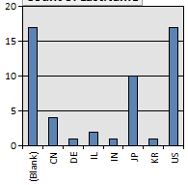
M4.1.6 Recent voting member history
New voters:

Slide 21
M4.1.7 ANA Status
The latest database is 11-11/0270r33 (Nov 2015)
Changes since last meeting: None

Slide 22
background data

Slide 23
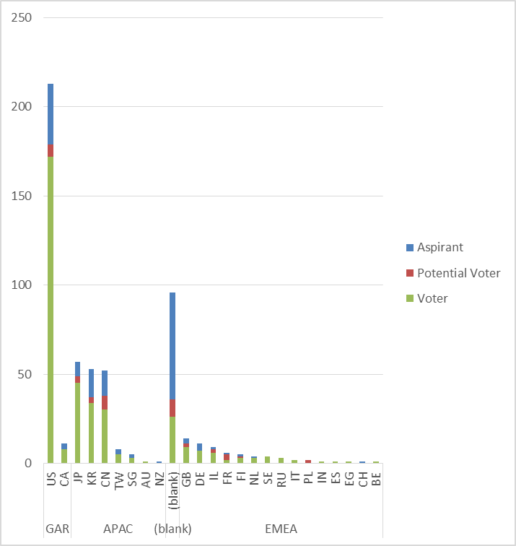
Membership by Country and Region

Slide 24
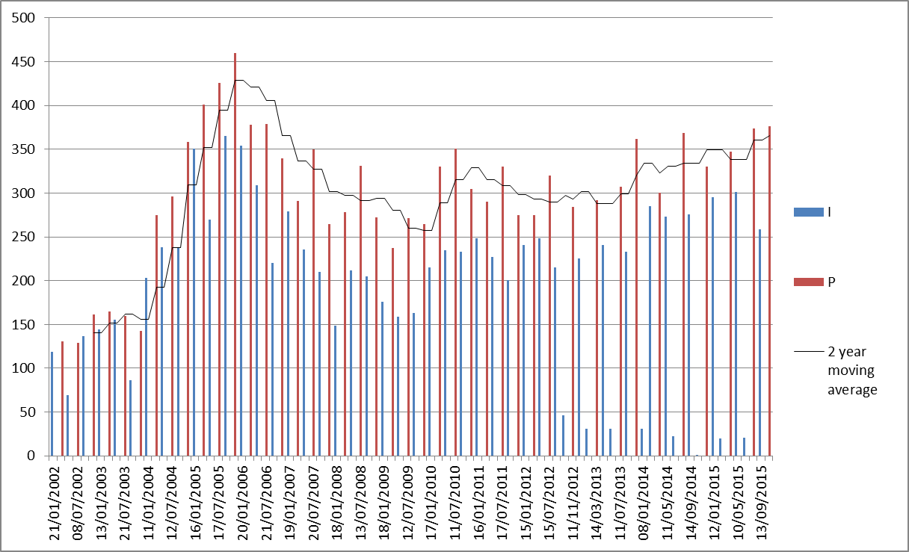
Meeting Attendance – Historic Data

Slide 25
Membership – Historic Data

