Slide 1
STA-to-STA Positioning
Date: 2015-10-28
Authors:

Slide 2
Motivation
STA-to-STA positioning is specified in the “Need of the project” of the 802.11az PAR:
  Current standardized technology already enables 802.11 based navigation for pedestrians, yet other usages and use cases are in need of additional positioning services:
    A more robust, accurate and precise location such as guidance to a product on a specific shelf while retaining the existing infrastructure deployment density.
    A highly scalable indoor positioning system for crowded metro stations and stadiums.
    Non-AP STA to non-AP STA positioning such as support for peer to peer connectivity and decision making.
STA-to-STA positioning use cases have not been extensively discussed and the scope needs to be clarified.

Slide 3
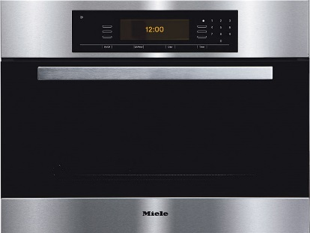
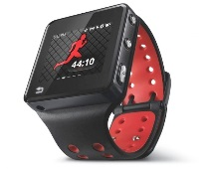

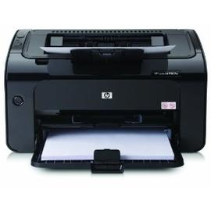





STA-to-STA use case 1:
Distance Measurement between STAs
IOT and social use cases [2]
  I’d like to get an indication when a friend of mine is 20m away, while we both use our smart phones and using local applications.
  I’d like to have an office printer let me know if my print job is waiting to print when I walk past it, the print job was sent from my UB to cloud based spooler.
  My kitchen oven pings me to check on the cake/casserole as I pass by it.
Person or property monitor
  To monitor important persons or properties, such as kids, patients, workers on some specific positions.
  When they leave a specific area, such as kids leave a playground/ parents for a predefined threshold, monitor device will alarm.
Notes:
For the positioning in 60GHz, users’ mobility could result in the blockage problem between the mobile node and the anchor node.
The user may not always find enough AP for positioning. (At least 3 APs are required for trilateration positioning).

Slide 4
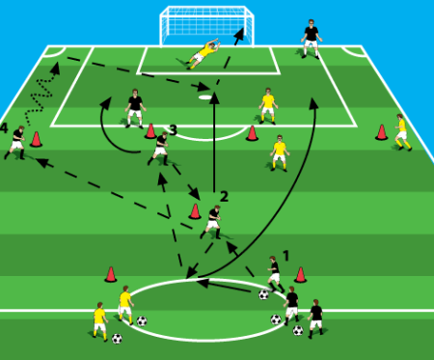
STA-to-STA use case 2
Relative Positioning between STAs
Professional coaching
  Soccer players may wear WiFi enabled vests, which support STA-to-STA positioning.
  The relative positions between players could be computed and transmitted to a coaching team.
  The coaching team may adjust their training strategy based on the positioning information
  Soccer players’ relative position information could be an important reference for a professional coaching team
Notes:
For the positioning in 60GHz, users’ mobility could result in the blockage problem between the mobile node and the anchor node.
The user may not always find enough AP for positioning. (At least 3 APs are required for trilateration positioning).

Slide 5
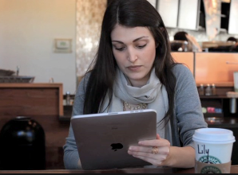


STA-to-STA use case 3
Cooperative Positioning
STA-to-STA cooperative positioning:
  Kate goes to a Starbucks to meet her friends
  She opens her Pad to play online games when she is waiting for her friend
  Her Pad is positioning enabled and is able to provide cooperative positioning services.
  Tom is passing by the Starbucks and his smart phone uses Kate’s Pad as cooperative node to improve positioning accuracy or use it as a temporal positioning anchor node when no enough fixed anchor node (such as APs) could be found
Notes:
For the positioning in 60GHz, users’ mobility could result in the blockage problem between the mobile node and the anchor node.
The user may not always find enough AP for positioning. (At least 3 APs are required for trilateration positioning).

Slide 6
Summary
STA1
STA-to-STA distance measurement
  Associated or unassociated STAs
  Infrastructure BSS/MBSS
STA-to-STA relative positioning
  Associated or unassociated STAs
  Infrastructure BSS (STA-to-STA communication/measurement support))/MBSS
STA-to-STA cooperative positioning
  Cooperative STAs:
    May not broadcast its cooperative capability
    May not broadcast its positioning information
    May only provide positioning service during a certain period
  Associated or unassociated STAs
  Infrastructure mode (STA-to-STA communication/measurement support)
STA2
STA4
STA1
STA2
STA3
AP1
AP2
AP3
STA2
STA1
STA4
STA3

Slide 7
Straw Poll
Do you agree to add the use cases listed in the Page 6 as STA-to-STA positioning use cases for 802.11az use case working draft?
  Y:
  N:
  A:

Slide 8
References
[1] 802.11 NGP SG Proposed PAR
[2] 11-14-1193-01-0wng-beyond-indoor-navigation

