Slide 1
Long range low power Use Cases for Indoor & Outdoor
Date: 2015-11-09
Authors:

Slide 2
Abstract
IoT is expected to be one of the most significant drivers of growth in technology markets
802.11 community has not seriously considered supporting IoT applications so far
In this presentation, we list various IoT use cases for indoor/outdoor and requirements for them

Slide 3
Characteristics for IoT Devices
 | Has data input and output? | Radio Trans. Tech. (WLAN/WPAN) | Data Speed | Power Limited
Central Controller | I, O | L, P | W.-Control
Set-top Box | I, O | L, P | W-UHD
Home Theater | I, O | L, P | W-UHD, W-Audio
Display, TV | I | L, P | W-UHD
Speaker | I | P | W-Audio
Door, Window Sensor | O | P | W.-Control | Y
Gas Sensor | O | P | W.-Control | Y
Smoke Sensor | O | P | W.-Control | Y
Gas Valve Sensor/Controller | I, O | P | W.-Control | Y
Heater/Air conditioner | I, O | L, P | W.-Control
Home Appliances | I, O | L, P | W-Data
Surveillance Camera | I, O | L, P | W-Video, W.-Control
Printer/Scanner | I, O | L, P | W-Data, W-Control
Wireless UHD: 10’s Gbps, Low latency
Wireless Video: 10-100Mbps, Low latency
Wireless Audio: Below 1Mbps, Low latency
Wireless Data: Below 10Mbps
Wireless Control: Below 1Mbps

Slide 4

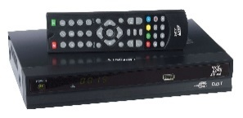
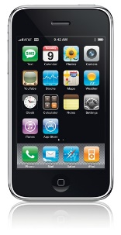
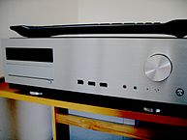
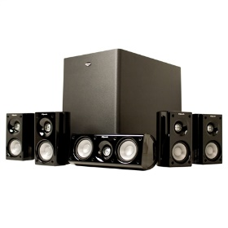
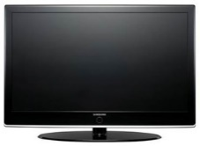
Use case for home theater (1)
Home theater devices are associated with the LRLP AP
LRLP AP
Controller (indoor mobile device)
Set top box
Home theater
Speakers
TV
LRLP for control
data

Slide 5
Use case for home theater (2)
The central controller is most likely a mobile device
Pairing is performed through an LRLP AP by the central controller (mobile device)
After connection setup, either Wi-Fi Direct or Bluetooth may be used for user data transfer between non-AP STAs

Slide 6
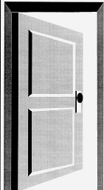
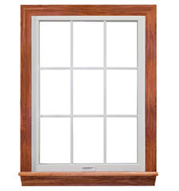
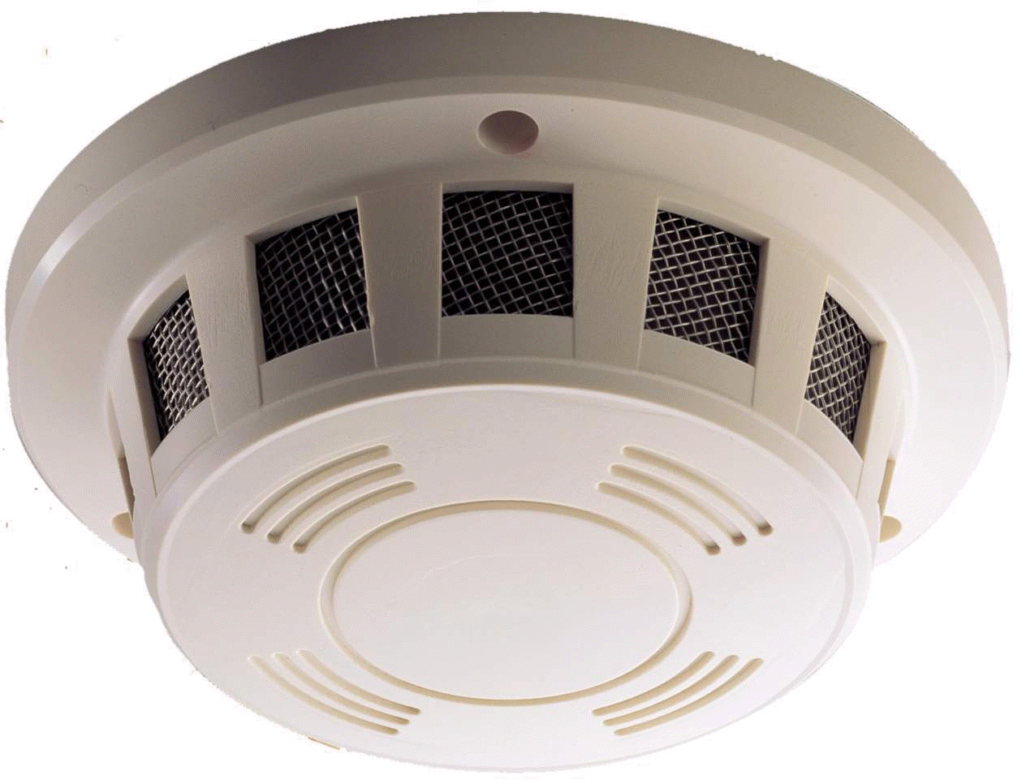
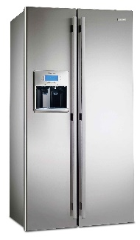
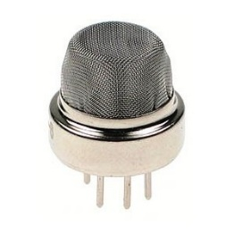
Use case for home security (1)
Door/window sensor, Gas sensor, Smoke detector, home appliances
Door
LRLP AP
Outdoor
mobile device
Window
Smoke detector
Home appliances
LRLP for control
Gas sensor
mobile+cable modem/xDSL
for control

Slide 7
Use case for home security (2)
Any abnormal state sends an alarm to the mobile device
Requirements
  Fast wakeup time: From a dormant state, the communication must be reestablished quickly through bypassing login procedure, pairing, DHCP, etc.
  Reconnection procedure must be secure as well

Slide 8
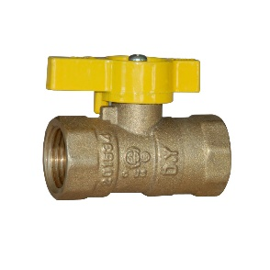
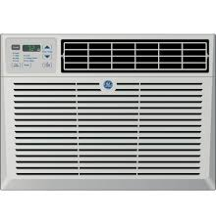
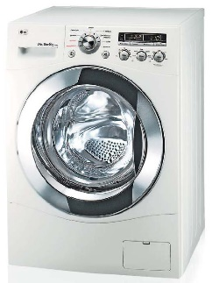
Use case for indoor device control
Gas value controller, Heater/AC, Home appliances, Surveillance cameras
Gas valve
controller
LRLP AP
Controller (outdoor
mobile device)
Heater
A/C
control
Washing machine
LTE+cable modem/xDSL
for control

Slide 9
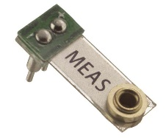
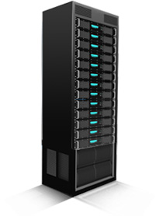
Use case for manufacturing (1)
Data collection from sensors in a manufacturing house
A chip maker is an example
LRLP AP
Vibration sensor
Data analysis server
Vibration sensor
LRLP data collection
Wired/wireless connection

Slide 10
Use case for manufacturing (2)
A chip maker monitors the vibration pattern from various facilities
Use the collected data to predict possible failures of the facilities
Reduces downtime of manufacturing process and improves the yield

Slide 11
Use case for manufacturing (3)
Requirements
  The stable data rate must be maintained even in multipath environment due to the dense and interfering facilities
  The number of sensors connected to the LRLP AP at the same time must be large enough
  To extend the coverage, an LRLP AP may be connected to another LRLP AP (multihop) and adaptive route selection between a server and sensors for multihop environment
  A connection between sensors and an analysis server must be secure
  Fast wakeup time on sensor devices
  Lightweight and low-power authentication scheme for sensors

Slide 12
Summary
For home theater use case, pairing between LRLP STAs is performed through LRLP AP by a mobile device (an LRLP STA in the same indoor) for direct connection between A/V devices
For home security use case, fast wakeup and secure reconnection for LRLP STAs are required
For indoor device control use case, a mobile device can control the indoor devices collocated with LRLP STAs
For manufacturing house, the connection should not be interfered by the manufacturing facilities, multihop is supported, and authentication is light

