Slide 1
60 GHz Channel Model for D2D Links
Date: 2015-11-09
Authors:

Slide 2
Abstract
This presentation introduces a stochastic 60 GHz channel model for D2D links.

Slide 3
Outline
Introduction
  Applicable usage models
  Channel modeling goals
  Limitations of existing models
Overview of proposed channel model
  Concept, advantages, limitations
Channel model implementation
  Key operations
  Performance
Conclusions

Slide 4
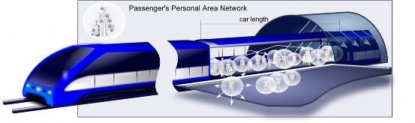
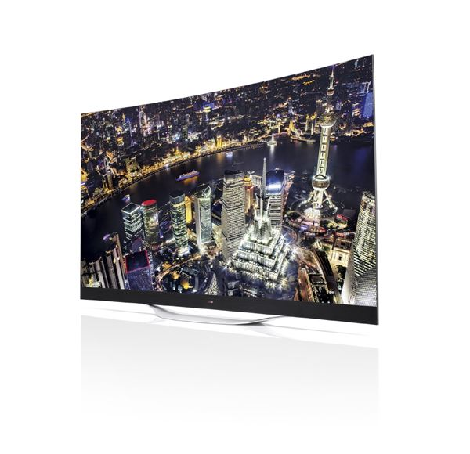
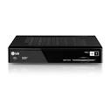

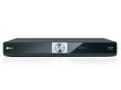






Applicable 802.11ay Usage Models
Channel model was originally designed for “AR/VR Headsets, High-End Wearables”
Also applies to other D2D-based models:
    8K UHD Wireless Transfer
    Office Docking
Wireless transfer
from fixed device
Set-top box
(TV controller)
Blu-ray player
Smartphone/
Tablet

Slide 5
Goals for the new channel model
Capabilities
  Provide complete CSI, e.g. complex impulse response, AoA, AoD, etc.
  Accurate for arbitrary link distances > 30cm
  Maintain spatial and temporal correlations
  Model self-blocking (hands, arms, etc.)
  Results are reproducible (based on the same seed)
Speed
  Thousands of samples per second
  Simplified environment representation (no 3D CAD models)

Slide 6
Limitations of conventional models
Most conventional channel models (HATA, ITU etc) are simple:
  The trend is fitted to a log-distance model
  Fluctuations around the trend are represented as random processes
Typically, two processes are used:
  Distance-dependent, frequency-flat (slow fading)
  Time-dependent, frequency-correlated (fast fading)
For mmWave, this channel information is not sufficient

Slide 7
Grid-based extensions (3GPP/IEEE)
Environment partitioned into a grid and assigned shadow fading values using log-normal distribution parametrized for environment
  For a given location, shadow fading is calculated by interpolating between grid values, thereby maintaining spatial correlation (note: value is same regardless of antenna orientation, TX/RX heights, etc.)
  Fast fading is added based on standard Rayleigh/Rician distribution, i.e. not directly connected to user movement
Grid box size is proportional to de-correlation distance
  Cellular frequencies require ~ 10m gridbox
  mmWave frequencies require ~ 0.1m gridbox (huge amount of data!)

Slide 8
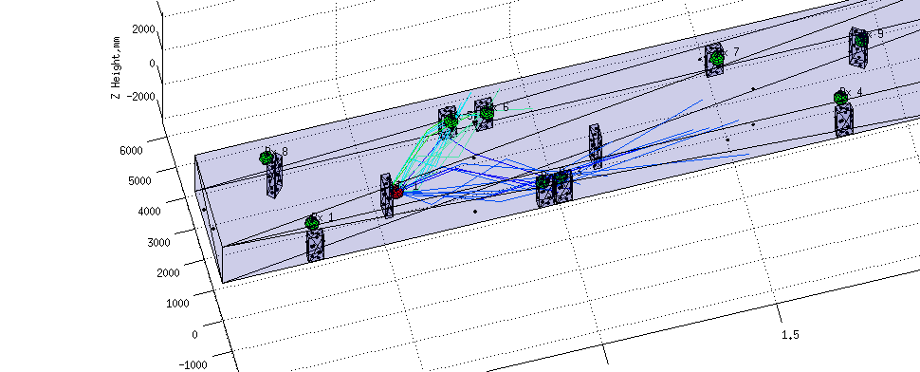
Using Ray Tracing to populate 3D grid
Standard large/small scale fading models do not fully capture mmWave channel - only ray tracing can provide necessary detail
An accurate 3D environment grid for mmWave requires:
  One full 3D environment grid for each potential TX location!
  Gridbox dimensions < 10x10x10 cm
  To determine received signal in every gridbox of a 5x5x2.5m room for one given TX location requires 62500 ray tracing runs!
We need a faster, more efficient method - can we reproduce results stochastically?

Slide 9
Outline
Introduction
  Applicable usage models
  Channel modeling goals
  Limitations of existing models
Overview of proposed channel model
  Concept, advantages, limitations
Channel model implementation
  Key operations
  Performance
Conclusions

Slide 10
Channel Model
At the receiver, the channel is a superposition of multipath components [MPC]
MPC can be characterized by:
  full 3D trajectory (including all reflections/diffractions)
  reflection/absorption/interaction loss
  initial power is equal to the TX power
Our channel model reproduces MPCs stochastically
  Preserves statistics of the sample environment
  Equivalent to ray tracing in level of detail
With MPC information, we can calculate:
  Path loss
  MIMO capacity
  Impulse response subject to given antenna
* MPC models assume isotropic TX and RX

Slide 11
Modeling MPCs
For any given TX/RX pair, ray tracing tells us:
  How many MPCs constitute the channel? (3 in the example)
  How many interactions happened per MPC (i.e. what is its order)?
  Where did the interactions happen? (points C, D, E, F in the example)
  What were the associated interaction losses?
MPCs are unique for each TX/RX pair, but MPCs should be spatially and temporally correlated.
MPC data is collected for sample environment; statistics are then drawn from the data and used to generate MPCs stochastically

Slide 12
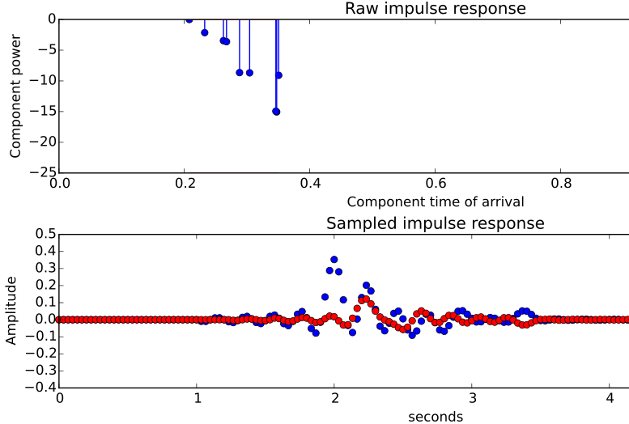
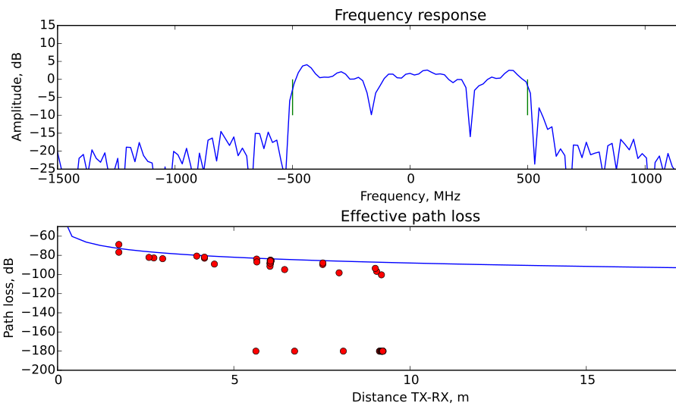
Processing of channel model output
MPC power is adjusted based on TX/RX antenna gains (models beamforming)
Impulse response [IR] is generated (weak components may be ignored)
IR is sampled at carrier frequency (capturing interference between MPCs)
ISI can be directly measured (based on symbol duration)
FFT of IR yields full CSI for OFDM
Coupling loss can be computed (for automatic gain control, power control tests)
But how do we produce the MPCs?

Slide 13
Limitations of the model
The geometry of the environment can not be too simple
  Randomness in the environment is good!
The environment should be statistically isotropic
  Density of objects should not vary significantly
One could extend the model to lift those restrictions

Slide 14
Outline
Introduction
  Applicable usage models
  Channel modeling goals
  Limitations of existing models
Overview of proposed channel model
  Concept, advantages, limitations
Channel model implementation
  Key operations
  Performance
Conclusions

Slide 15
Channel model implementation
Use ray tracing to evaluate channel for large enough number of TX/RX locations to fully capture sample environment
For a given TX/RX pair, stochastically reproduce MPCs as follows:
    Calculate number of MPCs of each order (LOS, 1st, 2nd, etc.) based on TX-RX distance and identify each MPC’s interaction points (yields trajectory)
    Reproduce each MPC’s losses
    Compute the power and delay of each MPC
    Apply smoothing to model diffraction
Apply necessary corrections (e.g. body blockage loss for wearables)
Reconstruct impulse response, run post-processing
    Compute effective RSS, ISI, frequency response, etc.

Slide 16
Processing ray tracing data
Learning data comes from statistically large number of random TX/RX links
Based on learning data we can compute:
  How many MPCs of each order are present for various TX/RX link lengths
  Distribution of hop lengths and mutual angles for various TX/RX link lengths
  Angle-dependent interaction loss statistics
  Correlation distances in various directions
  Other statistics as necessary

Slide 17
Reproducing MPCs – the challenge
Each MPC is shaped by one or more interaction sources
  E.g. reflective wall
  May come in and out of view
  Will appear at different angles
    depending on point of view
With TX/RX movement, interaction sources appear and disappear
  We approximate visibility of interaction sources w/ Boolean function (similar function used to determine visibility of LOS component)
  Any number of interaction sources may be active in the channel
With ray tracing all interactions are coupled to geometry (complex)
  With stochastic model interactions are drawn randomly and independently
  Average number of active interaction points depends on TX-RX distance
  Interaction sources stay active within a certain area to ensure proper correlation

Slide 18
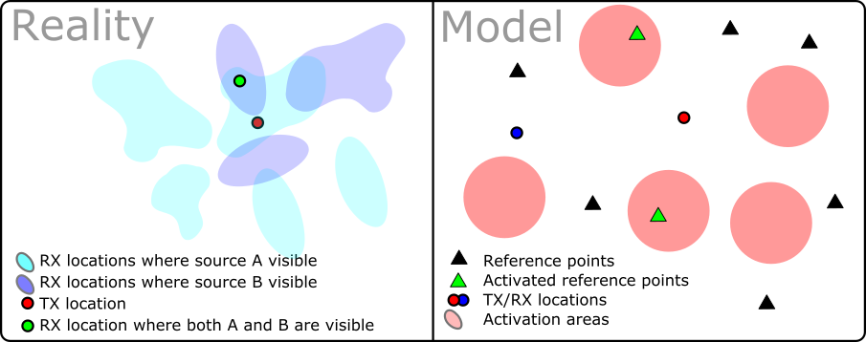
Reproducing MPCs – the model
Interaction sources are only visible to RX when in certain areas of environment
      Areas change as TX moves (requiring significant processing and data storage!)
We model interaction sources and their visibility using statistics from ray tracing
      Create stationary interaction points (not 1:1 mapped with original interaction sources) and mobile activations areas that move w/ TX and RX
      Overlap of activation area and interaction point represents an interaction for the MPC
      Size of an activation area encodes correlation distance

Slide 19
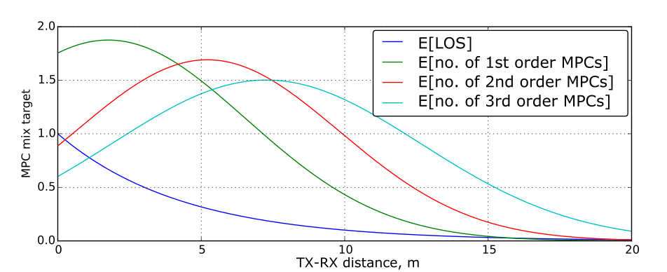
Reproducing MPCs – the statistics
Ray tracing tells us the mean and variance of the number of MPCs of each order present for a TX-RX link of a given distance
Average and variance of the number of “nth” order MPCs is modeled by varying the:
  density of activation areas in the environment (p)
  number of interaction points in the environment (N)
LOS is simply modeled as existing (or not) based on ray tracing statistics

Slide 20
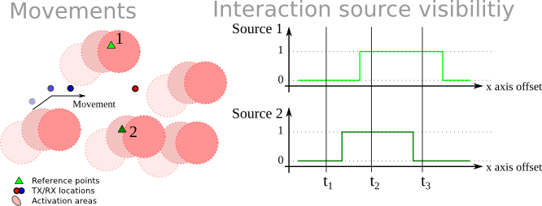
Reproducing MPCs – an example
Assume RX is moving toward TX
  Two 1st order MPCs are possible
  As RX moves, activation areas move overlapping the two possible interaction points at different times (each overlap represents the activation of a 1st order MPC)

Slide 21
Reproducing MPCs - summary
Now we can generate
  Presence of LOS path between the given TX/RX pair
  Interaction points for the NLOS paths present between the TX/RX pair
This data will have the
  Correct spatial correlations for the generated MPCs as TX and/or RX moves
  Correct variances and means of 1st, 2nd, 3rd, etc. order MPCs
  Correct cross-correlations between mean/variance in number of 1st, 2nd, 3rd, etc. order MPCs
Using this data, we now generate each MPC’s trajectory and interaction losses

Slide 22
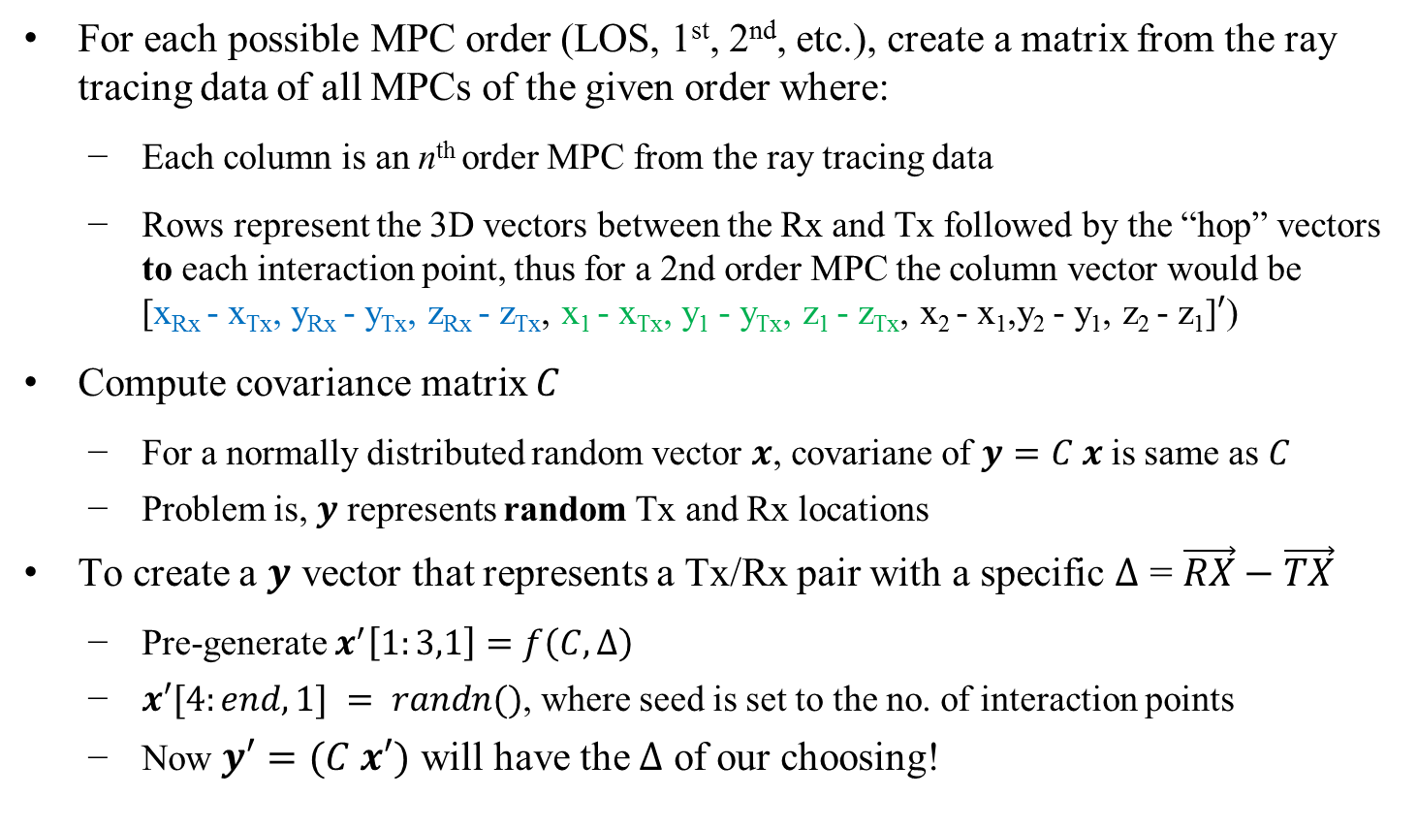
Producing MPC trajectories
For each possible MPC order (LOS, 1st, 2nd, etc.), create a matrix from the ray tracing data of all MPCs of the given order where:
    Each column is an n^{th} order MPC from the ray tracing data
    Rows represent the 3D vectors between the Rx and Tx followed by the “hop” vectors to each interaction point, thus for a 2nd order MPC the column vector would be [x_{Rx} - x_{Tx}, y_{Rx} - y_{Tx}, z_{Rx} - z_{Tx}, x₁ - x_{Tx}, y₁ - y_{Tx}, z₁ - z_{Tx}, x₂ - x₁,y₂ - y₁, z₂ - z₁]$′$)
Compute covariance matrix $C$
    For a normally distributed random vector $x$, covariane of $y=C x$ is same as $C$
    Problem is, $y$ represents random Tx and Rx locations
To create a $y$ vector that represents a Tx/Rx pair with a specific $∆$ = $\vec{RX}−\vec{TX}$
    Pre-generate $x^{′}\left[1:3,1\right]=f\left(C, ∆\right)$
    $x′[4:end,1] = randn()$, where seed is set to the no. of interaction points
    Now $y′=(C x′)$ will have the $∆$ of our choosing!

Slide 23
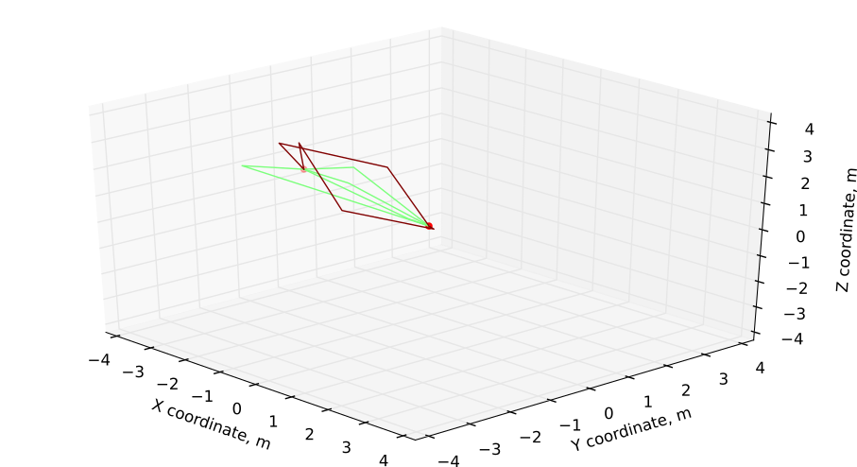
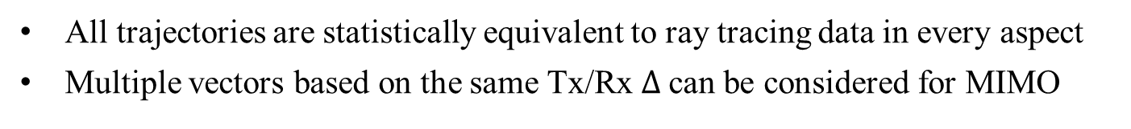
Producing MPC trajectories – results
All trajectories are statistically equivalent to ray tracing data in every aspect
Multiple vectors based on the same Tx/Rx $∆$can be considered for MIMO

Slide 24
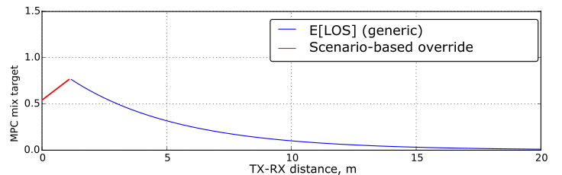
Special case: self-blocking
Normally, in a highly random environment, LOS is guaranteed as Tx/Rx distance goes to 0
  In practice, this is not the case; often the user is the major blocker
  Human bodies cause significant attenuation (> 60dB from palm alone)
  LOS path may be significantly attenuated by antenna polarization mismatch as well
Need to override LOS probability at very short ranges (< 50 cm)
  This should be done on case-by-case basis
  If the blockage does happen, we can still apply the NLOS model

Slide 25
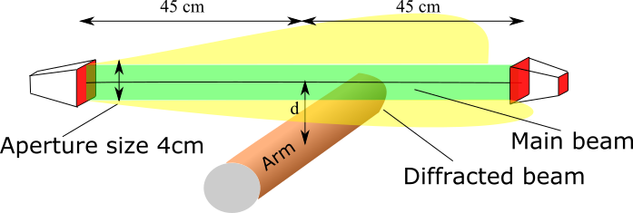
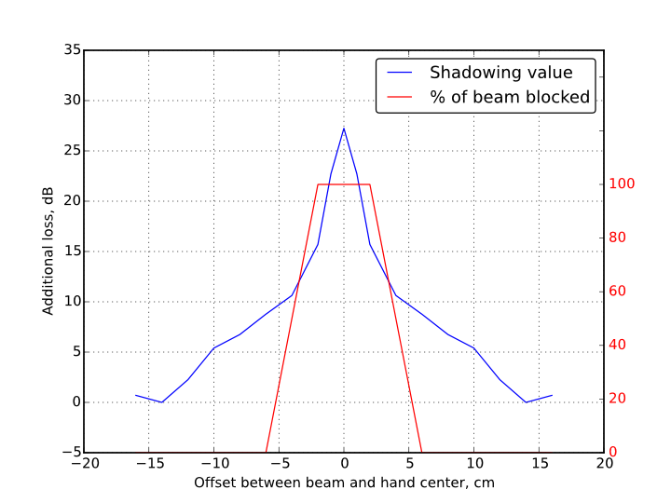
Special case: partial body blocking
Difficult to occlude entire mmWave beam with e.g. an arm
Depends on the antenna’s aperture, position of arm relative to TX/RX antennas, etc.
  Partially-blocked links can be considered LOS
  Simple model can be used to capture extra attenuation

Slide 26
Putting it all together
Calculate no. of 1st, 2nd, 3rd, etc. order MPCs for given TX/RX pair based on link distance
Determine trajectory of each MPC
Calculate power of each MPC
    = TX power - free space loss - interaction losses + antenna gains
Convolve MPCs with a sampled sinc function
    System bandwidth affects the period of the sinc function
    Doppler may be added based on TX and RX speeds
All sincs are then multiplied by their complex phase
    Phase encodes the time of arrival

Slide 27
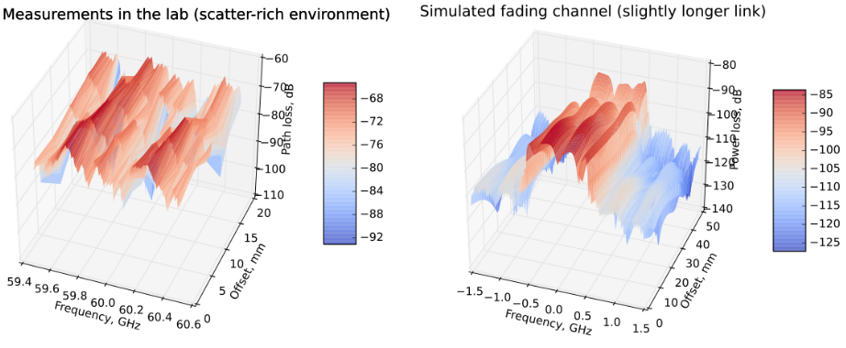
NLOS fading comparisons
Simulated multipath shows patterns similar to real one!

Slide 28
SNR comparisons
Based on 60 GHz channel measurement campaign:
    For each TX/RX channel measurement, the values from the best antenna orientations were recorded
    Data for both NLOS and LOS was collected
    Measured 50 cm phone-to-head links with varying head/body positions
    Assumed 62dB free space loss
Scenario type | Measured, dB (Min/Max) | Model, dB (Min/Max)
Rich multipath, LOS | -60/-64 | -57/-69
Rich multipath, NLOS | -67/-85 | -65/-83
Poor multipath, LOS | -62/-67 | -62/-64
Poor multipath, NLOS | 85 / 90 | 86 / --
(90% quantiles are given for min & max values)

Slide 29
Outline
Introduction
  Applicable usage models
  Channel modeling goals
  Limitations of existing models
Overview of proposed channel model
  Concept, advantages, limitations
Channel model implementation
  Key operations
  Performance
Conclusions

Slide 30
Conclusions
The proposed model effectively replaces ray tracing
    Full 3D impulse response is generated
    MIMO & beamforming data can be easily extracted
Accurate spatial correlations are maintained
    Deterministic operation
    Coherence distance explicitly modeled
Low computational complexity
    Most operations are basic vector algebra
    Ray tracing based data has been compressed and can be provided
High flexibility
    Arbitrary scenarios can be represented
    Other frequencies can be supported

