Slide 1
Update on 3GPP RAN3 Multi-RAT joint coordination
Date: 2015-10-28
Authors:

Slide 2
Abstract
This presentation gives a short update on the current status of the 3GPP Multi-RAT joint coordination (FS_MultiRAT_JC) work item

Slide 3
Background (1/2)
In 3GPP Release 13, a “Study on Multiple Radio Access Technology (Multi-RAT) joint coordination” was started with the goal of improving the overall coordination between different RATs (LTE/UMTS/GSM/CDMA/WLAN) for operators with multi-RAT networks
Clause 5.1 of TR 37.800 defined “Coordination involving 3GPP-WLAN”
Aim was to: a) report UE throughput in WLAN in order to follow-up on potential performance impacts and b) improve the eNB/NB broadcast performance for the Rel-12 WLAN interworking feature c) not impact 3GPP core nodes (MME, S-GW, P-GW) or other specifications (e.g., IEEE, WFA, WBA), pure RAN solution
Parameters to be exchanged from the WLAN to 3GPP nodes: BSS Load, UE Average data rate, WLAN identifiers (SSID, BSSID, HESSID), BSS Average Access Delay, BSS AC Access Delay, WAN Metrics
The WLAN Termination (WT) was introduced as a logical node where the Xw interface terminates
The placement and implementation of WT in WLAN is out of 3GPP scope
However WT functions and behaviour are specified by 3GPP
The work item was approved at RAN#68
Figure 1: Architecture for the Xw interface

Slide 4
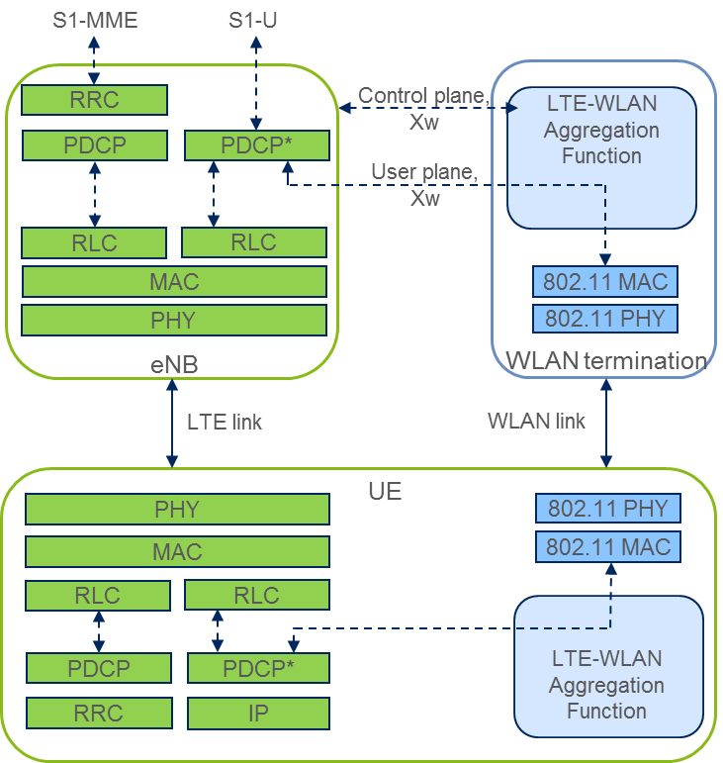
Background (2/2)
However, during the progress of the RAN3 work, a new RAN2 WI was approved: “LTE-WLAN Radio Level Integration and Interworking Enhancement” (RP-150510), which was considered to have impact on the Xw interface
The main goals were:
Enhance the Rel. 12 WLAN interworking feature with full network control (LWI)
Tight LTE-WLAN access aggregation at radio level (LWA), which follows the Dual-Connectivity concept specified in Rel. 12)
Note:
Subsequently, this work was extended for access aggregation over legacy WLAN (i.e., no impact on Xw): “LTE-WLAN RAN Level Integration supporting legacy WLAN” (RP-151615)
The main goal was:
1. Extend the aggregation solution to provide support for legacy WLAN deployments (i.e., based on IPSec)
Figure 2: Protocol stack for LTE-WLAN access aggregation

Slide 5
The Xw interface
The Xw interface is currently being standardized in RAN3. The specification follows the same principle as with other LTE network protocols (S1AP, X2AP)
Several specification documents cover different aspects of the interface:
1. TS 36.461 “Evolved Universal Terrestrial Radio Access Network (E-UTRAN) and Wireless LAN (WLAN); Xw layer 1”
2. TS 36.462 “Evolved Universal Terrestrial Radio Access Network (E-UTRAN) and Wireless LAN (WLAN); Xw signalling transport”
3. TS 36.463 “Evolved Universal Terrestrial Radio Access Network (E-UTRAN) and Wireless LAN (WLAN); Xw application protocol (XwAP).”
4. TS 36.464 “Evolved Universal Terrestrial Radio Access Network (E-UTRAN) and Wireless LAN (WLAN); Xw data transport.”
5. TS 36.465 “Evolved Universal Terrestrial Radio Access Network (E-UTRAN) and Wireless LAN (WLAN); Xw interface user plane protocol”

Slide 6
TS 36.461 “Evolved Universal Terrestrial Radio Access Network (E-UTRAN) and Wireless LAN (WLAN); Xw layer 1”
Latest agreements: R3-152244
It has been agreed to reuse the same L1 specification as for the S1 and X2 interfaces
Figure 3: Architecture for Xw, X2, S1 interfaces

Slide 7
TS 36.462 “Evolved Universal Terrestrial Radio Access Network (E-UTRAN) and Wireless LAN (WLAN); Xw signalling transport”
Latest agreements: R3-152247
Specifies the Signalling Transport over the Xw (how the Xw-AP signalling messages are transported over Xw)
SCTP Payload Protocol Identifier – assignment pending IANA approval
Only one single SCTP association between eNB and WT pair allowed
Figure 4: C-Plane connectivity of eNB and WT for LWA
Figure 5: Xw Interface Control Plane

Slide 8
TS 36.463 “Evolved Universal Terrestrial Radio Access Network (E-UTRAN) and Wireless LAN (WLAN); Xw application protocol (XwAP).”
Latest agreements: R3-152249
Control plane transport - protocols and procedures
Functions of XwAP:
Human-readable (i.e., tables) and machine-readable (i.e., ASN.1) description of procedures, messages, etc.
Function | Elementary Procedure(s)
WLAN Load Reporting | WT Status Reporting Initiation WT Status Reporting
Setting up the Xw | Xw Setup
WT Configuration Update | WT Configuration Update
LTE-WLAN Aggregation | WT Addition Preparation WT Association Confirmation eNB Initiated WT Modification WT Initiated WT Modification eNB Initiated WT Release WT Initiated WT Release
Reporting of General Error Situations | Error Indication
Resetting the Xw | Reset
Figure 6: Example: Xw Setup, successful operation

Slide 9
TS 36.464 “Evolved Universal Terrestrial Radio Access Network (E-UTRAN) and Wireless LAN (WLAN); Xw data transport.” and TS 36.465 “Evolved Universal Terrestrial Radio Access Network (E-UTRAN) and Wireless LAN (WLAN); Xw interface user plane protocol”
Latest agreements: R3-152213
User plane transport – protocols and procedures
Xw-U protocol
Figure 7: U-Plane connectivity of eNB and WT for LWA
Figure 8: Xw Interface User Plane

Slide 10
What does this all mean for IEEE?
The requirement from the beginning was to not have impact on IEEE protocols
The WLAN Termination (WT) behavior is defined only in the minimum terms required for the 3GPP-defined functionality
Implementation, functional split, deployment options are up to vendor choices; e.g., WT could be implemented as:
- interworking function on top of an AC
- co-located in an AP
- co-located in any other node

