Slide 1
Updated Box 5 Calibration Results
Date: 2015-11-09
Authors:

Slide 2
Abstract
In July meeting, some updated simulation conditions were summarized and 1 BSS results presented in [1].
In this contribution, we present the updated results for:
  2 BSS and 3 BSS results with defined traffic flow;
  Comparison plots with some discussion;

Slide 3
PHY Parameters
PHY parameters
BW | All BSSs at 5GHz [80 MHz, no dynamic bandwidth]
Primary channel | Aligned primary 20MHz channel for each co-80MHz-channel BSS; The detection of preamble and BA should only focus on primary 20MHz
Channel model | TGac D NLOS per link
Shadow fading | iid log-normal shadowing (5 or 0 dB standard deviation) per link
Preamble Type | Control: legacy 20us; Data: 11ac (20us+20us for 1antenna case)
AP/STA TX Power | 20/15 dBm per antenna
Power Spectral density | Scaled to 80 MHz
number of antennas at AP /STA | 1/1
AP /STA antenna gain | 0/-2 dBi
Noise Figure | 7dB
CCA-ED threshold | -56 dBm (measured across the entire bandwidth after large-scale fading)
Rx sensitivity/CCA-SD | -76 dBm (a packet with lower rx power is dropped)
Link Adaption | Fixed MCS =5 for 11ac SS6 and TBD for 11ax SS1-4
Channel estimation | Ideal unless otherwise specified
PHY abstraction | RBIR, BCC (see appendix 1&3 in [2])
Symbol length | 4us with 800ns GI per OFDM symbol

Slide 4
MAC Parameters
MAC parameters
Access protocol | [EDCA, AC_BE with default parameters] [CWmin = 15, CWmax = 1023, AIFSn=3 ]
Queue length | A single queue for each traffic link is set inside AP/STA sized of 2000 packets
Traffic type | UDP CBR with rate 10^8bps Random start time during a 10ms interval
MPDU size | 1544 Bytes (1472 Data + 28 IP header + 8 LLC header + 30 MAC header + 4 delimiter + 2 padding)
Aggregation | [A-MPDU / max aggregation size / BA window size, No A-MSDU, immediate BA without explicit request], Max aggregation: 32 MPDUs
Max number of retries | 10
Beacon | Disabled unless otherwise specified
RTS/CTS | OFF unless otherwise specified
Running time | >= 10s per drop
Output metric | -CDF or Histogram of per non-AP STA throughput (received bits/overall simulation time) -PER of all AP/STA (1 - # of success subframes / # of transmitted subframes)

Slide 5
Step-by-Step Box 5 Calibration (11ac SS6)
1 BSS (upper-right corner BSS B)
  DL only case
  UL only case
    1 STA: each STA-AP
    2 STAs: 3+9, 3+15, 3+27
    3 STAs: 3+9+15, 3+9+27
  DL & UL case
2 BSS (A+B)
  Both DL only
  Both UL only
  A DL and B UL
  A UL and B DL
3 BSS
  DL only
  UL only
  Mixed DL & UL

Slide 6
Step-by-Step Box 5 Calibration (11ac SS6)
Fixed Location and Association
STA1 | (5,-9.5)
STA2 | (3.5,7.5)
STA4 | (-4.5,0.5)
STA5 | (-1.5,6)
STA7 | (-9,-5)
STA8 | (-8.5,8.5)
STA10 | (-3,0.5)
STA11 | (-0.5,8)
STA13 | (-4,-4)
STA14 | (7.5,-1)
STA16 | (8,-6)
STA17 | (0,-7.5)
STA19 | (-2.5,-4.5)
STA20 | (0.5,-2)
STA22 | (0,-4.5)
STA23 | (-1.5,7)
STA25 | (3.5,-5)
STA26 | (9,9.5)
STA28 | (-8,-5.5)
STA29 | (1.5,3.5)
AP A | (0,0)
AP B | (40,20)
AP C | (-40,-20)
STA3 | (7.5+xb, ‑9.5+yb)
STA9 | (7+xb, -7.5+yb)
STA15 | (3+xb, -0.5+yb)
STA21 | (-6.5+xb, -3+yb)
STA27 | (‑6+xb, 2.5+yb)
STA6 | (-5.5+xc,4.5+yc)
STA12 | (7+xc,7+yc)
STA18 | (10+xc,0.5+yc)
STA24 | (3+xc,2.5+yc)
STA30 | (9.5+xc,3.5+yc)

Slide 7
Step-by-Step Box 5 Calibration (11ac SS6)
DL/UL traffic assigned for each STA
STA | DL | UL | STA | DL | UL
STA1 | y | y | STA23 | n | y
STA2 | y | y | STA25 | y | y
STA4 | y | y | STA26 | y | y
STA5 | y | y | STA28 | y | y
STA7 | y | y | STA29 | y | y
STA8 | y | y | STA3 | y | y
STA10 | y | n | STA9 | y | n
STA11 | y | n | STA15 | y | n
STA13 | y | n | STA21 | n | y
STA14 | y | n | STA27 | y | y
STA16 | y | n | STA6 | y | y
STA17 | y | n | STA12 | y | n
STA19 | y | n | STA18 | y | n
STA20 | y | n | STA24 | n | y
STA22 | n | y | STA30 | y | y
“y” means having DL/UL traffic flow; “n” means not having DL/UL traffic flow

Slide 8
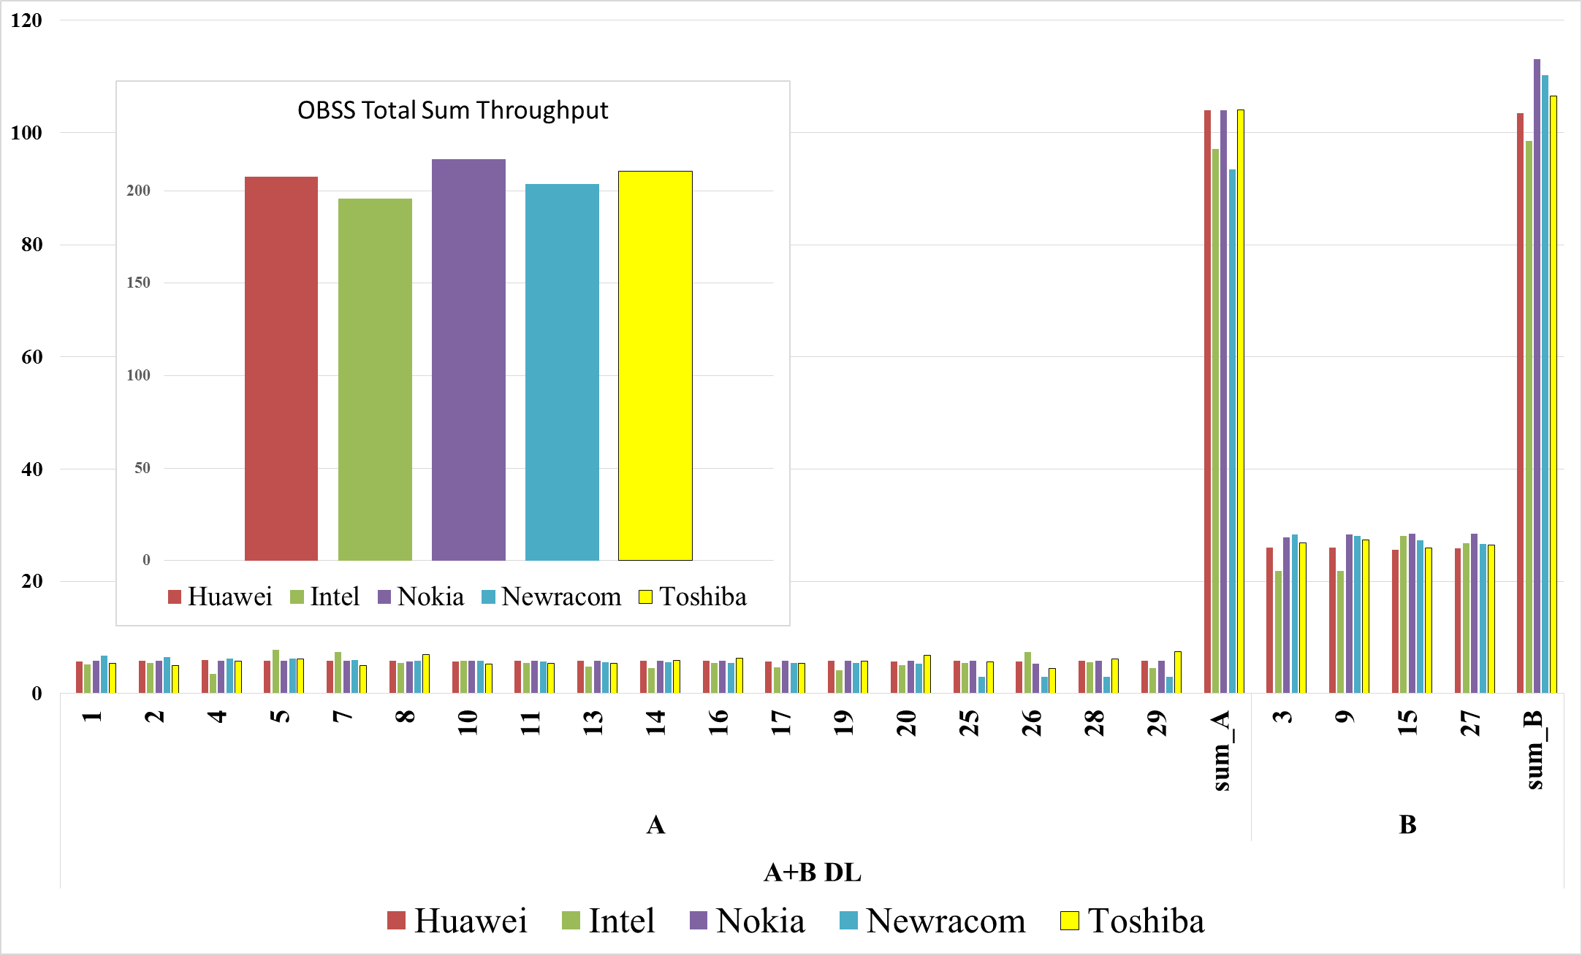
2 BSS (A+B) Simulation Results
DL-Only

Slide 9
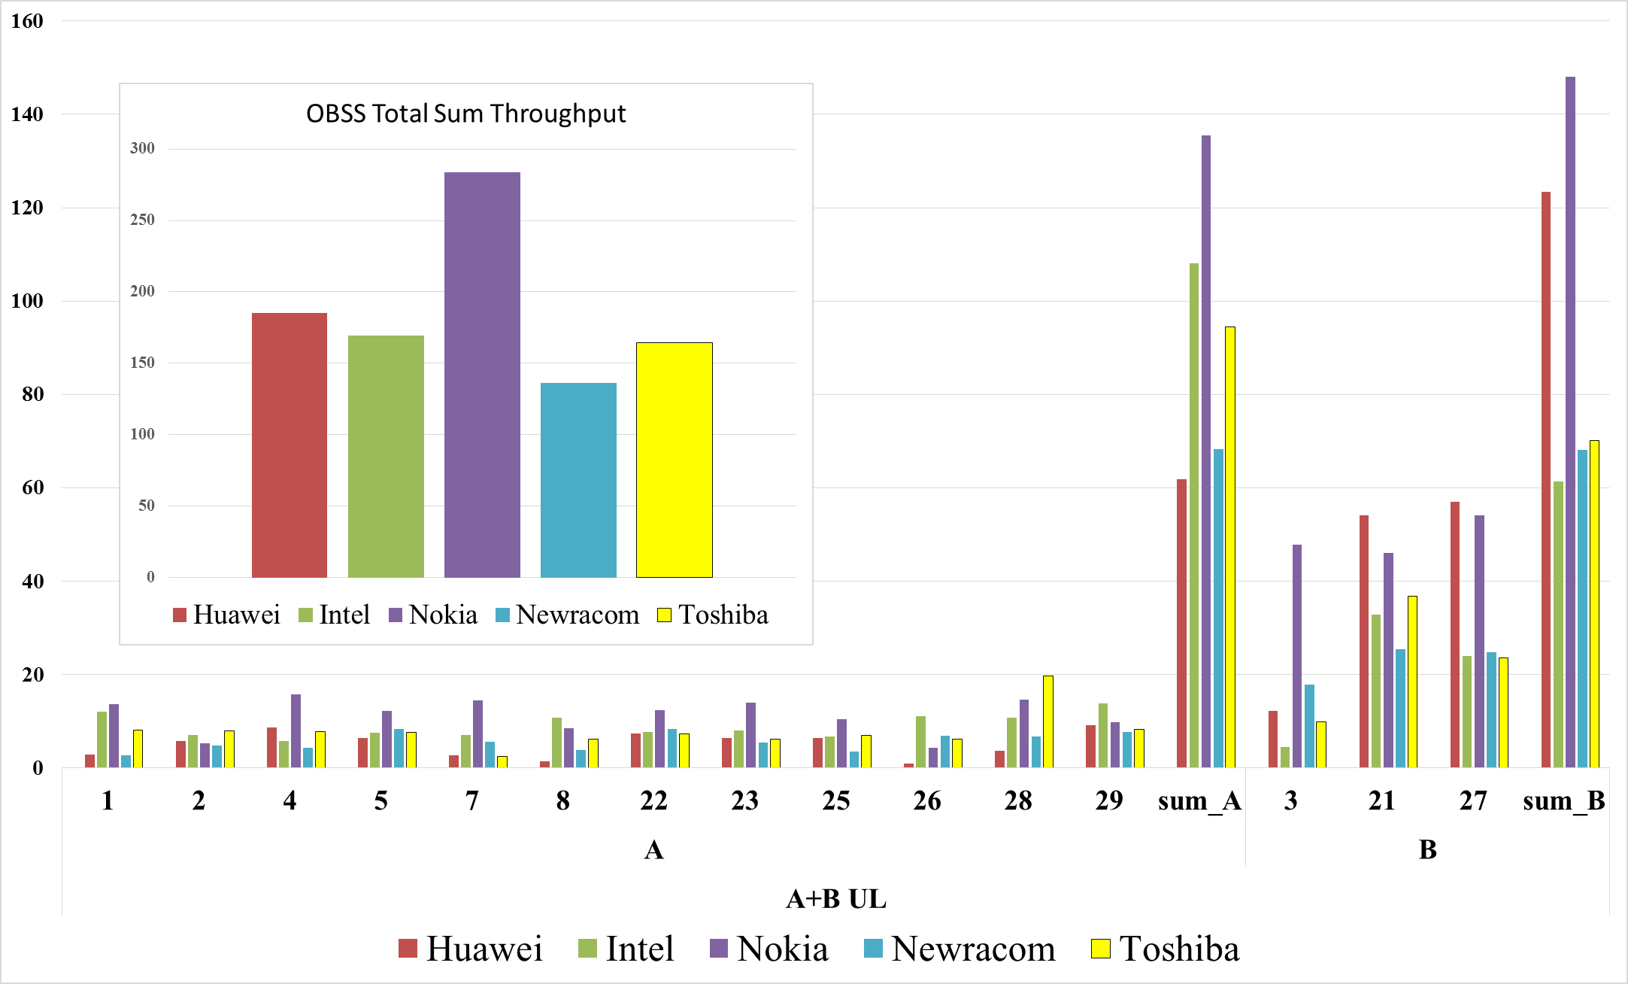
2 BSS (A+B) Simulation Results
UL-Only

Slide 10
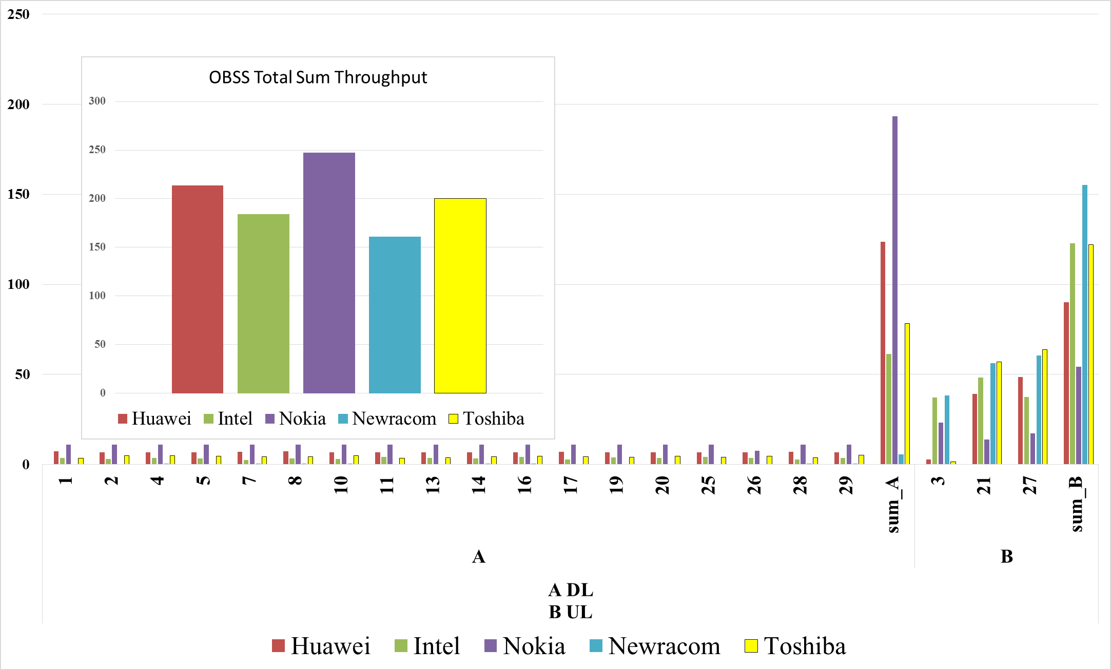
2 BSS (A+B) Simulation Results
A-DL / B – UL

Slide 11
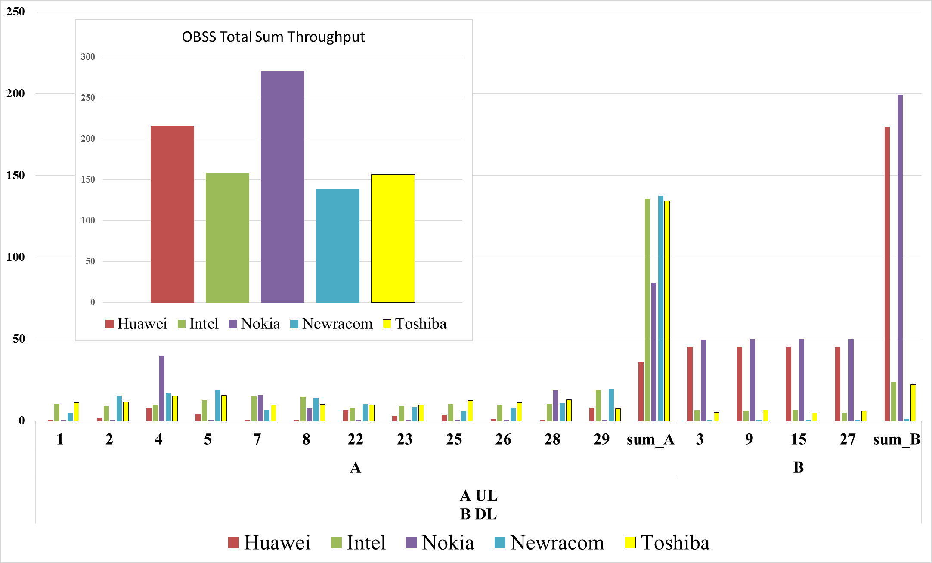
2 BSS (A+B) Simulation Results
A-UL / B - DL

Slide 12
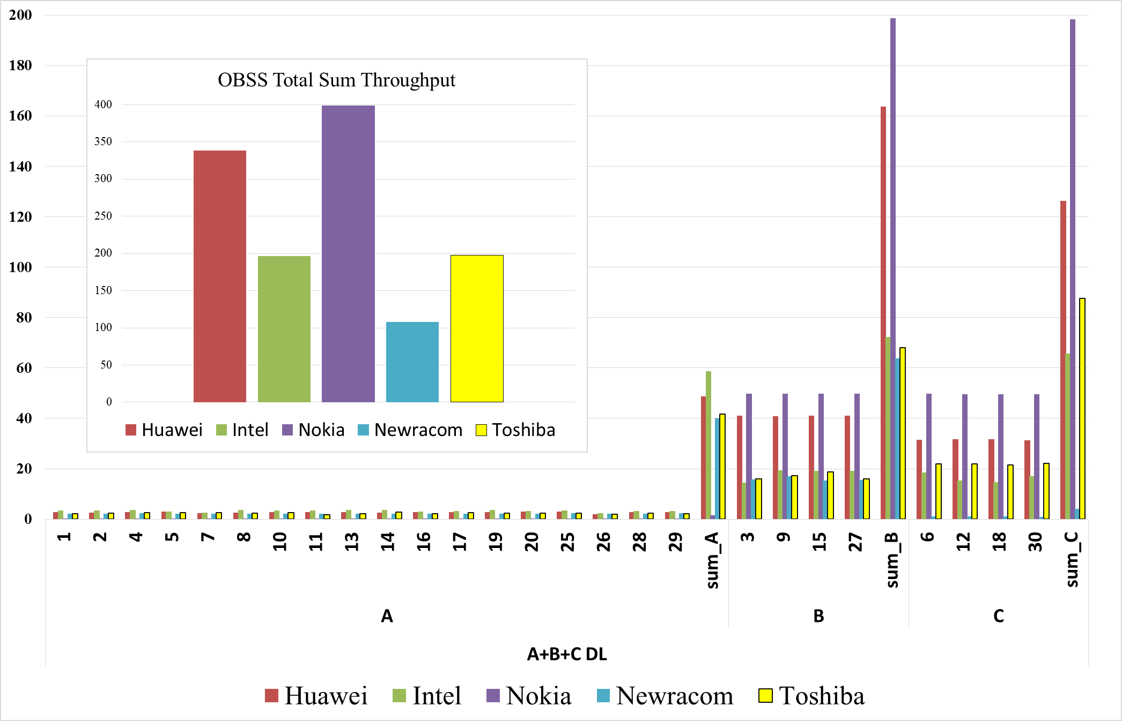
3 BSS DL-Only Simulation Results

Slide 13
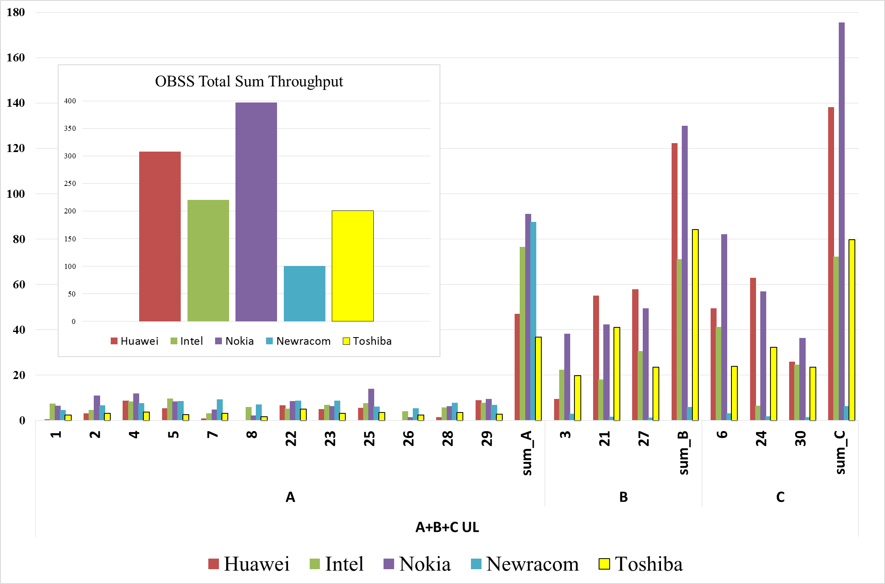
3 BSS UL-Only Simulation Results

Slide 14
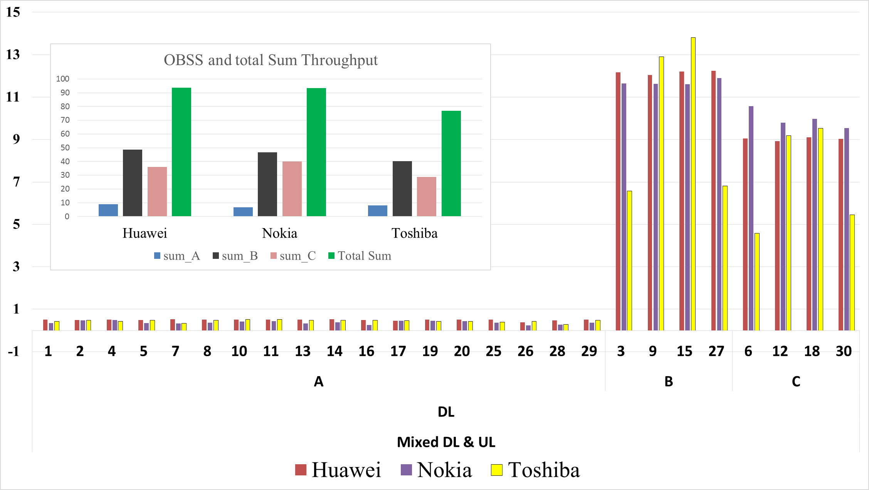
3 BSS Mixed Simulation Results (DL)

Slide 15
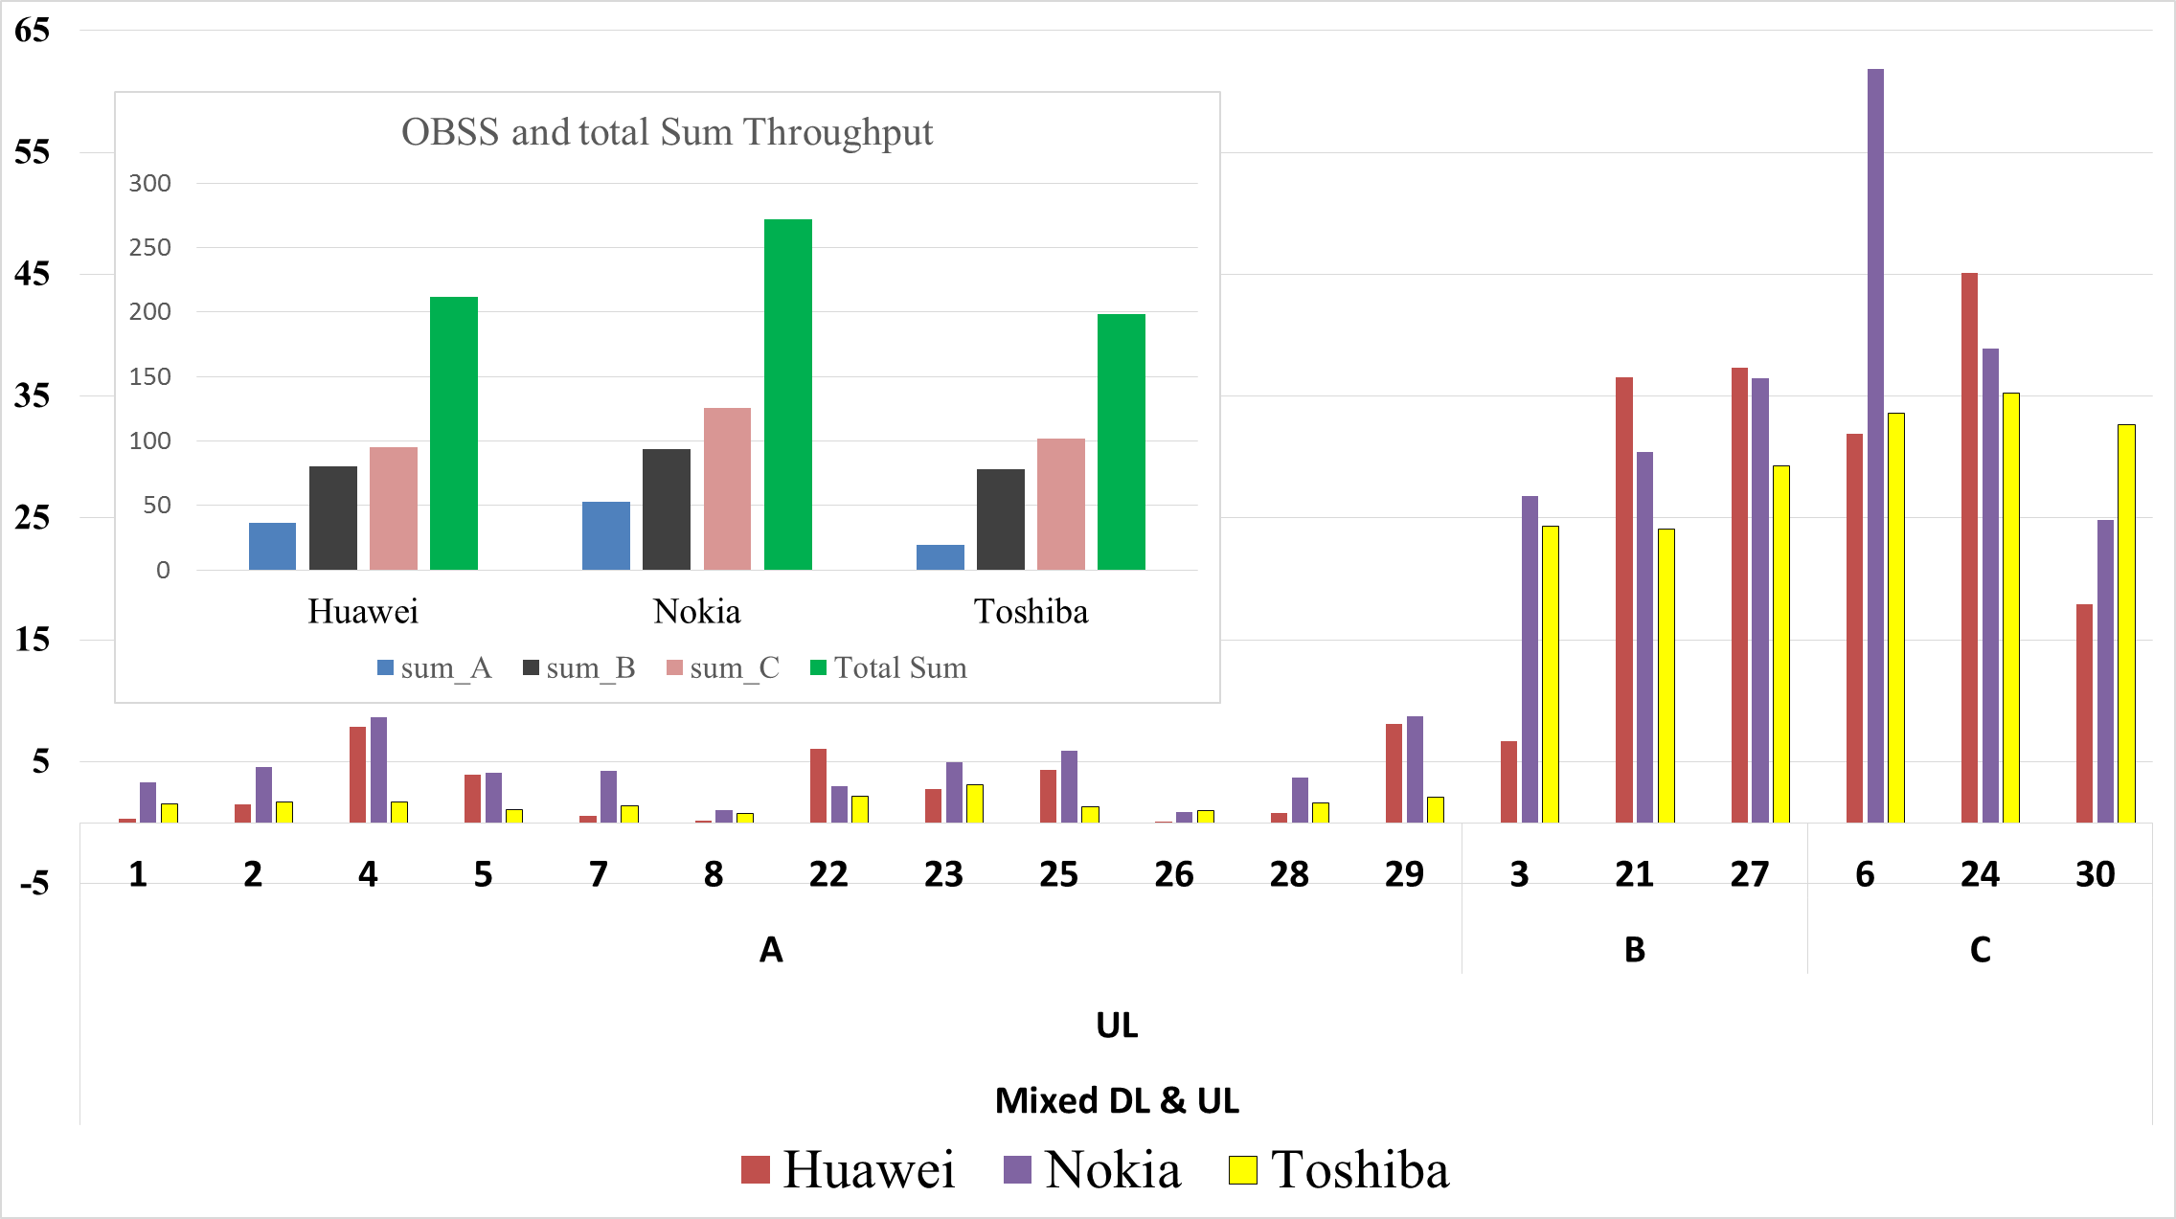
3 BSS Mixed Simulation Results (UL)

Slide 16
Observations
  Large variance in results for 2BSS and 3BSS cases from different companies
    2 BSS is better aligned than 3 BSS cases
  Observation from 1 BSS scenario of uniform per-STA throughput distribution for DL and distance-related throughput distribution for UL can be seen
  In 3 BSS case, BSS B and BSS C have similar throughput which is higher than BSS A
      BSS A gets interference packets from both BSS B and BSS C
      Hence, for large number STAs in BSS A, high ratio of STAs is nearly 0 throughput.
      Only few packets from BSS B and BSS C interfere
Notes:
In the DL case for 3 BSS if all 3 APs hear each other equally, each AP will have equal channel access probability and hence similar DL throughput

Slide 17
Conclusion
  It is hard to clarify whether the throughput ratio among BSSs is correct or not.
    Different throughput distribution among 3 BSSs seen in the comparison plots
  PER and/or average SINR of the STAs that have less throughput during UL cases in both 2 BSS and 3 BSS can be a starting point to align the results.
  Increase the simulation time as most of the BSS A stations do not obtain the channel access during the 3 BSS test cases.
  More analysis and offline discussions are required by companies to complete Box 5 calibration.

Slide 18
Reference
[1] 11-15/0680r3 Reference Box5 Calibration Assumptions and Parameters
[2] 11-15/0980r10 TGax Simulation Scenarios

