Slide 1
On TGax Scenario 4 channel model – follow-up
Date: 2015-11-09

Slide 2
Abstract
Assumptions of TGax scenarios 4 channel model are investigated. Proposals/recommendations to enhance the current channel model are provided related to minimum distance, LOS path-loss models and LOS occurrence correlation. Direct follow up from IEEE 802.11-15/1048r0 [1].

Slide 3
Minimum distance requirements for SCE#4
SCE#4 defines two minimum distance requirements [2]:
3D distance requirement of 1m applicable to all links, and
2D distance requirement of 10m applicable for STA to AP link only
STA to AP link 2D distance requirement seems to be an artifact from the early stage of TGax when channel models were not yet established
If we assume that path-loss formula is valid for 3D distance below 10m for STA-STA link then why we cannot assume that this formula is also valid for STA-AP link below 10m? (please note that path-loss formulas for distances below the breakpoint distance are the same for all links)
If needed, poor channel condition underneath AP antennas can be properly modeled by using appropriate antenna characteristics
Minimum 2D distance requirement for STA-AP links can be removed from the description of SCE#4 to eliminate the inconsistency related to the existence of two minimum distance requirements

Slide 4
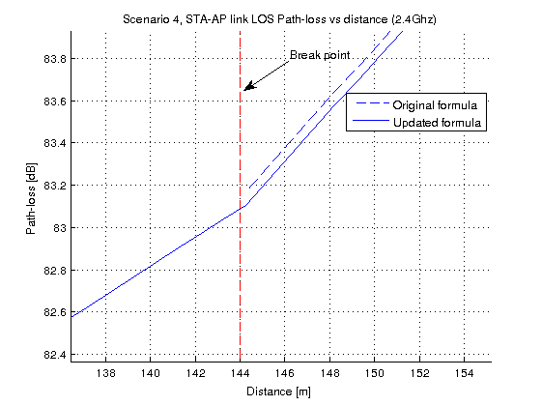
SCE#4 LOS Path-loss model discontinuity issue
ITU UMi LOS Path-loss is a two-slope model with a break point distance (d_{BP}) derived based on the Frensel zone theory
By allowing 3D distance for path-loss calculation (UMi LOS formula was originally derived for 2D distance) we introduce a discontinuity between the two slopes at the breakpoint distance for STA-AP link (see [1])
To preserve the continuity we need to update the model, as proposed below (for STA-STA and AP-AP links results remain the same as for the original formula) (see [3] fore derivation details)

Slide 5
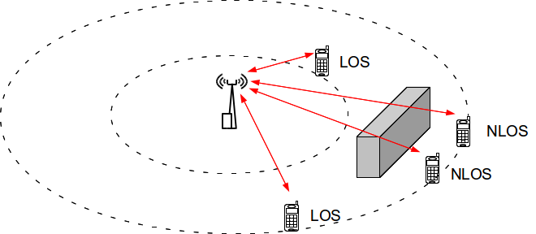
SCE#4 LOS occurrence correlation model
LOS occurrence is a slow process versus distance Δx as it is affected by buildings and/or obstacles thus, similarly to slow fading, LOS occurrence for STA-AP links for adjacent STAs should be correlated
LOS occurrence correlation, in contrast to slow fading, is not considered in ITU UMi

Slide 6
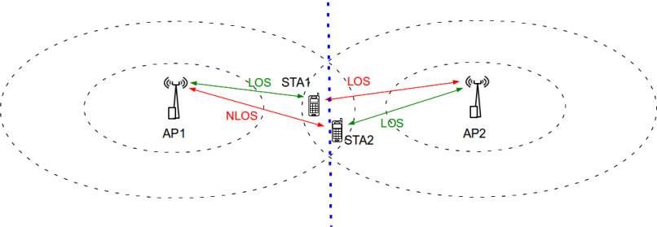
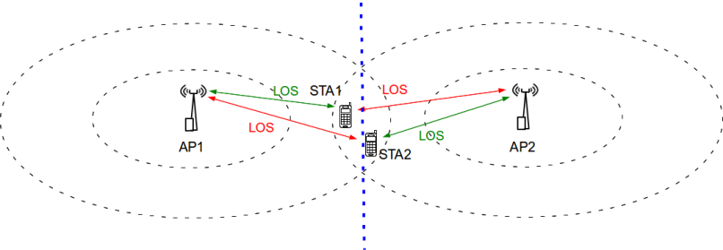
SCE#4 LOS occurrence correlation model
Ignoring the impact of LOS occurrence correlation may result in over-estimation of CSMA specific effects such as hidden terminal and “piggy in the middle” /capture effect
Boundary between two cells
Without correlation: Hidden terminal problem each time when STA2 transmits to AP2 whilst STA1 receives from AP1 (AP1 in NLOS with STA2 thus AP1 transmission does not trigger CCA busy in STA2).
Without correlation: Hidden terminal problem each time when one STA receives whilst other transmits
Boundary between two cells
With correlation: Both stations connected to AP2, thus no hidden terminal problem
With correlation: No threat of STA2 initiating transmission during STA1 reception from AP1 (AP1 transmission triggers CCA busy in STA2).

Slide 7
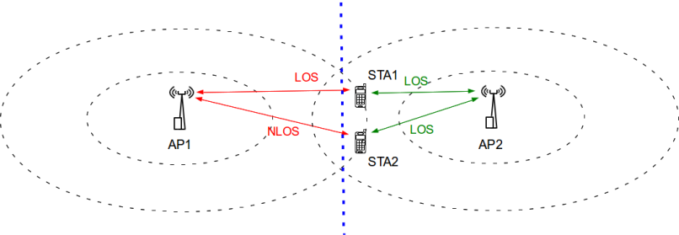
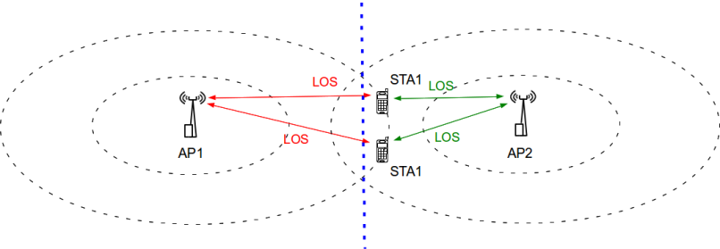
SCE#4 LOS occurrence correlation model
Ignoring the impact of LOS occurrence correlation may result in over-estimation of CSMA specific effects such as hidden terminal and “piggy in the middle”/capture effect
Boundary between two cells
Without correlation: AP1 transmission triggers CCA busy in STA1 due to LOS, thus lowering contention for STA2 and allowing STA2 to transmit more often (may lead to “piggy in the middle” problem)
Boundary between two cells
With correlation: STA1 and STA2 are both in LOS with AP1 and thus AP1 transmission triggers CCA busy in both STAs

Slide 8
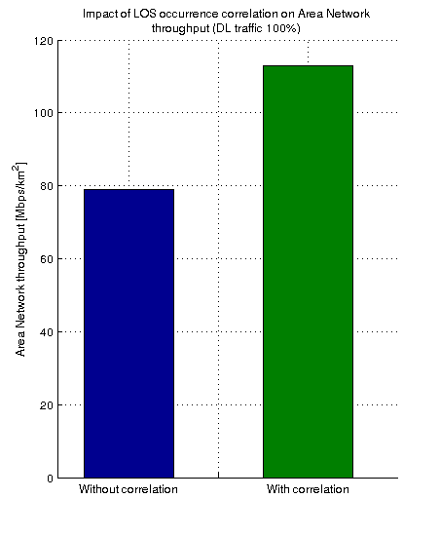
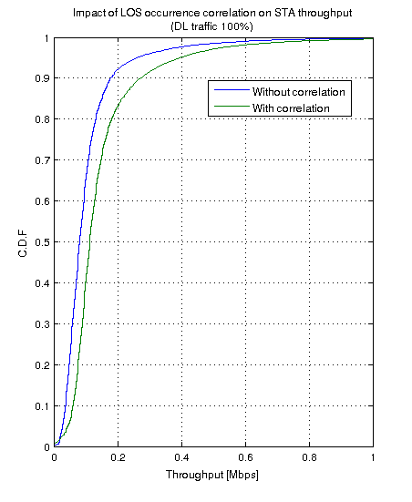
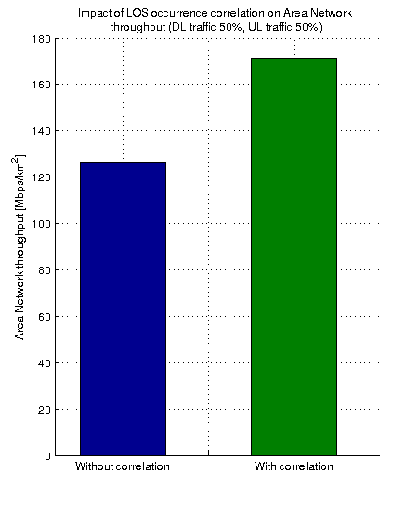
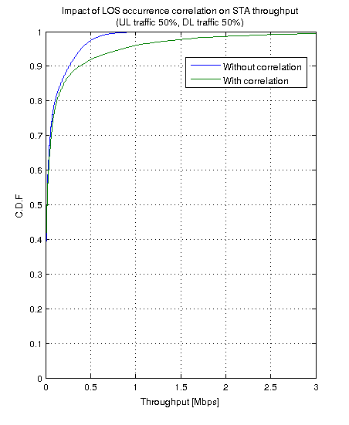
SCE#4 LOS occurrence correlation model
Impact of LOS occurrence correlation
35.4%
43.0%
DL traffic 100% scenario
UL traffic 50%, DL traffic 50% scenario
LOS occurrence correlation has a significant impact on simulation results
Assumption: d_{cor_los} = 13m (the same value as ITU UMi d_{cor_sf} for NLOS [3])

Slide 9
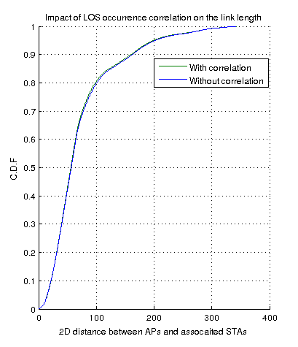
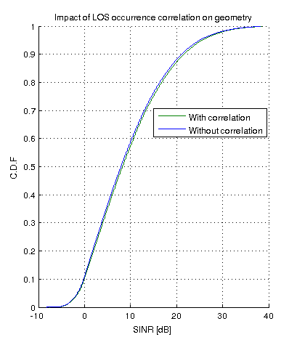
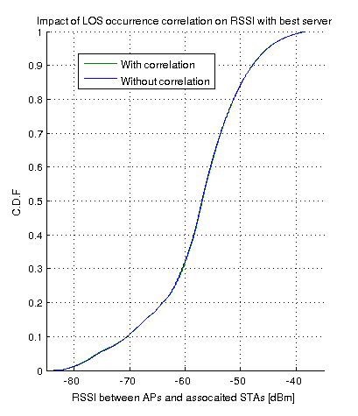
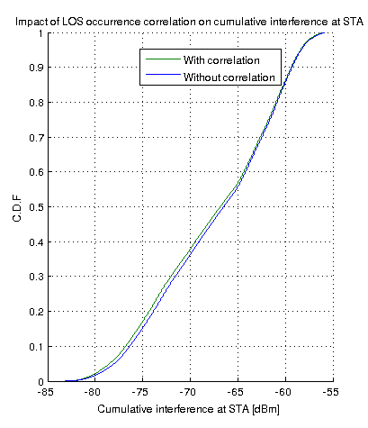
SCE#4 LOS occurrence correlation model
Impact of LOS occurrence correlation
Link lengths with no change (i.e. number of STAs in LOS and NLOS remains the same regardless correlation)
No impact on the Network Geometry
No impact on RSSI to best server
Slightly lower cumulative interference at STA
LOS occurrence correlation has a negligible impact on channel statistics

Slide 10
Summary
Two issues with existing SCE#4 channel model were highlighted and recommendations were provided
Proposal to improve existing SCE#4 channel model was presented and appropriate recommendations were provided

Slide 11
References
[1] IEEE 802.11-15/1048r0, On TGax Scenario 4 channel model (University of Surrey)
[2] 11-14-0980-14-00ax, TGax Simulation Scenarios
[3] 3GPP R1-133594: Remaining details of path loss modeling for elevation beamforming and FD-MIMO, RAN1#74, Qualcomm Incorporated, August 2013
[4] 3GPP R1-093486: Impact of relay site planning on LOS probability of the backhaul link, RAN1 #58, Ericsson, ST-Ericsson, Aug 2009
[5] 3GPP TR 36.873, Study on 3D channel model for LTE, v12.2.0, June 2015
[6] D. Har, H. H. Xia, and H. L. Bertoni, “Path-Loss Prediction Model for Microcells,” IEEE Trans Veh. Technol., vol.48, no.5, Sep. 1999, pp.1453-1462

Slide 12
Straw poll 1
Should the minimum 2D distance requirement of 10m for STA-AP links be removed from the description of SCE#4 in 11-14-980-14-00ax (Section 4), as proposed below?
Y:
N:
A:
STAs location | . STA antenna height1.5 m. STAs are placed randomly (uniform distribution) within the 19 cell area, at a minimum X-Y distance of 10 m from every AP. STA identifies AP from which it receives the highest power (based on distance-based pathloss and shadowing). STA associates to corresponding AP if the AP does not yet have N1 STAs associated to it; if AP already has N1 STAs associated to it then this STA is removed from the simulation. This process is repeated until each of the 19 APs has exactly N1 STAs associated to it. …{omitted} …

Slide 13
Straw poll 2
Should the SCE#4 LOS path-loss formula in 11-14-980-14-00ax (Section 4) be modified, to remove the discontinuity issue, as shown below?
Y:
N:
A:

Slide 14
Straw poll 3
Should the statement related to LOS occurrence correlation on Slide 18 be added to 11-14-980-14-00ax (Section 4)?
Y:
N:
A:

Slide 15
Channel model | [UMi] or UMa …{omitted}… In the above equations, the variable d is defined as: d = max(3D-distance [m],1) The distance based LOS occurrence correlation with normalized autocorrelation function R(Δx) and de-correlation distance (dcor) of 13m is to be considered for channel link between AP and STAs. Application of LOS occurrence correlation to channel links between AP to AP, and link between STA to STA is TBD. TBD Note: In case of UMi channel model, M.2135-1 defines that 50% of user are indoor users, but since indoor users can be served by indoor AP, we can change the percentage of users are indoor; need to decide which percentage [LC] prefer to set it to 0 [VE] set it to > 0 [SM] set it to 0 or merge scenarios 4 and 4a [Minho] “So, I think we don’t have to make light of the indoor users even when we considering outdoor and indoor at the same time.”

Slide 16
Backup slides

Slide 17
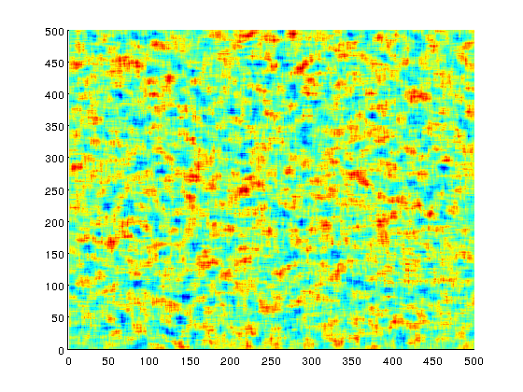
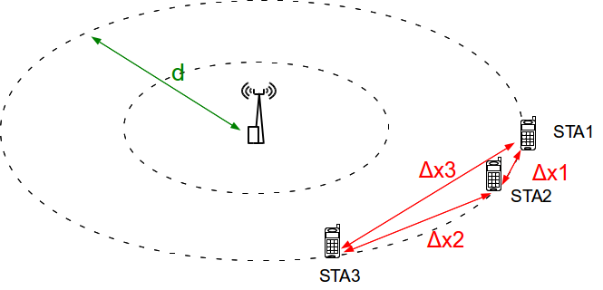
SCE#4 LOS occurrence correlation model
As shadowing and LOS occurrence are affected by the same buildings and/or obstacles,
normalized autocorrelation function R(Δx) for LOS occurrence can be described in a similar way as in case of shadowing [4]
de-correlation distance for LOS occurrence d_{cor_los} = d_{cor_sf} [4]
Example realization of spatially correlated Gaussian RV with d_{cor_los} = 13m

Slide 18
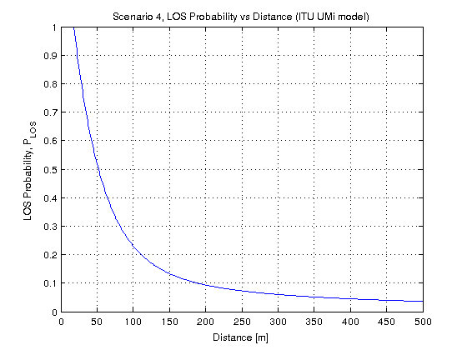
SCE#4 LOS occurrence correlation model
LOS occurrence generation procedure (based on [4]):
Let b_{ij}(i=1,2,…N, j = 1,2,… M) be a Boolean variable representing whether the i-th STA is in LOS with j-th AP (b_{ij}=1) or in NLOS (b_{ij} = 0), where N – number of STAs and M – number of APs
Let g_{ij}(i=1,2,…N, j = 1,2,… M) be a Gaussian random variable with σ² = 1 and µ = 0 which is spatially-correlated with de-correlation distance of d_{cor_los} (please note that g_{ij} for different j are independent, i.e. we assume no inter-AP correlation)
Let p_{ij}(i=1,2,…N, j = 1,2,… M) be the probability of being in LOS between i-th STA and j-th AP dependent on distance d_{ij}(i=1,2,…N, j = 1,2,… M)
Transformation of Uniform RN to Gaussian RN
(erfinv - Inverse error function)

Slide 19
Simulation parameter settings
Main simulation parameters
Parameter | Value
IEEE 802.11 standard | IEEE 802.11g (DSSS switched off)
Network layout | Hexagonal grid
Wrap-around | Yes (BSS layout with 6 rings)
STA/AP height | As defined in [1]
STA distribution | Random uniform distribution
Modeling of preamble reception | Not considered
Path loss model | As defined in [1]
Shadow fading model | Not considered
Fast fading model | Not considered
Mobility | Not considered
Number of orthogonal channels | 1
Carrier frequency | 2.4 GHz
Carrier bandwidth | 20.0 MHz
STA/AP Transmit power | 15.0 dBm / 20.0 dBm
STA/AP Rx sensitivity | -88.0 dBm
STA/AP Noise Figure | 7 dB
STA/AP Antenna type | Omni-directional
STA/AP Antenna Gain | -2.0 dBi / 0.0 dBi
STA/AP CCA Mode1 threshold | -68.0 dBm
STA-AP allocation rule | Strongest server (STAs always associate with APs with the strongest signal)
Traffic model | Full buffer (saturated model)
Traffic type | Non-elastic (UDP)
Traffic direction | Downlink only
Packet size (size of the packet transmitted on the air interface, i.e. with MAC, IP and TCP overheads) | 1500 bytes (Application layer packet size: 1424 bytes)
Other IEEE 802.11 related parameters
Parameter | Value
Beacon period | 100ms
Probe timeout /Number of probe requests send per scanned channel | 50ms / 2
Scanning period (unassociated state only) | 15s
RTS/CTS | Off
Packet fragmentation | Off
The maximum number of retransmission attempts for a DATA packet | 7
Rate adaptation algorithm | Mistrel
MAC layer queue size | 1000 packets
Number of beacons which must be consecutively missed by STA before disassociation | 10
Association Request Timeout / Number of Assoc Req. before entering scanning | 0.5s / 3
Transmission failure threshold for AP disassociation procedure | 0.99

