Slide 1
Implications of wrap-around for TGax Scenario 3 and Scenario 4 – follow-up
Date: 2015-11-09

Slide 2
Abstract
Implications of the use of Wrap-Around (WA) in TGax scenarios 3 and 4 are investigated. Simulations studies indicate significant differences in system performance with different number of simulated rings and also the need to reconsider some of the scenario specific simulation parameters. Direct follow up from IEEE 802.11-15/1049r1 [2].

Slide 3
SCE#3 and SCE#4 review
SCE#3 (Indoor Small BSSs) and SCE#4 (Outdoor Large BSS Scenarios) represent planned real-world deployments which may consist of hundreds of BSSs
To simplify simulation complexities hexagonal BSS layouts with a frequency reuse pattern are employed for both scenarios
BSS
BS
BSS
BSS
BSS
BSS
BSS
BSS
BSS
BSS
BSS
BSS
BSS
BSS
BSS
BSS
BSS
BSS
BSS
Figure 1. Layout of BSSs with Frequency reuse 1
Figure 2. Layout of BSSs using Frequency reuse 3

Slide 4
Problems with SCE#3 and SCE#4 hexagonal BSS layouts
BSSs located in the outer ring behave differently from BSSs located in the inner rings.
As a result, SCE#3 and SCE#4 hexagonal BSS layouts cannot be considered as a representative fraction of the actual deployments (i.e. we can assess performance only of the simulated layout, not the entire network)
Additionally, SCE#3 and SCE#4 hexagonal BSS layouts assume only 2 rings which may not allow for proper evaluation of mechanisms for improving spatial reuse (e.g. a single AP transmission in SCE#3 may silence all other APs and STAs due to existence of a single collision domain)

Slide 5
Possible solutions for problems with SCE#3 and SCE#4 hexagonal BSS layouts
Solution 1: Simulate the entire deployment instead of just a fraction
Requires definition of new BSS layouts with various number of rings and multiple simulation runs to cover a wide range of possible real-world deployments
Solution 2: Simulate with wrap-around to minimize border effects
With wrap-around no need to conduct multiple simulations for different BSS layout

Slide 6
Wrap-around with simulations of CSMA based systems
Issues related to the use of wrap-around, when used with insufficient number of rings:
Over-estimation of spatial reuse – happens when transmitters located outside of the boundaries of our network layout may trigger reception or CCA busy event in the central cell (specific for CSMA simulations)
Over-estimation of network geometry – happens when interferers located outside of the layout boundaries have a non-negligible impact on the SINR of the receivers located in the central cell (applicable to CSMA and non-CSMA simulations)
Under-estimation of CSMA specific effect such as “capture effect”, “hidden terminal problem”, etc.
Investigating the proper number of rings for simulations with wrap-around
Main parameters affecting number of rings (scenario specific): Inter-cell distance (ICD), CCA-SD threshold/RX sensitivity, CCA-ED threshold, TX-power, Path-loss model
Experimentally, simulations with different number of rings can help determine when the impact of the additional ring on the system performance can be neglected

Slide 7
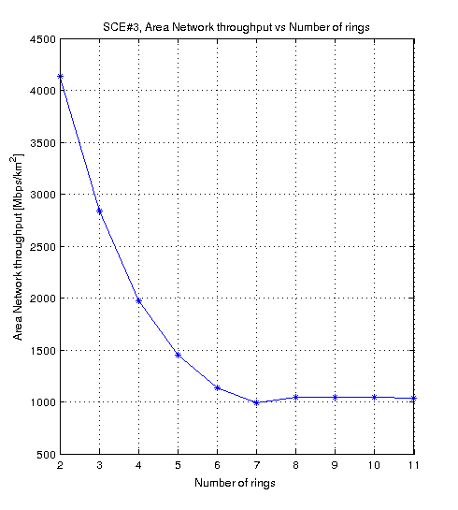
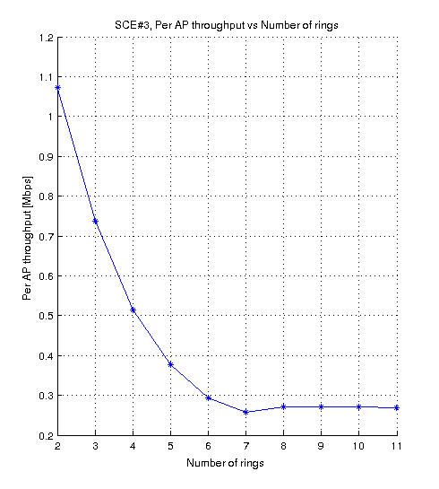
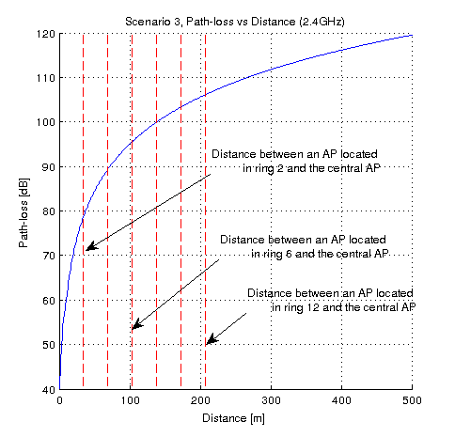
Wrap-around for SCE#3 and SCE#4 – investigating proper number of rings
Scenario 3
RX power seen by an AP in the second ring (from central AP) ~ -60dBm
217 BSSs
127 BSSs
169 BSSs
75%
Other simulation settings: IEEE 802.11g (DSSS switched off), Shadowing and Fast fading not considered, No rate adaptation (Data/Control rate 24Mbps/24Mbps), CCA-SD threshold/RX sensitivity = -78dBm, CCA-ED threshold = -58dBm, STA density = 2000 STAs per km2, Full buffer (non-elastic traffic), Packet size = 1500B, Downlink only, Preamble reception model not considered

Slide 8
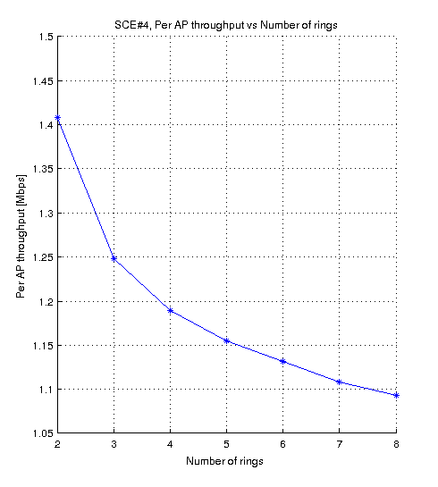
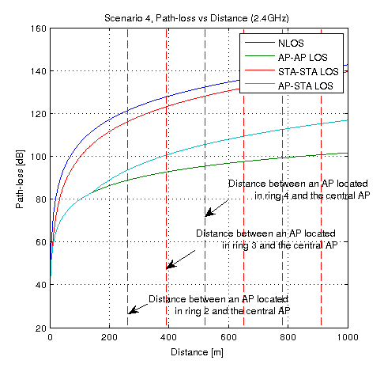
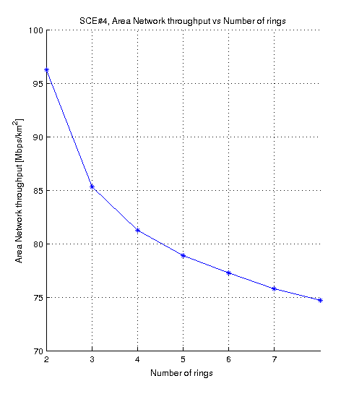
Wrap-around for SCE#3 and SCE#4 – investigating proper number of rings
Scenario 4
61 BSSs
127 BSSs
91 BSSs
22.4%
Other simulation settings: IEEE 802.11g (DSSS switched off), Shadowing and Fast fading not considered, Rate adaptation (Minstrel), CCA-SD threshold/RX sensitivity = -88dBm, CCA-ED threshold = -68dBm, STA density = 770 STAs per km2, Full buffer (non-elastic traffic), Packet size = 1500B, Downlink only, Preamble reception model not considered

Slide 9
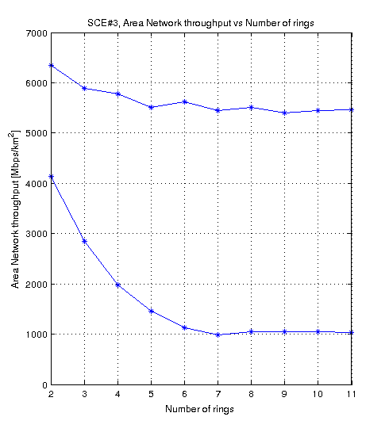
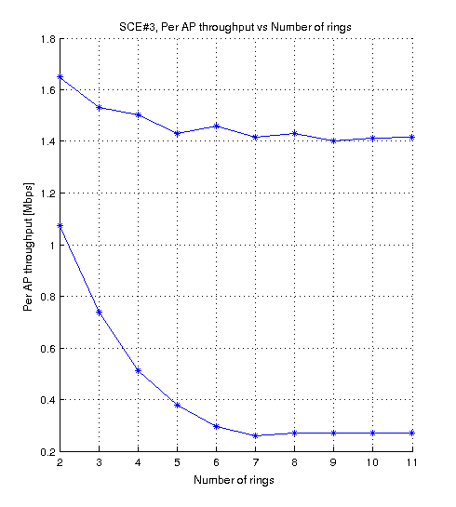
Wrap-around – potential ways for reducing number of rings for SCE#3 and SCE#4
Scenario 3
Reduce power settings
Increase Inter-Cell Distance (ICD) (e.g. simulations with reuse 3)
16%
61 BSSs
127 BSSs
91 BSSs
75%
If we reduce power to 0dBm for APs and -5dBm for STA, difference between results for ring 2 and ring 11 drops to 16%, compared to75% for the original scenario settings

Slide 10
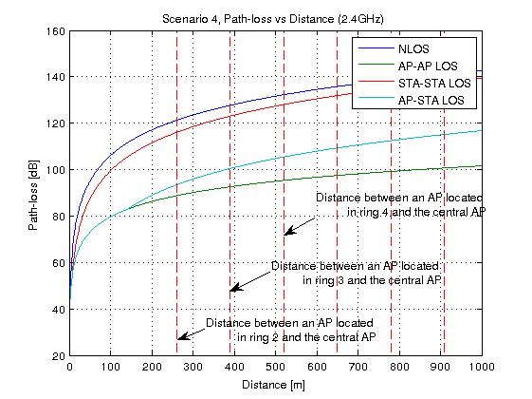
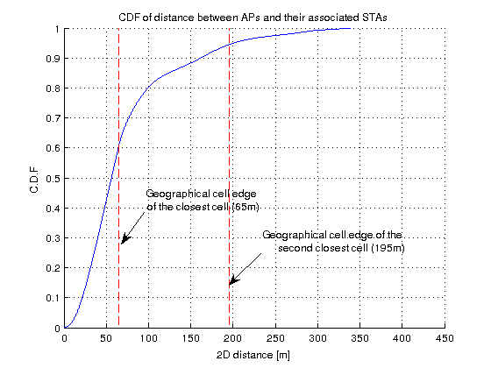
Wrap-around – potential ways for reducing number of rings for SCE#3 and SCE#4
Scenario 4
Introduce a PLOS cut-off to ensure that no two nodes can be in LOS after a certain distance (alternatively propose a new LOS probability function with a smaller tail)
Increase ICD (simulations with reuse 3)

Slide 11
Summary
Wrap-around is necessary for proper evaluation of SCE#3 and SCE#4 (assuming we simulate just a small fraction of the actual deployment instead of the whole network)
The accuracy of wrap-around technique depends to the size (i.e. number of rings) of the BSS layout
Number of rings is scenario specific and may change depending on simulation settings (e.g. 11ax only deployment vs mixed deployment)
Number of rings for SCE#3 and SCE#4 BSS layouts need to be sufficient to provide reliable results (if used with wrap-around)
AP/STA power settings for SCE#3 may need to be reconsidered to reduce simulation complexity (if used with wrap-around)
SCE#4 LOS probability function may need to be updated to reduce simulation complexity (if used with wrap-around)

Slide 12
References
[1] 11-14-0980-14-00ax, TGax Simulation Scenarios
[2] IEEE 802.11-15/1049r1, Implications of wrap-around for TGax Scenario 3 and Scenario 3 (University of Surrey)

Slide 13
Straw poll
Should the table on Slide 13 be added to 11-14-980-14-00ax (Section 3 and Section 4)?
Y:
N:
A:

Slide 14
Environment description | BSSsare placed in a regular and symmetric grid as in Figure 6 for frequency reuse 1 and Figure 7 for frequency reuse 3. Each hexagon in Figures6 and 7 has the following configuration: Radius (R): 10 meters Inter BSS distance (ICD): 2*h meters h=sqrt(R²-R²/4)
Wrap-around (radio-distance based) | Used with X number of rings (number of rings needs to be justified) / Not used
APs location | AP is placed at the center of the hexagon,with 3m antenna height
AP Type | HEW
Environment description | Outdoor street deployment BSS layout configuration Define a 19 hexagonal grid as in Figure 9 With ICD = 130m h=sqrt(R²-R²/4)/2
Wrap-around (radio-distance based) | Used with X number of rings (number of rings needs to be justified) / Not used
APs location | Place APs on thecenter of each hexagon Antenna height 10m.
AP Type | HEW

Slide 15
Backup slides

Slide 16
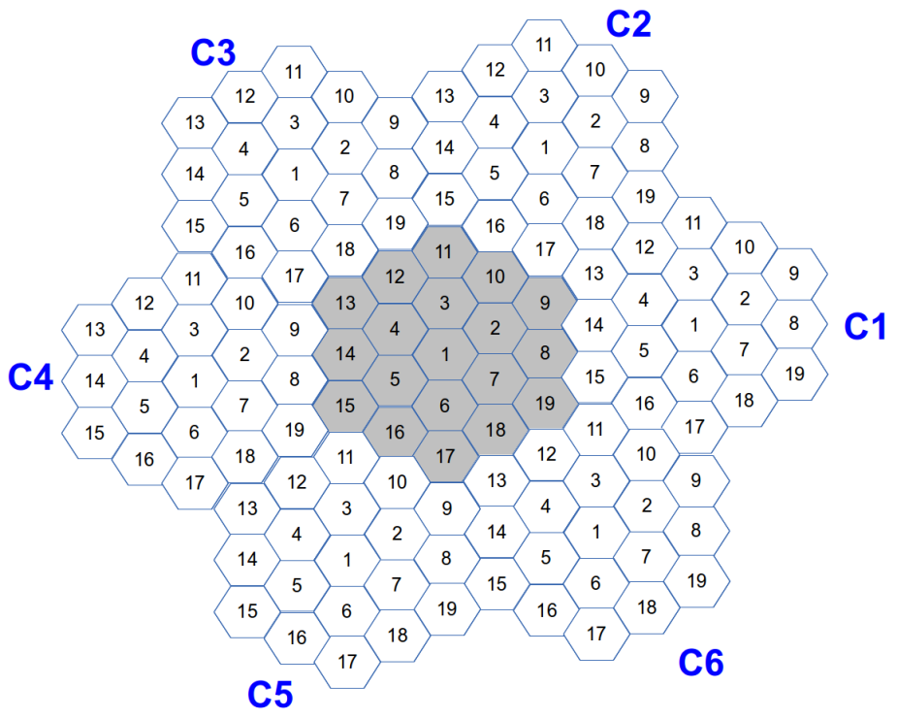
Wrap-around – basics
The original layout is extended to a cluster consisting of 6 displaced “virtual” copies of the original hexagonal network and the original hexagon network located in the center (see below)
There is a one-to-one mapping between cells of the central (original) hexagonal network and cells of each copy (each copy have the same antenna configuration, traffic, power settings, etc.)

Slide 17
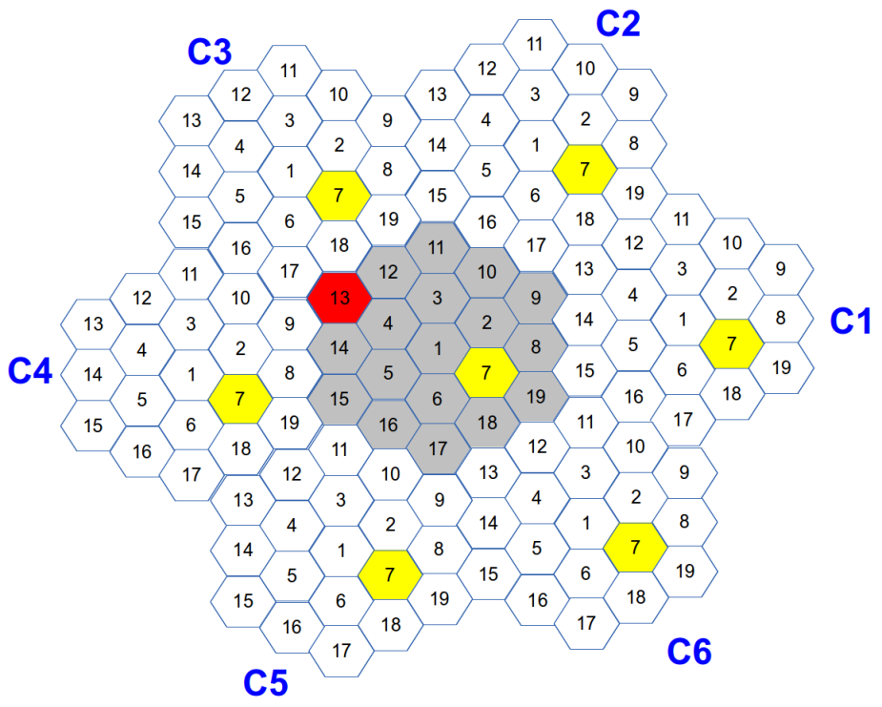
Wrap-around – basics
Simple example: AP7 transmits a beacon frame and we want to determine the RX power of this beacon at AP13
1) Determine the RX power for the beacon as if it was transmitted from all 7 locations of AP7
2) Select the max RX power which in this case corresponds to AP7 location in C3 (assuming simple, distance dependent path-loss model with no shadowing and omni-directional antennas)
Please note that for Radio distance based WA shortest distance does not always mean highest RX power!

Slide 18
Main simulation parameter settings
Main SCE#3 parameter settings as in [1]
Inter-cell distance (ICD) = 17.32m (10m radius),
AP/STA TX power = 20dBm / 15dBm
Path-loss model as defined in [1]
AP/STA antenna gain = 0.0dB / -2.0dB
AP/STA noise figure = 7.0dB / 7.0 dB
AP/STA antenna height = 3.0m / 1.5m
Main SCE#4 parameter settings as in [1]
Inter-cell distance (ICD) = 130 m (75m radius),
AP/STA TX power = 20dBm / 15dBm
Path-loss model as defined in [1]
AP/STA antenna gain = 0.0dB / -2.0dB
AP/STA noise figure = 7.0dB / 7.0 dB
AP/STA antenna height = 10.0m / 1.5m

Slide 19
Other simulation parameter settings
Main simulation parameters
Parameter | Value
IEEE 802.11 standard | IEEE 802.11g (DSSS switched off)
Network layout | Hexagonal grid
Wrap-around | Yes (variable number of rings)
STA/AP height | As defined in [1]
STA distribution | Random uniform distribution
Modeling of preamble reception | Not considered
Path loss model | As defined in [1]
Shadow fading model | Not considered
Fast fading model | Not considered
Mobility | Not considered
Number of orthogonal channels | 1
Carrier frequency | 2.4 GHz
Carrier bandwidth | 20.0 MHz
STA/AP Transmit power | 15.0 dBm / 20.0 dBm
STA/AP Rx sensitivity | -88.0 dBm (Scenario 4) -78.0 dBm (Scenario 3)
STA/AP Noise Figure | 7 dB
STA/AP Antenna type | Omni-directional
STA/AP Antenna Gain | -2.0 dBi / 0.0 dBi
STA/AP CCA Mode1 threshold | -68.0 dBm (Scenario 4) -58.0 dBm (Scenario 3)
STA-AP allocation rule | Strongest server (STAs always associate with APs with the strongest signal)
Traffic model | Full buffer (saturated model)
Traffic type | Non-elastic (UDP)
Traffic direction | Downlink only
Packet size (size of the packet transmitted on the air interface, i.e. with MAC, IP and TCP overheads) | 1500 bytes (Application layer packet size: 1424 bytes)
Other IEEE 802.11 related parameters
Parameter | Value
Beacon period | 100ms
Probe timeout /Number of probe requests send per scanned channel | 50ms / 2
Scanning period (unassociated state only) | 15s
RTS/CTS | Off
Packet fragmentation | Off
The maximum number of retransmission attempts for a DATA packet | 7
Rate adaptation algorithm | Mistrel / No Rate Adaptation (24Mbps/24Mbps)
MAC layer queue size | 1000 packets
Number of beacons which must be consecutively missed by STA before disassociation | 10
Association Request Timeout / Number of Assoc Req. before entering scanning | 0.5s / 3
Transmission failure threshold for AP disassociation procedure | 0.99

