Slide 1
System Performance Evaluation of 802.11ae
Date: 2015-11-07
Authors:

Slide 2
Abstract
IEEE 802.11ae describes Quality of Service for Management frames (QMF). Without QMF support stations send all management frame through the highest Access Category (AC). Even irrelevant or latency insensitive management traffic receive priority over Data traffic in lower ACs. Without QMF VoIP traffic is adversely affected by management traffic transmission occurring through the same AC. In this submission we present simulation results showing the impact to Voice quality.

Slide 3
Background
Various measurement studies outline that in dense deployments >60% may be management traffic, e.g. [1]
  Many management frames are sent at the most robust Modulation and Coding Scheme (MCS)
    1 Mb/s @ 2.4 GHz, 6 Mb/s @ 5 GHz
    Substantial airtime killer
Management frames severely impact VoIP transmissions
  Threatening market opportunity for “Wi-Fi calling”

Slide 4
IEEE 802.11ae-2012
Prioritization of Management frames
802.11ae specifies a mechanism for the prioritization of management frames
  Prevents overloading the highest priority
QMF (QoS management frame) policy, see [2]
Description | Subtype | QMF AC
Probe Request (individually addressed) | 0100 | AC_VO
Probe Request (group addressed) | 0100 | AC_BE
Probe Response | 0101 | AC_BE
Beacon | 1000 | AC_VO

Slide 5
Target and Scope
System simulation to understand
  Problems caused by flooded high priority management frames
  Effectiveness of the QMF policy as defined in 802.11ae
Study management frames: beacon, probe request/response
Source: [1] | CH1 2.4 GHz | CH120 5 GHz
Channel Utilization | 90% | 2%
Management Frames | 64% | 55%
Mgmt Frame Breakdown
Beacon | 33% | 70%
Probe Request | 10% | 6%
Probe Response | 56% | 22%

Slide 6
System Configuration
20 MHz channel @ 2.4 GHz
Management frame modeling
Description | QMF AC | Size | Transmission Characteristics
Probe Request (group addressed) | AC_BE | 122 B | Periodic transmission (5 Hz) MCS = Most robust
Probe Response | AC_BE | 250 B | MCS = Most robust
Beacon | AC_VO | 100 B | Periodic transmission (10 Hz) MCS = Most robust

Slide 7
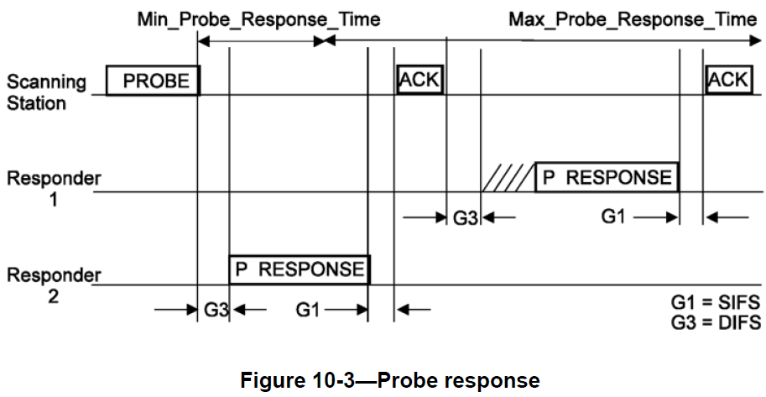
Probe Request/Response Procedure
Broadcast: channel contention to send response
  In the figure, G3 = AIFS + random backoff

Slide 8
Simulation Scenario
Airport scenario
  Open space and high traffic concentration
Deployment
  7 APs, 50 m ISD, all devices can sense each other
STAs and traffic
  Idle STAs: 30 STAs/AP, active group addressed probing
  VoIP (AC_VO) STAs: [6 … 12] STAs/AP

Slide 9
Simulation Results –
VoIP user experience
QMF increase system VoIP capacity significantly
  Satisfaction of each user depends on packet loss rate and latency

Slide 10
Simulation Results –
Frame Type Breakdown
The beacon packet percentage is significantly less than reported in [1]

Slide 11
Idle STA Only:
Management Frame Traffic
An AP is considered as active if sensing, transmitting or receiving
QMF increases AP activeness due to longer sensing time to transmit probe response frames
QMF OFF
QMF ON

Slide 12
Conclusion
Quality of Service (QMF) for Management frames provides a simple mechanism to prioritize management traffic through different Access Categories
The default 802.11ae categorization works well
  No dynamic management frame re-categorization needed
In dense deployments QMF helps substantially reducing traffic sent through highest priority Access Category
  Enhancing performance of high priority data transmissions
  Clearly improving VoIP over WLAN quality

Slide 13
References
K. Yunoki et al., “Understanding Current Situation of Public Wi-Fi Usage— Possible Requirements for HEW,” [Online]. Available: https://mentor.ieee.org/802.11/dcn/13/11-13-0523
G. R. Hiertz et al., “802.11ae & 802.11ax,” [Online]. Available: https://mentor.ieee.org/802.11/dcn/15/11-15-1013
IEEE, “IEEE Standard for Information technology—Telecommunications and information exchange between systems Local and metropolitan area networks—Specific requirements—Part 11: Wireless LAN Medium Access Control (MAC) and Physical Layer (PHY) Specifications,” Mar. 2012, Clause 10.1.4.3.3, p. 980.

