Slide 1
Strategies to reduce MIMO feedback overhead
Date: 2015-11-09
Authors:

Slide 2
Abstract
In this presentation we discuss strategies to reduce the MIMO feedback overhead. In particular, we focus on a compression technique that operates in the “spatial” direction by compressing multiple eigenmodes with fewer coefficients than the Givens decomposition.

Slide 3
Feedback overhead reduction in 11ax
In frequency: 11ac already adopted tone grouping such that feedback may be provided for every 2nd or 4th subcarrier
In time: high correlation of feedback coefficients in successive reports can be exploited by using some source coding techniques for compression (e.g., differential feedback)
In space: note that by going from 1 to 2 STA’s antennas the feedback bits in 11ac increase by 50%, going from 3 to 6 antennas the increase is 150%.
  In this presentation we show how multiple eigenmodes can be compressed by representing their vector space up to a rotation matrix

Slide 4
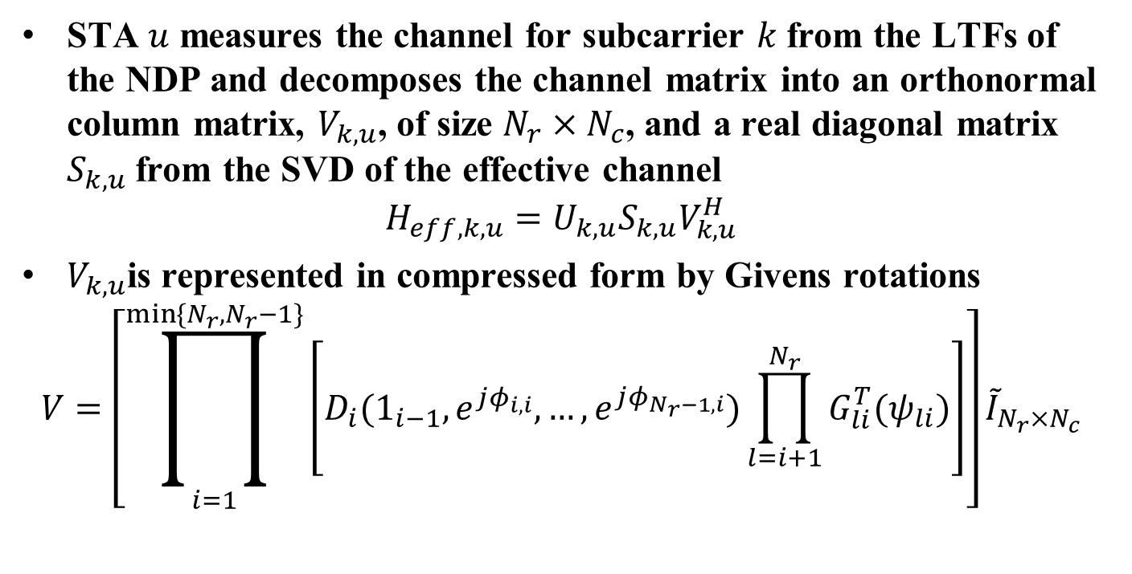
MIMO compressed feedback in 11ac
STA $u$ measures the channel for subcarrier $k$from the LTFs of the NDP and decomposes the channel matrix into an orthonormal column matrix, $V_{k,u}$, of size $N_{r}×N_{c}$, and a real diagonal matrix $S_{k,u}$ from the SVD of the effective channel
$$H_{eff,k,u}=U_{k,u}S_{k,u}V_{k,u}^{H}$$
$V_{k,u}$is represented in compressed form by Givens rotations
$$V=\left[\prod_{i=1}^{\min{\{N_{r},N_{r}−1\}}}{\left[D_{i}(1_{i−1},e^{jφ_{i,i}},…,e^{jφ_{N_{r}−1,i}})\prod_{l=i+1}^{N_{r}}{G_{li}^{T}(ψ_{li})}\right]}\right]{\tilde{I}}_{N_{r}×N_{c}}$$

Slide 5
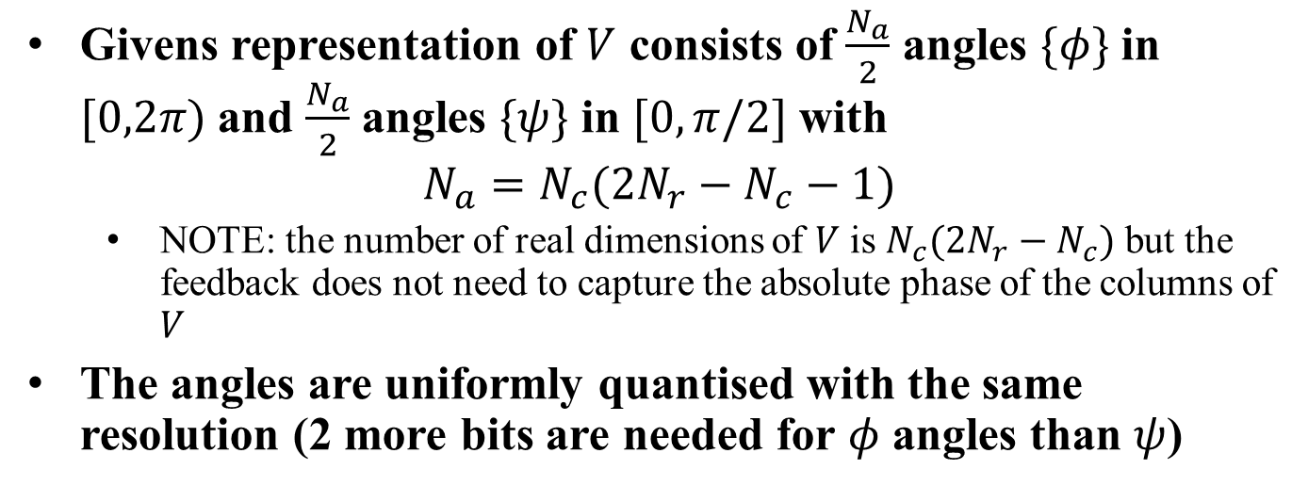
MIMO compressed feedback in 11ac
Givens representation of $V$ consists of $\frac{N_{a}}{2}$ angles $\{φ\}$ in $[0,2π)$ and $\frac{N_{a}}{2}$ angles $\{ψ\}$ in $[0,π/2]$ with
$$N_{a}=N_{c}(2N_{r}−N_{c}−1)$$
  NOTE: the number of real dimensions of $V$ is $N_{c}(2N_{r}−N_{c})$ but the feedback does not need to capture the absolute phase of the columns of $V$
The angles are uniformly quantised with the same resolution (2 more bits are needed for $φ$ angles than $ψ$)

Slide 6
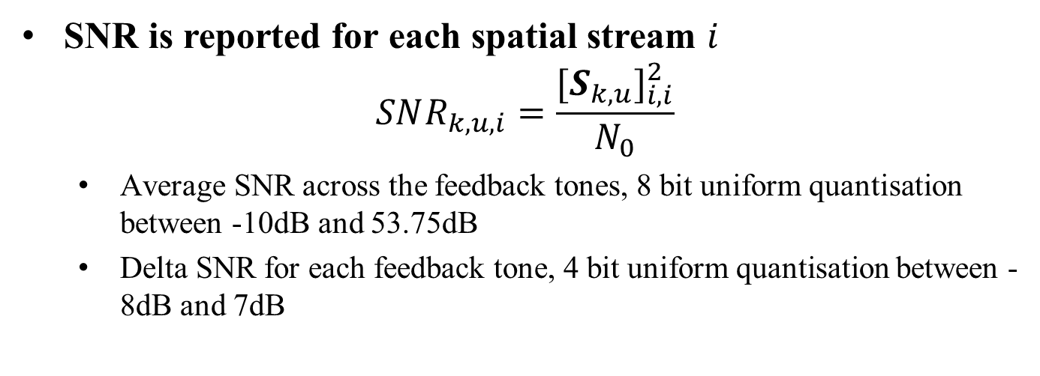
SNR reporting in 11ac
SNR is reported for each spatial stream $i$
$$SNR_{k,u,i}=\frac{{[S_{k,u}]}_{i,i}^{2}}{N_{0}}$$
  Average SNR across the feedback tones, 8 bit uniform quantisation between -10dB and 53.75dB
  Delta SNR for each feedback tone, 4 bit uniform quantisation between -8dB and 7dB

Slide 7
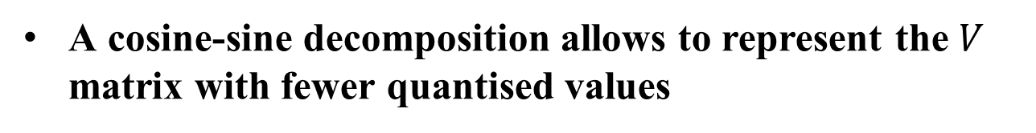


Modified representation of $V$
A cosine-sine decomposition allows to represent the $V$ matrix with fewer quantised values
The feedback signals a linear combination of the 11ac eigenmodes $V$

Slide 8
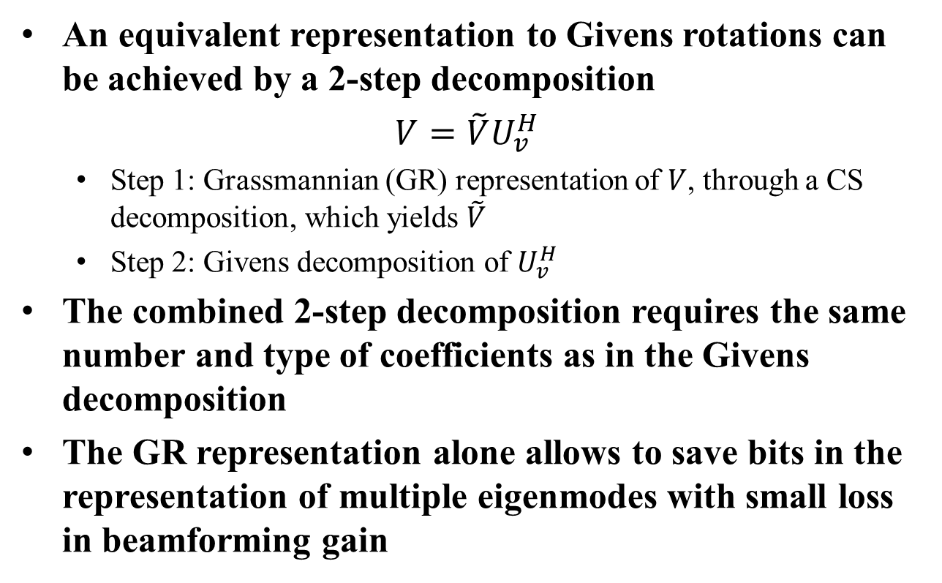

Modified representation of $V$
An equivalent representation to Givens rotations can be achieved by a 2-step decomposition
${V=\tilde{V}U}_{v}^{H}$
  Step 1: Grassmannian (GR) representation of $V$, through a CS decomposition, which yields $\tilde{V}$
  Step 2: Givens decomposition of $U_{v}^{H}$
The combined 2-step decomposition requires the same number and type of coefficients as in the Givens decomposition
The GR representation alone allows to save bits in the representation of multiple eigenmodes with small loss in beamforming gain

Slide 9
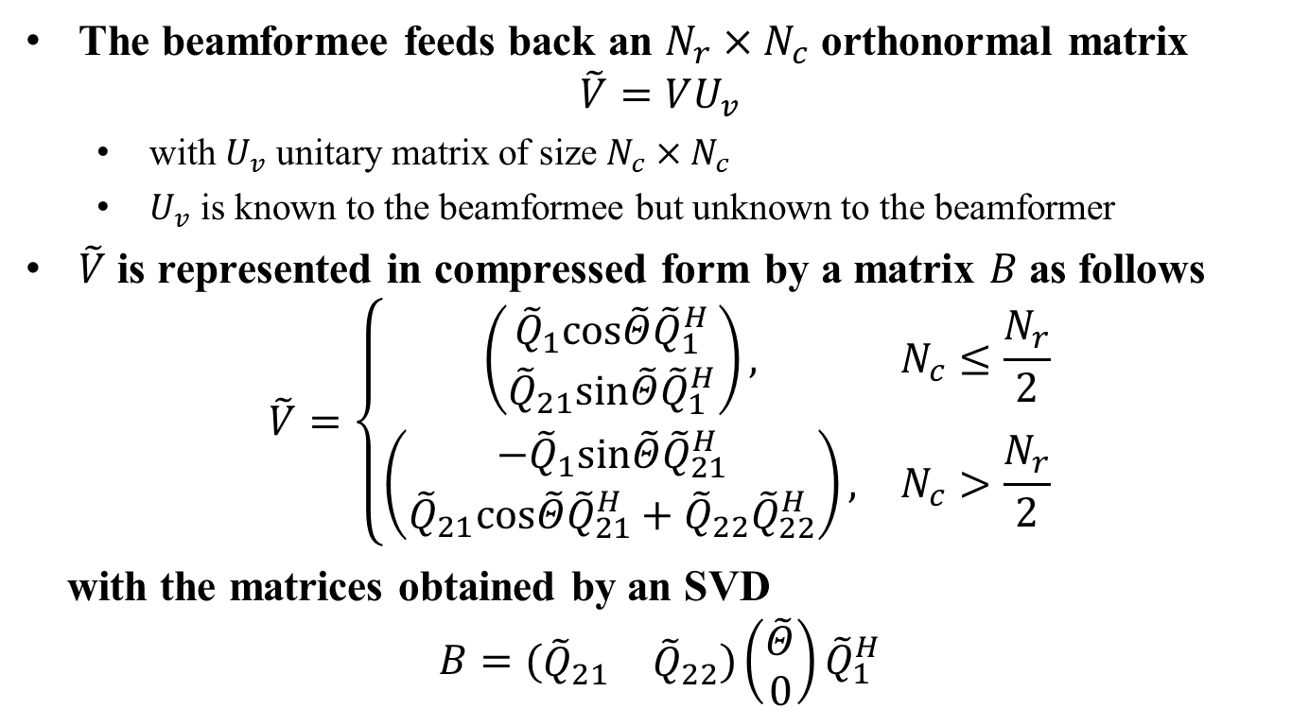
Proposal to add a new representation of the beamforming feedback matrix in 11ax
The beamformee feeds back an $N_{r}×N_{c}$ orthonormal matrix
$$\tilde{V}=VU_{v}$$
  with $U_{v}$ unitary matrix of size $N_{c}×N_{c}$
  $U_{v}$ is known to the beamformee but unknown to the beamformer
$\tilde{V}$ is represented in compressed form by a matrix $B$as follows
$$\tilde{V}=\left\{\begin{matrix}\left(\begin{aligned}{\tilde{Q}}_{1}cos\tilde{Θ}{\tilde{Q}}_{1}^{H} \\ {\tilde{Q}}_{21}sin\tilde{Θ}{\tilde{Q}}_{1}^{H}\end{aligned}\right), & N_{c}≤\frac{N_{r}}{2} \\ \left(\begin{aligned}−{\tilde{Q}}_{1}sin\tilde{Θ}{\tilde{Q}}_{21}^{H} \\ {\tilde{Q}}_{21}cos\tilde{Θ}{\tilde{Q}}_{21}^{H}+{\tilde{Q}}_{22}{\tilde{Q}}_{22}^{H}\end{aligned}\right), & N_{c}>\frac{N_{r}}{2}\end{matrix}\right.$$
with the matrices obtained by an SVD
$$B=(\begin{matrix}{\tilde{Q}}_{21} & {\tilde{Q}}_{22}\end{matrix})\left(\begin{aligned}\tilde{Θ} \\ 0\end{aligned}\right){\tilde{Q}}_{1}^{H}$$

Slide 10
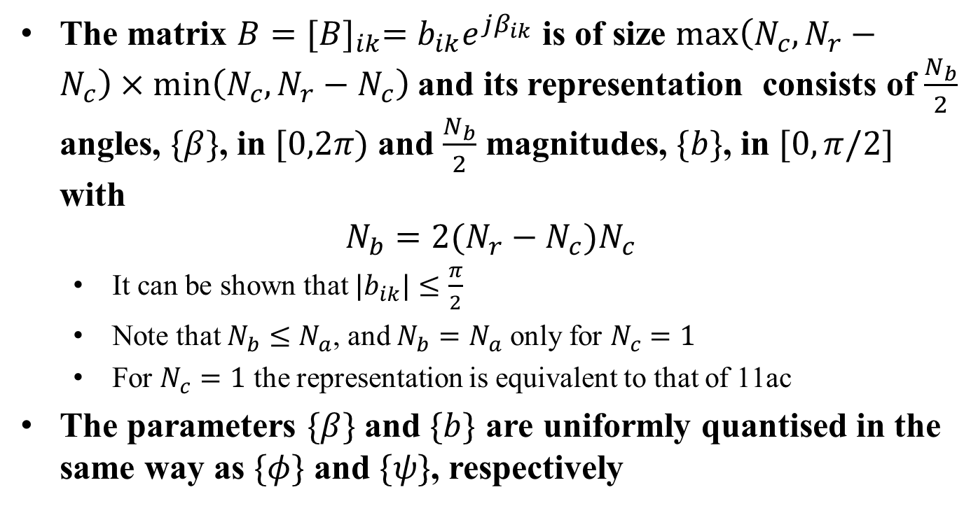
Proposal to add a new representation of the beamforming feedback matrix in 11ax
The matrix $B{=[B]}_{ik}=b_{ik}e^{jβ_{ik}}$ is of size $max\left(N_{c},N_{r}−N_{c}\right)×min\left(N_{c},N_{r}−N_{c}\right)$ and its representation consists of $\frac{N_{b}}{2}$ angles, $\{β\}$, in $[0,2π)$ and $\frac{N_{b}}{2}$ magnitudes, $\{b\}$, in $[0,π/2]$ with
$$N_{b}=2(N_{r}−N_{c})N_{c}$$
  It can be shown that $|b_{ik}|≤\frac{π}{2}$
  Note that $N_{b}≤N_{a}$, and $N_{b}=N_{a}$ only for $N_{c}=1$
  For $N_{c}=1$ the representation is equivalent to that of 11ac
The parameters $\{β\}$ and $\{b\}$ are uniformly quantised in the same way as $\{φ\}$ and $\{ψ\}$, respectively

Slide 11
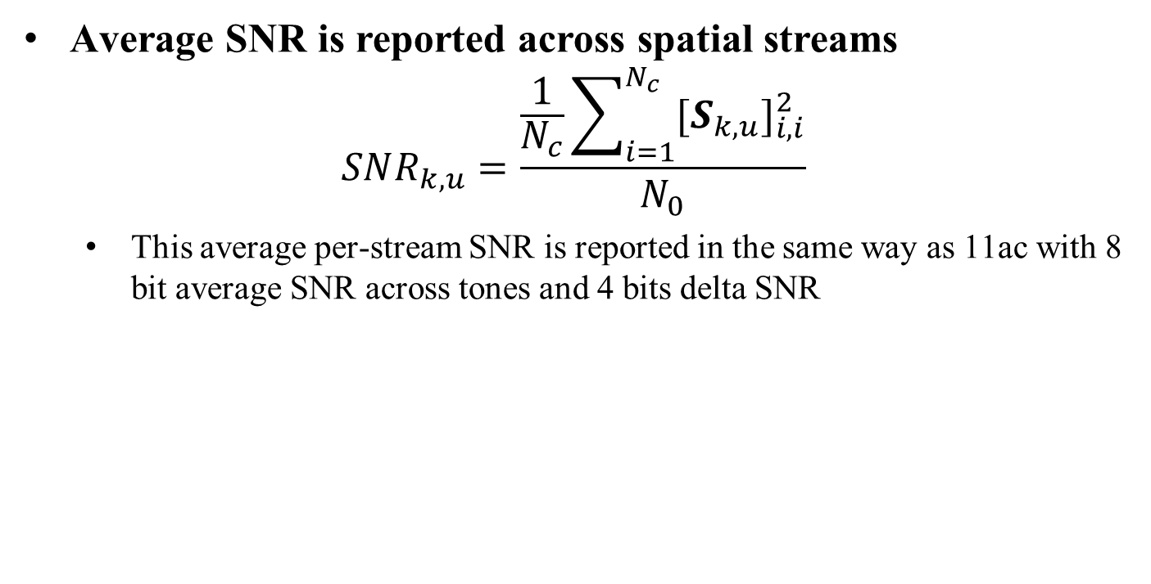
Proposed SNR reporting in 11ax
Average SNR is reported across spatial streams
$$SNR_{k,u}=\frac{\frac{1}{N_{c}}\sum_{i=1}^{N_{c}}{{[S_{k,u}]}_{i,i}^{2}}}{N_{0}}$$
  This average per-stream SNR is reported in the same way as 11ac with 8 bit average SNR across tones and 4 bits delta SNR

Slide 12

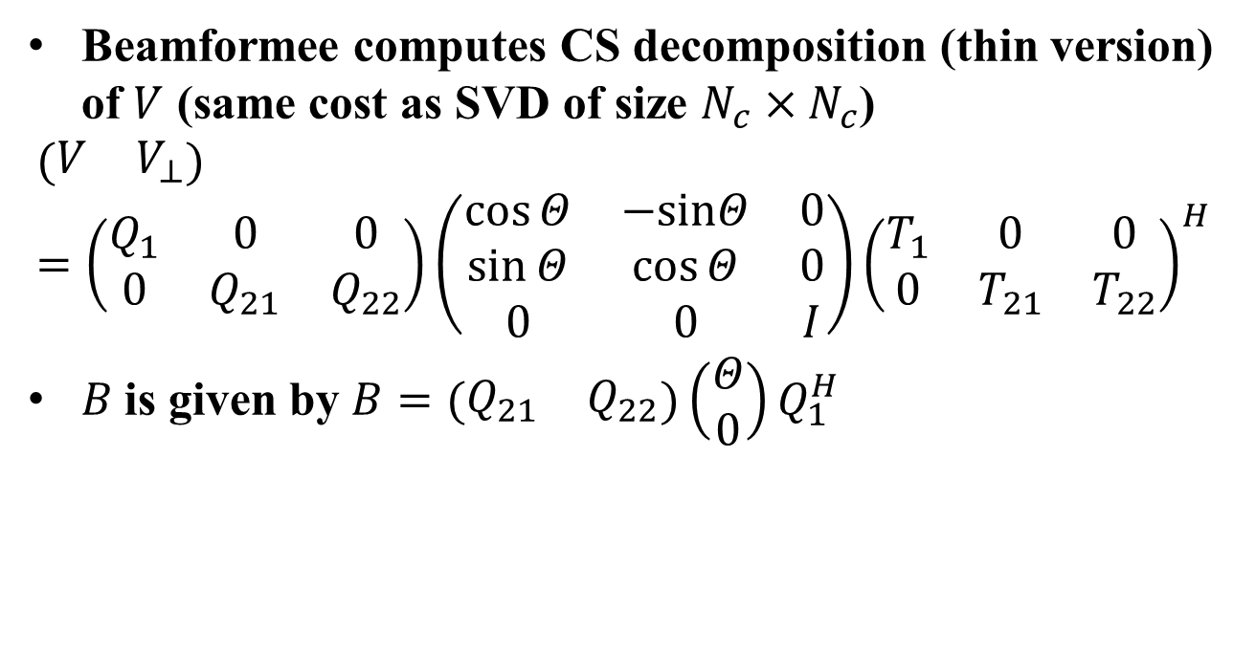
How the beamformee computes $B$
Beamformee computes CS decomposition (thin version) of $V$ (same cost as SVD of size $N_{c}×N_{c}$)
$$(\begin{matrix}V & V_{⊥}\end{matrix})=\left(\begin{matrix}Q_{1} & 0 & 0 \\ 0 & Q_{21} & Q_{22}\end{matrix}\right)\left(\begin{matrix}\cos{Θ} & −sinΘ & 0 \\ \sin{Θ} & \cos{Θ} & 0 \\ 0 & 0 & I\end{matrix}\right){\left(\begin{matrix}T_{1} & 0 & 0 \\ 0 & T_{21} & T_{22}\end{matrix}\right)}^{H}$$
$B$is given by $B=(\begin{matrix}Q_{21} & Q_{22}\end{matrix})\left(\begin{aligned}Θ \\ 0\end{aligned}\right)Q_{1}^{H}$

Slide 13
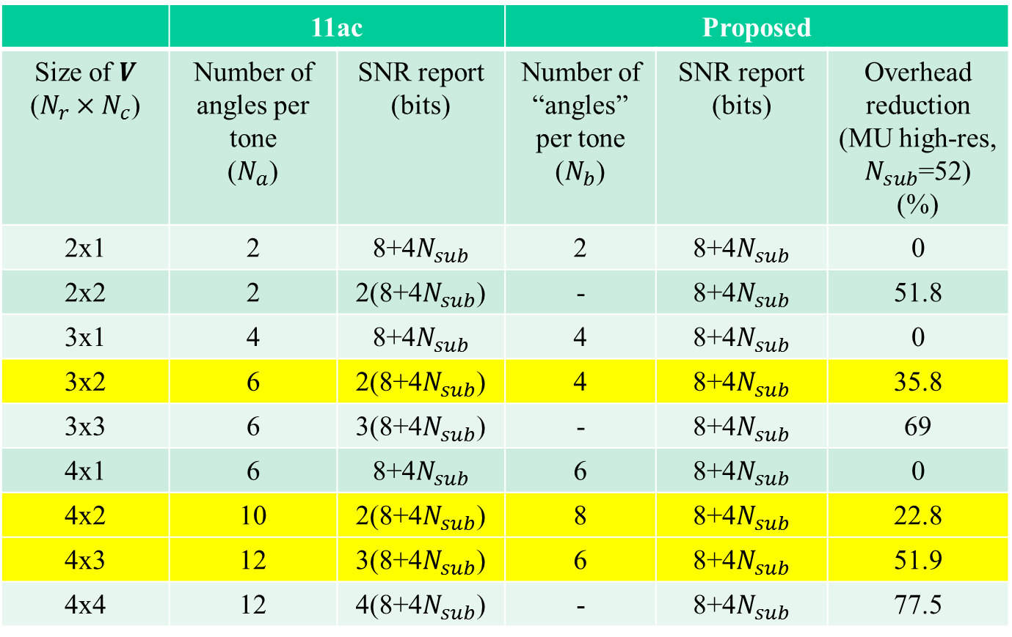
Overhead comparison
 | 11ac |  | Proposed
Size of $V$ ($N_{r}×N_{c}$) | Number of angles per tone ($N_{a}$) | SNR report (bits) | Number of “angles” per tone ($N_{b}$) | SNR report (bits) | Overhead reduction (MU high-res, $N_{sub}$=52) (%)
2x1 | 2 | 8+4$N_{sub}$ | 2 | 8+4$N_{sub}$ | 0
2x2 | 2 | 2(8+4$N_{sub}$) | - | 8+4$N_{sub}$ | 51.8
3x1 | 4 | 8+4$N_{sub}$ | 4 | 8+4$N_{sub}$ | 0
3x2 | 6 | 2(8+4$N_{sub}$) | 4 | 8+4$N_{sub}$ | 35.8
3x3 | 6 | 3(8+4$N_{sub}$) | - | 8+4$N_{sub}$ | 69
4x1 | 6 | 8+4$N_{sub}$ | 6 | 8+4$N_{sub}$ | 0
4x2 | 10 | 2(8+4$N_{sub}$) | 8 | 8+4$N_{sub}$ | 22.8
4x3 | 12 | 3(8+4$N_{sub}$) | 6 | 8+4$N_{sub}$ | 51.9
4x4 | 12 | 4(8+4$N_{sub}$) | - | 8+4$N_{sub}$ | 77.5

Slide 14
Further overhead reduction
The proposal can be combined with tone grouping and other techniques to reduce the overhead further in the time direction
  In particular by exploiting the correlation of the “angular” coefficients between consecutive reports in the time direction
  The same differential feedback techniques can be applied to the Givens coefficients as well as the proposed transformation coefficients.

Slide 15
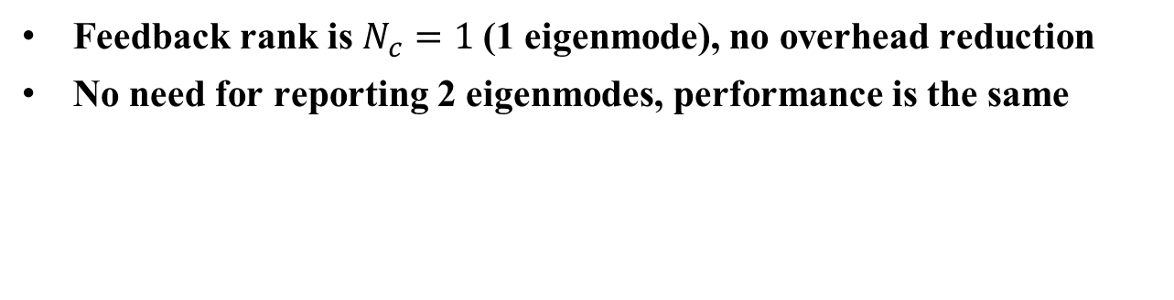
4 TX, 2 RX antennas, 3 STAs, 1 stream/STA
Feedback rank is $N_{c}=1$(1 eigenmode), no overhead reduction
No need for reporting 2 eigenmodes, performance is the same

Slide 16
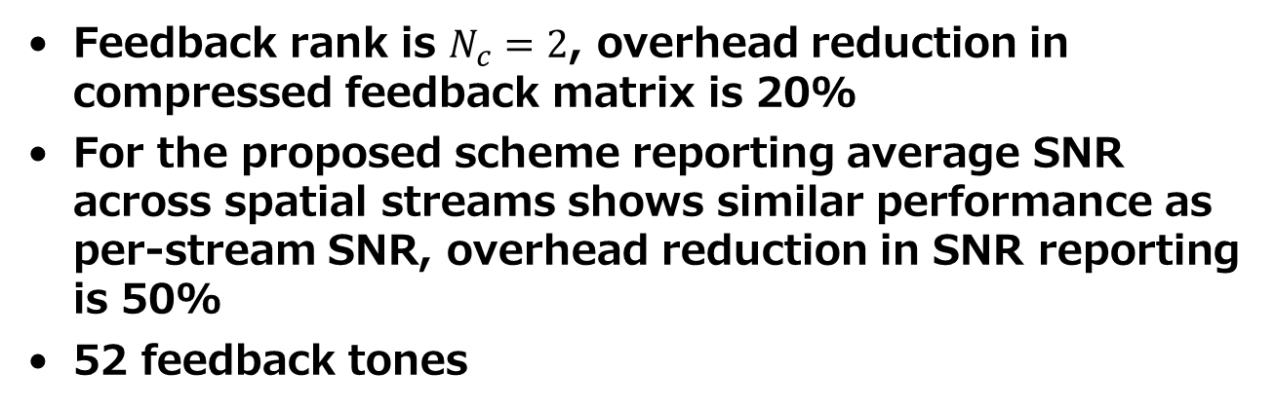
4 TX, 2 RX antennas, 2 STAs, 2 streams/STA
Feedback rank is $N_{c}=2$, overhead reduction in compressed feedback matrix is 20%
For the proposed scheme reporting average SNR across spatial streams shows similar performance as per-stream SNR, overhead reduction in SNR reporting is 50%
52 feedback tones
 | Feedback overhead V (bits/report) | Feedback overhead SNR (bits/report) | Overhead reduction (%)
11ac | 4160 | 432 | -
proposed | 3328 | 216 | 22.8%

Slide 19
Sensitivity to channel aging
We can trade off the reduced overhead for increased feedback granularity.

Slide 20
Performance in closed-loop SU-MIMO
3 TX, 2 RX antennas, 2 streams
4 TX, 3 RX antennas, 3 streams
 | Feedback overhead V (bits/report) | Feedback overhead SNR (bits/report) | Overhead reduction (%)
11ac | 2496 | 432 | -
proposed | 1664 | 216 | 35.8%
 | Feedback overhead V (bits/report) | Feedback overhead SNR (bits/report) | Overhead reduction (%)
11ac | 4992 | 648 | -
proposed | 2496 | 216 | 51.9%

Slide 21
There is some beamforming gain loss with GR feedback, which disappears when comparing at the same overhead with channel aging

Slide 22
Summary
MIMO Feedback overhead can be reduced by adopting different compression strategies
  in frequency (e.g., tone grouping),
  in time (e.g., differential feedback) and
  in space (spatial compression of multiple eigenmodes)
We showed how the representation of multiple eigenmodes can be modified to achieve a higher level of compression
Performance evaluation shows that the beamforming gain loss is minimal especially for MU-MIMO, whilst the overhead saving is substantial (typically between ~20% and 50%)

